Slide 1

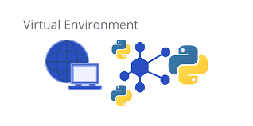
Virtual Environments for AI Projects
From Basic to Expert-Level Workflow
Dated: July 2025
Instructor : Fawad Bahadur
Github: bahadurCorvit

Slide 2


Training Objectives & Outcomes
1
Understand the role and benefits of virtual environments in AI projects
2
Learn how to create, activate, and manage isolated environments
3
Install and manage AI libraries (e.g., NumPy, Pandas, scikit-learn)
4
Integrate environments with Jupyter, IDEs, and automation workflows
Instructor : Fawad Bahadur

Slide 3

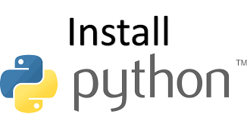
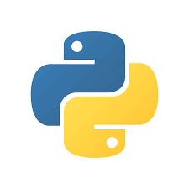

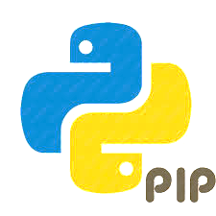

Python Basics – Pre-requisite
Why Learn This First?
Virtual environments depend on basic Python and command-line usage
You’ll use pip, terminal commands, and Python scripts during setup
Key Requirements
Python Installation
Download from: www.python.org
During install: ✔ Add Python to PATH
Verify:
bash
python –version
pip –version
2. Basic Command-Line Skills
Navigate: cd folder/
Create folder: mkdir ai_project
Run script: python script.py
3. IDE/Text Editor
Recommended: VS Code, PyCharm, JupyterLab
Tip
Always ensure your Python version is compatible with the AI libraries you plan to use (e.g., 3.8 to 3.11).
Instructor : Fawad Bahadur

Slide 4
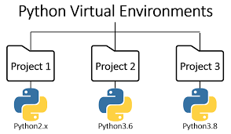

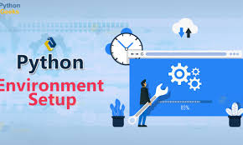
What is a Virtual Environment?
Definition
A virtual environment is an isolated workspace in Python where you can install packages and dependencies without affecting the global Python installation.
Why It Matters in AI Projects
Prevents version conflicts between projects
Keeps your system clean and organized
Allows different projects to use different library versions
Essential for reproducibility and collaboration
Without Virtual Env | With Virtual Env
Global installs | Isolated installs
Risk of conflicts | Safe experiments
Hard to replicate | Easy sharing via requirements.txt
Tip
Never install AI/ML libraries globally — always use a virtual environment.
Instructor : Fawad Bahadur

Slide 5
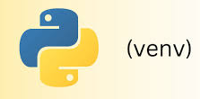
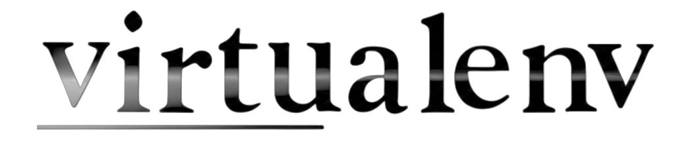
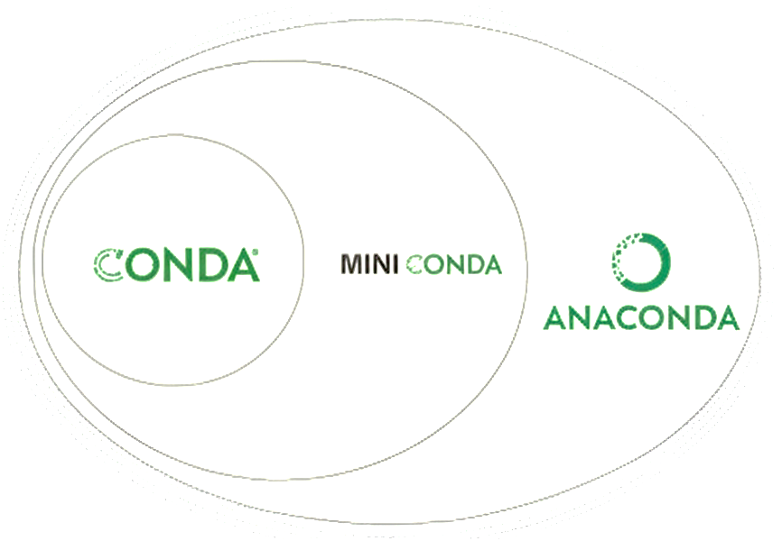
Virtual Environment Tools Overview
Common Tools for Creating Environments
venv
Built-in with Python 3.3+
Lightweight and simple
Ideal for basic AI projects
2. virtualenv
More features than venv
Works with older Python versions
Better for flexibility
3. conda (Anaconda/Miniconda)
Used widely in data science & AI
Manages packages and environments
Great for GPU-based projects and mixed language dependencies
Feature | venv | virtualenv | conda
Built-in | ✔ | ❌ | ❌
Lightweight | ✔✔ | ✔ | ❌
Package mgmt | pip | pip | conda/pip
Cross-platform | ✔ | ✔ | ✔
Tip
Use venv or conda depending on whether you prioritize simplicity or full-stack AI setups.
Instructor : Fawad Bahadur

Slide 6
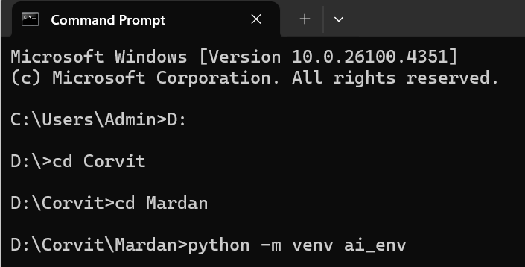
Creating an AI Environment using venv
Step-by-Step Guide
Open your terminal or command prompt
Navigate to your project folder
cd path/to/your/project
3. Create the environment
python -m venv ai_env
This creates a folder named ai_env with isolated Python.
What’s Inside ai_env/
Scripts/ → Activation and execution files
Lib/ → Installed libraries
Include/ → C headers (for compiling)
pyvenv.cfg → Config file with interpreter path
Best Practice
Keep your virtual environment in the root of your project folder (but don’t push it to GitHub)
Instructor : Fawad Bahadur

Slide 7
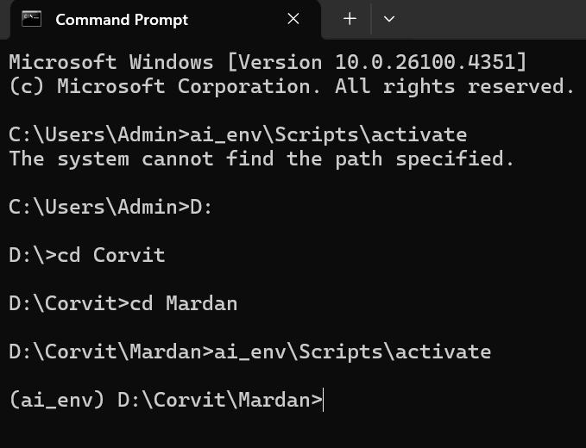
Activating & Deactivating the Environment
Activation Commands (OS Specific)
Windows (CMD):
ai_env\Scripts\activate
Windows (PowerShell):
\ai_env\Scripts\Activate.ps1
Mac/Linux:
source ai_env/bin/activate
Visual Cue
Once activated, your terminal prompt changes:
(ai_env) C:\Users\YourName\project>
Deactivate Environment
To exit the virtual environment:
deactivate
Tip
Always activate before running or installing anything
Keep one terminal open per environment to avoid confusion
Instructor : Fawad Bahadur

Slide 8
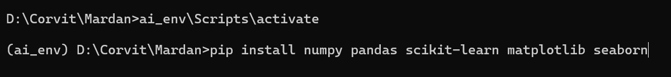


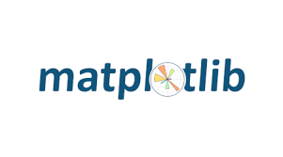

Installing Essential AI Libraries
Installing Packages with pip
After activating your environment, install core AI/data libraries:
pip install numpy pandas scikit-learn matplotlib seaborn
What These Libraries Do
NumPy: Numerical computing with arrays
Pandas: Data manipulation and analysis
scikit-learn: Machine learning algorithms
Matplotlib & Seaborn: Data visualization
Verifying Installation
Check installed packages and versions:
pip list
Tip
Use a requirements.txt file to save dependencies for reproducibility (covered in next slides).
Instructor : Fawad Bahadur

Slide 9
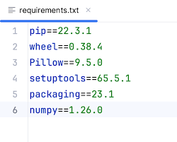
Managing Dependencies with requirements.txt
Why Save Dependencies?
Share exact package versions
Reproduce the same environment on any machine
Essential for collaboration and deployment
Creating requirements.txt
After installing your packages:
bash pip freeze > requirements.txt
Installing from requirements.txt
To recreate environment elsewhere:
bash pip install -r requirements.txt
Tip
Update requirements.txt regularly after adding or updating packages.
Instructor : Fawad Bahadur

Slide 10
Managing Environments with Conda
What is Conda?
An open-source package & environment manager
Supports Python & other languages
Popular in AI/data science for easy handling of complex dependencies
Activating Conda Environment
Bash conda activate ai_env
Installing Conda
Download & install Anaconda or Miniconda from https://conda.io
Use conda commands in terminal after installation
Installing Packages
Bash conda install numpy pandas scikit-learn matplotlib seaborn
Creating a Conda Environment
Bash conda create -n ai_env python=3.9
Tip
Conda manages both packages and environments, ideal for GPU-based AI projects.
Instructor : Fawad Bahadur

Slide 11
Best Practices for Virtual Environments
One Environment = One Project
Avoid using the same environment for multiple projects
Keeps dependencies clean and isolated
Never Push Env to Git
Add this to your .gitignore:
ai_env/
Pin Package Versions
Prevent future compatibility issues
Example:
bash pip install scikit-learn==1.3.2
Document Your Environment
Include setup steps in README.md
Example:
python -m venv ai_env source ai_env/bin/activate
pip install -r requirements.txt
Use requirements.txt or environment.yml
Always include with your code for reproducibility
Automate project setup for collaborators or deployment
Tip
Transition to Dask gradually by converting Pandas/NumPy code.
Instructor : Fawad Bahadur

Slide 12
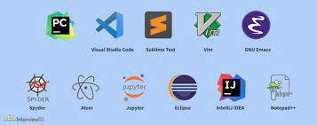
Using Virtual Environments in IDEs
Jupyter Notebooks
Run:
Bash
python -m ipykernel install --user --name=ai_env
Use kernel in notebook dropdown
Why Integrate with IDEs?
Enables features like code suggestions, debugging, linting
Ensures your environment is correctly used while developing
PyCharm
Add Interpreter:
Go to Settings > Project > Python Interpreter
Click gear → Add → Existing environment
Also works with Conda environments
VS Code
Select Interpreter:
Open Command Palette → Python: Select Interpreter
Choose your env:
.venv/bin/python or
ai_env\Scripts\python.exe
- Auto-activates env in terminal
Tip
Always double-check the interpreter path matches your virtual environment.
Instructor : Fawad Bahadur

Slide 13

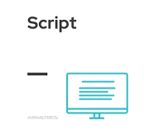
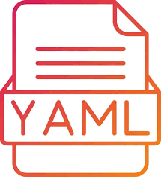

Automating Virtual Environment Setup
Why Automate?
Saves time in team setups
Ensures consistent environments
Ideal for onboarding, CI/CD, or deployment
Setup Script (venv + pip)
setup_env.sh (Linux/macOS):
Bash
python -m venv ai_env
source ai_env/bin/activate
pip install -r requirements.txt
setup_env.bat (Windows):
python -m venv ai_env
call ai_env\Scripts\activate
pip install -r requirements.txt
Conda Environment YAML
Create YAML:
conda env export > environment.yml
Recreate Env:
conda env create -f environment.yml
Tip
Add script or YAML instructions to your README.md.
Instructor : Fawad Bahadur

Slide 14
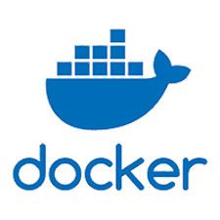
Virtual Environments vs Docker for AI Projects
Virtual Environments
Lightweight, quick to set up
Isolate Python packages
Great for development and small projects
Docker
Isolates the entire system (OS + Python + libs)
Ideal for deployment, scaling, and GPU compatibility
Works the same on every machine
Feature | Virtual Env | Docker
Scope | Python packages | Full environment
Portability | Medium | High
Reproducibility | Good | Excellent
Setup Complexity | Low | Moderate/High
Best Use | Dev & prototyping | Deployment & CI/CD
Try
Start with virtual envs, move to Docker for production or collaboration-heavy AI systems.
Instructor : Fawad Bahadur

Slide 15
Real-World Virtual Env Setup for AI Project
Project Goal: Predict Student Dropout Using AI
Folder Structure
Setup Steps
Bash
python -m venv ai_env
source ai_env/bin/activate
pip install -r requirements.txt
OR (Conda)
Bash
conda create -n ai_env python=3.10
conda activate ai_env
conda install numpy pandas scikit-learn jupyter
student-dropout-ai/
ai_env/ | Virtual environment (not in Git)
data/ | Raw & processed datasets
notebooks/ | Jupyter notebooks
src/ | Python scripts
outputs/ | Models, logs, results
requirements.txt | Dependencies
README.md | Setup + usage instructions
Tip
Use Dask-ML to scale your ML pipelines effortlessly.
Instructor : Fawad Bahadur

Slide 16
THANK YOU
Instructor : Fawad Bahadur

