Slide 1

Advance Python Course
Trainer: Fawad Bahadur Marwat

Slide 2
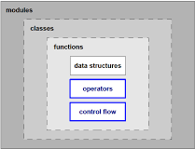
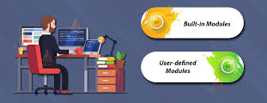
What is a Module?
A module in Python is just a .py file that contains functions, variables, or classes you can import and use in other Python files.

Slide 3

Step 1: Create a Python File (Module)
create a module named mymath.py
# mymath.py
def add(a, b):
return a + b
def subtract(a, b):
return a - b
PI = 3.14159
This file (mymath.py) is your user-defined module.

Slide 4

Step 2: Use (Import) the Module in Another File
Now create another Python file
— for example, main.py
# main.py
import mymath
result = mymath.add(10, 5)
print("Addition:", result)
print("Pi value:", mymath.PI)

Slide 5
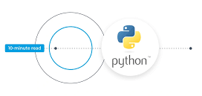
Step 3: Import Specific Functions
If you don’t want to import everything:
from mymath import add
print(add(3, 4))
# You can directly use add() without prefix
Or rename while importing:
import mymath as m
print(m.subtract(10, 5))

Slide 6
The csv Module
Used for reading and writing .csv files.
Common methods:
csv.reader()
csv.writer()
Example:
import csv
with open('students.csv') as f:
reader = csv.reader(f)
for row in reader:
print(row)

Slide 7
Conti…
Working with dictionaries:
csv.DictReader() → returns each row as a dictionary.
csv.DictWriter() → writes dictionary rows.
Custom delimiter:
csv.reader(file, delimiter=';’)
Example:
with open('data.csv') as file:
reader = csv.DictReader(file)
for row in reader:
print(row['Name'], row['Age'])

Slide 8
THANK YOU

