Slide 1

Advance Python Course
Trainer: Fawad Bahadur Marwat

Slide 2
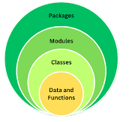
What Are Modules and Packages?
Module:
A Python file (.py) that contains code (functions, variables, classes).
Package:
A collection (folder) of multiple related modules with an __init__.py file.
Analogy:
Module → Chapter, Package → Book
Example:
# importing a module
import math

Slide 3
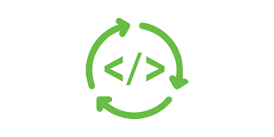
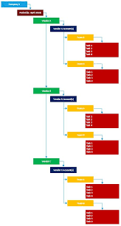

Why Use Packages?
✅ Reuse existing tested code
✅ Organize large projects
✅ Increase readability and maintainability
✅ Avoid writing boilerplate code
Example: Instead of writing your own square root function — just use math.sqrt().

Slide 4

Importing Modules
Types of Imports:
1. Entire module:
import math
print(math.pi)
2. Specific item:
from math import sqrt
print(sqrt(25))
3. Using alias:
import math as m
print(m.e)

Slide 5
Exploring the math Module (Introduction)
Purpose: Perform mathematical operations easily.
Function | Description
math.sqrt(x) | Square root
math.pow(a,b) | Power
math.ceil(x) | Round up
math.floor(x) | Round down
math.pi / math.e | Constants
Example:
import math
print(math.sqrt(16))
print(math.ceil(3.2))

Slide 6
Conti…
Trigonometric & Logarithmic Functions
Function | Description
math.sin(x) | Sine of x (radians)
math.cos(x) | Cosine of x
math.tan(x) | Tangent of x
math.log(x) | Natural log
math.log10(x) | Base-10 log
Example:
import math
angle = 90
print(math.sin(math.radians(angle)))

Slide 7
Conti…
Advanced Features:
math.factorial(5) → 120
math.gcd(18, 24) → 6
math.isclose(1.001, 1.002) → Compare floats
math.isnan(x), math.isfinite(x) → Check values
Example:
print(math.gcd(24, 36))
print(math.isclose(0.1+0.2, 0.3))

Slide 8
THANK YOU

