Slide 1

Advance Python Course
Trainer: Fawad Bahadur Marwat

Slide 2
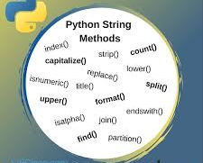
What Are String Methods?
Built-in methods in Python that allow querying or transforming string data.
Strings are immutable in Python — all mutations return new strings.
Examples of Uses:
Formatting user input
Searching and cleaning data
Data transformation for NLP

Slide 3
What Are String Methods?
Method | Description | Example
upper() | Converts all characters to uppercase | 'hello'.upper() → 'HELLO'
isupper() | Checks if all characters are uppercase | 'HELLO'.isupper() → True
Usage: Normalizing text for comparison.

Slide 4
Conti…
Method | Description | Example
lower() | Converts all characters to lowercase | 'HELLO'.lower() → 'hello'
islower() | Checks if all characters are lowercase | 'hello'.islower() → True
Usage: Frequency analysis, e.g., word or letter frequency in text

Slide 5

Count
Purpose: Counts occurrences of a substring.
Syntax: string.count(substring)
Example:
'banana'.count('a') # Output: 3
Usage: Frequency analysis, e.g., word or letter frequency in text

Slide 6
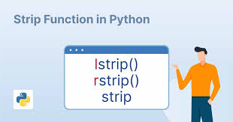
Strip
Purpose: Removes leading and trailing whitespace (or specified characters).
Syntax: string.strip([chars])
Example:
' hello '.strip() # Output: 'hello'
Variants: lstrip(), rstrip()

Slide 7
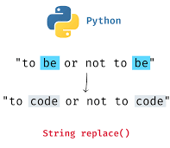
replace()
Purpose: Replaces all occurrences of a substring with another.
Syntax: string.replace(old, new[, count])
Example:
'hello world'.replace('l', '*') # Output: 'he**o wor*d'
Usage: Data cleaning, text normalization.

Slide 8
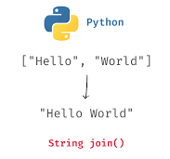
join()
Purpose: Joins a list of strings into one string, using a separator.
Syntax: separator.join(iterable)
Example:
'-'.join(['a', 'b', 'c']) # Output: 'a-b-c'
Usage: Creating CSV lines, structured data formats.

Slide 9
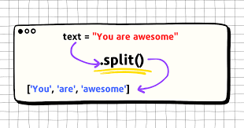
split()
Purpose: Splits a string into a list using a delimiter.
Syntax: string.split([separator])
Example:
'a-b-c'.split('-') # Output: ['a', 'b', 'c']
Usage: Tokenization, parsing files.

Slide 10
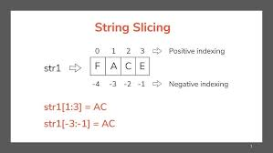
Substrings (Slicing)
Syntax: string[start:end]
Example:
text = 'Python'
text[1:4] # 'yth'
text[:3] # 'Pyt'
text[3:] # 'hon'
Note: End index is exclusive.

Slide 11
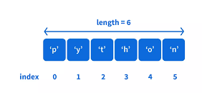
index()
Purpose: Returns the first index of a substring, raises error if not found.
Syntax: string.index(substring)
Example:
'hello'.index('e') # Output: 1
Difference from find():
index() raises an error if not found.
find() returns -1.

Slide 12
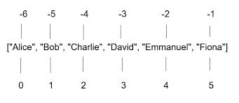
Negative Indexing
Purpose: Access characters from the end of a string.
Syntax: string[-n]
Example:
text = 'hello'
text[-1] # 'o'
text[-2] # 'l'
Use case: Extracting suffixes, reverse traversal.

Slide 13

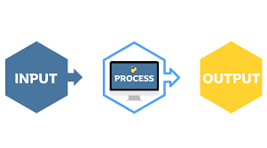

Real-World Applications
Data Cleaning
User Input Processing
Natural Language Processing (NLP)
Log File Parsing
Building Command-Line Interfaces

Slide 14
Summary Table of All Methods
Method | Description | Example
upper() | Convert to uppercase | 'hi'.upper() → 'HI'
isupper() | Check if all chars are uppercase | 'HI'.isupper() → True
lower() | Convert to lowercase | 'HI'.lower() → 'hi'
islower() | Check if all chars are lowercase | 'hi'.islower() → True
count() | Count substring occurrences | 'aaa'.count('a') → 3
strip() | Remove leading/trailing spaces | ' hi '.strip() → 'hi'
replace() | Replace substrings | 'abc'.replace('a', 'x')
join() | Join strings with separator | '-'.join(['a', 'b'])
split() | Split string into list | 'a-b'.split('-')
index() | Find index of substring | 'abc'.index('b') → 1
[-1] | Negative index | 'abc'[-1] → 'c'
Use case: Extracting suffixes, reverse traversal.

Slide 15
THANK YOU

