Slide 1

Advance Python Course
Trainer: Fawad Bahadur Marwat

Slide 2
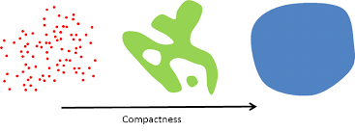
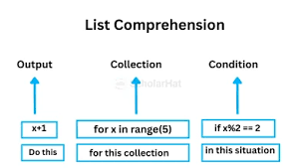
Introduction to List Comprehension
Definition: "List comprehension is a concise way to create lists in Python.“
Why it's used: Readability, compactness, performance.
Example:
numbers = [x for x in range(5)]
print(numbers) # [0, 1, 2, 3, 4]

Slide 3
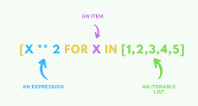
Traditional Approach vs List Comprehension
Traditional Loop:
result = []
for i in range(5):
result.append(i**2)
List Comprehension:
result = [i**2 for i in range(5)]

Slide 4
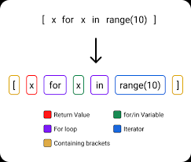
Basic Syntax
Structure:
[expression for item in iterable]
Example:
fruits = ["apple", "banana", "cherry"]
upper_fruits = [fruit.upper() for fruit in fruits]

Slide 5
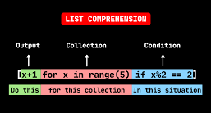
Adding Conditions (If Statements)
Syntax:
[expression for item in iterable if condition]
Example:
even_numbers = [n for n in range(10) if n % 2 == 0]

Slide 6
With Else (Conditional Expressions)
Syntax:
[true_value if condition else false_value for item in iterable]
Example:
numbers = [n if n % 2 == 0 else "Odd" for n in range(5)]
Traditional:
numbers = []
for n in range(5):
if n % 2 == 0:
numbers.append(n)
else:
numbers.append("Odd")
print(numbers)

Slide 7
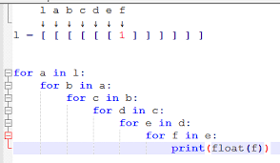
Nested List Comprehension
Example
matrix = [[1,2,3], [4,5,6], [7,8,9]]
flat = [num for row in matrix for num in row]
Traditional:
matrix = [[1, 2, 3], [4, 5, 6], [7, 8, 9]]
flat = []
for row in matrix:
for num in row:
flat.append(num)
print(flat)

Slide 8
Multiple If Conditions
Example
filtered = [x for x in range(50) if x % 2 == 0 if x % 5 == 0]
Traditional:
filtered = []
for x in range(50):
if (x % 2 == 0) and (x % 5 == 0):
filtered.append(x)
print(filtered)

Slide 9
Using Functions in List Comprehension
Traditional:
def square(n):
return n * n
squares = []
for x in range(5):
result = square(x)
squares.append(result)
print(squares)
Example
def square(n):
return n*n
squares = [square(x) for x in range(5)]

Slide 10
Dictionary & Set Comprehension
Dictionary comprehension:
squares = {x: x**2 for x in range(5)}
Set comprehension:
unique_squares = {x**2 for x in [1,2,2,3]}
Traditional:
data_list = [1, 2, 2, 3]
unique_squares = set()
for x in data_list:
squared_value = x ** 2
unique_squares.add(squared_value)
print(unique_squares)

Slide 11
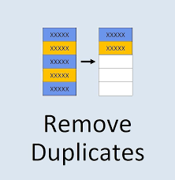

Real-World Use Cases
Removing duplicates
Filtering data
Extracting specific info from a dataset
Traditional:
words = ["hello", "world", "python"]
long_words = []
for w in words:
if len(w) > 5:
long_words.append(w)
print(long_words)
Example:
words = ["hello", "world", "python"]
long_words = [w for w in words if len(w) > 5]

Slide 12
THANK YOU

