Slide 1

Advance Python Course
Trainer: Fawad Bahadur Marwat

Slide 2




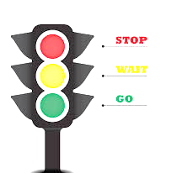
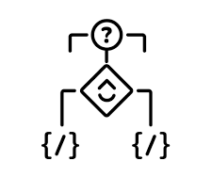

Conditional Statements
Definition
Conditional statements enable programs to execute different actions based on whether a condition evaluates to True or False.
Condition
A logical expression resulting in a boolean (True or False).
Purpose
Controls program flow by enabling decision-making.
Real-Life Analogy
Traffic light:
Green → Cars go.
Red → Cars stop.
Why Use Them?
Execute actions when a condition is True.
Skip actions when a condition is False.

Slide 3
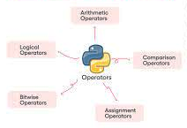
Operators in Python
✅ Arithmetic: +, -, *, /, **, %
✅ Comparison: ==, !=, <, >, <=, >=
✅ Logical: and, or, not
✅ Assignment: =, +=, -= etc.

Slide 4
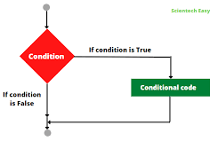

Conditions in Python
Definition
Expressions evaluating to True or False
Usage
Control flow in if, if-else, if-elif-else statements
Example
How It Works: x > 5 evaluates to True, triggering the print statement.
x = 5
if x > 5:
print("x is greater than 5")

Slide 5


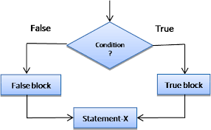
If Statements in Python
Purpose
Example
Execute a code block only if a condition is True
num = 10
if num > 5:
print("The number is greater than 5")
Syntax
if keyword, followed by a condition, then a colon :
num > 5 evaluates to True, so the message is printed.
If num <= 5, the print statement is skipped.
Behavior
True condition: Code block executes
False condition: Code block is skipped

Slide 6
If-else Statements in Python
Purpose
Example
Execute one code block if a condition is True,
otherwise execute a different code block.
num = 10
if num > 5:
print("The number is greater than 5")
else:
print(“The number is not greater than 5”)
Syntax
If a condition is True, then execute a code block; else, execute a different code block.
Behavior
True condition: Code block 1 executes
False condition: Code block 2 executes

Slide 7
If-Elif-Else Statements in Python
Purpose
Example
Evaluate multiple conditions sequentially
Syntax
score = 75
if score >= 90:
print("Grade: A")
elif score >= 80:
print("Grade: B")
elif score >= 70:
print("Grade: C")
else:
print("Grade: D")
if: Checks the first condition
elif: Checks additional conditions if previous ones are False
else: Runs if no conditions are True (optional fallback)
Behavior
Executes the first True condition’s block or the else block if none are True

Slide 8
THANK YOU

