Slide 1

Advance Python Course
Trainer: Fawad Bahadur Marwat

Slide 2

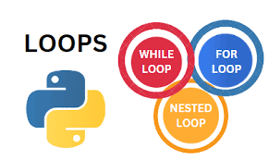

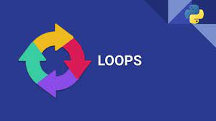

Introduction to Loops in Python
What Are Loops?
Programming structures that repeat instructions until a condition is met.
Enable iteration over data structures or repetitive task automation.
Why Use Loops?
Reduce code redundancy
Automate repetitive tasks
Improve code efficiency and readability
Types of Loops
while Loop: Repeats while a condition is `True`
for Loop: Iterates over a sequence (e.g., lists, tuples, strings)

Slide 3


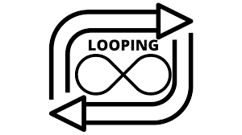

Iterating with Python Loops
What Is Iteration?
Accessing each item in a collection (e.g., list, tuple, string) one by one.
How Loops Work
Iterate over Python data structures: lists, dictionaries, sets, strings.
Enable sequential processing of items in an iterable.
Key Points
Loops provide sequential access to elements.
Use loops to read or modify items in sequences (e.g., lists, strings).

Slide 4

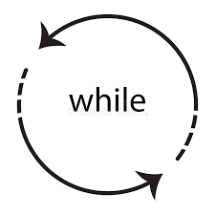
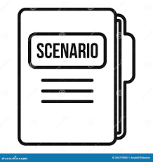

The while Loop in Python
How It Works
Example
Executes a code block as long as a condition is True.
Stops when the condition becomes False.
count = 0
while count < 3:
print("Counting:", count)
count += 1
Useful Scenarios
Explanation
Checks if count < 3 (True initially).
Prints count and increments by 1.
Stops when count reaches 3 (False).
When the number of iterations is unknown (e.g., reading a file until its end).

Slide 5
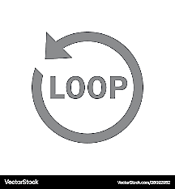
The for Loop in Python
How It Works
Example
Iterates over each item in an iterable
(e.g., list, string, dictionary) until all items are processed.
colors = ["red", "green", "blue"]
for color in colors:
print("Color:", color)
Useful Scenarios
Explanation
List: Loops through colors, printing each item.
When the number of iterations is known or iterating over a collection (e.g., lists, strings).

Slide 6

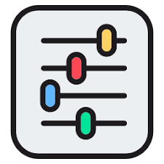
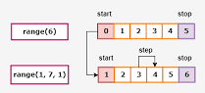
The range() Function in Python
Purpose
Example
Generates a sequence of numbers for iterating a specific number of times.
for i in range(1, 6):
print(i)
for i in range(5, 0, -1):
print(i)
Parameters
Start: starting number (default: 0)
Stop: end number (non-inclusive)
Step: increment/decrement (default: 1)

Slide 7

The break Statement in Python
Purpose
Example
Exits a loop prematurely when a specific condition is met.
for number in range(10):
if number == 5:
break
print(number)
When to Use
Explanation
Loops through numbers 0 to 9.
When number == 5, break stops the loop.
Output: Prints 0, 1, 2, 3, 4.
To stop a loop immediately (e.g., when finding a target element in a list).

Slide 8
The continue Statement in Python
Purpose
Example
Skips the current iteration and proceeds to the next one without exiting the loop.
for i in range(5):
if i == 2:
continue
print(i)
When to Use
Explanation
Loops through numbers 0 to 4.
When i == 2, continue skips the print statement.
To bypass specific iterations (e.g., skipping unwanted values in a dataset).

Slide 9
The Pass Statement in Python
Purpose
Example
A null operation; acts as a placeholder when no action is needed.
Used where code is syntactically required but not yet implemented.
for i in range(5):
if i < 3:
pass
print(i)
When to Use
Explanation
Loops through numbers 0 to 4.
When i < 3, pass does nothing, and the loop continues.
Output: Prints 0, 1, 2, 3, 4.
As a temporary placeholder (e.g., in empty loops, functions, or try blocks).

Slide 10
THANK YOU

