Slide 1

Advance Python Course
Trainer: Fawad Bahadur Marwat

Slide 2




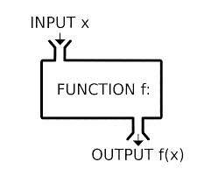
Introduction to Function in Python
Definition
Named, reusable code blocks for specific tasks.
Example
Purpose
def greet(name):
print(f"Hello, {name}!")
greet("Alice") # Output: Hello, Alice!
Organize code into manageable parts.
Promote reusability, reduce redundancy.
Enable multiple calls throughout a program.
Explanation
greet function takes name parameter and prints a greeting.
Syntax
Use def keyword, function name, and parameters in ().

Slide 3
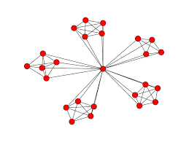


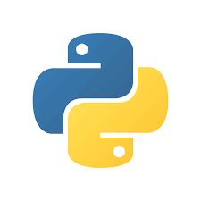
Functions: Modularity & Reusability
Modularity
Encapsulate functionality for organized, navigable code.
Develop, test, and debug functions independently.
Enhances software quality and maintainability.
Code Reusability
Reuse functions across programs or sections.
Eliminates redundant code.
Keeps codebase clean and maintainable.

Slide 4
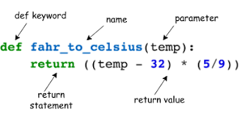
Function Definition in Python
Syntax
Use def keyword, function name, and () for parameters.
Parameters (optional) accept inputs for the function.
Example
def add(a, b):
return a + b
print(add(3, 4)) # Output: 7
Purpose
Define reusable code to perform specific tasks.
Return results using return (optional).
Explanation
add function takes parameters a and b.
Returns their sum using return.

Slide 5

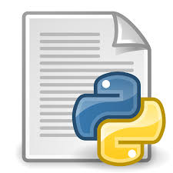

Executing Functions in Python
Function Execution
Example
Runs when called, executing the function’s code body.
def greet(name):
print(f"Hello, {name}!")
greet("Alice") # Output: Hello, Alice!
greet("Bob") # Output: Hello, Bob!
greet("Charlie") # Output: Hello, Charlie!
Calling Syntax
Use function name followed by ().
Include arguments in () if required.
Explanation
greet function is called multiple
times with different arguments.
Multiple Calls
Reuse functions by calling them multiple times.

Slide 6

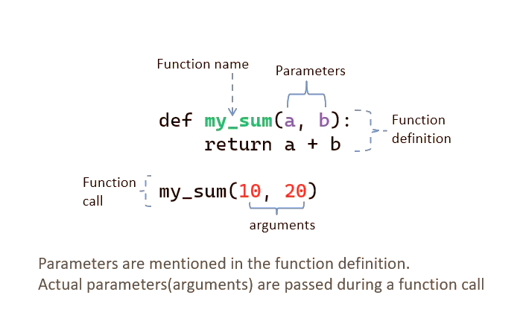

Function Arguments in Python
Definition
Values (arguments) passed to a function for processing.
Used as inputs for calculations or manipulations.
Example
def multiply(a, b):
return a * b
result = multiply(4, 5)
print(result) # Output: 20
Importance
Enable generic, flexible functions.
Avoid hardcoding, work with varied data.
Benefits
Dynamic functionality with different inputs.
Improves code readability and maintainability.

Slide 7
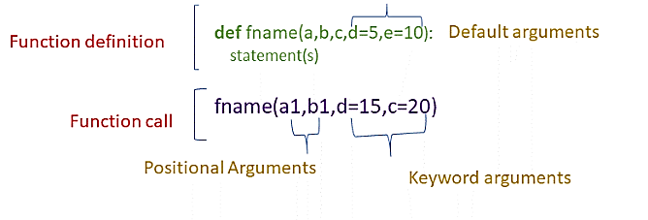
Positional Arguments in Python
Definition
Example
Arguments passed in the order of function parameters.
First argument matches first parameter, and so on.
def divide(numerator, denominator):
if denominator == 0:
return "Error: Cannot divide by zero."
return numerator / denominator
result1 = divide(10, 2) # Output: 5.0
result2 = divide(2, 10) # Output: 0.2
print(result1)
print(result2)
Key Point
Order matters; incorrect order causes logical errors.
Explanation
Correct: divide(10, 2) → 10 / 2 = 5.0.
Incorrect order: divide(2, 10) → 2 / 10 = 0.2.

Slide 8
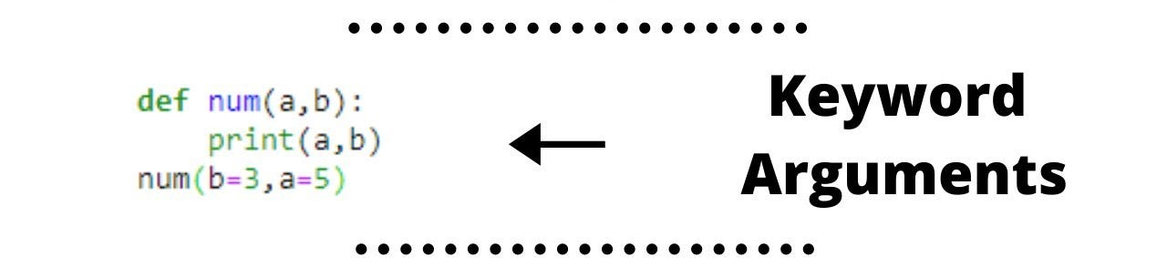
Keyword Arguments in Python
Definition
Specify parameter names and values when calling a function.
Allows arguments to be passed in any order.
Example
def profile(name, age, city):
return f"{name} is {age} years old and lives in {city}."
info = profile(age=30, name="Alice", city="New York")
print(info) # Output: Alice is 30 years old and lives in New York.
Benefits
Clarity: Clearly indicates what each argument represents.
Flexibility: Order-independent, ideal for optional parameters.
Explanation
Arguments passed using parameter names, ignoring order.

Slide 9
*args in Python
Definition
Example
Allows a function to accept any number of positional arguments.
Arguments are collected as a tuple.
def concatenate_strings(*args):
return " ".join(args)
result = concatenate_strings("Hello", "world", "from", "Python!")
print(result) # Output: Hello world from Python!
Benefits
Ideal when the number of arguments is unknown.
Explanation
*args gathers all arguments into a tuple.
join() combines them into a single string.

Slide 10
THANK YOU

