Slide 1

Advance Python Course
Trainer: Fawad Bahadur Marwat

Slide 2




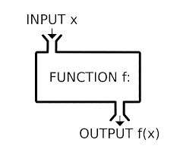
Introduction to Function in Python
Definition
Named, reusable code blocks for specific tasks.
Example
Purpose
def greet(name):
print(f"Hello, {name}!")
greet("Alice") # Output: Hello, Alice!
Organize code into manageable parts.
Promote reusability, reduce redundancy.
Enable multiple calls throughout a program.
Explanation
greet function takes name parameter and prints a greeting.
Syntax
Use def keyword, function name, and parameters in ().

Slide 3
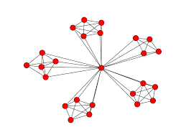


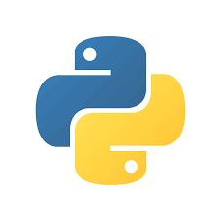
Functions: Modularity & Reusability
Modularity
Encapsulate functionality for organized, navigable code.
Develop, test, and debug functions independently.
Enhances software quality and maintainability.
Code Reusability
Reuse functions across programs or sections.
Eliminates redundant code.
Keeps codebase clean and maintainable.

Slide 4
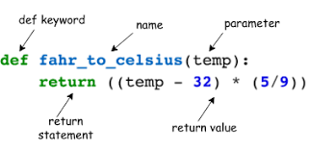
Function Definition in Python
Syntax
Use def keyword, function name, and () for parameters.
Parameters (optional) accept inputs for the function.
Example
def add(a, b):
return a + b
print(add(3, 4)) # Output: 7
Purpose
Define reusable code to perform specific tasks.
Return results using return (optional).
Explanation
add function takes parameters a and b.
Returns their sum using return.

Slide 5

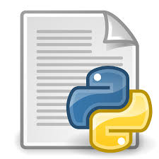

Executing Functions in Python
Function Execution
Example
Runs when called, executing the function’s code body.
def greet(name):
print(f"Hello, {name}!")
greet("Alice") # Output: Hello, Alice!
greet("Bob") # Output: Hello, Bob!
greet("Charlie") # Output: Hello, Charlie!
Calling Syntax
Use function name followed by ().
Include arguments in () if required.
Explanation
greet function is called multiple
times with different arguments.
Multiple Calls
Reuse functions by calling them multiple times.

Slide 6

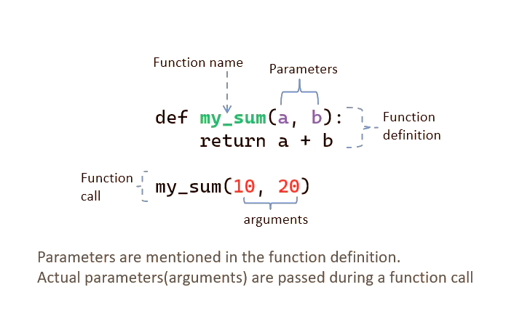

Function Arguments in Python
Definition
Values (arguments) passed to a function for processing.
Used as inputs for calculations or manipulations.
Example
def multiply(a, b):
return a * b
result = multiply(4, 5)
print(result) # Output: 20
Importance
Enable generic, flexible functions.
Avoid hardcoding, work with varied data.
Benefits
Dynamic functionality with different inputs.
Improves code readability and maintainability.

Slide 7
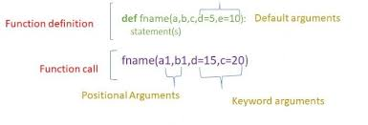
Types of Arguments:
Positional Arguments
Keyword Arguments
Default Arguments
Variable-length Arguments

Slide 8
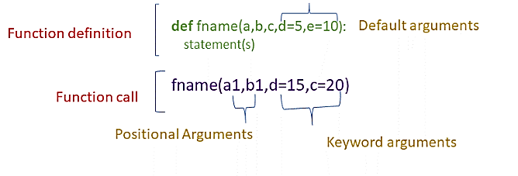
Positional Arguments in Python
Definition
Example
Arguments passed in the order of function parameters.
First argument matches first parameter, and so on.
def divide(numerator, denominator):
if denominator == 0:
return "Error: Cannot divide by zero."
return numerator / denominator
result1 = divide(10, 2) # Output: 5.0
result2 = divide(2, 10) # Output: 0.2
print(result1)
print(result2)
Key Point
Order matters; incorrect order causes logical errors.
Explanation
Correct: divide(10, 2) → 10 / 2 = 5.0.
Incorrect order: divide(2, 10) → 2 / 10 = 0.2.

Slide 9
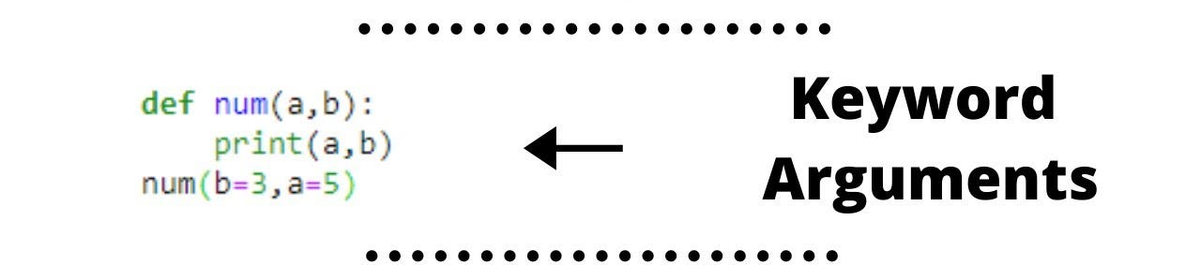
Keyword Arguments in Python
Definition
Specify parameter names and values when calling a function.
Allows arguments to be passed in any order.
Example
def profile(name, age, city):
return f"{name} is {age} years old and lives in {city}."
info = profile(age=30, name="Alice", city="New York")
print(info) # Output: Alice is 30 years old and lives in New York.
Benefits
Clarity: Clearly indicates what each argument represents.
Flexibility: Order-independent, ideal for optional parameters.
Explanation
Arguments passed using parameter names, ignoring order.

Slide 10
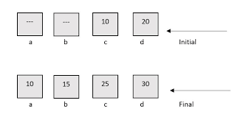
Default Arguments
What are they?
Default arguments are pre-defined values assigned to function parameters.
If the caller doesn't provide a value for that parameter, the function automatically uses the default.
Example
def calculate_price(i, q=1, discount=0.1):
final_price = (i.price * q) * (1 - discount)
return final_price
Correct: def func(a, b=2, c=3):
Incorrect: def func(a, b=2, c):

Slide 11



Conti…
Why use them?
Flexibility: They allow a single function to handle multiple use cases, from simple to complex, without needing to create multiple functions.
Readability: They make the function call cleaner and more concise, as you only need to specify arguments that deviate from the standard behavior.
Backward Compatibility: If you add a new parameter to an existing function, giving it a default value ensures that all previous calls to that function will continue to work without modification.

Slide 12
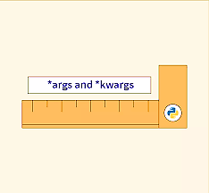
Variable-Length Arguments
Variable-length arguments allow a function to accept a dynamic number of arguments.
This means you can call the function with zero, one, or many arguments.
It's especially useful for generic functions that process data collections.
Why use them?
Flexibility
Readability
Abstraction

Slide 13
Positional Arguments (*args)
Definition
Example
Allows a function to accept any number of positional arguments.
Arguments are collected as a tuple.
def concatenate_strings(*args):
return " ".join(args)
result = concatenate_strings("Hello", "world!")
print(result) # Output: Hello world!
Benefits
Ideal when the number of arguments is unknown.
Explanation
*args gathers all arguments into a tuple.
join() combines them into a single string.

Slide 14
Keyword Arguments (**kwargs)
Purpose: To handle a variable number of keyword (named) arguments.
Syntax: A double asterisk (**) is used before a parameter name, typically **kwargs.
Behavior: All extra keyword arguments are collected into a dictionary.
def create_profile(**profile_data):
print("Creating profile...")
for key, value in profile_data.items():
print(f"{key.capitalize()}: {value}")
create_profile(name="John Doe", age=30, city="New York")
# Output:
# Creating profile...
# Name: John Doe
# Age: 30
# City: New York

Slide 15
Return Values from Functions
The return statement sends back a value from the function to the caller.
The function execution stops when a return is encountered.
def add(a, b):
return a + b
result = add(5, 3)
print(result) # Output: 8

Slide 16
How Functions Work (Behind the Scenes)
Step 1: The function definition is loaded into memory.
Step 2: A function call is made, and arguments are passed into the function.
Step 3: The function code block is executed.
Step 4: The return value (if any) is sent back to the calling location.

Slide 17
Nested Functions & Closures
Nested Functions
Functions defined inside other functions.
Closures
When a nested function remembers its enclosing function’s variables.
Example
def outer_function(outer_variable):
def inner_function(inner_variable):
return outer_variable + inner_variable
return inner_function
add_five = outer_function(5)
print(add_five(10)) # Output: 15

Slide 18
Lambda Functions (Anonymous Functions)
Example
A lambda function is an anonymous, small function defined using the lambda keyword.
Quick operations, such as in functional programming patterns (map, filter, reduce).
square = lambda x: x ** 2
print(square(4))
# Output: 16

Slide 19
Mutable vs. Immutable Arguments
Mutable Objects
Lists, dictionaries, sets, etc., can be changed within a function.
Immutable Objects
Integers, strings, tuples, etc., cannot be modified within a function.
Example
def modify_list(lst):
lst.append(4)
my_list = [1, 2, 3]
modify_list(my_list)
print(my_list) # Output: [1, 2, 3, 4]

Slide 20
Best Practices for Writing Functions
Keep functions small and focused on one task.
Use meaningful function names.
Avoid side effects.
Document your functions with docstrings.

Slide 21
THANK YOU

