Slide 1
Total Consumed Story Points: 40.0
Date: 2024-09-19

Slide 2
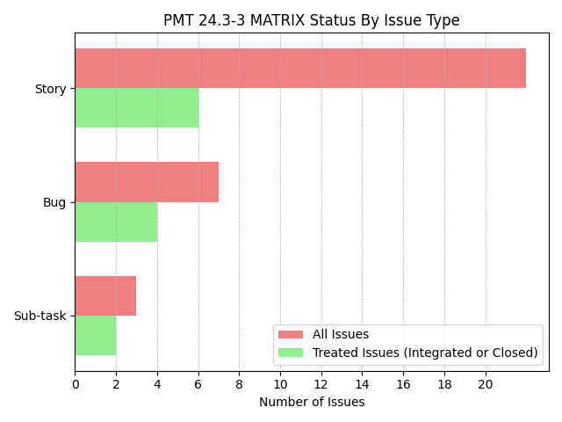

Slide 3
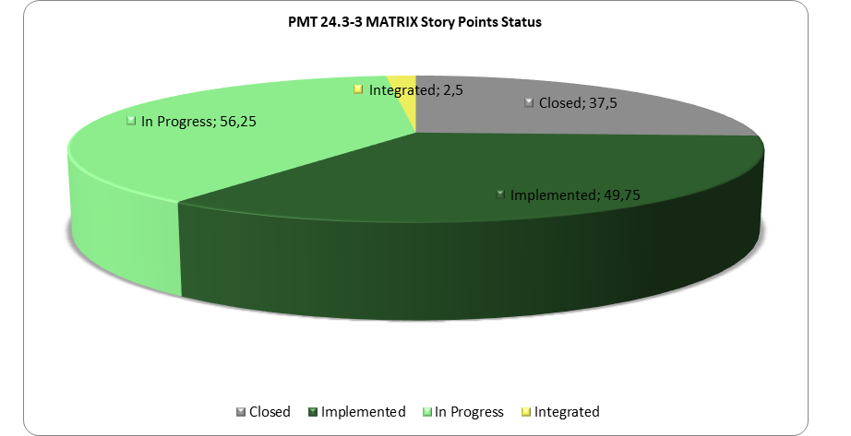

Slide 4
