Slide 1
Total Consumed Story Points: 16.25
Date: 2024-09-20

Slide 2
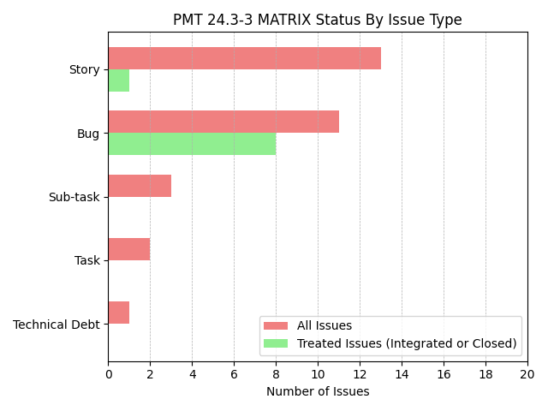

Slide 3
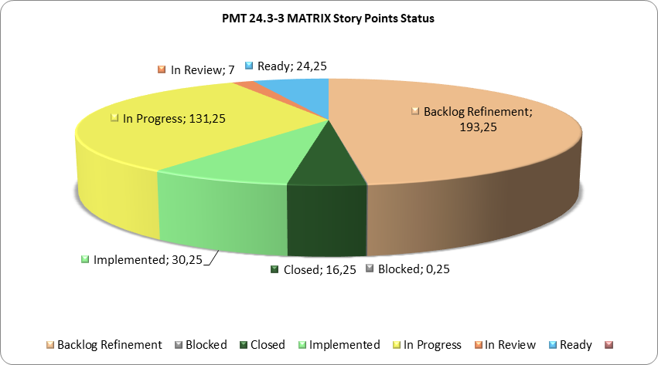

Slide 4
