Slide 1

Matrix-Tunis Sprints Metrics PMT24.3-2 SEPTEMBER2024
2024/09/24

Slide 2
MATRIX
2024/09/24

Slide 3
MATRIX - SEPTEMBER2024 – PMT24.3-2
Highlights
Our contributions:
Epics:
-
Technical debts & support:
-
Bugs:
-
Lowlights / Amelioration axes /working on
2024/09/24

Slide 4
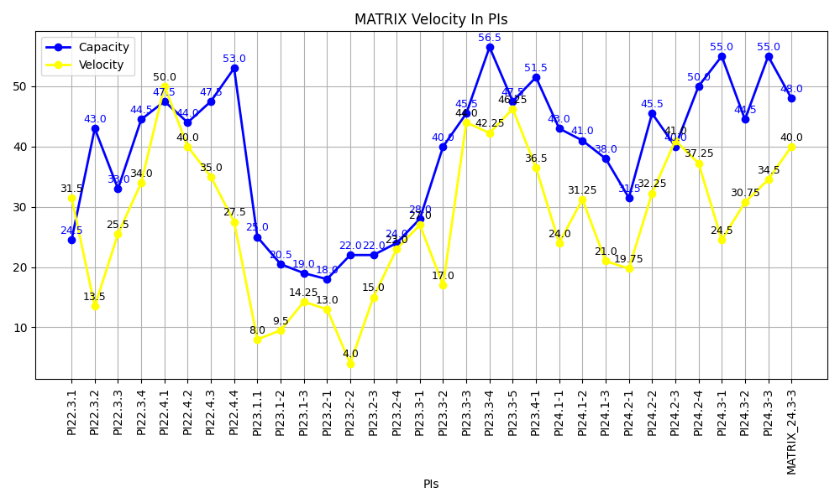
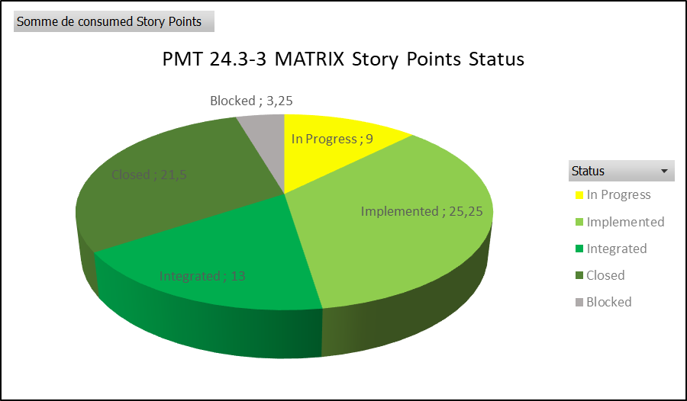
MATRIX - SEPTEMBER2024 – PMT24.3-2
2024/09/24

Slide 5
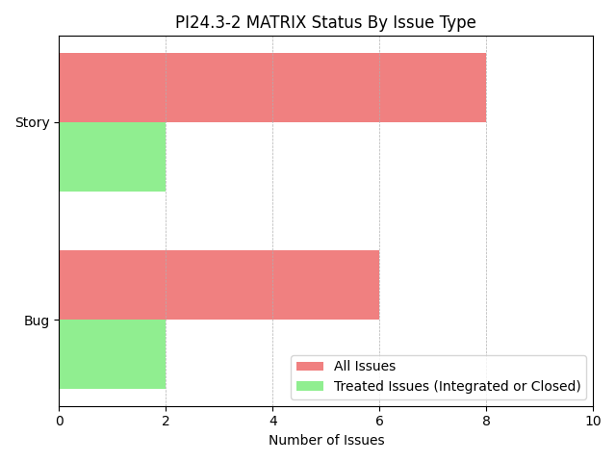
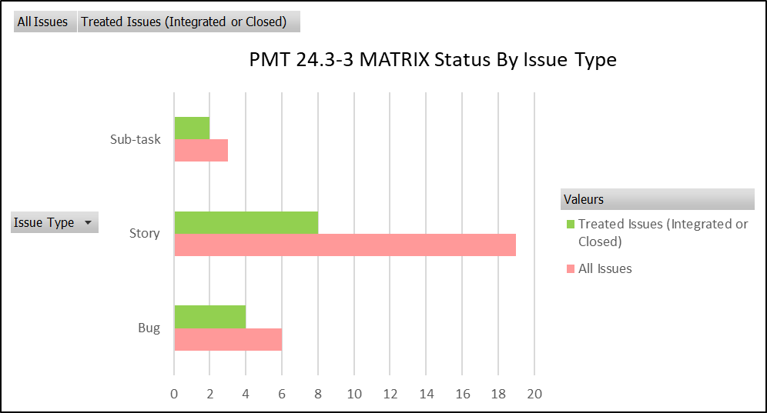
MATRIX - SEPTEMBER2024 – PMT24.3-2
2024/09/24

Slide 6
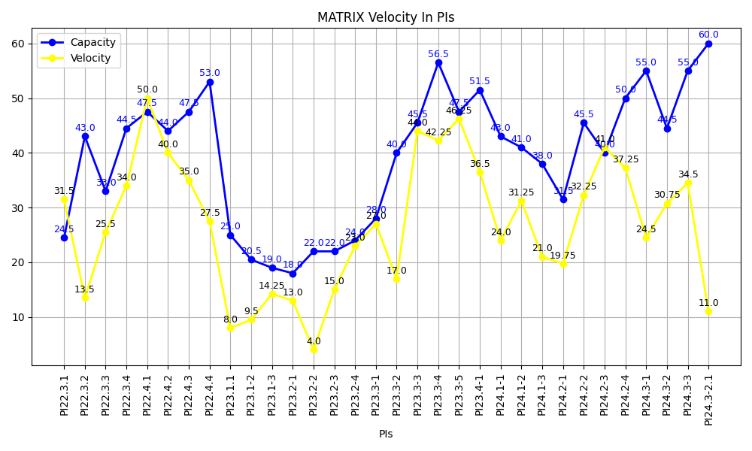
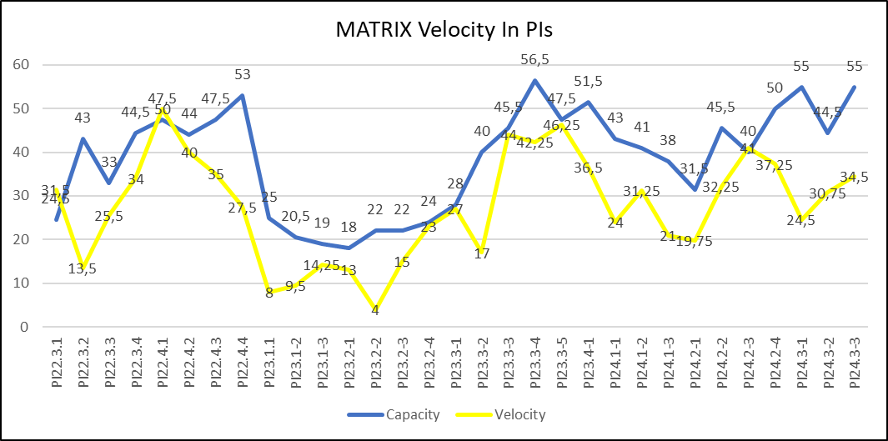
MATRIX - SEPTEMBER2024 – PMT24.3-2
2024/09/24

Slide 7
MATRIX - SEPTEMBER2024 – PMT24.3-2
2024/09/24

Slide 8
MATRIX - SEPTEMBER2024 – PMT24.3-2
2024/09/24

Slide 9
MATRIX - SEPTEMBER2024 – PMT24.3-2
Sprint PI 24.3-3– closed User Stories/Tasks/Bugs
2024/09/24

Slide 10
MATRIX - SEPTEMBER2024 – PMT24.3-2
Sprint PI 24.3-3 – User Stories/Tasks/Bugs Not closed
2024/09/24

Slide 11
september2024- Holidays
2024/09/24

Slide 12

2024/09/24

