Slide 1
Dr. Malak Abdullah
Titanic: Machine Learning from Disaster
Ammar Assaaf
Bahaa Gdiesat

Slide 2
Predict the survival of a passenger on the Titanic
Attributes may use : Pclass, Name Sex, Age, SibSp, Parch, Ticket, Fare, Cabin and Embarked.
Goal: to predict if a passenger survived the sinking of the Titanic or not. For each PassengerId in the test set, you must predict a 0 or 1 value for the Survived variable.
Metrics: the percentage of passengers you correctly predict ”accuracy” .
Submission File Format: csv file with exactly 418 entries plus a header row. Your submission MUST predect if those passengers survived the sinking.
We used the “Gaussian Naive Bayes”

Slide 3
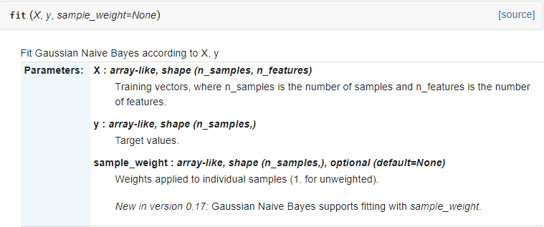
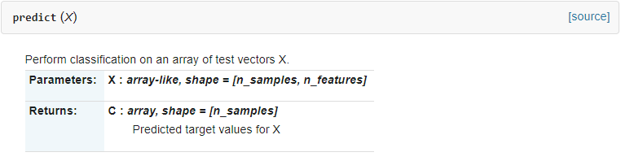
Gaussian Naive Bayes
Train you code
Inputs used
Output target
dataset
Returns the predict value
Data to be tested

Slide 4
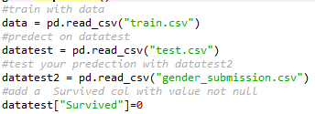
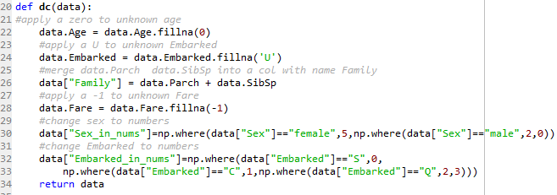

Code
Read the data.
Read the data you want to predict on.
Test your prediction on.
Fill null data with unique values.
Combine cols (solves the assumption of independence among features ).
Test your prediction on.

Slide 5

Code
Train your model. Apply on the data to test survival.
missed prediction = if (you predict survived but he didn’t + you predict not survived but he did survived ).
Simplify to (your predict != actual survival)
We want the count of all of these elements for our calculations.
(total number of test data)

Slide 6


