Slide 1

Distributed Systems
Multi-Client Chat System with Lamport Clock Synchronization
Realized by: : Bahaeddine Hamrouni & Amir Ben Rejeb

Slide 2
1
Introduction
2
System Overview & Architecture
Plan
3
Communication & Implementation
4
Lamport Clock Integration
5
Results & Conclusion
2

Slide 3
1
Introduction
3

Slide 4

1
introduction
2
Sys. Overview & architecture
3
Communication & implementation
4
Lamport clock
5
Results & Conclusion
Distributed systems
multiple independent processes
No shared global clock between processes
Event ordering becomes a critical challenge
4

Slide 5

1
introduction
2
Sys. Overview & architecture
3
Communication & implementation
4
Lamport clock
5
Results & Conclusion
Lamport logical clocks provide
Logical (not physical) time
Causal ordering of events
5

Slide 6

1
introduction
2
Sys. Overview & architecture
3
Communication & implementation
4
Lamport clock
5
Results & Conclusion
Project goals
multi-client chat system
Integrate Lamport clocks
6

Slide 7
2
System Overview & Architecture
7

Slide 8


1
Introduction
2
Sys. Overview & architecture
3
Communication & implementation
4
Lamport clock
5
Results & Conclusion
Centralized client–server model
8

Slide 9
1
Introduction
2
Sys. Overview & architecture
3
Communication & implementation
4
Lamport clock
5
Results & Conclusion
Server
Accept client connections
Maintain list of connected users
Route private messages
9

Slide 10
1
Introduction
2
Sys. Overview & architecture
3
Communication & implementation
4
Lamport clock
5
Results & Conclusion
Client
Send and receive messages
Maintain a local Lamport clock
10

Slide 11
1
Introduction
2
Sys. Overview & architecture
3
Communication & implementation
4
Lamport clock
5
Results & Conclusion
Communication
TCP/IP socket-based
Text-based message protocol
11

Slide 12
3
Communication & Implementation
12

Slide 13

1
Introduction
2
Sys. Overview & architecture
3
Communication & implementation
4
Lamport clock
5
Results & Conclusion
Communication based on TCP sockets
Private messages
System messages (user list updates)
PRIVATE:<sender>:<receiver>:<message>:<lamportClock>
13

Slide 14


1
Introduction
2
Sys. Overview & architecture
3
Communication & implementation
4
Lamport clock
5
Results & Conclusion
ChatServer.java: connection handling and routing
ClientHandler.java: per-client communication thread
ChatClient.java: message handling and clock logic
MultiChatWindow.java: GUI management
14

Slide 15
4
Lamport Clock Integration
15

Slide 16
1
Introduction
2
Sys. Overview & architecture
3
Communication & implementation
4
Lamport clock
5
Results & Conclusion
Each client maintains a local Lamport clock
Increment clock before sending a message
Attach clock value to outgoing message
On receive:
clock = max(localClock, receivedClock) + 1
16

Slide 17
1
Introduction
2
Sys. Overview & architecture
3
Communication & implementation
4
Lamport clock
5
Results & Conclusion
Purpose
Preserve causal ordering of events
Avoid reliance on physical time
17

Slide 18
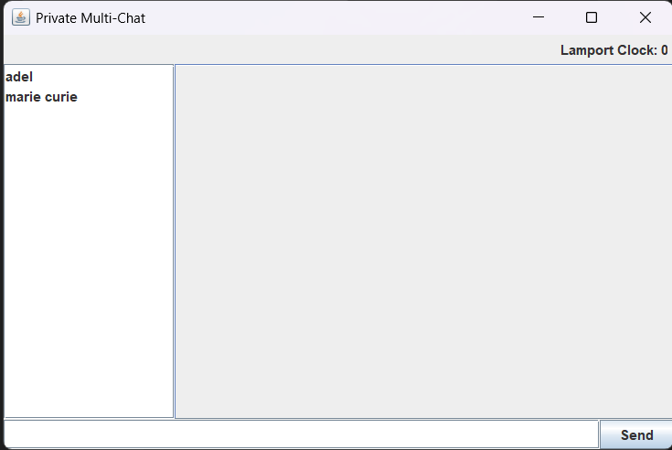
1
Introduction
2
Sys. Overview & architecture
3
Communication & implementation
4
Lamport clock
5
Results & Conclusion
Lamport clock initially set to 0
18

Slide 19
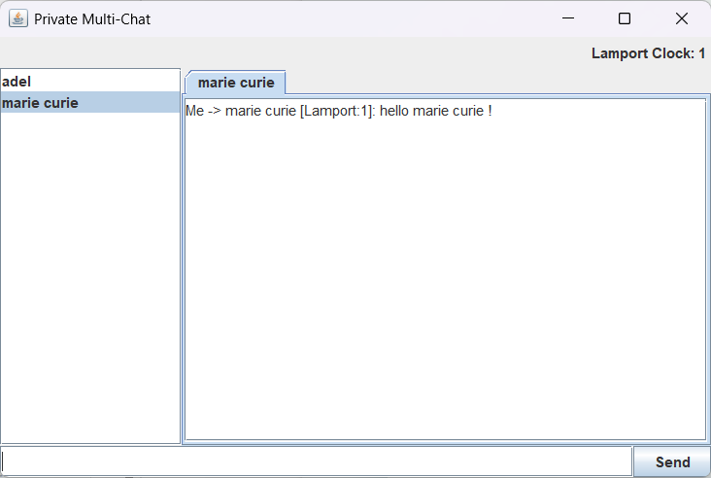
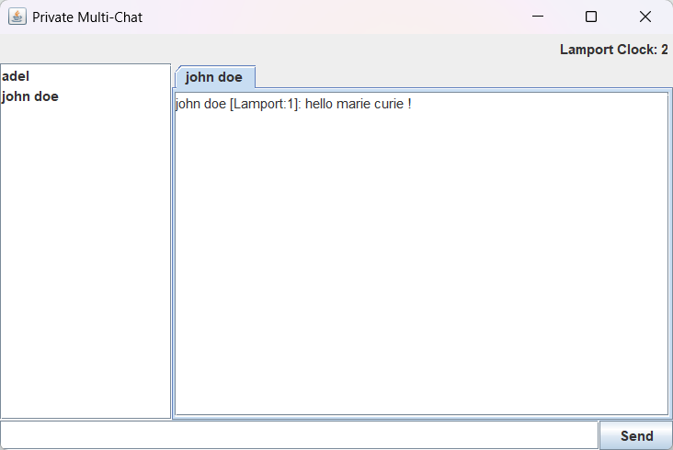
1
Introduction
2
Sys. Overview & architecture
3
Communication & implementation
4
Lamport clock
5
Results & Conclusion
On send
On recieve
19

Slide 20
5
Results & Conclusion
20

Slide 21

1
Introduction
2
Sys. Overview & architecture
3
Communication & implementation
4
Lamport clock
5
Results & Conclusion
Observed behavior:
Correct private message delivery
Proper Lamport clock updates on send and receive
Causal ordering preserved
21

Slide 22

1
Introduction
2
Sys. Overview & architecture
3
Communication & implementation
4
Lamport clock
5
Results & Conclusion
The project validates the practical use of Lamport clocks
Demonstrates a correct and reliable distributed chat system
22

Slide 23
Thank you

