Slide 1
Trading Stocks with Machine Learning

Slide 2
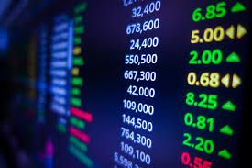
Our App
Trades the S&P 500 based on Machine Learning Predictions
Delivers secure account monitoring platform for users
Live Dashboard
Account Creation & User Profile
S&P 500 trading information
Hosted in the cloud with AWS

Slide 3
Machine Learning with LSTM
Long Short Term Memory

Slide 4
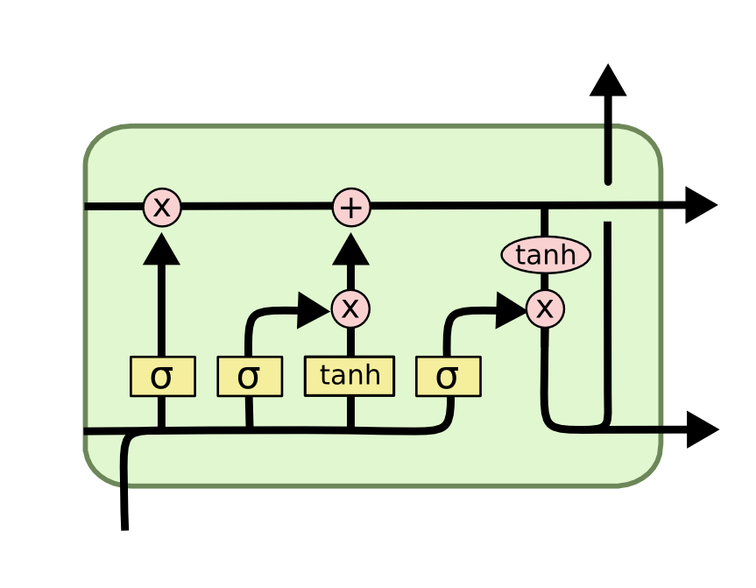
What is LSTM?
LSTM cells – mini neural networks inside a larger neural network
Designed to allow for memory of information

Slide 5
Building the Model
Train, Test, Repeat

Slide 6
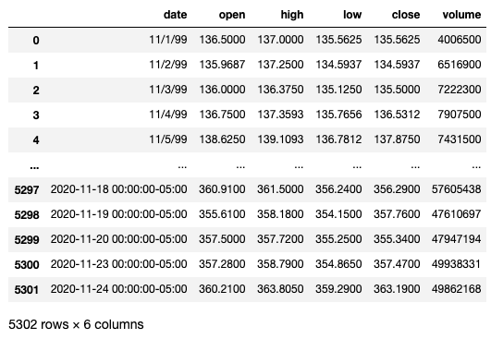
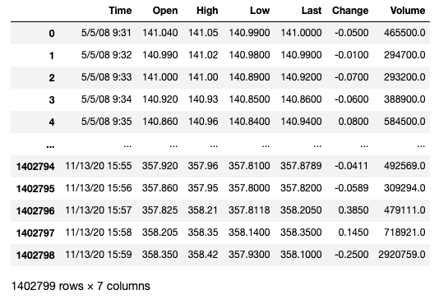
Datasets
Daily - Alpha vantage
Per Minute - Barchart.com

Slide 7
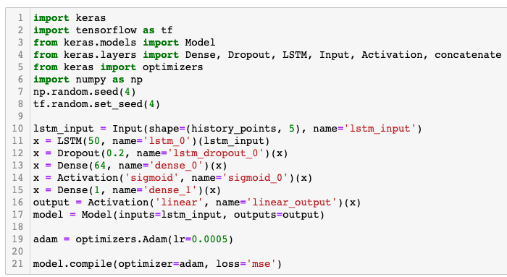
Building the Model
Input layer has shape of (50, 5)
Dropout layer – prevents overfitting
Activation layer – allows model to tune its weights
Dense layers – brings all the LSTM data together

Slide 8
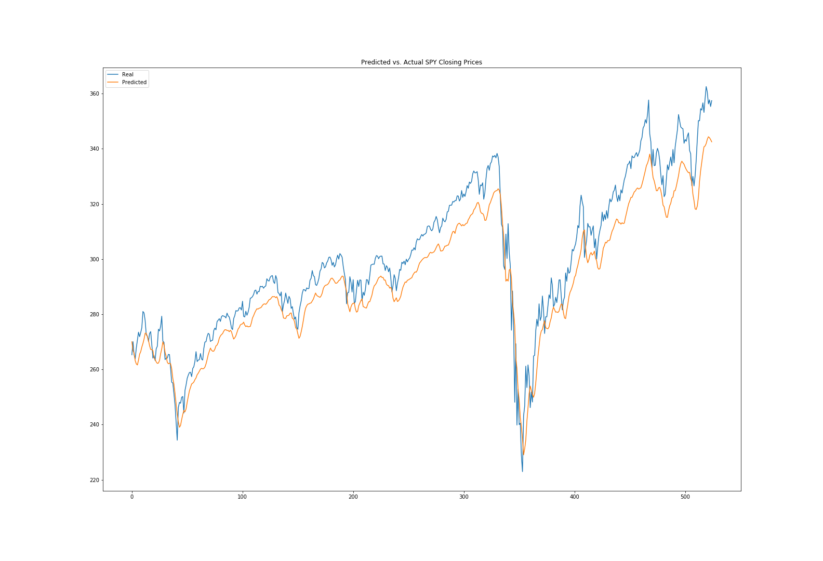
Results

Slide 9
Thank you for an amazing class. We will miss you all.
Lets stay connected.
Use your new knowledge to create value.
Never stop learning.
You are going to do great.

