Slide 1
Nemorix
A Virtual Memory Runtime for Persistent AI Agents
OS-Inspired KV-Cache Tiering: GPU VRAM → CXL → CPU RAM → SSD
Baha eddine Ouni
imec Innovation Challenge · 2026 · Ask: new internal R&D track
Notes:
Persistent AI agents are coming to every enterprise. The thing stopping them isn't compute -- it's memory. Nemorix is an operating system for agent memory. In simulation, it runs 50 agents on a GPU that fits 6, wakes them 120 times faster, and cuts cost per agent by about 85%. Let me show you.

Slide 2
THE PROBLEM
AI agents lose their memory when the GPU fills up
▶ One long-context agent = ~20 GB of KV-cache. An 80 GB H100 fits only 4–6 agents.
▶ When VRAM fills, today's engines discard agent context and recompute from scratch.
▶ Recompute cost: 1–2 seconds of latency on every single wake-up.
▶ Result: low agent density, slow resumes, high cost.
1–2 s
wasted on every
agent resume
0 of 50 agents
meet a 200 ms SLA today
Notes:
When you run an AI agent, it builds up a memory called the KV-cache -- for a long conversation that's about 20 gigabytes. A top-end H100 GPU only fits a handful. So today's engines -- vLLM, TensorRT -- do the brutal thing: when memory fills, they throw the agent's memory away. Next time it wakes, it recomputes from scratch. One to two seconds of dead time, every resume. It caps how many agents you can run, and it's expensive.

Slide 3
WHY NOW
The bottleneck isn't compute — it's memory management
The bottleneck in agentic AI is the absence of a memory layer built for agent persistence.
75–98%
100s
2024–26
of an agent's life is spent idle (waiting on humans, tools, CI)
of concurrent agents enterprises want — not six
shift from stateless chat to persistent, long-running agents
Notes:
The market just shifted from stateless chatbots to persistent agents that run for hours. Those agents are idle 75 to 98 percent of the time -- yet their memory sits in the most expensive real estate in the data center. Nobody has built a memory manager designed for this. That's the gap.

Slide 4
THE INSIGHT
Agents are processes. KV-cache is virtual memory.
Operating System | Nemorix
Process | AI agent
RAM (fast, small) | GPU VRAM
Swap / disk (slow, big) | CXL → RAM → SSD
Page fault | Agent wakes, cache not in GPU
Page replacement (LRU) | Semantic eviction
Page it,
don't delete it.
60 years of proven OS theory, applied to AI agents for the first time.
Notes:
Operating systems solved this in the 1960s. Your laptop runs more apps than fit in RAM by paging idle parts out to disk and back -- invisibly. We do exactly that for agents: an agent is a process, its KV-cache is its memory, and instead of deleting it when the GPU is full, we page it down to cheaper storage and bring it back in milliseconds. The idea stands on 60 years of proven theory.

Slide 5
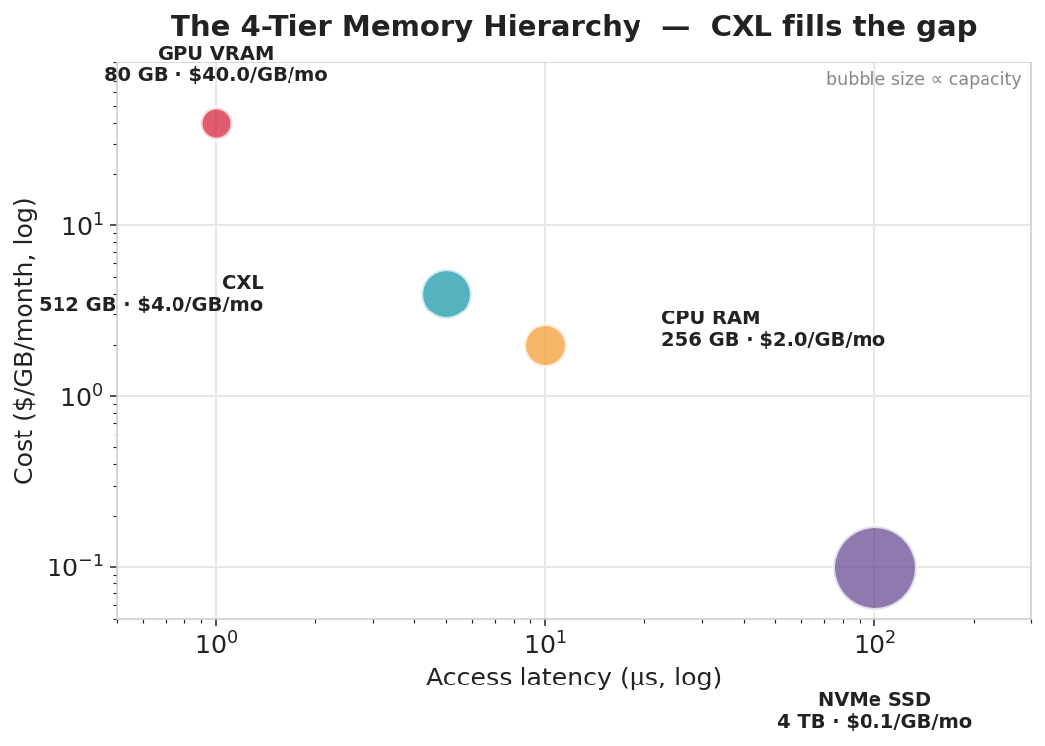
THE SOLUTION
A 4-tier memory runtime for agent KV-cache
Plus four mechanisms:
• Lifecycle scheduling
move idle agents down proactively
• Semantic eviction
keep what matters most
• Progressive page-in
load first layers, stream the rest
• Compression FP16→FP8→INT4
per-tier, <1.8% quality loss
CXL is the enabler: 10× cheaper than
VRAM, fast enough for <100 ms resume.
Notes:
Nemorix manages each agent's memory across four tiers. The star is CXL -- Compute Express Link -- 10x cheaper than GPU memory but fast enough to wake an agent in under 100 milliseconds. We add lifecycle-aware scheduling, semantic eviction that decides what's worth keeping, and progressive page-in that loads just the first layers an agent needs to start responding.

Slide 6
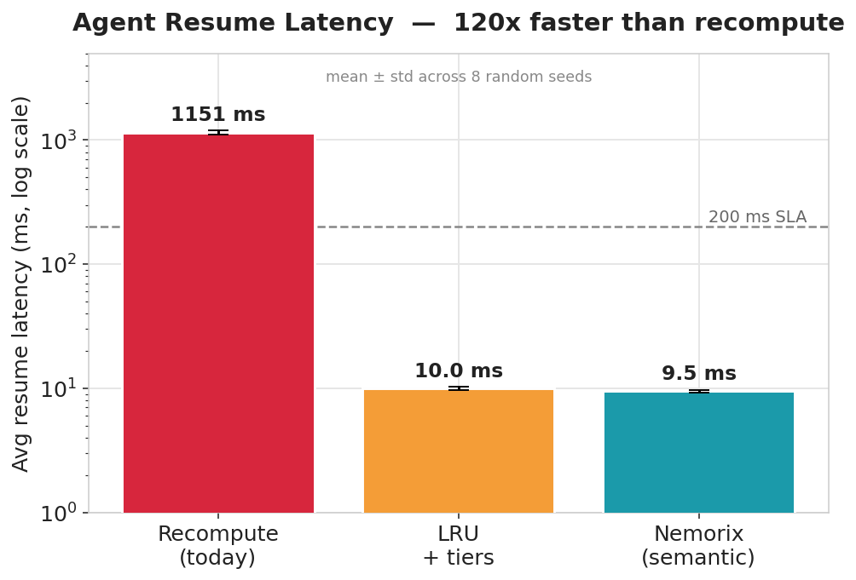
THE RESULTS ★
120× faster resume — verified across 8 seeds
120×
50/50
faster resume (1,151 → 9.5 ms)
agents under SLA (vs 0/50 today)
~85%
8×
lower cost per agent-hour
agent density (50 vs 6 per GPU)
Spread across seeds ≈ 2% — not a cherry-picked result.
Notes:
Here's the proof. Average resume latency drops from about 1,150 milliseconds to 9.5 -- 120x faster. Every one of the 50 agents now meets a 200-millisecond SLA; with recompute, zero do. Cost per agent-hour falls about 85%. And these are averaged over eight random seeds with only about 2% variation. Not one lucky run.

Slide 7
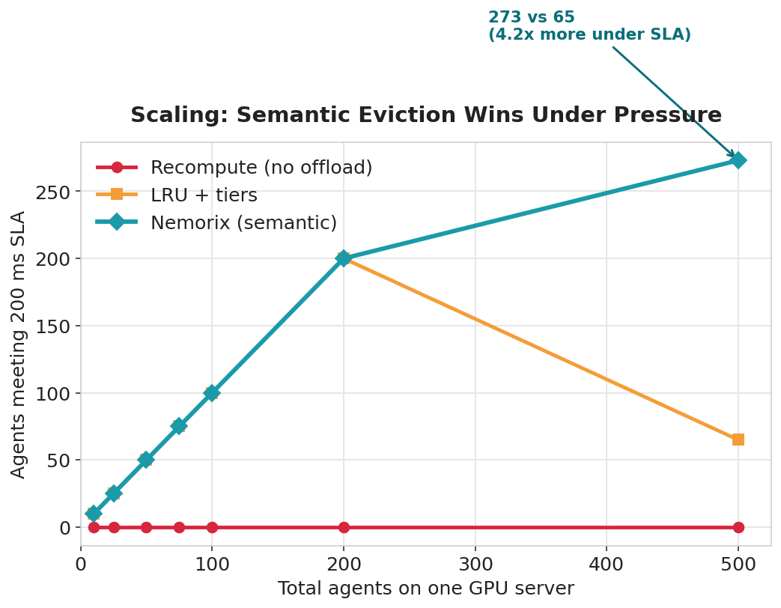
THE DIFFERENTIATOR ★
Semantic eviction wins under pressure
Policy @ 500 agents | SLA
LRU (recency only) | 65 / 500
Nemorix (semantic) | 273 / 500
4.2× more agents
kept under SLA at scale.
Protects high-priority, high-attention, expensive-to-rebuild agents — the defensible algorithmic edge.
Notes:
At small scale, LRU and Nemorix are similar -- CXL does the heavy lifting. The difference shows at 500 agents when the hierarchy is full. Plain LRU keeps 65 agents under SLA. Nemorix keeps 273 -- over four times more -- because semantic eviction protects the agents that matter. That's our defensible algorithmic edge.

Slide 8
BEYOND STATE OF THE ART
First to combine CXL + lifecycle + semantic
System | Multi-tier | CXL | Semantic eviction | Agent-centric
vLLM | partial | No | No (LRU) | No (request)
NVIDIA Dynamo | Yes | No | No | semi
FlexGen / Mooncake | Yes | No | No | No (throughput)
Liaw & Chen '25 | — | Yes (training) | — | No
Nemorix | Yes (4-tier) | Yes | Yes | Yes
Every ingredient exists somewhere. Nobody combines them. Nemorix is the only system at the intersection.
Notes:
Every ingredient exists, but nobody combines them. vLLM is request-centric and LRU-only. Dynamo has tiers but no CXL. FlexGen and Mooncake optimize batch throughput, not agent persistence. There's CXL work -- but for training, a different problem. Nemorix is the only system at the intersection of CXL, agent-lifecycle scheduling, and semantic eviction.

Slide 9
WHY IMEC
Uniquely positioned: simulation → silicon
▶ World-class CXL & memory-system expertise
▶ Hardware-software co-design capability
▶ Access to semiconductor partners (Samsung, SK Hynix)
▶ HPC infrastructure for real H100 + CXL validation
▶ Deep-tech commercialization support
Notes:
This is why imec is the right home. Nemorix's bet is CXL -- and imec has world-class CXL and memory expertise, hardware-software co-design, direct relationships with Samsung and SK Hynix, and the HPC infrastructure to validate on real hardware. Almost no one else on earth can take this from simulation to production. That's our unfair advantage.

Slide 10
THE BUSINESS MODEL
Open core — the playbook behind $62B Databricks
Product | Who buys it | Price
Nemorix Core (OSS) | Everyone — adoption engine | Free (MIT license)
Nemorix Enterprise | Cloud providers, AI companies | $15–25K / GPU / year
Nemorix Cloud | Startups, mid-market | $0.02 / agent-hour
10:1 ROI
Customer saves $150K/yr
in GPU costs, pays us $15K
Easy CFO approval.
Year 2
Year 3
Year 5
$750K ARR
$5M ARR
$100M ARR
50 customers
200 customers
2,000 customers
Notes:
How does this make money? Same playbook that built Databricks into a 62-billion dollar company: open core. The base runtime is free and open source -- that drives adoption. The enterprise version adds multi-node CXL pooling, dashboards, RBAC, and support at 15 to 25 thousand per GPU per year. And a managed cloud service for pay-per-use. A customer saving 150K a year in GPU costs happily pays us 15K -- that's 10-to-1 ROI. Year 5 target: 100 million ARR, 85% gross margin.

Slide 11
MARKET & EXIT
$45B market — three paths to outsized returns
$45B
$8B
$100M+
25–35%
CAGR
Growing every
quarter
TAM
SAM
SOM (Yr 5)
AI inference infrastructure
Persistent agent serving
Our realistic capture
Exit Path | How | Potential
Category leader | "Nemorix" = agent memory (like K8s = orchestration) | $2B+
Strategic acquisition | NVIDIA, Samsung, Intel buy the software layer | $500M–$2B
Hardware partnership | CXL vendors co-invest to drive adoption | Revenue + equity
Comparable exits: Databricks $62B · HashiCorp $6.8B (IBM) · Mellanox $6.9B (NVIDIA) · Redis $2B+
Notes:
The AI inference infrastructure market is 45 billion, growing 25 to 35 percent a year. Persistent agent serving is an 8 billion segment. Three exit paths: become the category leader like Kubernetes, strategic acquisition by NVIDIA or Samsung, or hardware partnerships. For imec: equity, IP, and recognition as the birthplace of AI virtual memory. Comparable exits range from 2 to 62 billion.

Slide 12
THE ASK & PLAN
Fund a new R&D track to validate on real hardware
Phase | What | Outcome
Now ✓ | Simulator + paper draft | 74 tests, preprint-ready
0–6 mo | Workshop paper + arXiv | priority + credibility
3–9 mo | vLLM + real H100 + CXL DIMM | measured, not simulated
6–12 mo | Eviction study + OSS release | adoption + citations
12–36 mo | Spin-out / license / upstream | value capture
€80–120K
hardware POC
CXL module + engineering time + cloud GPU credits
Notes:
What I'm asking for is 80 to 120 thousand euros to validate Nemorix on real hardware. The simulator is done. The next milestone is integrating with vLLM and running on a real H100 with a CXL DIMM here at imec. From there: a paper, an open-source release, and a choice of spin-out or license.

Slide 13
Turn the GPU memory wall
into a memory hierarchy.
▶ Lower resume latency → real-time, long-context agents
▶ Lower cost & higher density → labs, hospitals, public institutions can deploy
▶ More sustainable use of existing GPUs
Make persistent AI agents practical without hyperscale infrastructure.
Notes:
The impact is democratization. Today, running fleets of persistent agents needs hyperscale budgets. Nemorix lets a research lab, a hospital, or a public institution do it on the hardware they already have -- faster, cheaper, more sustainably. We turn the GPU memory wall into a memory hierarchy. Thank you -- I'd love your questions.

Slide 14
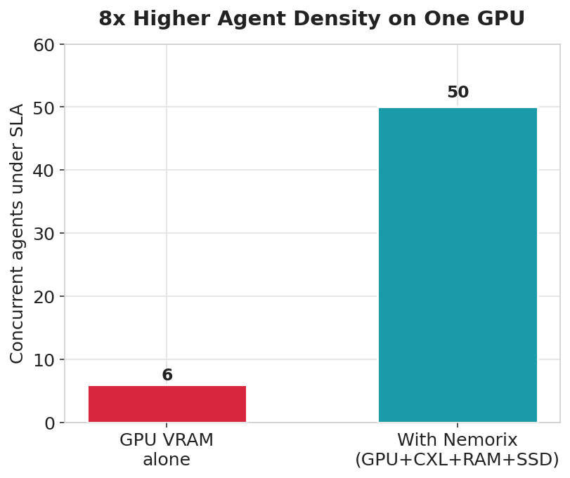
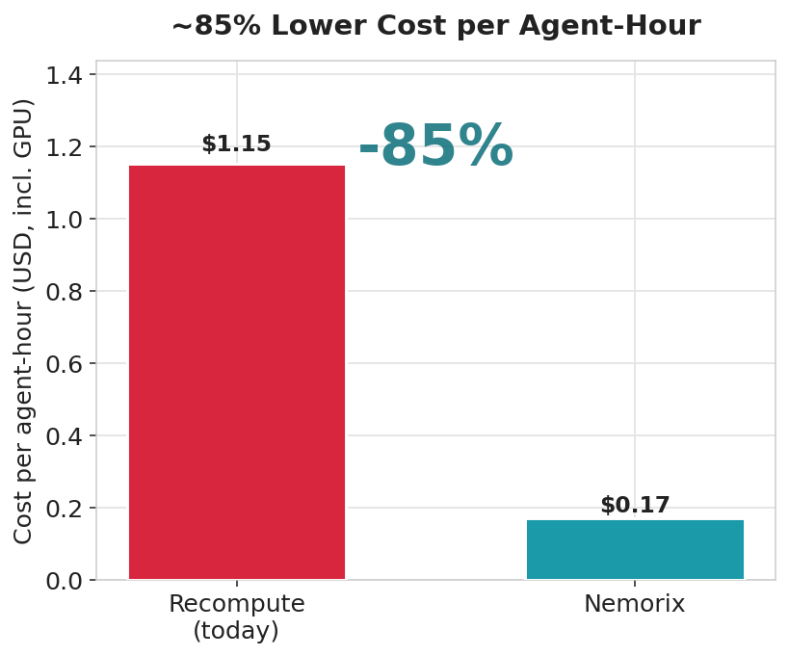
APPENDIX
Supporting data: density & cost
Notes:
Backup slide. Left: Nemorix raises concurrent agents under SLA from 6 to 50 on one GPU. Right: cost per agent-hour drops about 85%. Both reproducible from results.json.

Slide 15
APPENDIX
Reproducibility & honesty
The honesty line:
“This is simulation, calibrated to published hardware specs — not yet measured on real hardware. That's exactly what the hardware-validation phase is for.”
Sources: H100 HBM3 datasheet, Samsung CMM-D CXL 2.0, NVMe Gen4, MLPerf v4.0, KIVI/KVQuant.
Reproduce every number:
pip install -e ".[dev]"
python -m pytest tests/ -v
python benchmarks/run_simulation.py
python benchmarks/run_robustness.py
python benchmarks/compare_policies.py
74 automated tests · every constant from a datasheet
Notes:
Backup. Every number is reproducible with these commands, and every hardware constant traces to a published datasheet. Always lead with the honesty line: this is simulation calibrated to specs, and hardware validation is the next milestone.

