Slide 1

Tutorial: Calibrated Rectification Using OpenCV (Bouguet’s Algorithm)
Michael Hornáček
Stereo Vision VU 2013
Vienna University of Technology

Slide 2
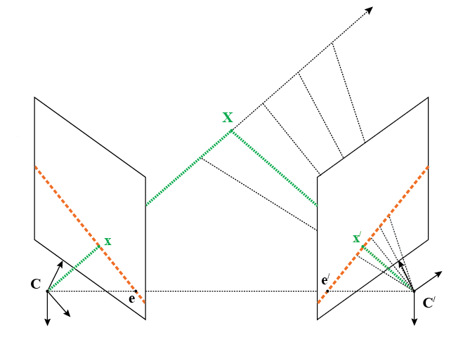
Epipolar Geometry
Given x in the left image, reduces the search for x’ to the epipolar line in the right image corresponding to x (1D search space)

Slide 3
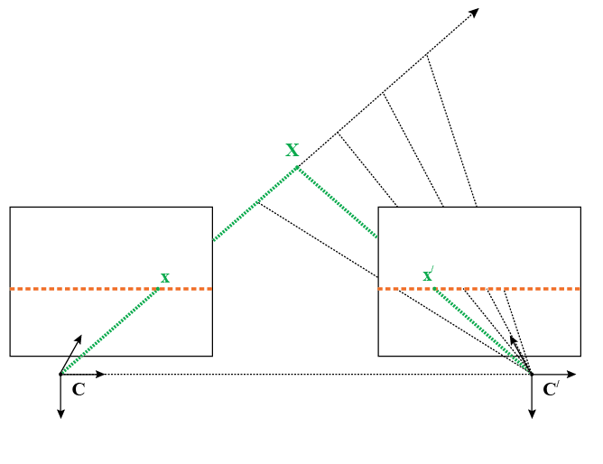
Rectified Epipolar Geometry
Speeds up and simplifies the search by warping the images such that correspondences lie on the same horizontal scanline

Slide 4
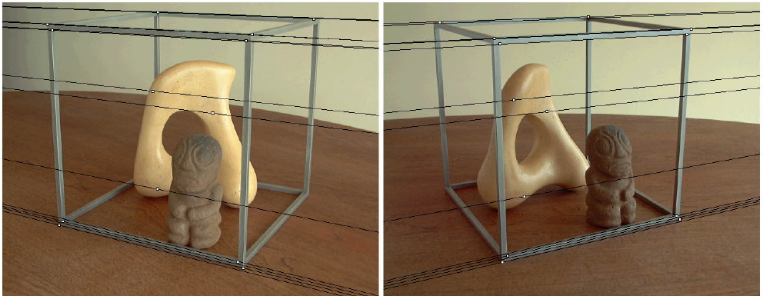
Epipolar Geometry

Slide 5
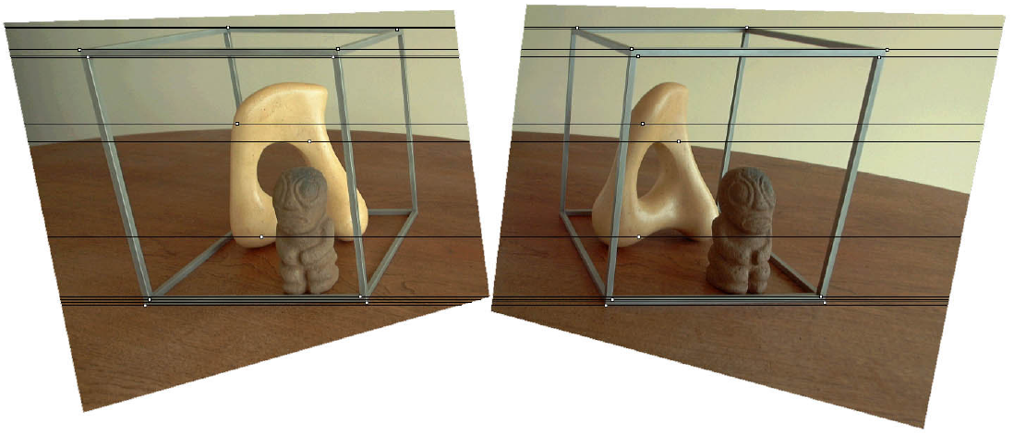
Rectified Epipolar Geometry
From approach of
Loop and Zhang

Slide 6
Homogeneous Coordinates

Slide 7
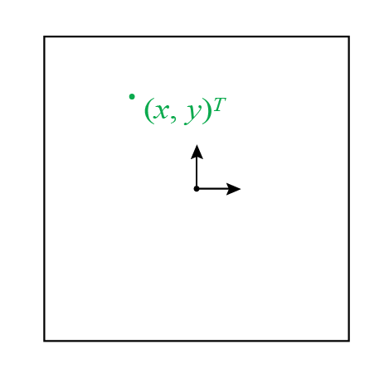
A Point in the Plane (Inhomogeneous Coordinates)
We can represent a point in the plane as an inhomogeneous 2-vector (x, y)^{T}

Slide 8
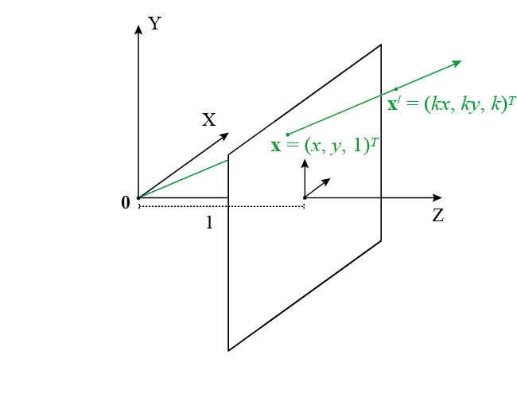
A Point in the Plane (Homogeneous Coordinates)
“is proportional to”
We can represent that same point in the plane equivalently as any homogeneous 3-vector (kx, ky, k)^{T}, k ≠ 0

Slide 9
Homogeneous vs. Inhomogeneous
The homogeneous 3-vector x ~ (kx, ky, k)^{T} represents the same point in the plane as the inhomogenous 2-vector x = (kx/k, ky/k)^{T} = (x, y)^{T}
Generalizes to higher-dimensional spaces
^

Slide 10

Why Use Homogeneous Coordinates?
Lets us express projection (by the pinhole camera model) as a linear transformation of X, meaning we can encode the projection function as a single matrix P

Slide 11
Pinhole Camera Model

Slide 12
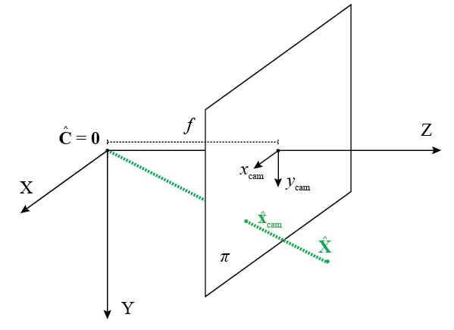
(x_{cam}, y_{cam})^{T}: Projected Pt in Camera Coordinates [mm]
^
Canonical pose: camera center C is at origin 0 of world coordinate frame, camera is facing in positive Z-direction with x_{cam} and y_{cam} aligned with the X- and Y-axes, respectively

Slide 13
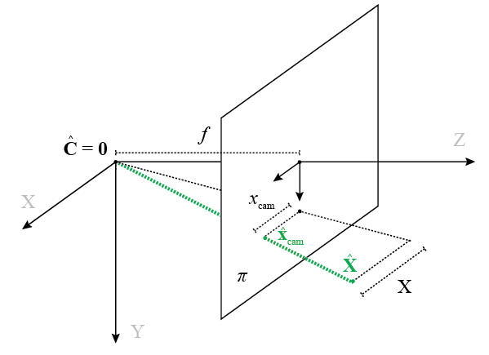
(x_{cam}, y_{cam})^{T}: Projected Pt in Camera Coordinates [mm]

Slide 14
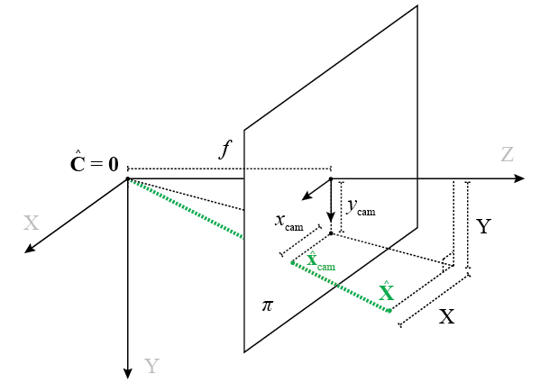
(x_{cam}, y_{cam})^{T}: Projected Pt in Camera Coordinates [mm]

Slide 15
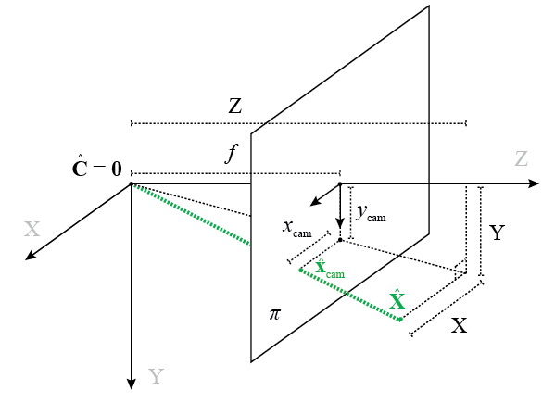
(x_{cam}, y_{cam})^{T}: Projected Pt in Camera Coordinates [mm]

Slide 16
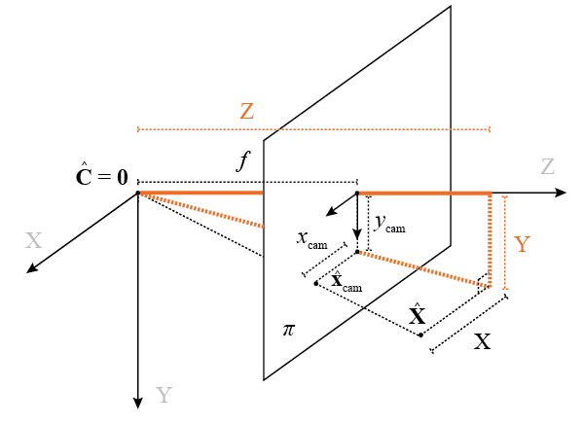
(x_{cam}, y_{cam})^{T}: Projected Pt in Camera Coordinates [mm]

Slide 17
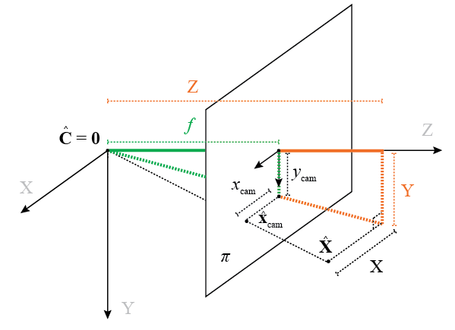
(x_{cam}, y_{cam})^{T}: Projected Pt in Camera Coordinates [mm]

Slide 18
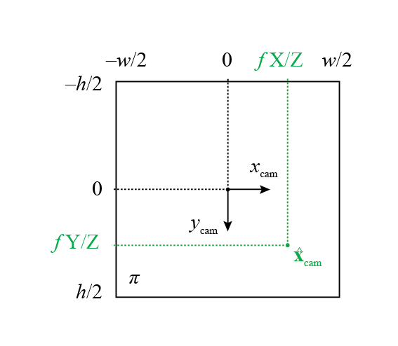
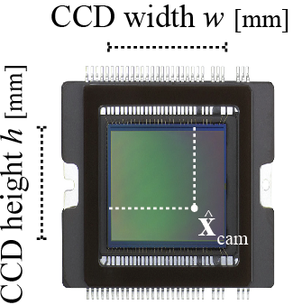
(x_{cam}, y_{cam})^{T}: Projected Pt in Camera Coordinates [mm]

Slide 19
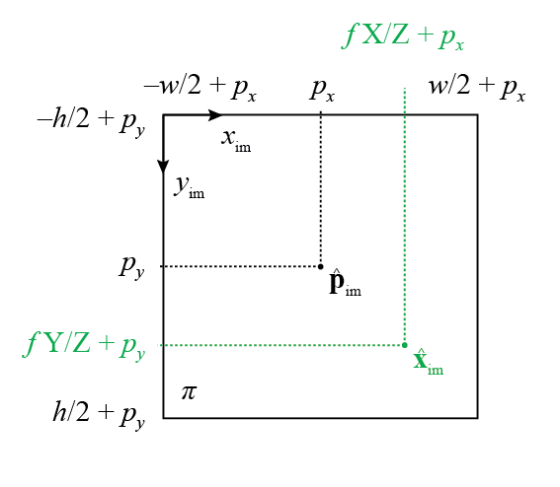
(x_{im}, y_{im})^{T}: Projected Pt in Image Coordinates [mm]

Slide 20
(x_{im}, y_{im})^{T}: Projected Pt in Image Coordinates [mm]
w / 2
0
w / 2
w
0
common assumption
p_{x} = w / 2
p_{y} = h / 2
h / 2
h / 2
h

Slide 21
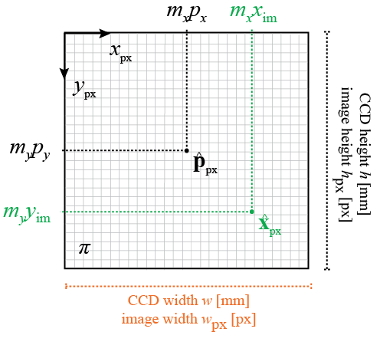
(x_{px}, y_{px})^{T}: Projected Pt in Pixel Coordinates [px]
w_{px} [px]
w [mm]
m_{x} =
h_{px} [px]
h [mm]
m_{y} =
x_{im} = fX/Z+p_{x} [mm]
y_{im} = fY/Z+p_{y} [mm]

Slide 22
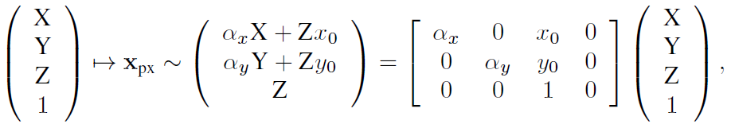
(x_{px}, y_{px})^{T}: Projected Pt in Pixel Coordinates [px]
invertible 3x3 camera calibration matrix K

Slide 23
Omitted for Brevity: Distortions and Skew
Typically pixel skew is disregarded and images can be undistorted in a pre-processing step using distortion coefficients obtained during calibration, allowing us to use the projection matrix presented

Slide 24
Pinhole Camera in Non- canonical Pose

Slide 25
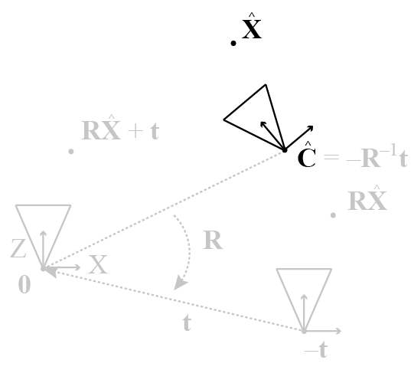
World-to-Camera Transformation

Slide 26
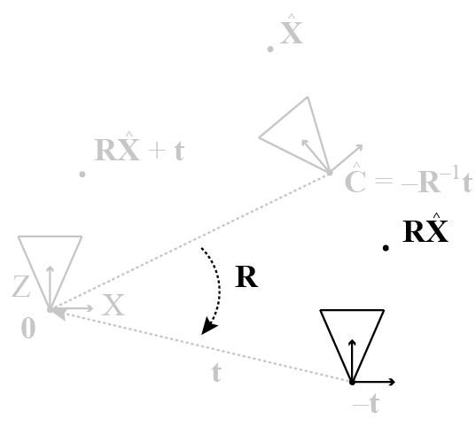
World-to-Camera Transformation

Slide 27
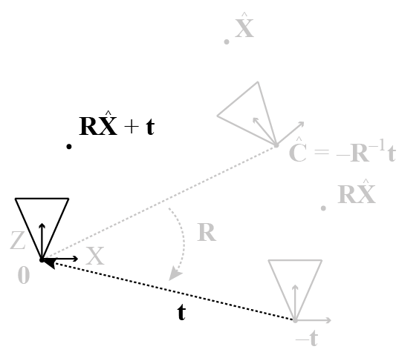
World-to-Camera Transformation

Slide 28
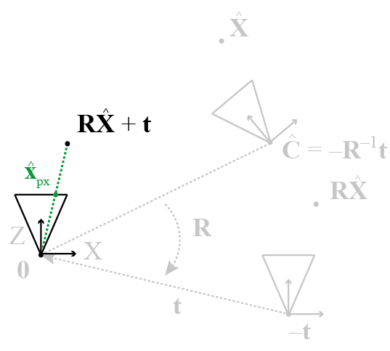
World-to-Camera Transformation
^
We now project ((RX + t)^{T}, 1)^{T} using [K | 0] as before

Slide 29
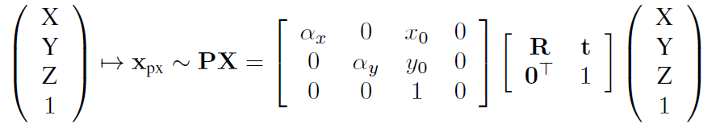
(x_{px}, y_{px})^{T}: Projected Pt in Pixel Coordinates [px] for Camera in Non-canonical Pose
invertible 4x4 world-to-camera rigid body transformation matrix
We use this decomposition rather than the equivalent and more common P = K[R | t] since it will allow us to reason more easily about combinations of rigid body transformation matrices

Slide 30
Geometry of Two Views

Slide 31

Relative Pose of P and P’
Given two cameras P, P’ in non-canonical pose,
their relative pose is obtained by expressing both cameras in terms of the camera coordinate frame of P

Slide 32
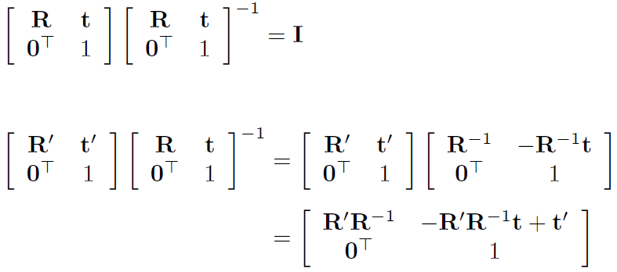
Relative Pose of P and P’
You will need this for the exercise

Slide 33
Rotation about the Camera Center

Slide 34
Rotation about the Camera Center
Rectifying our cameras will involve rotating them about their respective camera center, from which we obtain the corresponding pixel transformations for warping the images

Slide 35
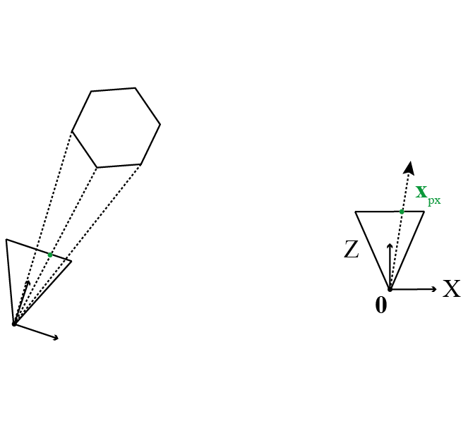
Pixel Transformation under Rotation about the Camera Center

Slide 36
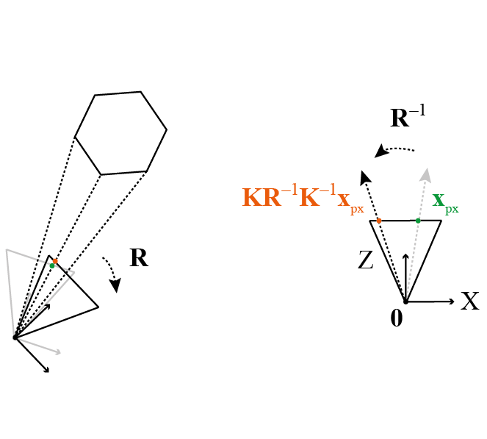
Pixel Transformation under Rotation about the Camera Center
Observe that rotation about the camera center does not cause new occlusions!

Slide 37
Rectification via Bouguet’s Algorithm (Sketch)

Slide 38
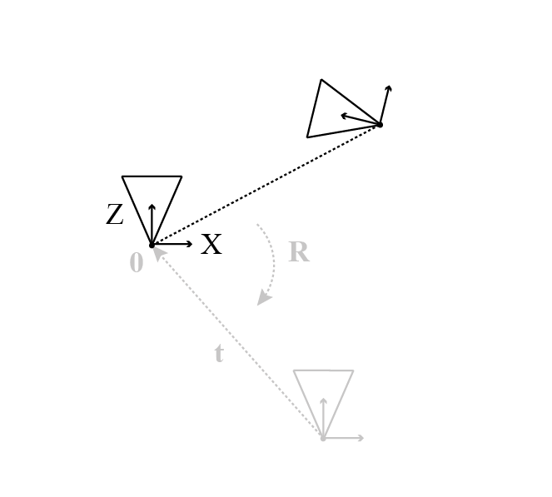
Step 0: Unrectified Stereo Pair
Right camera expressed in camera coordinate frame of left camera

Slide 39
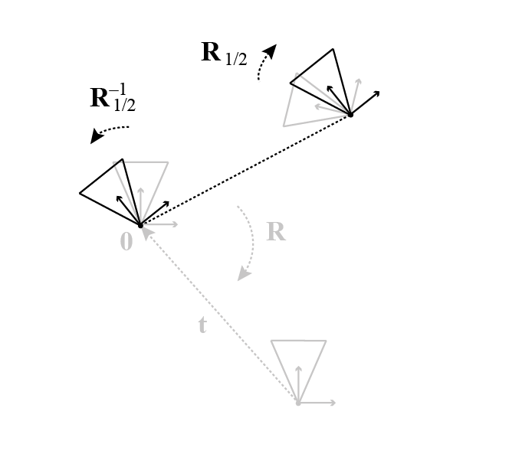
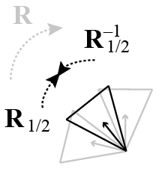
Step 1: Split R Between the Two Cameras
Both cameras are now oriented the same way w.r.t. the baseline vector

Slide 40
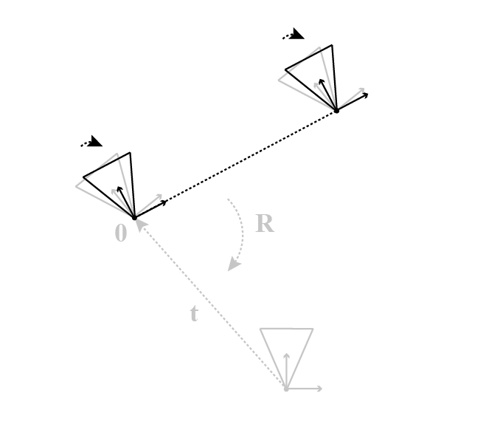
Step 2: Rotate Camera x-axes to Baseline Vector
Note that this rotation is the same for both cameras

Slide 41
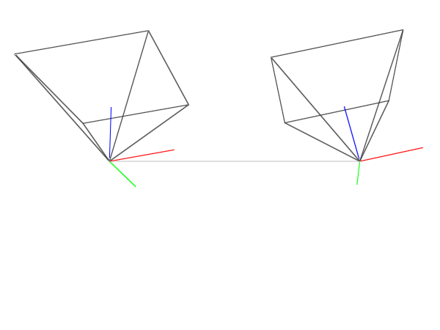
Before: Stereo Pair

Slide 42
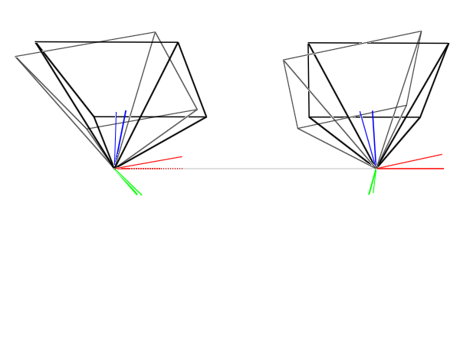
After: Stereo Pair Rectified via Bouguet’s Algorithm

Slide 43
Bouguet’s Algorithm in OpenCV

Slide 44
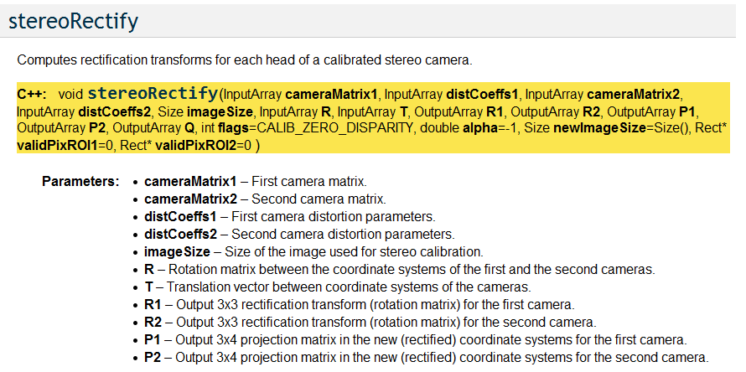
Rectification
camera calibration matrix K
cf. slide 32
output

Slide 45
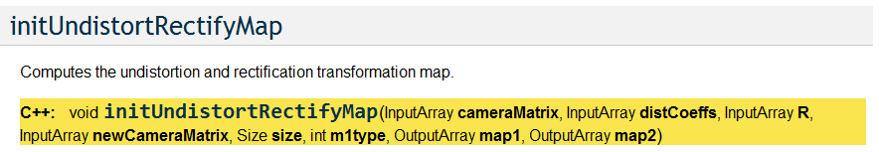
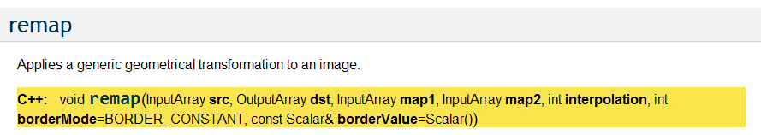
Warping the Images

Slide 46
Literature
G. Bradsky and A. Kaehler, Learning OpenCV: Computer Vision with the OpenCV Library, 2004, O’Reilly, Sebastopol, CA.
S. Birchfield. “An Introduction to Projective Geometry (for computer vision),” 1998, http://robotics.stanford.edu/~birch/projective/.
R. Hartley and A. Zisserman, Multiple View Geometry in Computer Vision, 2004, Cambridge University Press, Cambridge, UK.
Y. Ma et al., An Invitation to 3-D Vision, 2004, Springer Verlag, New York, NY.
C. Loop and Z. Zhang, “Computing Rectifying Homographies for Stereo Vision,” in CVPR, 1999.

Slide 47
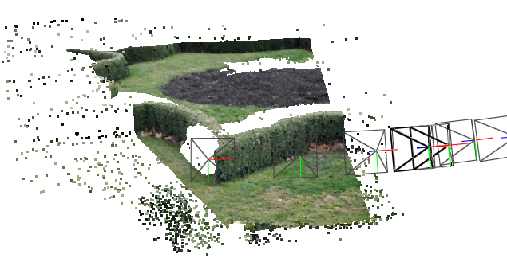
Thank you for your attention!
Cameras and sparse point cloud recovered using Bundler SfM; overlayed dense point cloud recovered using stereo block matching over a stereo pair rectified via Bouguet’s algorithm

