Slide 1

Computer Science Department
Master’s Thesis Presentation
Title: Distributed Intelligence Model for Internet of Things Applications
by
Baha Rababah

Slide 2
Computer Science Department
Title: Distributed Intelligence Model for Internet of Things Applications
Advisor : Rasit Eskicioglu, Ph.D.
1st Reader : Ruppa K. Thulasiram , Ph.D.
2nd Reader : Ahmed Ashraf, Ph.D.
ChairPerson : Max Turgeon, Ph.D.

Slide 3

Contents:
Introduction
Related Work
Model Design
Implementation
Evaluation
Conclusions
Contributions
Future Work
References

Slide 4
1. Introduction
Definitions and Brief Background
Problem statement
Motivation
Contribution

Slide 5
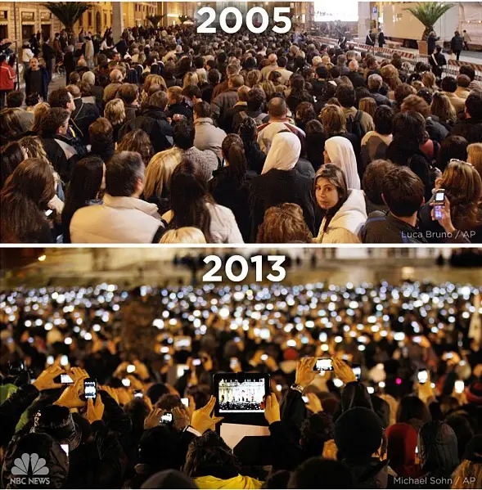
1. Introduction
Definitions and Brief Background

Slide 6
1. Introduction
Definitions and Brief Background
Internet of Things (IoT):
Billions of physical devices around the world that are now connected to the internet, all collecting and sharing data.
It is expected that :
8.4 billions smart devices will be associated with Internet by 2022 [1].
machine to machine connection is expected to reach 27 billions by 2024 [1].

Slide 7
1. Introduction
Definitions and Brief Background
Cloud computing:
Distant servers hosted on the internet to store, manage, and process data, rather than a local server.
Edge computing:
Enable the technologies that allow computing to be done at the edge of the network, close to the end devices.

Slide 8
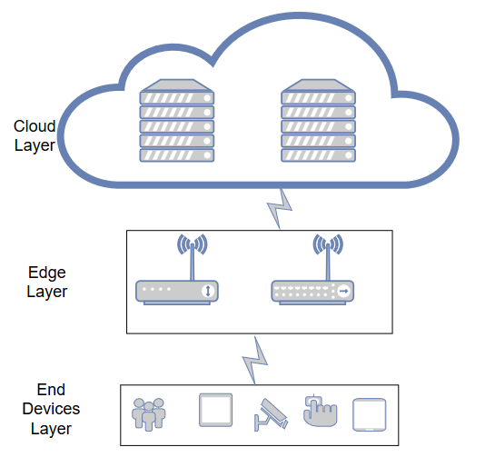
1. Introduction
Definitions and Brief Background
Common scenario of IoT Processing Data:
End devices Collect data from the environment.
Edge connect cloud and end devices by different transmission protocols.
Cloud processes the data, obtain the Knowledge and make the decision.

Slide 9
1. Introduction
Definitions and Brief Background.
Common scenario Challenges:
Latency.
Security and privacy.
High bandwidth.
Power consumptions.

Slide 10
1. Introduction
Problem statement
Development of IoT applications:
Development kits.
Open hardware.
Open software.
IoT Applications Deployment:
Platform as a service (PaaS).
Resources and IoT cloud services.

Slide 11
Problem statement
IoT gateway segment, controller shortened the development of IoT applications.
The complication is still at the software level.
Those boards are not intelligence enough to extract the knowledge from the raw data.
1. Introduction

Slide 12
1. Introduction
The problem statement can be summarized in three points:
Currently, IoT gateway used for basic tasks.
Rules based processing: applying predefined rules that are not efficient with IoT applications:
Require large number of rules.
Fails to scale well.
Cannot deal with undefined conditions.
IoT Boards such as raspberry pi has Limited computational capabilities with the size of IoT generated data.
What the gateway should do when it is overloaded!!!!

Slide 13
1. Introduction
Motivation
IoT vision is to integrate people, things, services, and context information [2].
In order to achieve this vision, new proposed models are required.
Those models should consider:
Real time data.
Fast decision.
Combining edge and cloud in one model is essential to enhance IoT applications.

Slide 14
1. Introduction
Contributions
This Work present a Distributed Intelligence Model (DIM).
Distributed intelligence in IoT means to distribute the intelligence over the edge and cloud layers in order to provide the required functionality and performance for IoT applications.
It will enable IoT gateway to extract most of the knowledge from the sensors’ data in order to make the decision without sending the data to the cloud.
If the gateway unable to achieve the task, the task will be offloaded to the cloud.

Slide 15
1. Introduction
Contributions
Distributed Intelligence Model (DIM) Features:
Local data processing of the most real time data for fast decision and action making.
Offload coming tasks when the gateway is overload.
Avoid sending most of the data to the cloud for security and privacy purposes.
Enable IoT network to be more resourceful in terms of energy and communication bandwidth.

Slide 16
2. Related Work
The concept “Internet of Things” was firstly introduced by Kevin Ashton, the Executive Director of Auto-ID Labs at MIT [3].
In 2009, Jong-Wang et al. [4] came up with sensor network system that consists of one main server and a number of servers acting as gateways and connecting with different sensor networks. Design such system require a lot of configurations and high hardware cost.
In 2011, Bian et al. [5] utilize android phone to be temporary used smart home gateway that can predict user behaviour to shut down unused devices. This works aimed to provide a dynamic home gateway that can reduce the wasted energy of smart home.
In 2015, Babu et al. [6] present architectural design for integration cloud and IoT called Cloud -Assisted and Agent - Oriented for Internet of Things (IoT) Architecture, but it is totally cloud based.

Slide 17
2. Related Work
[7] In 2018, Rahmani et al. also suggest an intelligence e-health IoT gateway for remote health monitors system at the edge of the network in a three level architecture. The gateway is able to provide several services such as real time data processing, local storage, and embedded data mining.
[8] In 2018, Rahman et al. proposed a Distributed Intelligence model for Internet of Things (IoT) gateway based on belief network and reinforcement learning to learn, predict, and make a decision. This sys-tem starts based on a small number of predefined rules, after that, the system can change the rules based on past experience

Slide 18
2. Related Work
Summary
There are large amount of work being done to enable the gateway at edge layer.
There are only small improvement towards providing intelligence to the gateway.
Furthermore, small amount of work performed in collaborating between the IoT gateway and the cloud when gateway is unable to analyse the data, make the decision, and take the action.

Slide 19
3. Design
The Proposed Model
Designing Edge Intelligence
Designing Cloud Intelligence
Workflow

Slide 20
3. Design
Designing Edge Intelligence
IoT Gateway:
Receive data and task from end devices.
Decide where the task should be executed.
Process local tasks based on an Neural Networks algorithm.

Slide 21
3. Design
Designing Edge Intelligence
IoT Gateway task offloading decision:
CPU utilization threshold (t).
Locally.
Offload.

Slide 22
3. Design
Designing Edge Intelligence
IoT Gateway process local tasks:
Neural Networks algorithms are tested:
Multi-layer Perceptron Neural Networks.
Long Short Term Memory.
Gated Recurrent Units.

Slide 23
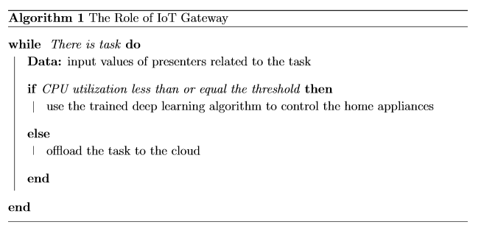
3. Design
Designing Edge Intelligence
IoT Gateway Role.

Slide 24
3. Design
Designing Cloud Intelligence
Receive offloaded task.
Processes tasks based on prior-beliefs probability distribution.

Slide 25
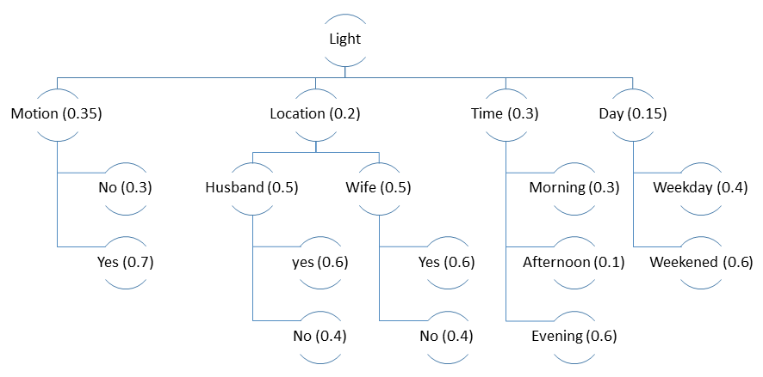
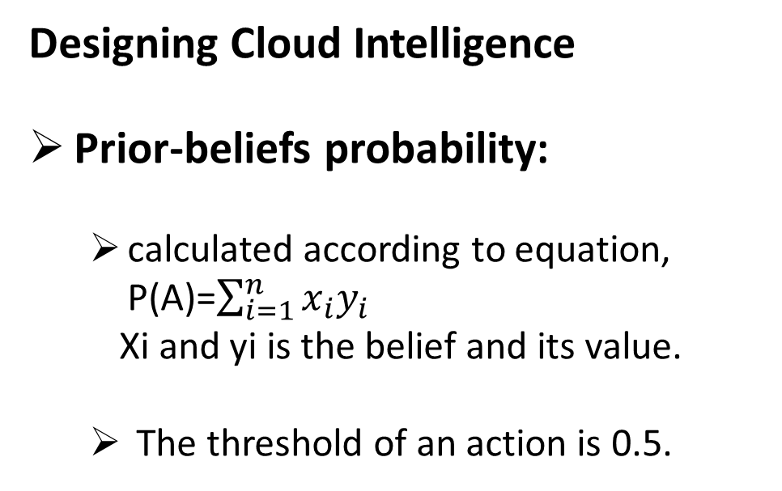
3. Design
Designing Cloud Intelligence
Prior-beliefs probability:
calculated according to equation, P(A)=$\sum_{i=1}^{n}{x_{i}y_{i}}$
Xi and yi is the belief and its value.
The threshold of an action is 0.5.

Slide 26
3. Design
Designing Cloud Intelligence
Prior-beliefs probability example:
motion sensor does not detect motion,
husband and wife are inside,
time is evening,
day is weekend,
The probability of turning the light on/off, is:
P(l) = (0.35 * 0.3) +2 (0.2 * 0.5 * 0.6) + (0.3 * 0.6) + (0.15 * 0.6) = 0.495.
P(l) < 0.5.
The decision is to turn the light off.

Slide 27
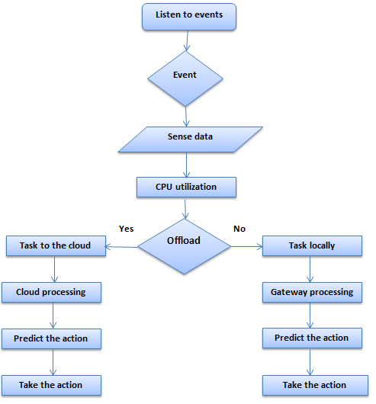
3. Design
Workflow

Slide 28
4. Implementation
The Operational Model
Real experiment of Distributed Intelligence smart home IoT system is conducted.
Combines cloud and edge to control the light and temperature in the living room.
A husband and wife live in the house.

Slide 29
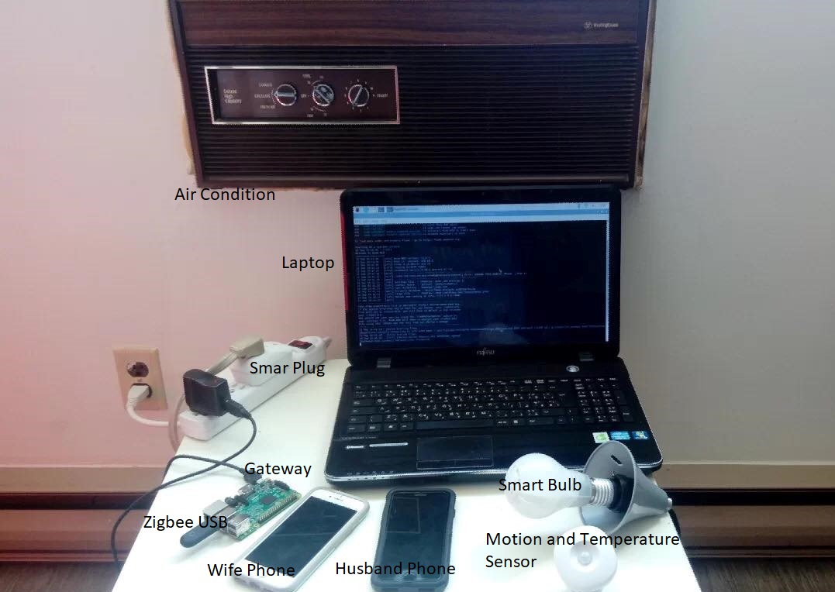
4. Implementation
The Operational Model

Slide 30
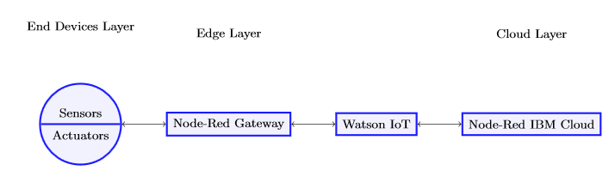
4. Implementation
The Operational Model
The implementation has three main phases:
End devices layer implementation.
Edge layer implementation.
Cloud layer implementation.

Slide 31
4. Implementation
The Operational Model
End devices layer:
Consists of sensors and actuators.
Devices:
Motion sensor.
Temperature sensor.
Smart bulb.
Smart plug.
Mobile phones (for husband and wife).
Devices | Producer | Communication
Smart Plug | Sylvania | ZigBee
Motion sensor | Samsung | ZigBee
Temp sensor | Samsung | ZigBee
Bulb | Cree | ZigBee
iPhone 7 | Apple | Wi-Fi
iPhone 8 | Apple | Wi-Fi

Slide 32
4. Implementation
The Operational Model
Edge Layer:
IoT gateway.
Raspberry Pi 3 Model.
Raspbian GNU/Linux version 10.
Manage and control end layer devices.
Connecting devices in the end layer to the IoT gateway:
Wi-Fi .
ZigBee USB (Conbee II).
Node-Red platform (v1.0.3)

Slide 33
4. Implementation
The Operational Model
Edge Layer:
The gateway collects the sensors’ data every 10 minutes for two weeks and save it in a csv file to create two datasets (for light and temperature).

Slide 34
4. Implementation
The Operational Model
Edge Layer:
Light’s dataset features:
Light status.
Motion.
Husband’s location.
Wife’s location.
Day.
Time.

Slide 35
4. Implementation
The Operational Model
Edge Layer:
Temperature’s dataset features:
Air condition’s status.
Temperature.
Motion.
Husband’s location.
Wife’s location.
Time.

Slide 36
4. Implementation
The Operational Model
Cloud Layer:
IBM cloud.
Node-Red Starter Kit.
Prior beliefs.

Slide 37
4. Implementation
Intelligent IoT Gateway
Artificial Neural Networks (ANN):
Multi-layer Perceptron Neural Networks (MLPNN).
Long-Short Term Memory (LSTM).
Gated Recurrent Units (GRUs).

Slide 38
4. Implementation
Intelligent IoT Gateway
Python.
an input layer, a hidden layer, and an output layer.
For controlling the light, the input layer has five neurons.
Motion.
Husband’s location.
Wife’s location.
Time.
Day.

Slide 39
4. Implementation
Intelligent IoT Gateway
For controlling the temperature, the input layer has five neurons .
Motion.
Temperature.
Husband’s location.
Wife’s location.
Time.

Slide 40
4. Implementation
Intelligent IoT Gateway
For MLPNN, the number of neurons in the hidden layer is chosen experimentally:
using cross validation:
testing all the values from the number of neurons in input layer to less than twice of the number of neurons in input layer.

Slide 41
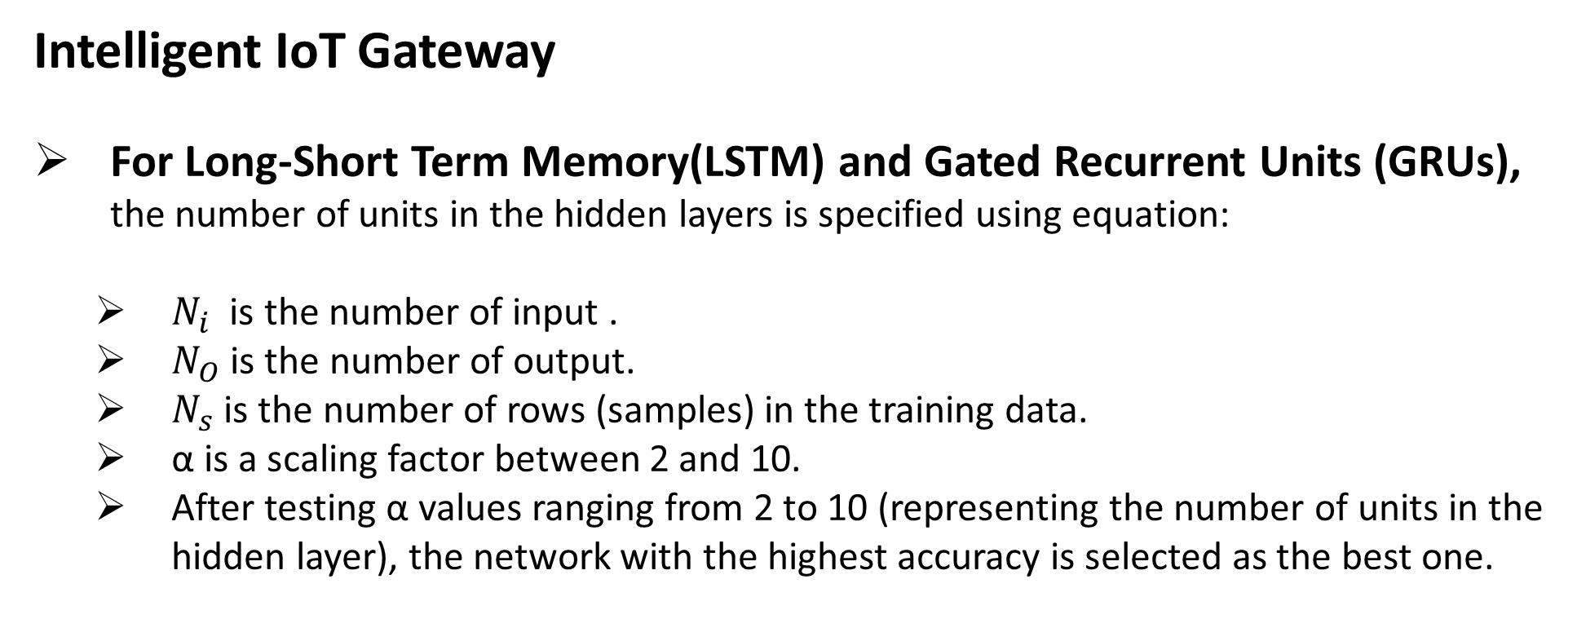
4. Implementation
Intelligent IoT Gateway
For Long-Short Term Memory(LSTM) and Gated Recurrent Units (GRUs), the number of units in the hidden layers is specified using equation:
$N_{i}$ is the number of input .
$N_{O}$ is the number of output.
$N_{s}$ is the number of rows (samples) in the training data.
α is a scaling factor between 2 and 10.
After testing α values ranging from 2 to 10 (representing the number of units in the hidden layer), the network with the highest accuracy is selected as the best one.

Slide 42
4. Implementation
Intelligent IoT Gateway
Next step is the training.
Training means using a learning algorithm to estimate network weight to reduce the overall error between the value estimated by the trained network and the target value.

Slide 43
4. Implementation
Intelligent IoT Gateway
Parameters | MLPNN | LSTM | GRUs
Hidden layers | 1 | 1 | 1
Activation function | sigmoid | relu | relu
Nodes | 9 | 50 | 50
Optimizer | adam | adam | adam
Loss | binary_crossentropy | binary_crossentropy | binary_crossentropy
epochs | 10 | 10 | 10
Batch size | 5 | 5 | 5
Verbose | 1 | 1 | 1

Slide 44
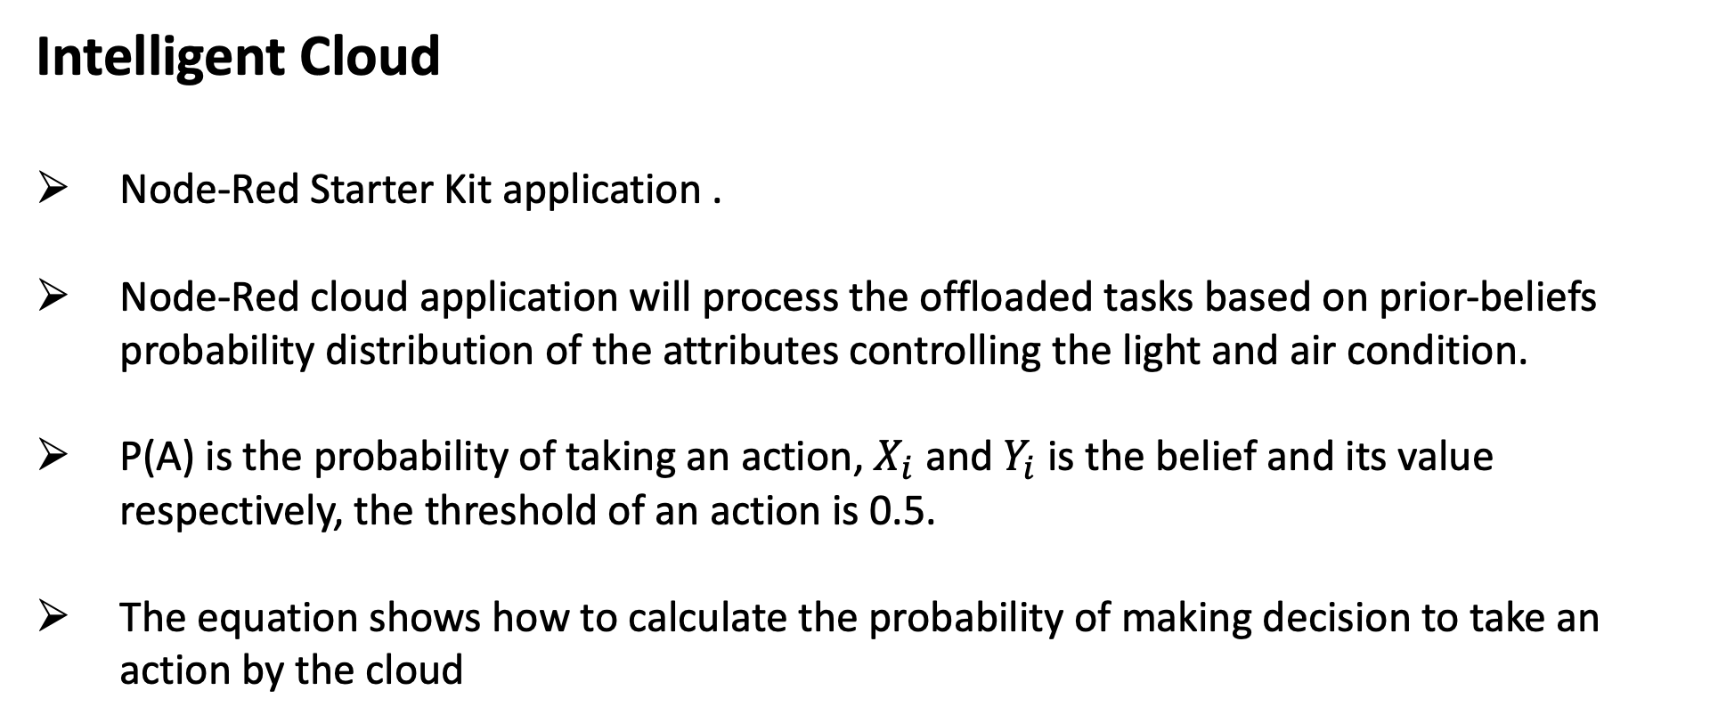
4. Implementation
Intelligent Cloud
Node-Red Starter Kit application .
Node-Red cloud application will process the offloaded tasks based on prior-beliefs probability distribution of the attributes controlling the light and air condition.
P(A) is the probability of taking an action, $X_{i}$ and $Y_{i}$ is the belief and its value respectively, the threshold of an action is 0.5.
The equation shows how to calculate the probability of making decision to take an action by the cloud

Slide 45
5. Evaluation
Artificial Neural Networks Algorithms
IoT Gateway Performance

Slide 46
5. Evaluation
Artificial Neural Networks Algorithms
Confusion Matrix.
Comparison of the three algorithms.
ROC (Receiver Operating Characteristic ) curve.

Slide 47
5. Evaluation
Artificial Neural Networks Algorithms
Confusion Matrix.
 | Predicted: No |  |  | Predicted: Yes
 | MLPNN | LSTM | GRUs | MLPNN | LSTM | GRUs
Actual: No | 626 | 612 | 603 | 1 | 15 | 24
Actual: Yes | 98 | 20 | 17 | 39 | 117 | 120
 | Predicted 0 | Predicted 1
Actual 0 | TN | FP
Actual 1 | FN | TP

Slide 48
5. Evaluation
Artificial Neural Networks Algorithms
Comparison of the three algorithms with respect to:
Accuracy is simply a ratio of correct predictions to the overall observations. (TP+TN)/(N+P)
Precision is the ratio of correctly predicted positive observations to all predicted positive observations. TP/(TP+FP)
Recall is a ratio of correctly predicted positive observations to all observations in the actual ‘yes’ class. TP/(TP+FN)
F1-score is a weighted average of precision and recall. F1 = 2*Precision*Recall/(Precision + Recall)

Slide 49
5. Evaluation
Comparison of the three ANN algorithms.
Parameters | Accuracy (%) | Precision (%) | Recall (%) | F1-Score (%)
MLPNN | 87 | 28 | 80 | 44
LSTM | 95 | 85 | 89 | 87
GRUs | 95 | 88 | 83 | 85

Slide 50
5. Evaluation
Artificial Neural Networks Algorithms
ROC curve: It is a plot of the false positive rate (x-axis) versus the true positive rate (y-axis)
False Positive Rate = False Positives / (False Positives + True Negatives)
True Positive Rate = True Positives / (True Positives + False Negatives)

Slide 51
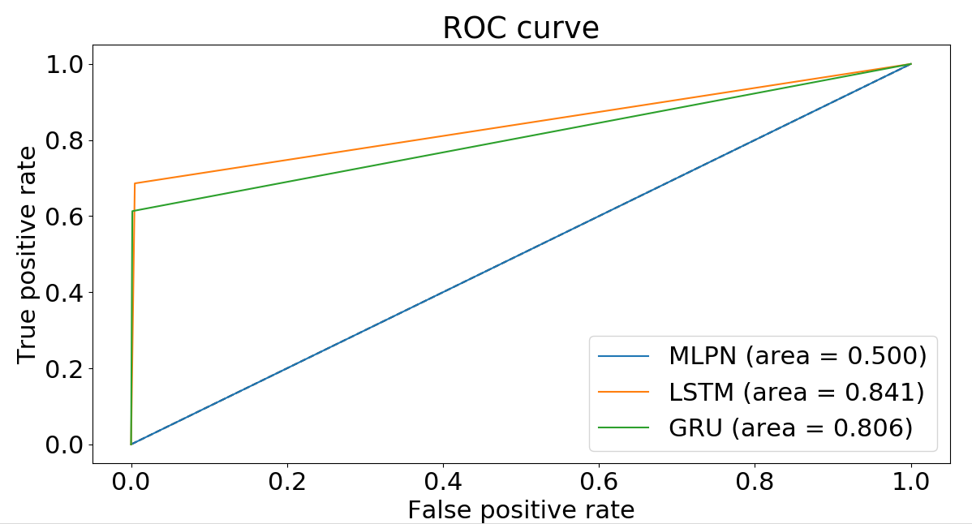
5. Evaluation
Artificial Neural Networks Algorithms
ROC curve:
MLPNN: 0.50
LSTM: 0.84
GRU: 0.80

Slide 52
5. Evaluation
IoT Gateway Performance
Two scenarios were built.
Offloading ( DIM).
No offloading (local ).
The scenarios were compared according to:
Tasks Processing Time.
Gateway CPU Utilization.

Slide 53
5. Evaluation
IoT Gateway Performance
This process starts with four parallel tasks (two light-control tasks and two temperature-control tasks).
When one of the tasks ends, the gateway chooses a random delay (1-20 seconds) to start another task

Slide 54
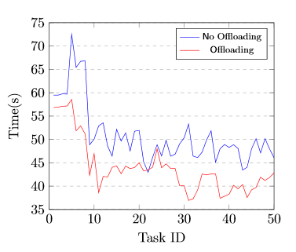
5. Evaluation
IoT Gateway Performance
Tasks Processing Time.
presents the processing times of the first 50 tasks processed locally for both no-offloading and offloading.
No Offloading (DIM): 42 s and 53 s.
Offloading 36 s and 46 s.
Enforcing the gateway to process all coming tasks locally causes either a delay or a connection loss when it is overloaded.

Slide 55
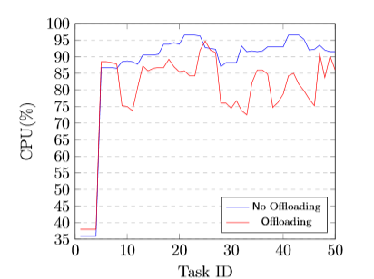
5. Evaluation
IoT Gateway Performance
No offloading: fluctuating between 87% and 96% for all remaining tasks.
Offloading: fluctuating between 72% and 94%.
With offloading, it is less than 90% most of the time.
without offloading is usually greater than 90%.

Slide 56
5. Evaluation
IoT Gateway Performance
The no-offloading scenario enforces all new tasks to be processed locally without testing the operation of the gateway.
The gateway might be unable to process more tasks because doing so would cause service interruptions.
The offloading threshold guarantees that the CPU utilization never reaches 100%, which ensures that the gateway runs smoothly and continuously without any service interruptions.

Slide 57
5. Evaluation
Distributed Intelligence Model (DIM)
Local data processing of the most real time data for fast decision and action making.
Offload coming tasks when the gateway is overload.
Avoid sending most of the data to the cloud for security and privacy purposes.
Enable IoT network to be more resourceful in terms of energy and communication bandwidth.

Slide 58
6. Conclusion
The concept of Distributed Intelligence (DI) in the context of Internet of Things(IoT) was presented.
We investigated in details the ability of an IoT gateway and cloud to process IoT data.
We conducted a proof of concept implementation of an IoT system that includes our demonstration of the Distributed Intelligence Mode.
The model was applied to a smart home system, aimed to control home appliances.

Slide 59
6. Conclusion
Three types of Artificial Neural Networks were evaluated.
The results showed that Long-Short Term Memory (LSTM) has the best performance over Multi-layer Perceptron Neural Networks (MLPNN) and Gated Recurrent Units (GRUs).
The Long-Short Term Memory (LSTM) on the gateway to process the local tasks to control home appliances based on past experience.
For processing offloaded task on the cloud, we implemented prior beliefs on the cloud.

Slide 60
6. Conclusion
We built two scenarios for evaluating our model that are edge based smart home system and Distributed Intelligence smart home system.
We compared between the scenarios with regard to task processing time and gateway CPU utilization.
The model showed that the collaboration between the gateway and the cloud helps the gateway to run smoothly and continuously without service interruption.

Slide 61
7. Contributions
Local data processing of the most real time data for fast decision and action making.
Offload coming tasks when the gateway is overload.
Avoid sending most of the data to the cloud for security and privacy purposes.
Enable IoT network to be more resourceful in terms of energy and communication bandwidth.

Slide 62
7. Contributions
Rababah B, Alam T, Eskicioglu R. The Next Generation Internet of Things Architecture Towards Distributed Intelligence: Reviews, Applications, and Research Challenges. Journal of Telecommunication, Electronic and Computer Engineering (JTEC). 2020 Jul 1;12(2).
Rababah B, Eskicioglu R. Distributed Intelligence Model for IoT Applications Based on Neural Networks. International Journal of Computer Network and Information Security(IJCNIS), accepted.

Slide 63
8. Future work
In order to enhance the presented model, a few work can be performed in the future:
Implement an Artificial Neural Networks (ANN) algorithm on the cloud.
Investigate another offloading criteria and compare between them for supporting service level.
Finally, test the model for large scale IoT systems such as traffic management.

Slide 64
9. References
[1] R. Kandaswamy and D. Furlonger,Blockchain-based transformation: A gart-ner trend insight report,https : / / www . gartner . com / en / doc / 3869696 -blockchain-based-transformation-a-gartner-trend-insight-report#a-1126710717, Last accessed on 2020-04-04, May 2013.
[2] J. Miranda, N. M ̈akitalo, J. Garcia-Alonso, J. Berrocal, T. Mikkonen, C. Canal,and J. M. Murillo, “From the internet of things to the internet of people,”IEEEInternet Computing, vol. 19, no. 2, pp. 40–47, 2015.
[3] K. Ashton, “That ‘internet of things’ thing,”RFID journal, vol. 22, no. 7,pp. 97–114, 2009.
[4] J.-W. Yoon, Y.-k. Ku, C.-S. Nam, and D.-R. Shin, “Sensor network middle-ware for distributed and heterogeneous environments,” in2009 InternationalConference on New Trends in Information and Service Science, IEEE, 2009,pp. 979–982.
[5] J. Bian, D. Fan, and J. Zhang, “The new intelligent home control systembased on the dynamic and intelligent gateway,” in2011 4th IEEE Interna-tional Conference on Broadband Network and Multimedia Technology, IEEE,2011, pp. 526–530

Slide 65
9. References
[6] S. M. Babu, A. J. Lakshmi, and B. T. Rao, “A study on cloud based internetof things: Cloudiot,” in2015 global conference on communication technologies(GCCT), IEEE, 2015, pp. 60–65.
[7] A. M. Rahmani, T. N. Gia, B. Negash, A. Anzanpour, I. Azimi, M. Jiang,and P. Liljeberg, “Exploiting smart e-health gateways at the edge of healthcareinternet-of-things: A fog computing approach,”Future Generation ComputerSystems, vol. 78, pp. 641–658, 2018.
[8] H. Rahman and R. Rahmani, “Enabling distributed intelligence assisted futureinternet of things controller (fitc),”Applied computing and informatics, vol. 14,no. 1, pp. 73–87, 2018.
[9] R. Sosa, C. Kiraly, and J. D. P. Rodriguez, “Offloading execution from edgeto cloud: A dynamic node-red based approach,” in10th IEEE InternationalConference on Cloud Computing Technology and Science (CloudCom), IEEE,Nicosia, Cyprus, 2018, pp. 149–152

Slide 66
Computer Science Department
Thank You
Questions?

