Slide 1

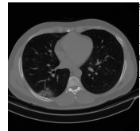
COVID-19 Patients Detection Strategy based on Radiomic 3D Reconstruction
Bahare Zare
Supervisor:
Dr. Hamid Usefi Supervisor: Dr. Hamid

Slide 2
Outline
Radiomics
Radiomics technique
Radiomics limitation
Radiomics features grouping
The goal of radiomics
The COVID-19 patient detection strategy
Applying radiomics on COVID dataset
CT images
Data collection
Subset of dataset
Implementation using ML
Conversion of pixel value to Hundsfeld units
Segmentation
Masking

Slide 3
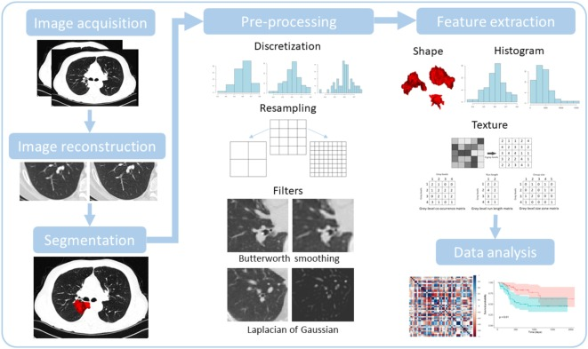
Radiomics
Radiomics
a method that extracts a large number of features from medical images using data characterisation algorithms.
The hypothesis of radiomics
distinctive imaging features between disease forms may be useful for predicting prognosis and therapeutic response

Slide 4
Radiomics technique
Technique of radiomics
can be applied to any medical study where a pathological process can be imaged.
Integrated radiomics database
The imaging data needs to be exported from the clinics. This is already a very challenging step

Slide 5
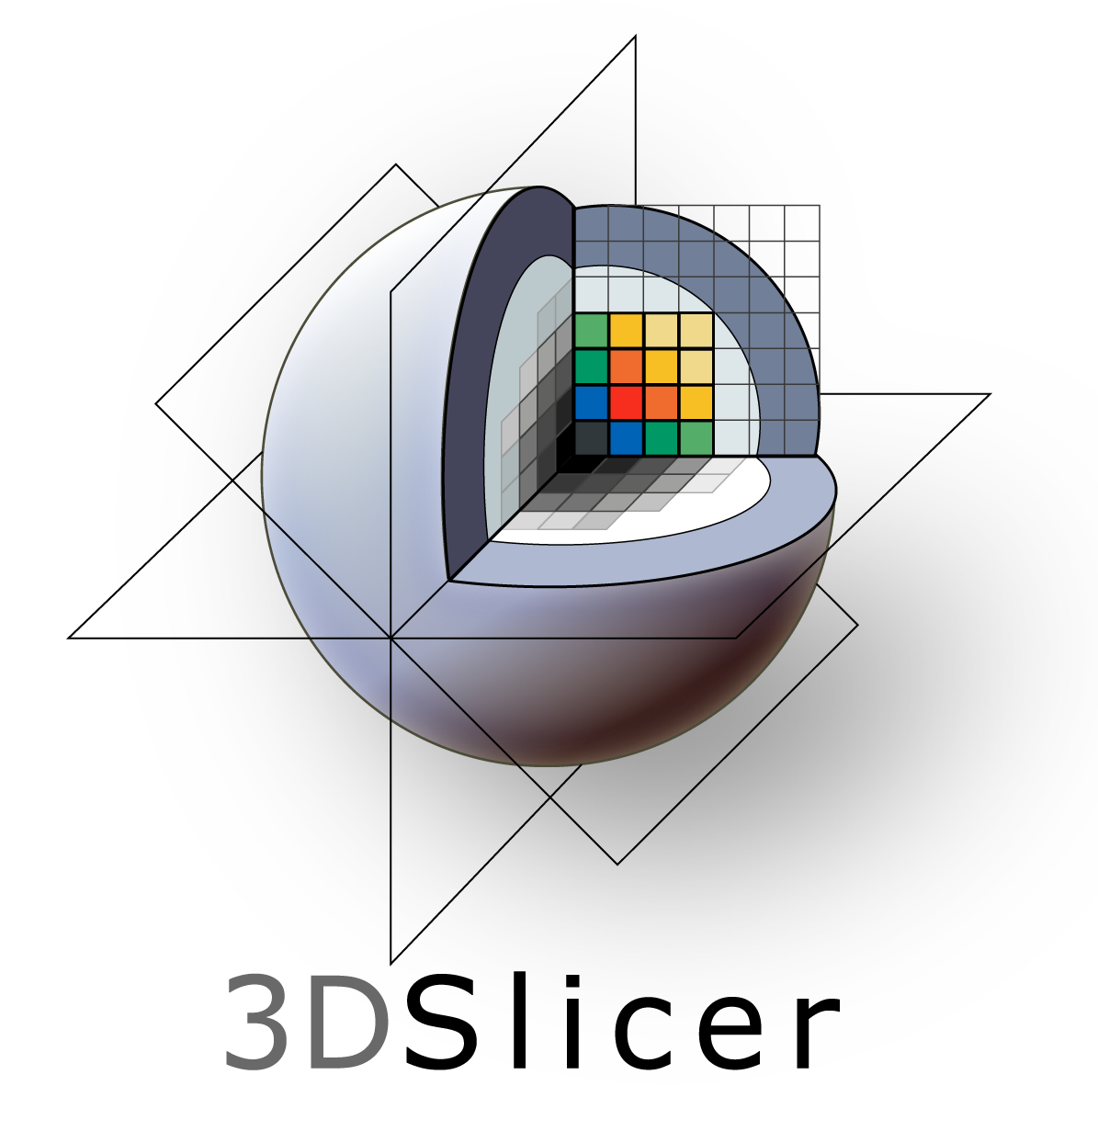
Radiomics limitation
Machine learning methods in radiomics
because of the large image data, it would be too much work to perform the segmentation manually for every single image
an automated process has to be used

Slide 6
Radiomics features grouping
Radiomic features can be divided into some groups that one of them is GLCM
Level Co-occurrence Matrix (GLCM) method is a way of extracting second order statistical texture features. Third and higher order textures consider the relationships among three or more pixels.

Slide 7
The goal of radiomics
The aim is to apply the Machine Learning method based on Radiomics to identify new patients as humans can hardly do.

Slide 8
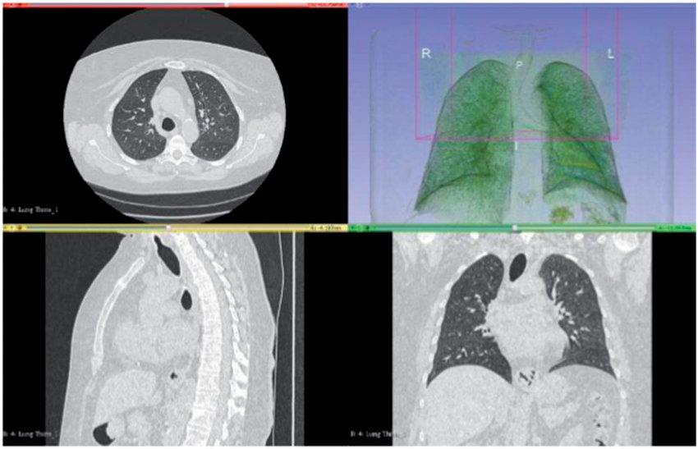
The COVID-19 patient detection strategy

Slide 9
Applying radiomics on COVID dataset
CXR vs CT
CT plays a significant role in diagnosis and management of COVID-19

Slide 10
CT images
I)
II)
III)
In the modern CT scanners, a rotating X-ray generator sends multiple X-ray beams into the object from multiple angles.
The amount of the radiation passed through the object is then captured by sensitive radiation detectors,
The images are reconstructed using the Filtered Back Projection (FBP) reconstruction method. The reconstruction matrix size (output size of the images) is set to 512×512

Slide 11
Data collection
COVID-CT-MD dataset contains volumetric chest CT scans of
169 patients positive for COVID-19 infection,
60 patients with CAP,
and 76 normal patients.

Slide 12
Subset of dataset
A subset of 54 COVID-19, and 25 CAP cases were analyzed by the first radiologist to identify and label slices with evidence of infection.
Besides CT slices, clinical data is collected for the patients, which includes the following:
Patients’ age
Patients’ gender
Patients’ weight
Clinical characteristics: including symptoms, reason for scanning, and patients’ history; Surgery history;
Follow-up: some of the COVID-19 patients are followed-up after scanning and their status including recovery, hospital admission, and death is recorded;
RT-PCR: positive RT-PCR outcome is available for some of the COVID-19 patients.

Slide 13
Data collection
COVID-19, CAP and Normal participants are placed in separate folders, within which patients are arranged in folders, followed by CT scan slices in DICOM format

Slide 14
Implementation using ML
Loaded DICOM data using pydicom package
Use 1D, 2D, and 3D plots to display DICOM images.
Pre-processed data for future machine learning projects
Conversion of pixel value to Houndsfield units
Normalization and resampling
Segmentation
Masking

Slide 15
Implementation using ML
The whole dataset is 20GB, but each examination is about 50MB.
Here we'll use the patient ID P001 from that dataset, which has been labeled as positive for COVID_19.
To perform 3D plotting, we will use Web GL to make visualization interactive.

Slide 16
HU histogram
HU's are useful because all CT scans regardless of the absolute number of photons that the scanner detector captured are standardized.
HU frequently have been used in CT scans as a quantitative scale for describing radio density

Slide 17
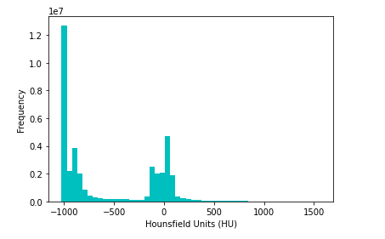
HU histogram for one COVID patient

Slide 18
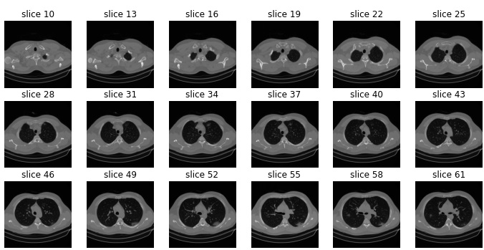
Sample of patient slices

Slide 19
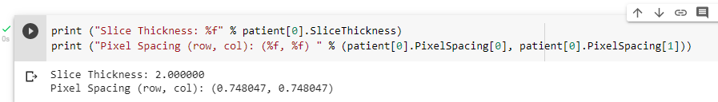
Explanation of slices
Slices are separated, so their thickness and locations are not clear.

Slide 20
Auto-detecting the boundaries of images
Machine learning algorithms are more effective when we clearly define what looking for. One way is creating different models for different parts of a chest CT. For example, a convolutional network model for the lungs would perform better than a general-purpose grid for the whole chest. Therefore, it is often helpful to pre-process the image data by auto-detecting the boundaries surrounding a volume of interest.

Slide 21
Feature engineering
Normalizing images
Identifying the proper threshold, creating 2 K-means clusters comparing centered on soft tissue/bone vs lung/air.
Using Erosion and Dilation, the net effect of removing tiny features like pulmonary vessels or noise
Applying label to each distinct region as separate image
Applying bounding boxes for each image label to identify infections
Creating the masks for lung fields.
Applying mask to the original image to erase voxels outside of the lung fields.

Slide 22
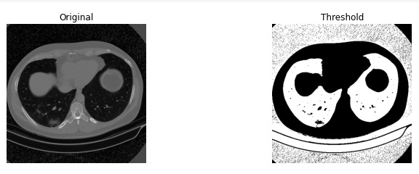
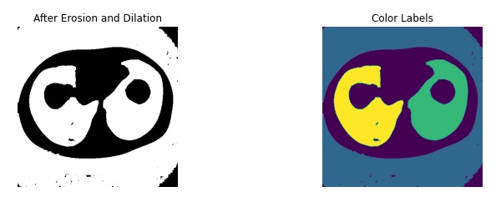
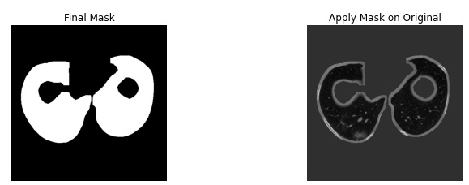
Masking results

Slide 23
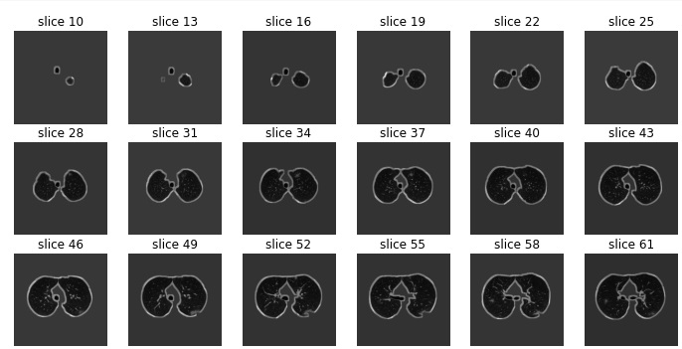
Mask results on all slices

Slide 24
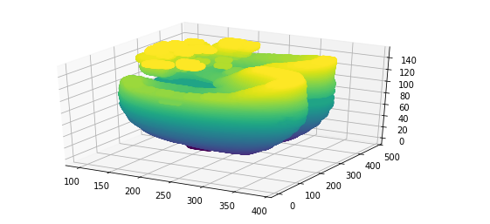
3D reconstruction

Slide 25
Approaches
Now that all the slices can be reconstructed for each patient and different the number of slices are not important.
There are two approaches to analyzing this dataset. In the first deep-learning-based approach, we can train deep learning architectures with a multi-tasks strategy for slice-level classification. Recently, there have been many studies on using neural network models to segment medical images for disease recognition but fewer in recognizing COVID-19 patients. In the second approach, by using 3-dimensional reconstructions algorithms and by using feature selection methods and capturing visual content of images for indexing and retrieval we will be able to classify the whole CT scan into normal, COVID-19, or Cap classes.

Slide 26
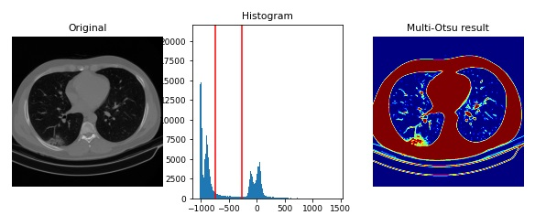
Infection Segmentation

Slide 27
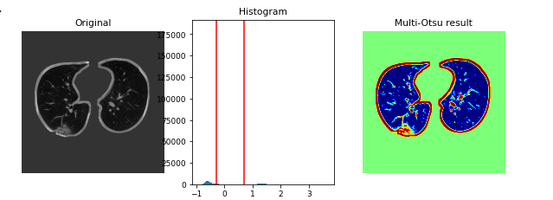
Infection segmentation

Slide 28
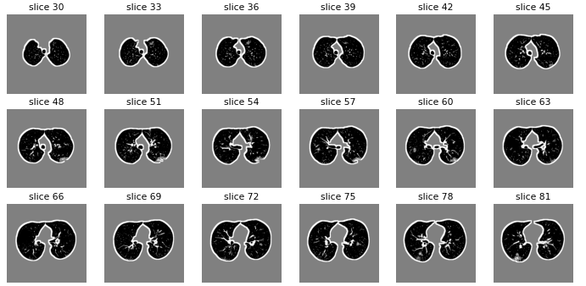
Mask results on all slices

Slide 29
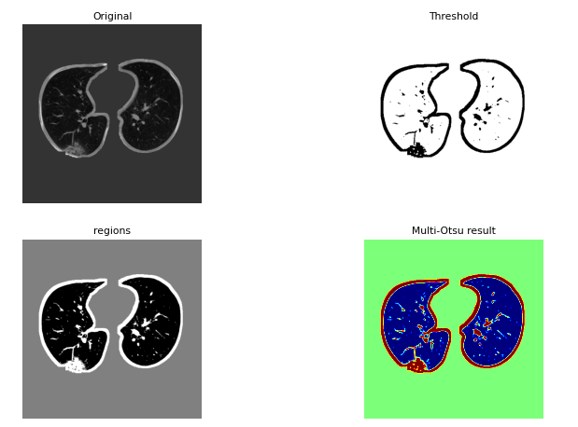
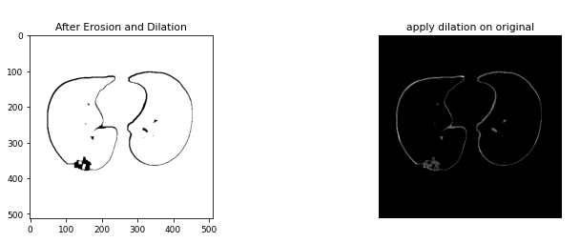
Masking results

Slide 30
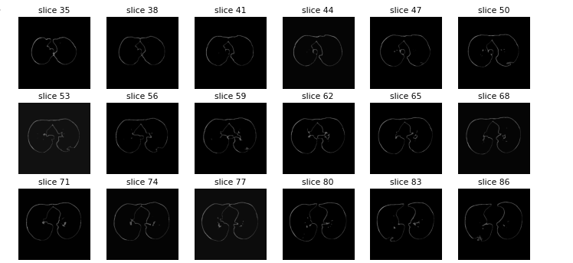
Mask results on all slices

Slide 31
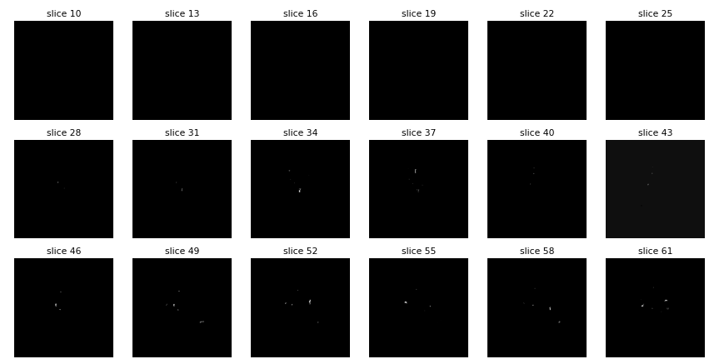
After removing borders

Slide 32
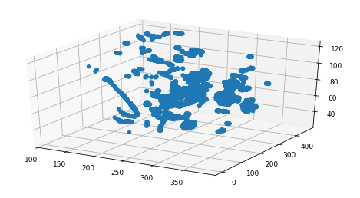
3D infection reconstruction

Slide 33
References
https://www.nature.com/articles/s41597-021-00900-3
https://github.com/ShahinSHH/COVID-CT-MD
https://www.slicer.org/
http://citeseerx.ist.psu.edu/viewdoc/summary?doi=10.1.1.414.9698

Slide 34
Question and Answer
Thank you for your attention

