Slide 1
Simple DIY Hydroponics

Slide 2
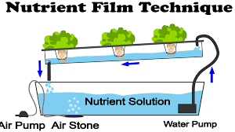
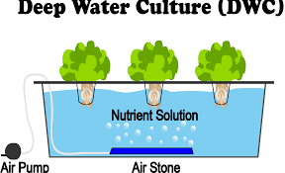
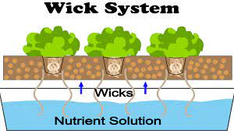
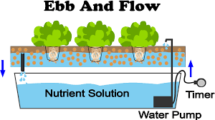
Types of Hydroponics
We chose NFT for ease of construction and available materials
Source: https://www.nosoilsolutions.com

Slide 3
DIY NFT Hydroponics Materials
PVC (1 length per row + bends for each additional row)
Water reservoir (5 gallon bucket)
½” hose
Submersible pump
Grommets
Stand (scrap wood?)
Rockwool (medium for seed germination)
Nutrients (vendor recommendation)
Mesh pots

Slide 4
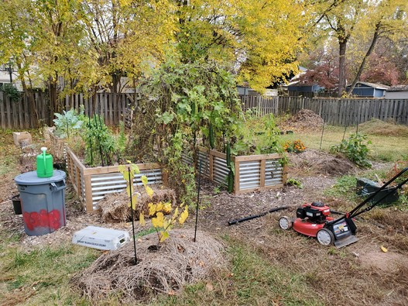
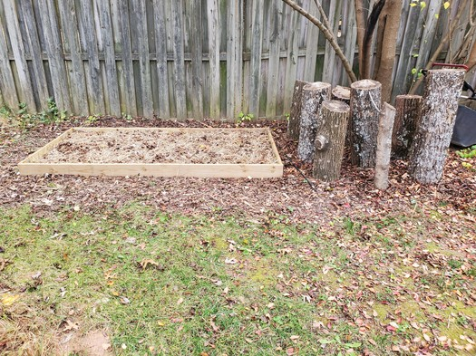
Identifying Space
Plenty of outdoor space in garden, but it will freeze soon

Slide 5
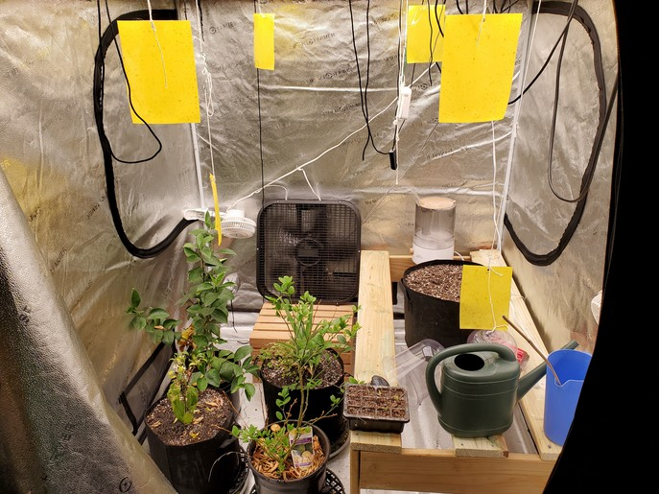
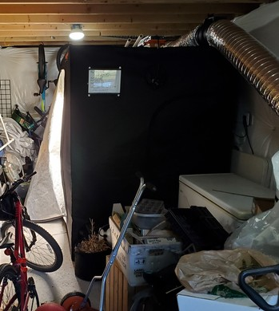
Indoor?
Indoor grow tent with LED light and makeshift table

Slide 6
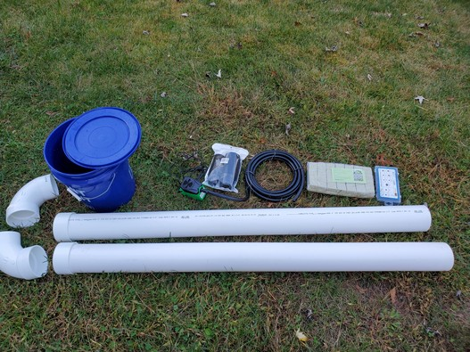
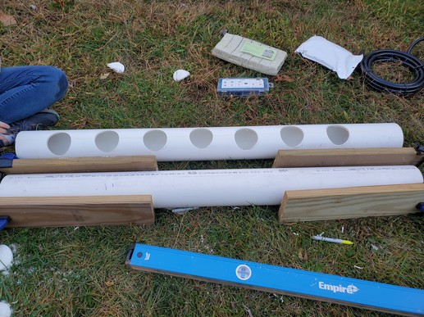
Construction
Drill holes to hold 3” mesh cups which will hold medium (rockwool)

Slide 7
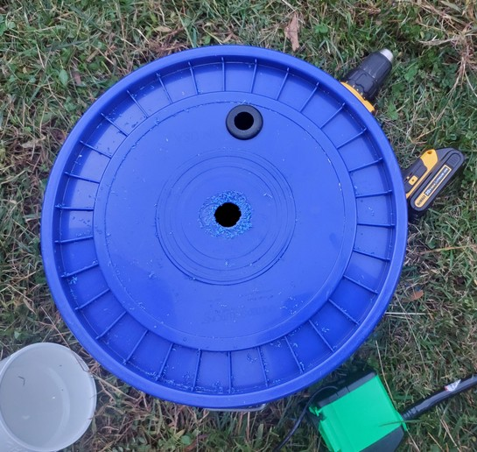
Construction (Cont.)
Terrible hole saw, invest in a quality one
5 gallon bucket will act as water reservoir

Slide 8
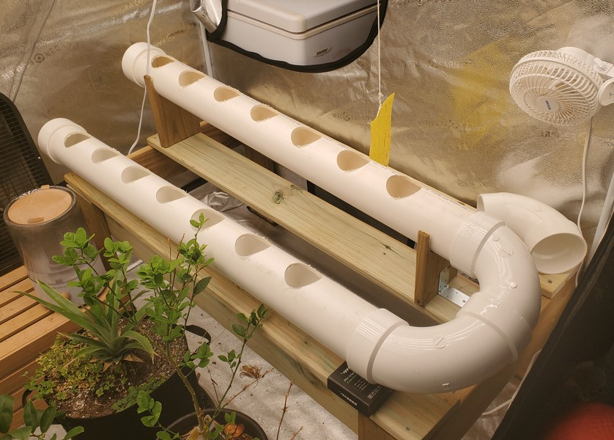
Assembly

Slide 9
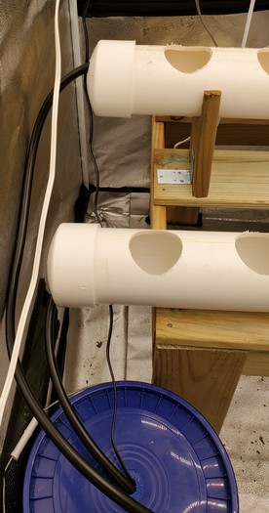
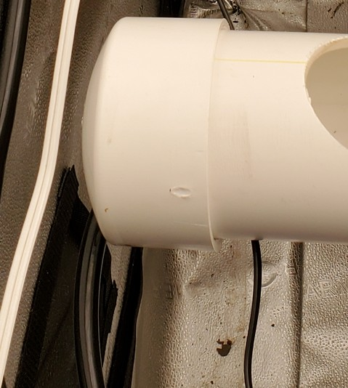
Assembly (Cont.)
This end leaks, needs a better fit for the hose

Slide 10
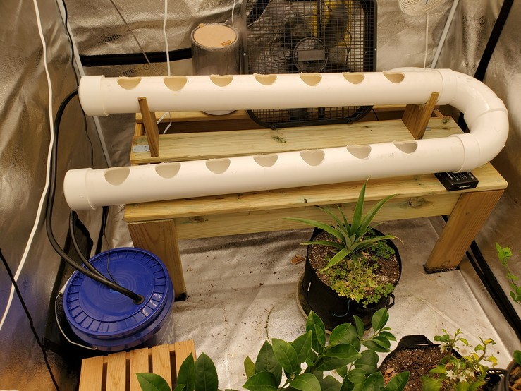
Assembled
Water flows out of the reservoir, through the PVC channels, then back into the reservoir for re-circulation Nutrients will be added to the reservoir, holes in PVC channels will hold mesh pots with rockwool and germinated seeds

Slide 11
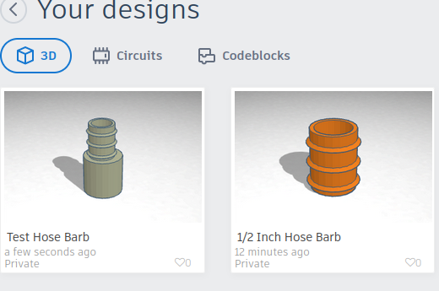
Next Steps
Improve seals
Print funnel for end
Automation (arduino + Pi for temp/humidity/nutrient control)
DWC pots
Fogponics/aeroponics/other methods

Slide 12
References
https://www.nosoilsolutions.com/6-different-types-hydroponic-systems/
https://youtu.be/nyqykZK2Ev4
https://www.instructables.com/Quick-NFT-Hydroponic-System/

