Slide 1
Catalog For Reference Dashboarding

Slide 2
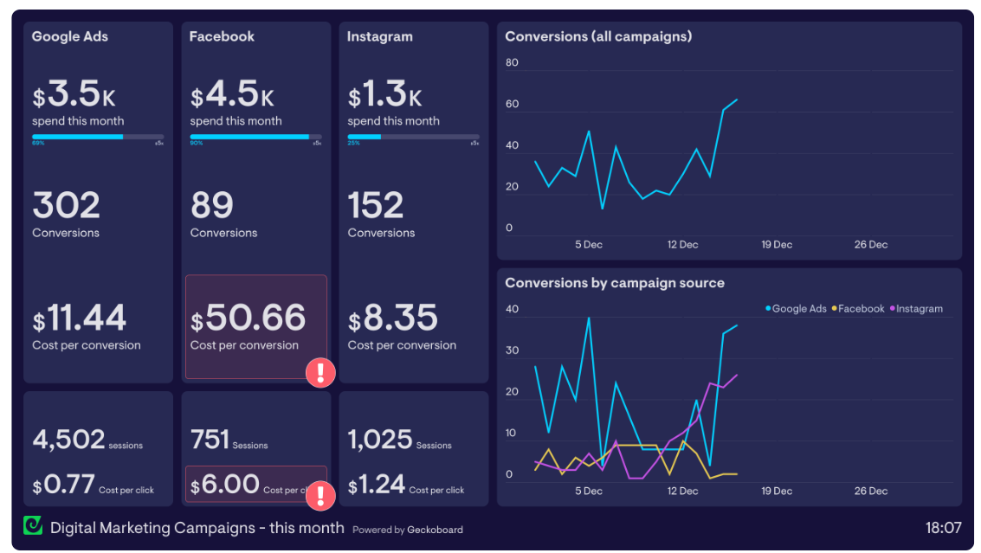
Digital marketing campaign dashboard
A digital marketing dashboard provides a single view of the KPIs Digital Marketing Managers need to see, in order to understand their digital marketing campaigns, and take action to optimize performance.
Ref: https://www.geckoboard.com/dashboard-examples/marketing/digital-marketing-dashboard/

Slide 3
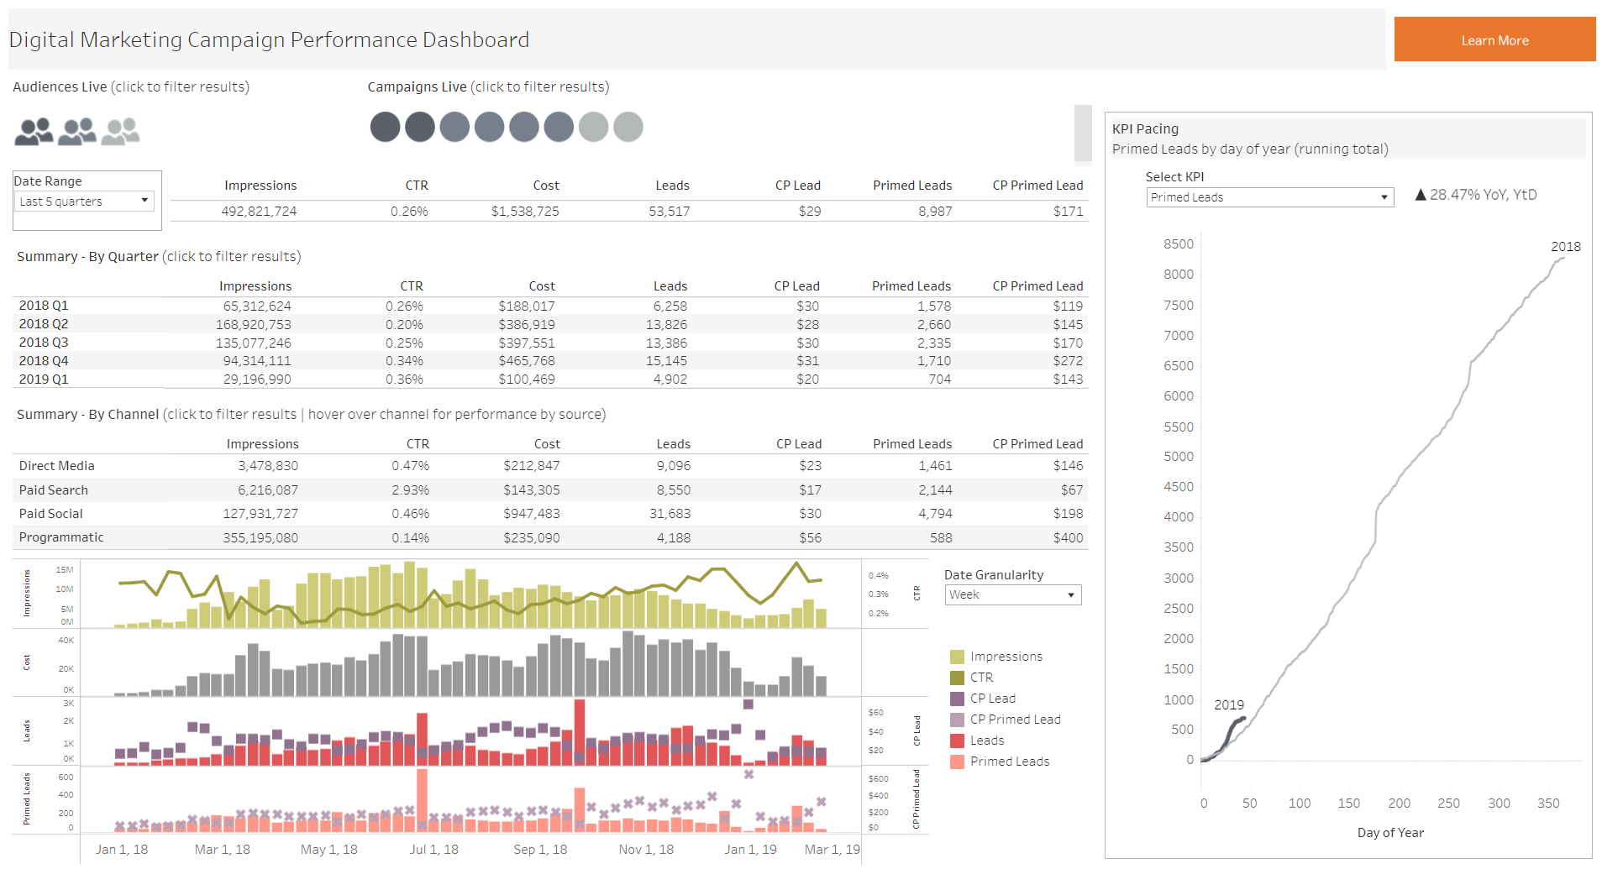
Digital marketing campaign dashboard
It aggregates key performance indicators (KPIs) for digital marketing campaigns, including impressions, click-through rate (CTR), cost, leads generated, cost per lead (CP Lead), primed leads, and cost per primed lead (CP Primed Lead). The data is organized into multiple sections: an overall summary, a quarterly breakdown, and a channel-specific analysis for direct media, paid search, paid social, and programmatic advertising. A line graph shows the trend for impressions, CTR, CP Lead, and leads over time, and there’s a pacing chart indicating the cumulative primed leads over the year, compared to the previous year.
Ref: https://public.tableau.com/app/profile/tableau.for.marketing/viz/DigitalMarketingCampaignPerformanceDashboard/DigitalMarketingCampaignPerformanceDashboard

Slide 4
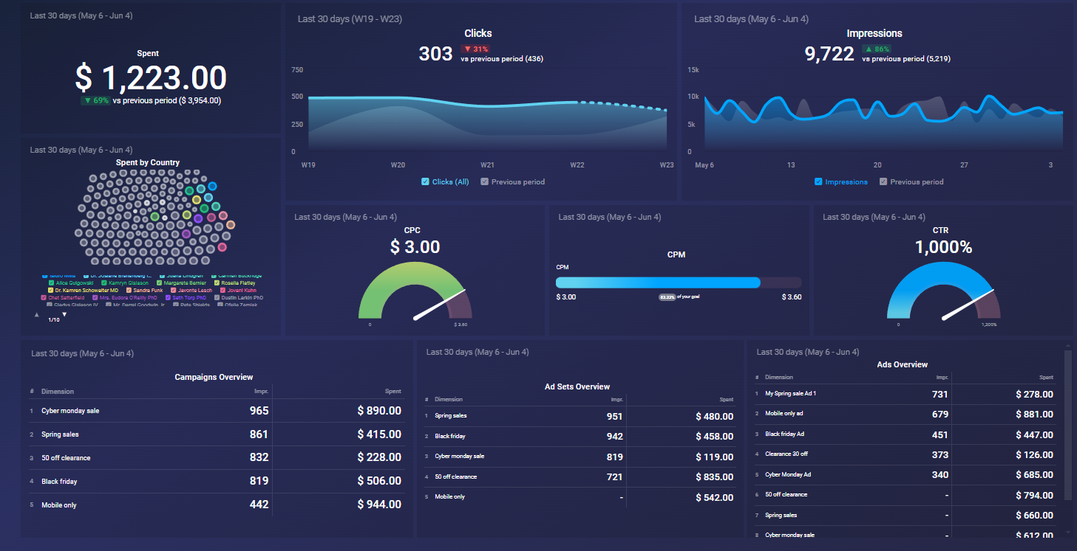
Facebook Ads Performance Overview
Ref: https://databox.com/dashboard-examples/facebook-ads

Slide 5
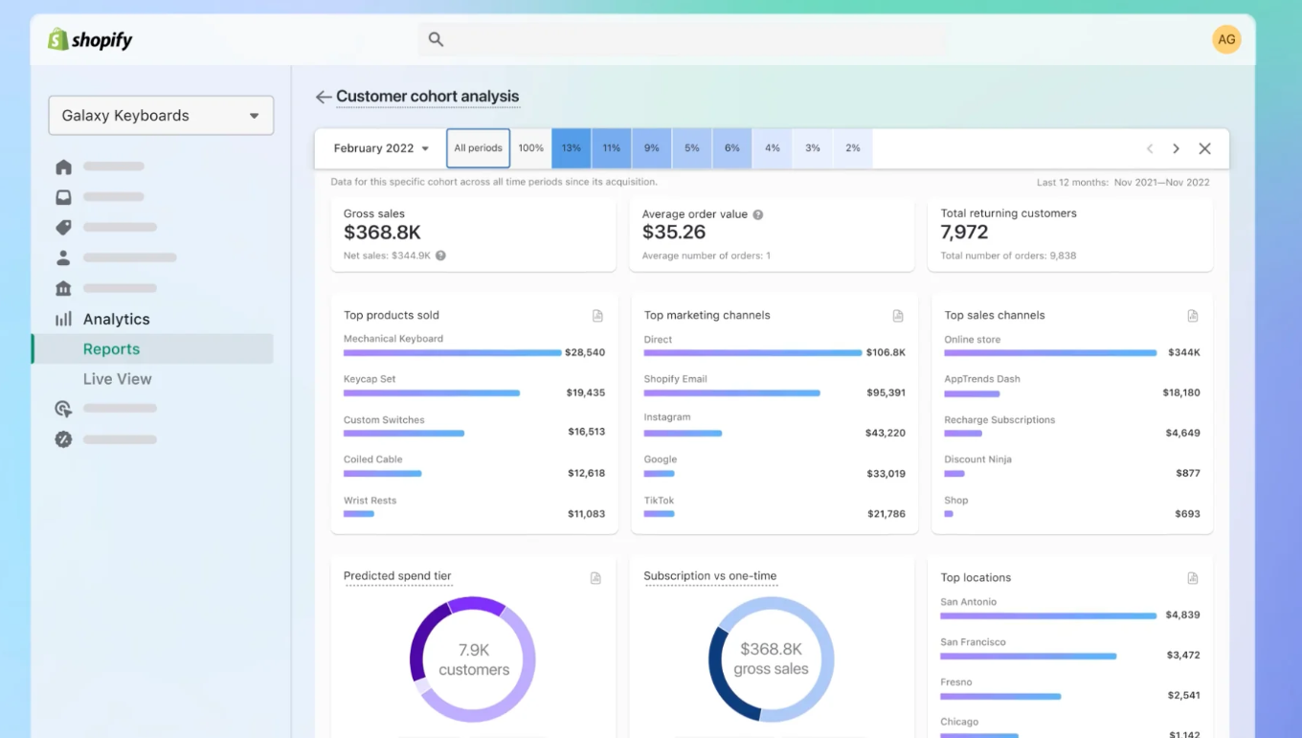
Customer Cohort Analysis
Ref: https://www.shopify.com/id/blog/marketing-analytics

