Slide 1
NumPy (and SciPy)
Travis E. Oliphant
oliphant@enthought.com
Enthought, Inc.
www.enthought.com

Slide 2
What is NumPy?
Python is a fabulous language
  Easy to extend
  Great syntax which encourages easy to write and maintain code
  Incredibly large standard-library and third-party tools
No built-in multi-dimensional array (but it supports the needed syntax for extracting elements from one)‏
NumPy provides a fast built-in object (ndarray) which is a multi-dimensional array of a homogeneous data-type.

Slide 3
NumPy
Website -- http://numpy.scipy.org/
Offers Matlab-ish capabilities within Python
NumPy replaces Numeric and Numarray
Initially developed by Travis Oliphant (building on the work of dozens of others)
Over 30 svn “committers” to the project
NumPy 1.0 released October, 2006
~20K downloads/month from Sourceforge.
  This does not count:
    Linux distributions that include NumPy
    Enthought distributions that include NumPy
    Mac OS X distributions that include NumPy
    Sage distributes that include NumPy

Slide 4
Overview of NumPy
N-D ARRAY (NDARRAY)
UNIVERSAL FUNCTIONS (UFUNC)
N-dimensional array of rectangular data
Element of the array can be C-structure or simple data-type.
Fast algorithms on machine data-types (int, float, etc.)
        functions that operate element-by-element and return result
        fast-loops registered for each fundamental data-type
        sin(x) = [sin(x_{i}) i=0..N]
        x+y = [x_{i} + y_{i} i=0..N]

Slide 5
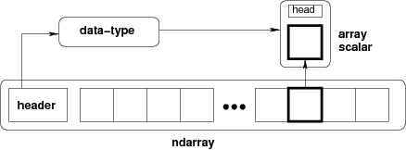
NumPy Array
  A NumPy array is an N-dimensional homogeneous collection of “items” of the same “kind”. The kind can be any arbitrary structure and is specified using the data-type.

Slide 6
NumPy Array
A NumPy array is a homogeneous collection of “items” of the same “data-type” (dtype)‏
>>> import numpy as N
>>> a = N.array([[1,2,3],[4,5,6]],float)‏
>>> print a
[[1. 2. 3.]
[4. 5. 6.]]
>>> print a.shape, ”\n”, a.itemsize
(2, 3)‏
8
>>> print a.dtype, a.dtype.type
'<f8' <type 'float64scalar'>
>>> type(a[0,0])‏
<type 'float64scalar'>
>>> type(a[0,0]) is type(a[1,2])
True

Slide 7
Introducing NumPy Arrays
SIMPLE ARRAY CREATION
ARRAY SHAPE
>>> a = array([0,1,2,3])
>>> a
array([0, 1, 2, 3])
# shape returns a tuple
# listing the length of the
# array along each dimension.
>>> a.shape
(4,)
>>> shape(a)
(4,)
# size reports the entire
# number of elements in an
# array.
>>> a.size
4
>>> size(a)
4
CHECKING THE TYPE
>>> type(a)
<type 'array'>
NUMERIC ‘TYPE’ OF ELEMENTS
ARRAY SIZE
>>> a.dtype
dtype(‘int32’)
BYTES PER ELEMENT
>>> a.itemsize # per element
4

Slide 8
Introducing NumPy Arrays
BYTES OF MEMORY USED
CONVERSION TO LIST
# returns the number of bytes
# used by the data portion of
# the array.
>>> a.nbytes
12
# convert a numpy array to a
# python list.
>>> a.tolist()
[0, 1, 2, 3]
# For 1D arrays, list also
# works equivalently, but
# is slower.
>>> list(a)
[0, 1, 2, 3]
NUMBER OF DIMENSIONS
>>> a.ndim
1
ARRAY COPY
# create a copy of the array
>>> b = a.copy()
>>> b
array([0, 1, 2, 3])

Slide 9

Setting Array Elements
ARRAY INDEXING
BEWARE OF TYPE
COERSION
>>> a[0]
0
>>> a[0] = 10
>>> a
[10, 1, 2, 3]
>>> a.dtype
dtype('int32')
# assigning a float to into # an int32 array will
# truncate decimal part.
>>> a[0] = 10.6
>>> a
[10, 1, 2, 3]
# fill has the same behavior
>>> a.fill(-4.8)
>>> a
[-4, -4, -4, -4]
FILL
# set all values in an array.
>>> a.fill(0)
>>> a
[0, 0, 0, 0]
# This also works, but may
# be slower.
>>> a[:] = 1
>>> a
[1, 1, 1, 1]

Slide 10
Multi-Dimensional Arrays
MULTI-DIMENSIONAL ARRAYS
NUMBER OF DIMENSIONS
>>> a = array([[ 0, 1, 2, 3],
[10,11,12,13]])
>>> a
array([[ 0, 1, 2, 3],
[10,11,12,13]])
>>> a.ndims
2
GET/SET ELEMENTS
>>> a[1,3]
13
>>> a[1,3] = -1
>>> a
array([[ 0, 1, 2, 3],
[10,11,12,-1]])
(ROWS,COLUMNS)
column
row
>>> a.shape
(2, 4)
>>> shape(a)
(2, 4)
ELEMENT COUNT
ADDRESS FIRST ROW USING SINGLE INDEX
>>> a.size
8
>>> size(a)
8
>>> a[1]
array([10, 11, 12, -1])

Slide 11
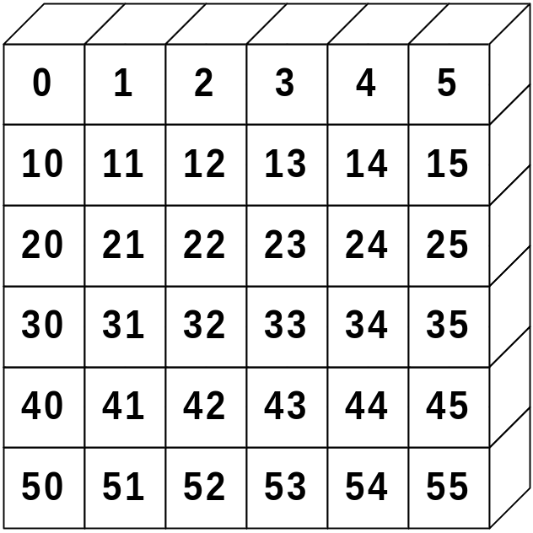
Array Slicing
SLICING WORKS MUCH LIKE STANDARD PYTHON SLICING
>>> a[0,3:5]
array([3, 4])
>>> a[4:,4:]
array([[44, 45],
[54, 55]])
>>> a[:,2]
array([2,12,22,32,42,52])
STRIDES ARE ALSO POSSIBLE
>>> a[2::2,::2]
array([[20, 22, 24],
[40, 42, 44]])

Slide 12
Memory Model
>>> print a.strides
(24, 8)‏
>>> print a.flags.fortran, a.flags.contiguous
False True
>>> print a.T.strides
(8, 24)‏
>>> print a.T.flags.fortran, a.T.flags.contiguous
True False
Every dimension of an ndarray is accessed by stepping (striding) a fixed number of bytes through memory.
If memory is contiguous, then the strides are “pre-computed” indexing-formulas for either Fortran-order (first-dimension varies the fastest), or C-order (last-dimension varies the fastest) arrays.

Slide 13
Array slicing (Views)‏
Memory model allows “simple indexing” (integers and slices) into the array to be a view of the same data.
Other uses of view
>>> b = a[:,::2]
>>> b[0,1] = 100
>>> print a
[[ 1. 2. 100.]]
[ 4. 5. 6.]]
>>> c = a[:,::2].copy()‏
>>> c[1,0] = 500
>>> print a
[[ 1. 2. 100.]]
[ 4. 5. 6.]]
>>> b = a.view('i8')‏
>>> [hex(val.item()) for val in b.flat]
['0x3FF0000000000000L',
'0x4000000000000000L',
'0x4059000000000000L',
'0x4010000000000000L',
'0x4014000000000000L',
'0x4018000000000000L']

Slide 14
Slices Are References
Slices are references to memory in original array. Changing values in a slice also changes the original array.
>>> a = array((0,1,2,3,4))
# create a slice containing only the
# last element of a
>>> b = a[2:4]
>>> b[0] = 10
# changing b changed a!
>>> a
array([ 1, 2, 10, 3, 4])
Notes:
Good
1. More efficient because it doesn’t force array copies for every operation.
2. It is often nice to rename the view of an array for manipulation. (A view of the odd and even arrays)
Bad
1. Can cause unexpected side-effects that are hard to track down.
2. When you would rather have a copy, it requires some ugliness.

Slide 15
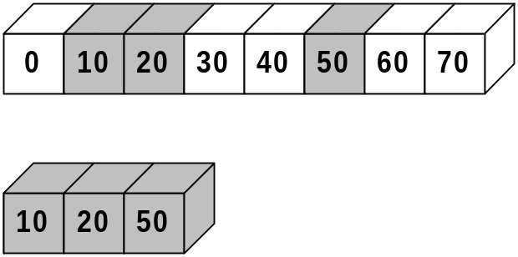
Fancy Indexing
INDEXING BY POSITION
INDEXING WITH BOOLEANS
>>> a = arange(0,80,10)
# fancy indexing
>>> y = a[[1, 2, -3]]
>>> print y
[10 20 50]
# using take
>>> y = take(a,[1,2,-3])
>>> print y
[10 20 50]
>>> mask = array([0,1,1,0,0,1,0,0],
... dtype=bool)
# fancy indexing
>>> y = a[mask]
>>> print y
[10,20,50]
# using compress
>>> y = compress(mask, a)
>>> print y
[10,20,50]
a
y

Slide 16

Fancy Indexing in 2D
>>> a[(0,1,2,3,4),(1,2,3,4,5)]
array([ 1, 12, 23, 34, 45])
>>> a[3:,[0, 2, 5]]
array([[30, 32, 35],
[40, 42, 45]])
[50, 52, 55]])
>>> mask = array([1,0,1,0,0,1],
dtype=bool)
>>> a[mask,2]
array([2,22,52])
Unlike slicing, fancy indexing creates copies instead of views into original arrays.

Slide 17
Data-types
There are two related concepts of “type”
  The data-type object (dtype)‏
  The Python “type” of the object created from a single array item (hierarchy of scalar types)‏
The dtype object provides the details of how to interpret the memory for an item. It's an instance of a single dtype class.
The “type” of the extracted elements are true Python classes that exist in a hierarchy of Python classes
Every dtype object has a type attribute which provides the Python object returned when an element is selected from the array

Slide 18
NumPy dtypes
Basic Type | Available NumPy types | Comments
Boolean | bool | Elements are 1 byte in size
Integer | int8, int16, int32, int64, int128, int | int defaults to the size of int in C for the platform
Unsigned Integer | uint8, uint16, uint32, uint64, uint128, uint | uint defaults to the size of unsigned int in C for the platform
Float | float32, float64, float, longfloat, | Float is always a double precision floating point value (64 bits). longfloat represents large precision floats. Its size is platform dependent.
Complex | complex64, complex128, complex | The real and complex elements of a complex64 are each represented by a single precision (32 bit) value for a total size of 64 bits.
Strings | str, unicode | Unicode is always UTF32 (UCS4)
Object | object | Represent items in array as Python objects.
Records | void | Used for arbitrary data structures in record arrays.

Slide 19
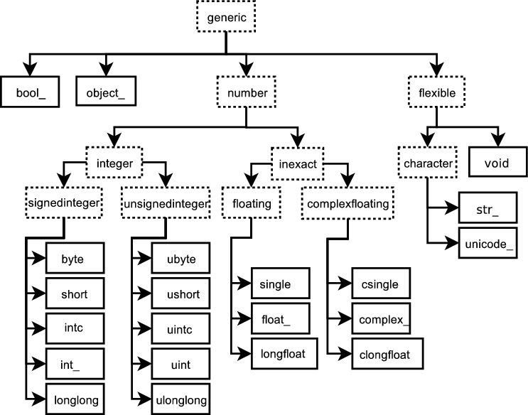
Built-in “scalar” types

Slide 20
Data-type object (dtype)‏
There are 21 “built-in” (static) data-type objects
New (dynamic) data-type objects are created to handle
  Alteration of the byteorder
  Change in the element size (for string, unicode, and void built-ins)‏
  Addition of fields
  Change of the type object (C-structure arrays)
Creation of data-types is quite flexible.
New user-defined “built-in” data-types can also be added (but must be done in C and involves filling a function-pointer table)‏

Slide 21
Data-type fields
An item can include fields of different data-types.
A field is described by a data-type object and a byte offset --- this definition allows nested records.
The array construction command interprets tuple elements as field entries.
>>> dt = N.dtype(“i4,f8,a5”)‏
>>> print dt.fields
{'f1': (dtype('<i4'), 0), 'f2': (dtype('<f8'), 4), 'f3': (dtype('|S5'), 12)}
>>> a = N.array([(1,2.0,”Hello”), (2,3.0,”World”)], dtype=dt)‏
>>> print a['f3']
[Hello World]

Slide 22
Array Calculation Methods
SUM FUNCTION
SUM ARRAY METHOD
>>> a = array([[1,2,3],
[4,5,6]], float)
# Sum defaults to summing all
# *all* array values.
>>> sum(a)
21.
# supply the keyword axis to
# sum along the 0th axis.
>>> sum(a, axis=0)
array([5., 7., 9.])
# supply the keyword axis to
# sum along the last axis.
>>> sum(a, axis=-1)
array([6., 15.])
# The a.sum() defaults to
# summing *all* array values
>>> a.sum()
21.
# Supply an axis argument to
# sum along a specific axis.
>>> a.sum(axis=0)
array([5., 7., 9.])
PRODUCT
# product along columns.
>>> a.prod(axis=0)
array([ 4., 10., 18.])
# functional form.
>>> prod(a, axis=0)
array([ 4., 10., 18.])

Slide 23
Min/Max
MIN
MAX
>>> a = array([2.,3.,0.,1.]) >>> a.min(axis=0)
0.
# use Numpy’s amin() instead
# of Python’s builtin min()
# for speed operations on
# multi-dimensional arrays.
>>> amin(a, axis=0)
0.
>>> a = array([2.,1.,0.,3.]) >>> a.max(axis=0)
3.
# functional form
>>> amax(a, axis=0)
3.
ARGMIN
ARGMAX
# Find index of minimum value.
>>> a.argmin(axis=0)
2
# functional form
>>> argmin(a, axis=0)
2
# Find index of maximum value.
>>> a.argmax(axis=0)
1
# functional form
>>> argmax(a, axis=0)
1

Slide 24
Statistics Array Methods
MEAN
STANDARD DEV./VARIANCE
>>> a = array([[1,2,3],
[4,5,6]], float)
# mean value of each column
>>> a.mean(axis=0)
array([ 2.5, 3.5, 4.5])
>>> mean(a, axis=0)
array([ 2.5, 3.5, 4.5])
>>> average(a, axis=0)
array([ 2.5, 3.5, 4.5])
# average can also calculate
# a weighted average
>>> average(a, weights=[1,2],
... axis=0)
array([ 3., 4., 5.])
# Standard Deviation
>>> a.std(axis=0)
array([ 1.5, 1.5, 1.5])
# Variance
>>> a.var(axis=0)
array([2.25, 2.25, 2.25])
>>> var(a, axis=0)
array([2.25, 2.25, 2.25])

Slide 25
Other Array Methods
CLIP
ROUND
# Limit values to a range
>>> a = array([[1,2,3],
[4,5,6]], float)
# Set values < 3 equal to 3.
# Set values > 5 equal to 5.
>>> a.clip(3,5)
>>> a
array([[ 3., 3., 3.],
[ 4., 5., 5.]])
# Round values in an array.
# Numpy rounds to even, so
# 1.5 and 2.5 both round to 2.
>>> a = array([1.35, 2.5, 1.5])
>>> a.round()
array([ 1., 2., 2.])
# Round to first decimal place.
>>> a.round(decimals=1)
array([ 1.4, 2.5, 1.5])
POINT TO POINT
# Calculate max – min for
# array along columns
>>> a.ptp(axis=0)
array([ 3.0, 3.0, 3.0])
# max – min for entire array.
>>> a.ptp(axis=None)
5.0

Slide 26
Summary of (most) array attributes/methods
BASIC ATTRIBUTES
a.dtype – Numerical type of array elements. float32, uint8, etc.
a.shape – Shape of the array. (m,n,o,...)
a.size – Number of elements in entire array.
a.itemsize – Number of bytes used by a single element in the array.
a.nbytes – Number of bytes used by entire array (data only).
a.ndim – Number of dimensions in the array.
SHAPE OPERATIONS
a.flat – An iterator to step through array as if it is 1D.
a.flatten() – Returns a 1D copy of a multi-dimensional array.
a.ravel() – Same as flatten(), but returns a ‘view’ if possible.
a.resize(new_size) – Change the size/shape of an array in-place.
a.swapaxes(axis1, axis2) – Swap the order of two axes in an array. a.transpose(*axes) – Swap the order of any number of array axes. a.T – Shorthand for a.transpose()
a.squeeze() – Remove any length=1 dimensions from an array.
Notes:
These are definitely summaries – I have not included all the arguments for functions in many cases.

Slide 27
Summary of (most) array attributes/methods
FILL AND COPY
a.copy() – Return a copy of the array.
a.fill(value) – Fill array with a scalar value.
CONVERSION / COERSION
a.tolist() – Convert array into nested lists of values.
a.tostring() – raw copy of array memory into a python string.
a.astype(dtype) – Return array coerced to given dtype.
a.byteswap(False) – Convert byte order (big <-> little endian).
COMPLEX NUMBERS
a.real – Return the real part of the array.
a.imag – Return the imaginary part of the array.
a.conjugate() – Return the complex conjugate of the array.
a.conj()– Return the complex conjugate of an array.(same as conjugate)

Slide 28
Summary of (most) array attributes/methods
SAVING
a.dump(file) – Store a binary array data out to the given file.
a.dumps() – returns the binary pickle of the array as a string.
a.tofile(fid, sep="", format="%s") Formatted ascii output to file.
SEARCH / SORT
a.nonzero() – Return indices for all non-zero elements in a.
a.sort(axis=-1) – Inplace sort of array elements along axis.
a.argsort(axis=-1) – Return indices for element sort order along axis. a.searchsorted(b) – Return index where elements from b would go in a.
ELEMENT MATH OPERATIONS
a.clip(low, high) – Limit values in array to the specified range.
a.round(decimals=0) – Round to the specified number of digits.
a.cumsum(axis=None) – Cumulative sum of elements along axis.
a.cumprod(axis=None) – Cumulative product of elements along axis.

Slide 29
Summary of (most) array attributes/methods
REDUCTION METHODS
All the following methods “reduce” the size of the array by 1 dimension by carrying out an operation along the specified axis. If axis is None, the operation is carried out across the entire array.
a.sum(axis=None) – Sum up values along axis.
a.prod(axis=None) – Find the product of all values along axis.
a.min(axis=None)– Find the minimum value along axis.
a.max(axis=None) – Find the maximum value along axis.
a.argmin(axis=None) – Find the index of the minimum value along axis.
a.argmax(axis=None) – Find the index of the maximum value along axis.
a.ptp(axis=None) – Calculate a.max(axis) – a.min(axis)
a.mean(axis=None) – Find the mean (average) value along axis.
a.std(axis=None) – Find the standard deviation along axis.
a.var(axis=None) – Find the variance along axis.
a.any(axis=None) – True if any value along axis is non-zero. (or)
a.all(axis=None) – True if all values along axis are non-zero. (and)

Slide 30
Array Operations
SIMPLE ARRAY MATH
MATH FUNCTIONS
>>> a = array([1,2,3,4])
>>> b = array([2,3,4,5])
>>> a + b
array([3, 5, 7, 9])
# Create array from 0 to 10
>>> x = arange(11.)
# multiply entire array by
# scalar value
>>> a = (2*pi)/10.
>>> a
0.62831853071795862
>>> a*x
array([ 0.,0.628,…,6.283])
# inplace operations
>>> x *= a
>>> x
array([ 0.,0.628,…,6.283])
# apply functions to array.
>>> y = sin(x)
Numpy defines the following constants:
  pi = 3.14159265359
  e = 2.71828182846

Slide 31
Universal Functions
ufuncs are objects that rapidly evaluate a function element-by-element over an array.
Core piece is a 1-d loop written in C that performs the operation over the largest dimension of the array
For 1-d arrays it is equivalent to but much faster than list comprehension
>>> type(N.exp)‏
<type 'numpy.ufunc'>
>>> x = array([1,2,3,4,5])‏
>>> print N.exp(x)‏
[ 2.71828183 7.3890561 20.08553692 54.59815003 148.4131591 ]
>>> print [math.exp(val) for val in x]
[2.7182818284590451, 7.3890560989306504,20.085536923187668,
54.598150033144236,148.4131591025766]

Slide 32
Mathematic Binary Operators
a + b → add(a,b)
a - b → subtract(a,b)
a % b → remainder(a,b)
a * b → multiply(a,b)
a / b → divide(a,b)
a ** b → power(a,b)
MULTIPLY BY A SCALAR
ADDITION USING AN OPERATOR FUNCTION
>>> a = array((1,2))
>>> a*3.
array([3., 6.])
>>> add(a,b)
array([4, 6])
ELEMENT BY ELEMENT ADDITION
IN PLACE OPERATION
# Overwrite contents of a.
# Saves array creation
# overhead
>>> add(a,b,a) # a += b
array([4, 6])
>>> a
array([4, 6])
>>> a = array([1,2])
>>> b = array([3,4])
>>> a + b
array([4, 6])

Slide 33
Comparison and Logical Operators
equal (==)
greater_equal (>=)
logical_and
logical_not
not_equal (!=)
less (<)
logical_or
greater (>)
less_equal (<=)
logical_xor
2D EXAMPLE
>>> a = array(((1,2,3,4),(2,3,4,5)))
>>> b = array(((1,2,5,4),(1,3,4,5)))
>>> a == b
array([[True, True, False, True],
[False, True, True, True]])
# functional equivalent
>>> equal(a,b)
array([[True, True, False, True],
[False, True, True, True]])

Slide 34
Bitwise Operators
bitwise_and (&)
bitwise_or (|)
invert (~)
bitwise_xor
right_shift(a,shifts)
left_shift (a,shifts)
BITWISE EXAMPLES
>>> a = array((1,2,4,8))
>>> b = array((16,32,64,128))
>>> bitwise_or(a,b)
array([ 17, 34, 68, 136])
# bit inversion
>>> a = array((1,2,3,4), uint8)
>>> invert(a)
array([254, 253, 252, 251], dtype=uint8)
# left shift operation
>>> left_shift(a,3)
array([ 8, 16, 24, 32], dtype=uint8)
Notes:
Bitwise operators only work on Integer arrays.
note: invert means bitwise_not (there is not a bitwise_not operator) -- probably should be though. invert is ambiguous. bitwise_not isn’t.
?? Why does left_shift convert the array from ‘b’ to ‘i’?

Slide 35

Trig and Other Functions
TRIGONOMETRIC
OTHERS
sin(x) sinh(x)
cos(x) cosh(x)
arccos(x) arccosh(x)
arctan(x) arctanh(x)
arcsin(x) arcsinh(x)
arctan2(x,y)
exp(x) log(x)
log10(x) sqrt(x)
absolute(x) conjugate(x)
negative(x) ceil(x)
floor(x) fabs(x) hypot(x,y) fmod(x,y) maximum(x,y) minimum(x,y)
hypot(x,y)
Element by element distance
calculation using
Notes:
difference between fabs, abs,absolute?
timing wise, fabs is about twice as slow on
Windows 2K as the other two. yikes!!

Slide 36
Broadcasting
When there are multiple inputs, then they all must be “broadcastable” to the same shape.
  All arrays are promoted to the same number of dimensions (by pre-prending 1's to the shape)‏
  All dimensions of length 1 are expanded as determined by other inputs with non-unit lengths in that dimension.
>>> x = [1,2,3,4];
>>> y = [[10],[20],[30]]
>>> print N.add(x,y)‏
[[11 12 13 14]
[21 22 23 24]
[31 32 33 34]]
>>> x = array(x)‏
>>> y = array(y)‏
>>> print x+y
[[11 12 13 14]
[21 22 23 24]
[31 32 33 34]]
x has shape (4,) the ufunc sees it as having shape (1,4)‏
y has shape (3,1)‏
The ufunc result has shape (3,4)

Slide 37
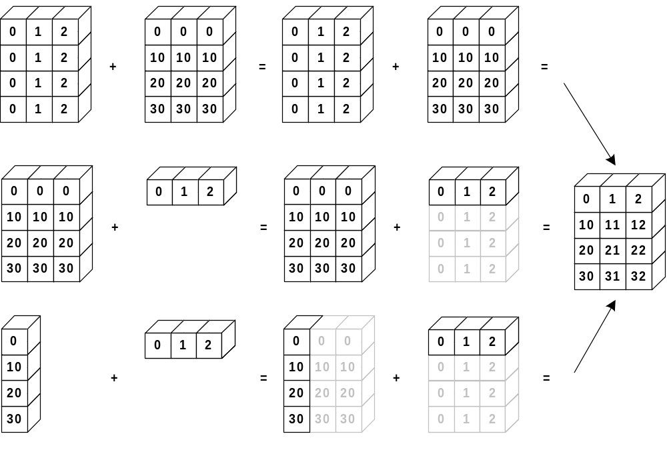
Array Broadcasting
4x3
4x3
4x3
3
stretch
4x1
3
stretch
stretch

Slide 38
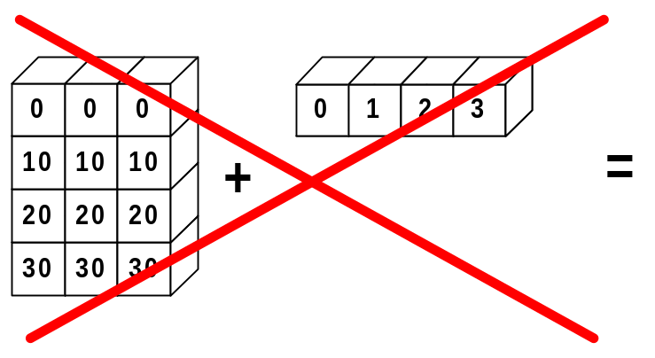
Broadcasting Rules
The trailing axes of both arrays must either be 1 or have the same size for broadcasting to occur. Otherwise, a “ValueError: frames are not aligned” exception is thrown.
mismatch!
4x3
4

Slide 39
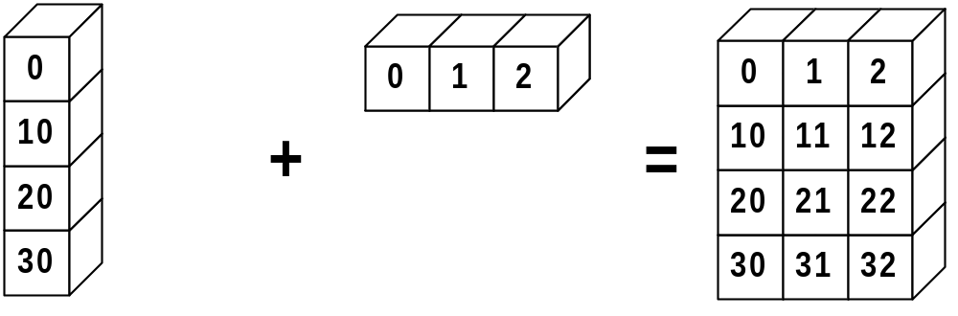
Broadcasting in Action
>>> a = array((0,10,20,30))
>>> b = array((0,1,2))
>>> y = a[:, None] + b

Slide 40
Universal Function Methods
The mathematic, comparative, logical, and bitwise operators that
take two arguments (binary operators) have special methods that operate on arrays:
        op.reduce(a,axis=0)
        op.accumulate(a,axis=0)
        op.outer(a,b)
        op.reduceat(a,indices)

Slide 41
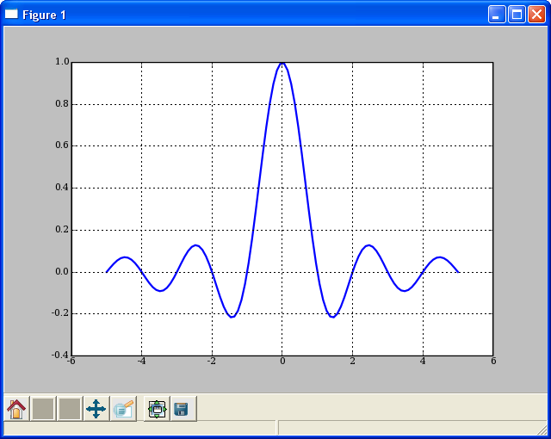
Vectorizing Functions
VECTORIZING FUNCTIONS
Example
# attempt
>>> sinc([1.3,1.5])
TypeError: can't multiply sequence to non-int
>>> x = r_[-5:5:100j]
>>> y = vsinc(x)
>>> plot(x, y)
# special.sinc already available
# This is just for show.
def sinc(x):
if x == 0.0:
return 1.0
else:
w = pi*x
return sin(w) / w
SOLUTION
>>> from numpy import vectorize
>>> vsinc = vectorize(sinc)
>>> vsinc([1.3,1.5])
array([-0.1981, -0.2122])

Slide 42
Interface with C/C++/Fortan
Python excels at interfacing with other languages
  weave (C/C++)‏
  f2py (Fortran)‏
  pyrex
  ctypes (C)‏
  SWIG (C/C++)‏
  Boost.Python (C++)‏
  RPy / RSPython (R)‏

Slide 43
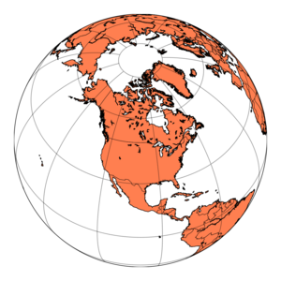
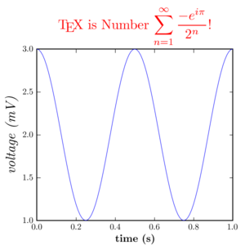
Matplotlib
Requires NumPy extension. Provides powerful plotting commands.
http://matplotlib.sourceforge.net

Slide 44
Recommendations
Matplotlib for day-to-day data exploration.
Matplotlib has a large community, tons of plot types, and is well integrated into ipython. It is the de-facto standard for ‘command line’ plotting from ipython.
Chaco for building interactive plotting applications
Chaco is architected for building highly interactive and configurable plots in python. It is more useful as plotting toolkit than for making one-off plots.

Slide 45
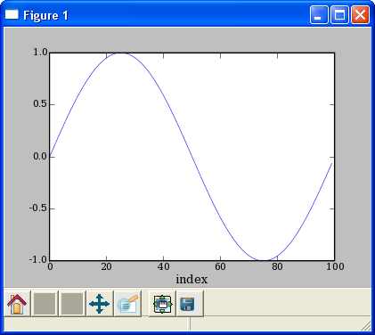
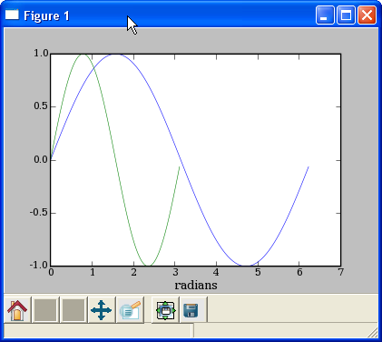
Line Plots
PLOT AGAINST INDICES
MULTIPLE DATA SETS
>>> x = arange(50)*2*pi/50.
>>> y = sin(x)
>>> plot(y)
>>> xlabel(‘index’)
>>> plot(x,y,x2,y2)
>>> xlabel(‘radians’)

Slide 46
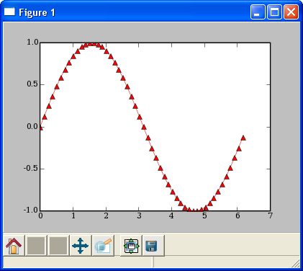
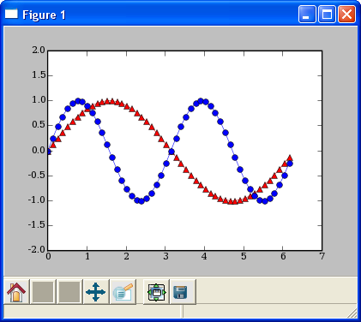
Line Plots
LINE FORMATTING
MULTIPLE PLOT GROUPS
# red, dot-dash, triangles
>>> plot(x,sin(x),'r-^')
>>> plot(x,y1,'b-o', x,y2), r-^')
>>> axis([0,7,-2,2])

Slide 47
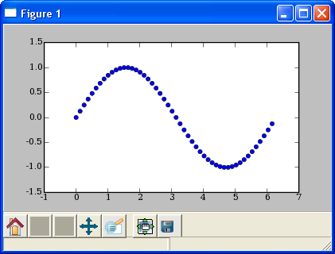
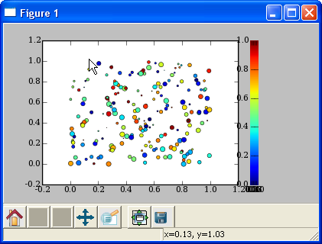
Scatter Plots
SIMPLE SCATTER PLOT
COLORMAPPED SCATTER
>>> x = arange(50)*2*pi/50.
>>> y = sin(x)
>>> scatter(x,y)
# marker size/color set with data
>>> x = rand(200)
>>> y = rand(200)
>>> size = rand(200)*30
>>> color = rand(200)
>>> scatter(x, y, size, color)
>>> colorbar()

Slide 48
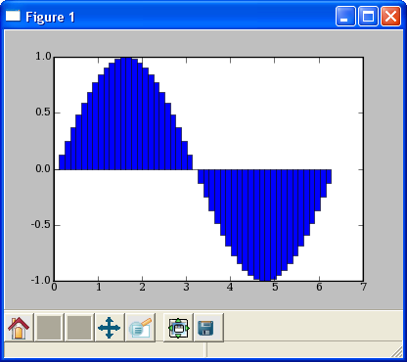
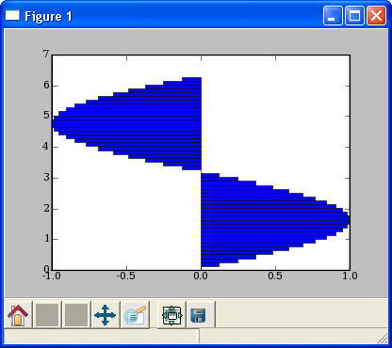
Bar Plots
BAR PLOT
HORIZONTAL BAR PLOT
>>> bar(x,sin(x),
... width=x[1]-x[0])
>>> hbar(x,sin(x),
... height=x[1]-x[0],
... orientation=‘horizontal’)

Slide 49
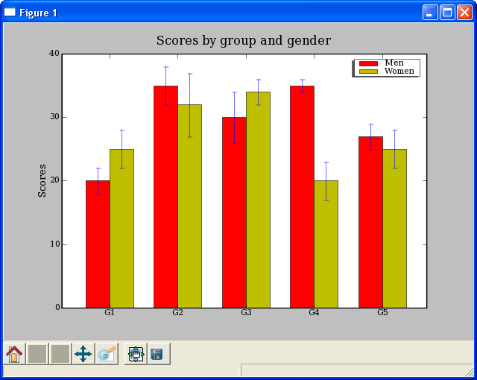
Bar Plots
DEMO/MATPLOTLIB_PLOTTING/BARCHART_DEMO.PY

Slide 50
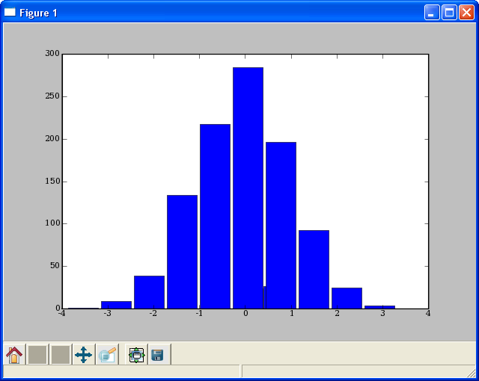
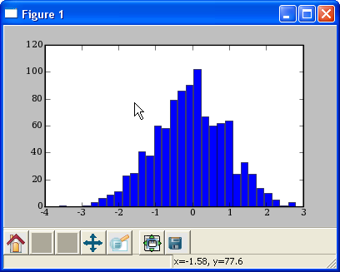
HISTOGRAMS
HISTOGRAM
HISTOGRAM 2
# plot histogram
# default to 10 bins
>>> hist(randn(1000))
# change the number of bins
>>> hist(randn(1000), 30)

Slide 51
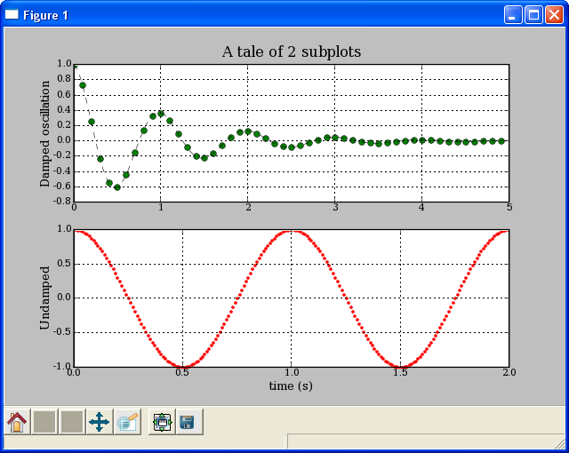
Multiple Plots using Subplot
DEMO/MATPLOTLIB_PLOTTING/EXAMPLES/SUBPLOT_DEMO.PY
def f(t):
s1 = cos(2*pi*t)
e1 = exp(-t)
return multiply(s1,e1)
t1 = arange(0.0, 5.0, 0.1)
t2 = arange(0.0, 5.0, 0.02)
t3 = arange(0.0, 2.0, 0.01)
subplot(211)
l = plot(t1, f(t1), 'bo', t2, f(t2),
'k--')
setp(l, 'markerfacecolor', 'g')
grid(True)
title('A tale of 2 subplots')
ylabel('Damped oscillation')
subplot(212)
plot(t3, cos(2*pi*t3), 'r.')
grid(True)
xlabel('time (s)')
ylabel('Undamped')
show()

Slide 52
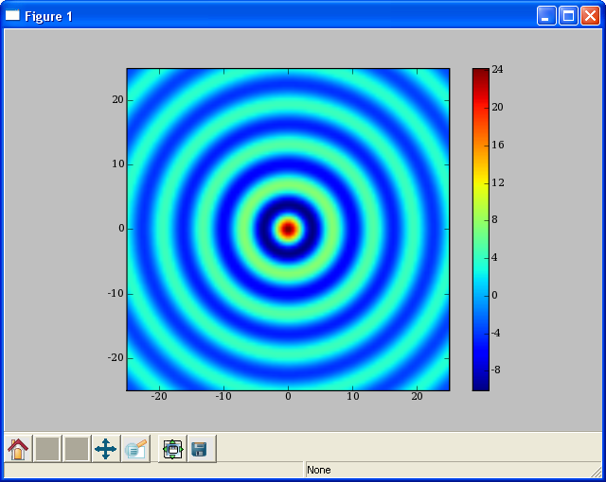
Image Display
# Create 2d array where values
# are radial distance from
# the center of array.
>>> from numpy import mgrid
>>> from scipy import special
>>> x,y = mgrid[-25:25:100j,
... -25:25:100j]
>>> r = sqrt(x**2+y**2)
# Calculate bessel function of
# each point in array and scale
>>> s = special.j0(r)*25
# Display surface plot.
>>> imshow(s, extent=[-25,25,-25,25])
>>> colorbar()

Slide 53
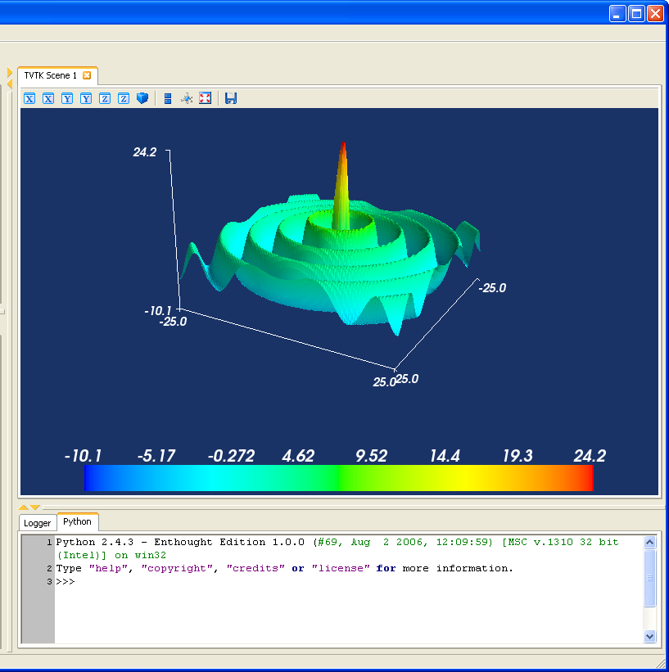
Surface plots with mlab
# Create 2d array where values
# are radial distance from
# the center of array.
>>> from numpy import mgrid
>>> from scipy import special
>>> x,y = mgrid[-25:25:100j,
... -25:25:100j]
>>> r = sqrt(x**2+y**2)
# Calculate bessel function of
# each point in array and scale
>>> s = special.j0(r)*25
# Display surface plot.
>>> from enthought.mayavi \
import mlab
>>> mlab.surf(x,y,s)
>>> mlab.scalarbar()
>>> mlab.axes()

Slide 54
SciPy Overview
Available at www.scipy.org
Open Source BSD Style License
Over 30 svn “committers” to the project
CURRENT PACKAGES
Special Functions (scipy.special)
Signal Processing (scipy.signal)
Image Processing (scipy.ndimage)
Fourier Transforms (scipy.fftpack)
Optimization (scipy.optimize)
Numerical Integration (scipy.integrate)
Linear Algebra (scipy.linalg)
Input/Output (scipy.io)
Statistics (scipy.stats)
Fast Execution (scipy.weave)
Clustering Algorithms (scipy.cluster)
Sparse Matrices (scipy.sparse)
Interpolation (scipy.interpolate)
More (e.g. scipy.odr, scipy.maxentropy)

Slide 55
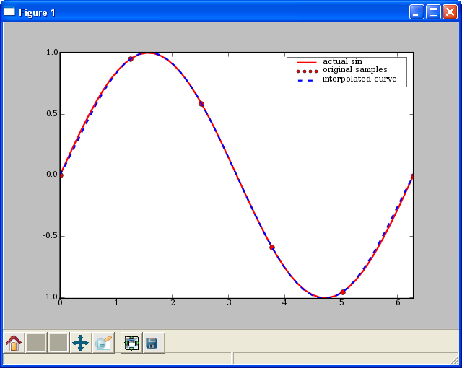
1D Spline Interpolation
# demo/interpolate/spline.py
from scipy.interpolate import interp1d
from pylab import plot, axis, legend
from numpy import linspace
# sample values
x = linspace(0,2*pi,6)
y = sin(x)
# Create a spline class for interpolation.
# kind=5 sets to 5th degree spline.
# kind=0 -> zeroth order hold.
# kind=1 or ‘linear’ -> linear interpolation
# kind=2 or
spline_fit = interp1d(x,y,kind=5)
xx = linspace(0,2*pi, 50)
yy = spline_fit(xx)
# display the results.
plot(xx, sin(xx), 'r-', x,y,'ro',xx,yy, 'b--',linewidth=2)
axis('tight')
legend(['actual sin', 'original samples', 'interpolated curve'])

Slide 56
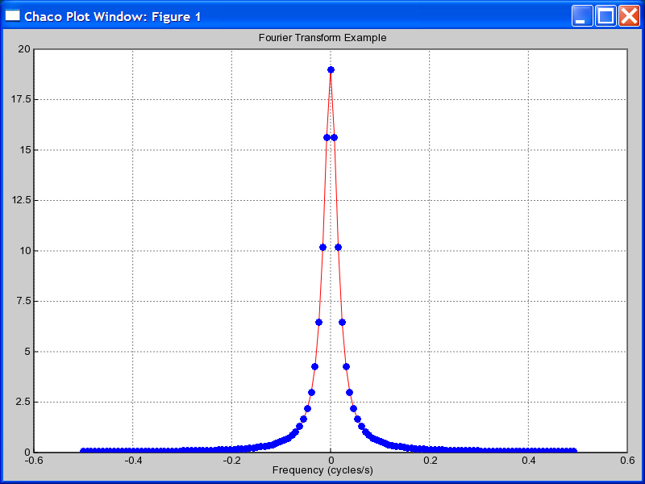
FFT
scipy.fft --- FFT and related functions
>>> n = fftfreq(128)*128
>>> f = fftfreq(128)
>>> ome = 2*pi*f
>>> x = (0.9)**abs(n)
>>> X = fft(x)
>>> z = exp(1j*ome)
>>> Xexact = (0.9**2 - 1)/0.9*z / \
... (z-0.9) / (z-1/0.9)
>>> f = fftshift(f)
>>> plot(f, fftshift(X.real),'r-',
... f, fftshift(Xexact.real),'bo')
>>> title('Fourier Transform Example')
>>> xlabel('Frequency (cycles/s)')
>>> axis(-0.6,0.6, 0, 20)

Slide 57
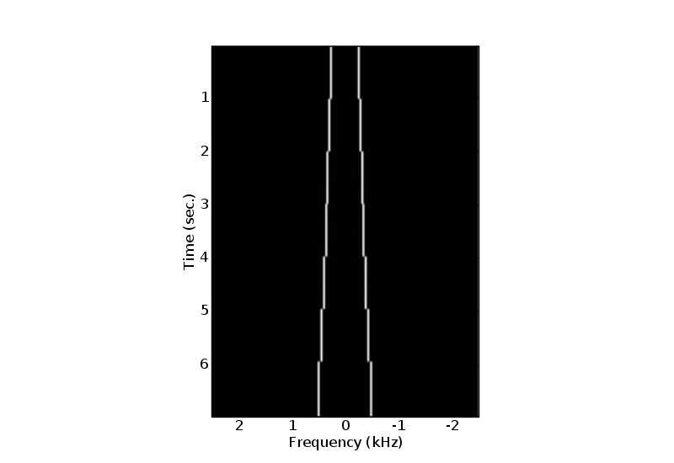
FFT
EXAMPLE --- Short-Time Windowed Fourier Transform
rate, data = read('scale.wav')
dT, T_window = 1.0/rate, 50e-3
N_window = int(T_window * rate)
N_data = len(data)
window = get_window('hamming', N_window)
result, start = [], 0
# compute short-time FFT for each block
while (start < N_data – N_window):
end = start + N_window
val = fftshift(fft(window*data[start:end]))
result.append(val)
start = end
lastval = fft(window*data[-N_window:])
result.append(fftshift(lastval))
result = array(result,result[0].dtype)

Slide 58
Signal Processing
scipy.signal --- Signal and Image Processing
What’s Available?
Filtering
  General 2-D Convolution (more boundary conditions)
  N-D convolution
  B-spline filtering
  N-D Order filter, N-D median filter, faster 2d version,
  IIR and FIR filtering and filter design
LTI systems
  System simulation
  Impulse and step responses
  Partial fraction expansion

Slide 59
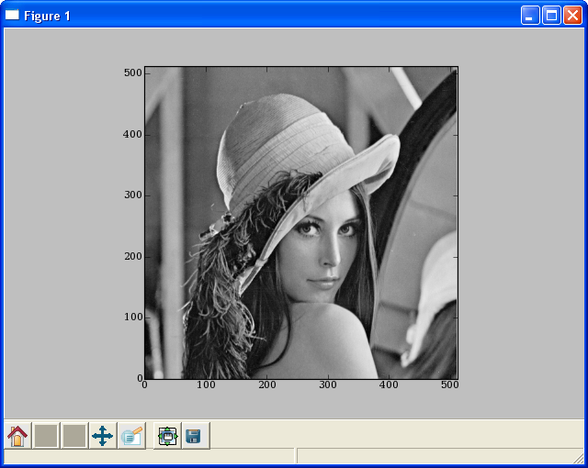
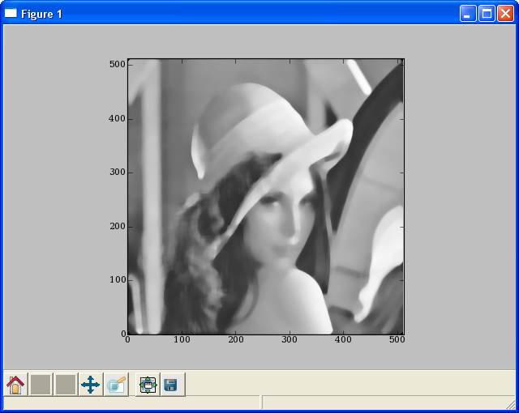
Image Processing
# The famous lena image is packaged with scipy
>>> from scipy import lena, signal
>>> lena = lena().astype(float32)
>>> imshow(lena, cmap=cm.gray)
# Blurring using a median filter
>>> fl = signal.medfilt2d(lena, [15,15])
>>> imshow(fl, cmap=cm.gray)
LENA IMAGE
MEDIAN FILTERED IMAGE

Slide 60
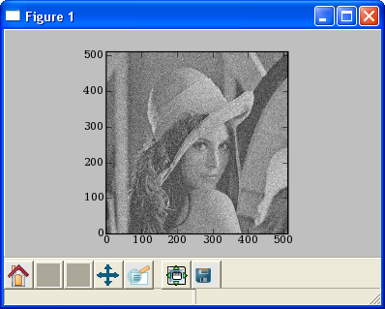
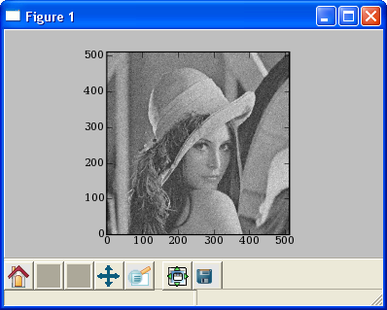
Image Processing
# Noise removal using wiener filter
>>> from scipy.stats import norm
>>> ln = lena + norm(0,32).rvs(lena.shape)
>>> imshow(ln)
>>> cleaned = signal.wiener(ln)
>>> imshow(cleaned)
NOISY IMAGE
FILTERED IMAGE

Slide 61
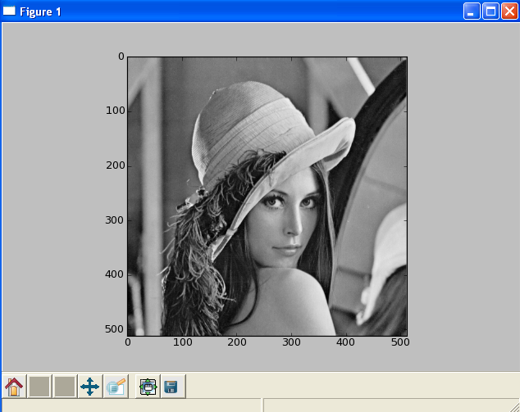
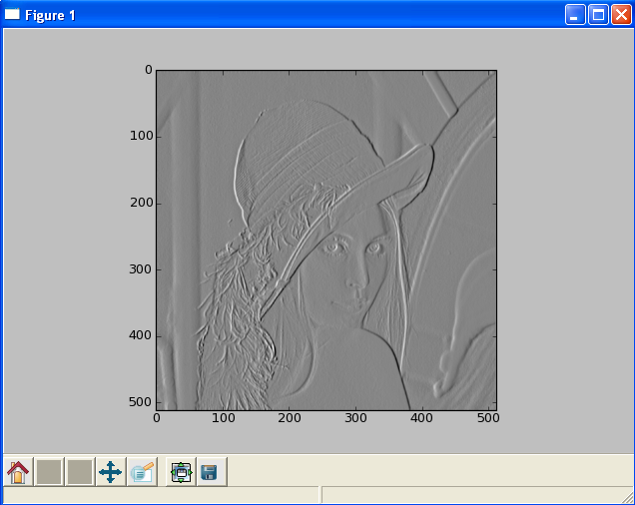
Image Processing
# Edge detection using Sobel filter
>>> from scipy.ndimage.filters import sobel
>>> imshow(lena)
>>> edges = sobel(lena)
>>> imshow(edges)
NOISY IMAGE
FILTERED IMAGE

Slide 62
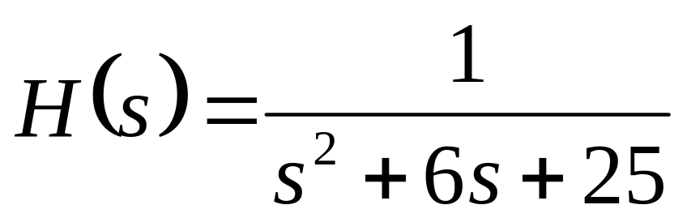
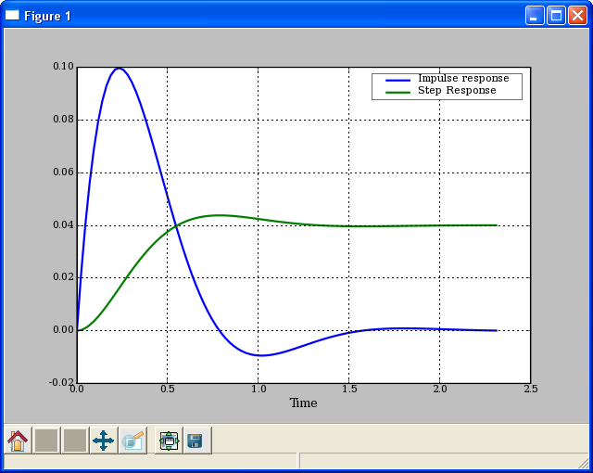
LTI Systems
>>> b,a = [1],[1,6,25]
>>> ltisys = signal.lti(b,a)
>>> t,h = ltisys.impulse()
>>> ts,s = ltisys.step()
>>> plot(t,h,ts,s)
>>> legend(['Impulse response','Step response'])

Slide 63
Optimization
scipy.optimize --- unconstrained minimization and root finding
Unconstrained Optimization
  fmin (Nelder-Mead simplex), fmin_powell (Powell’s method), fmin_bfgs (BFGS quasi-Newton method), fmin_ncg (Newton conjugate gradient), leastsq (Levenberg-Marquardt), anneal (simulated annealing global minimizer), brute (brute force global minimizer), brent (excellent 1-D minimizer), golden, bracket
Constrained Optimization
  fmin_l_bfgs_b, fmin_tnc (truncated newton code), fmin_cobyla (constrained optimization by linear approximation), fminbound (interval constrained 1-d minimizer)
Root finding
  fsolve (using MINPACK), brentq, brenth, ridder, newton, bisect, fixed_point (fixed point equation solver)

Slide 64
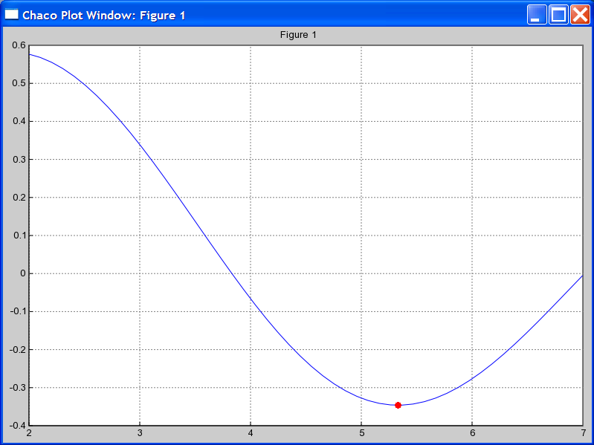
Optimization
EXAMPLE: MINIMIZE BESSEL FUNCTION
# minimize 1st order bessel
# function between 4 and 7
>>> from scipy.special import j1
>>> from scipy.optimize import \
fminbound
>>> x = r_[2:7.1:.1]
>>> j1x = j1(x)
>>> plot(x,j1x,’-’)
>>> hold(True)
>>> x_min = fminbound(j1,4,7)
>>> j1_min = j1(x_min)
>>> plot([x_min],[j1_min],’ro’)

Slide 65
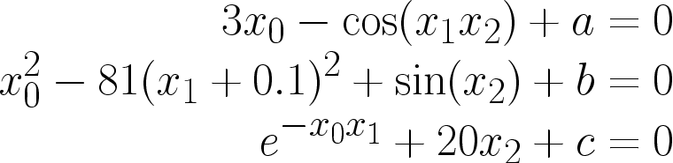
Optimization
EXAMPLE: SOLVING NONLINEAR EQUATIONS
Solve the non-linear equations
>>> def nonlin(x,a,b,c):
>>> x0,x1,x2 = x
>>> return [3*x0-cos(x1*x2)+ a,
>>> x0*x0-81*(x1+0.1)**2 + sin(x2)+b,
>>> exp(-x0*x1)+20*x2+c]
>>> a,b,c = -0.5,1.06,(10*pi-3.0)/3
>>> root = optimize.fsolve(nonlin, [0.1,0.1,-0.1],args=(a,b,c))
>>> print root
[ 0.5 0. -0.5236]
>>> print nonlin(root,a,b,c)
[0.0, -2.231104190e-12, 7.46069872e-14]
starting location for search

Slide 66
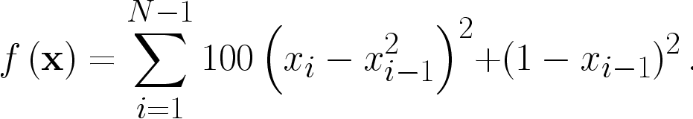
Optimization
EXAMPLE: MINIMIZING ROSENBROCK FUNCTION
Rosenbrock function
WITHOUT DERIVATIVE
USING DERIVATIVE
>>> rosen = optimize.rosen
>>> import time
>>> x0 = [1.3,0.7,0.8,1.9,1.2]
>>> start = time.time()
>>> xopt = optimize.fmin(rosen,
x0, avegtol=1e-7)
>>> stop = time.time()
>>> print_stats(start, stop, xopt)
Optimization terminated successfully.
Current function value: 0.000000
Iterations: 316
Function evaluations: 533
Found in 0.0805299282074 seconds
Solution: [ 1. 1. 1. 1. 1.]
Function value: 2.67775760157e-15
Avg. Error: 1.5323906899e-08
>>> rosen_der = optimize.rosen_der
>>> x0 = [1.3,0.7,0.8,1.9,1.2]
>>> start = time.time()
>>> xopt = optimize.fmin_bfgs(rosen,
x0, fprime=rosen_der, avegtol=1e-7)
>>> stop = time.time()
>>> print_stats(start, stop, xopt)
Optimization terminated successfully.
Current function value: 0.000000
Iterations: 111
Function evaluations: 266
Gradient evaluations: 112
Found in 0.0521121025085 seconds
Solution: [ 1. 1. 1. 1. 1.]
Function value: 1.3739103475e-18
Avg. Error: 1.13246034772e-10

Slide 67
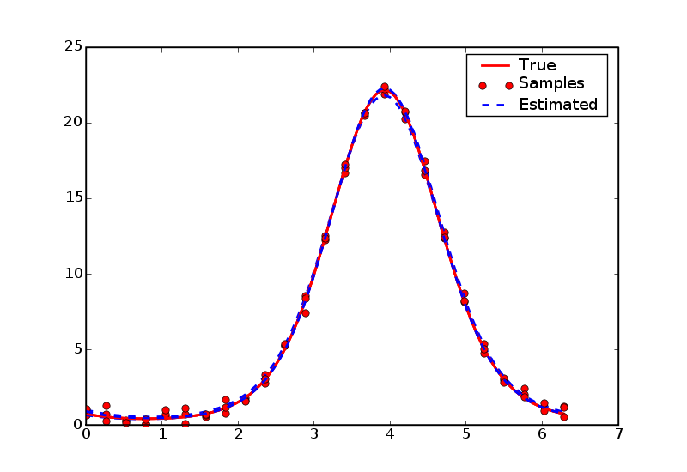
Optimization
EXAMPLE: Non-linear least-squares data fitting
# fit data-points to a curve
# demo/data_fitting/datafit.py
>>> from numpy.random import randn
>>> from numpy import exp, sin, pi
>>> from numpy import linspace
>>> from scipy.optimize import leastsq
>>> def func(x,A,a,f,phi):
return A*exp(-a*sin(f*x+pi/4))
>>> def errfunc(params, x, data):
return func(x, *params) - data
>>> ptrue = [3,2,1,pi/4]
>>> x = linspace(0,2*pi,25)
>>> true = func(x, *ptrue)
>>> noisy = true + 0.3*randn(len(x))
>>> p0 = [1,1,1,1]
>>> pmin, ier = leastsq(errfunc, p0,
args=(x, noisy))
>>> pmin
array([3.1705, 1.9501, 1.0206, 0.7034])

Slide 68
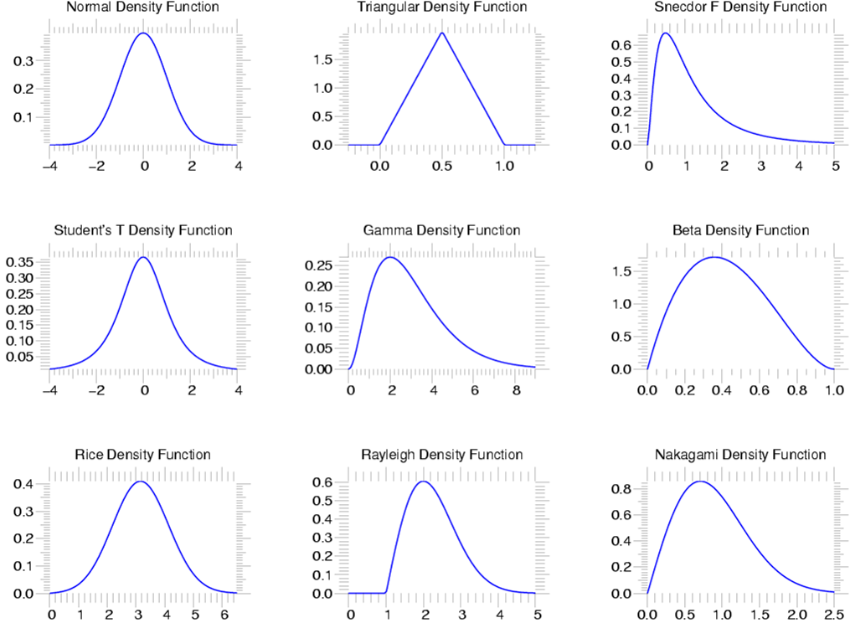
Statistics
scipy.stats --- CONTINUOUS DISTRIBUTIONS
over 80 continuous distributions!
METHODS
pdf
cdf
rvs
ppf
stats

Slide 69
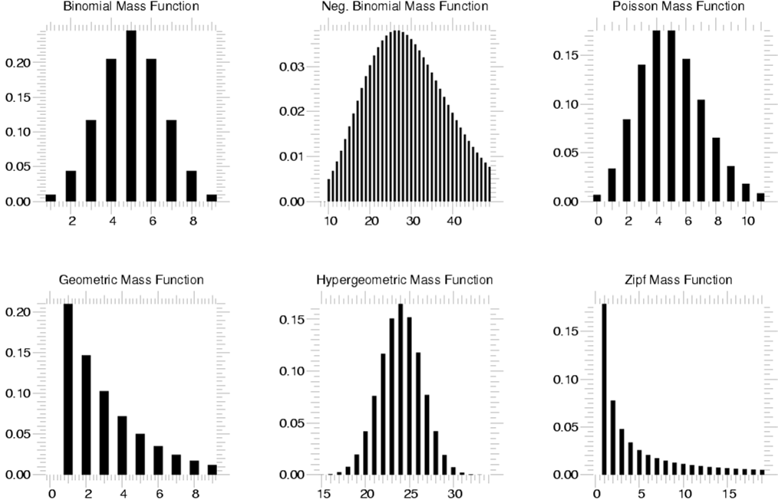
Statistics
scipy.stats --- Discrete Distributions
10 standard discrete distributions (plus any arbitrary finite RV)
METHODS
pdf
cdf
rvs
ppf
stats

Slide 70
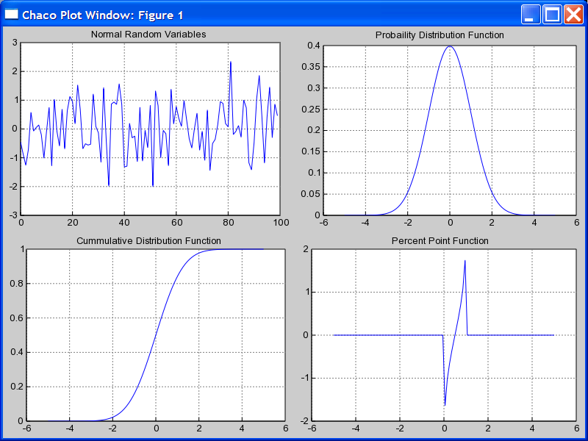
Using stats objects
DISTRIBUTIONS
# Sample normal dist. 100 times.
>>> samp = stats.norm.rvs(size=100)
>>> x = r_[-5:5:100j]
# Calculate probability dist.
>>> pdf = stats.norm.pdf(x)
# Calculate cummulative Dist.
>>> cdf = stats.norm.cdf(x)
# Calculate Percent Point Function
>>> ppf = stats.norm.ppf(x)

Slide 71
Statistics
scipy.stats --- Basic Statistical Calculations on Data
numpy.mean, numpy.std, numpy.var, numpy.cov
stats.skew, stats.kurtosis, stats.moment
scipy.stats.bayes_mvs --- Bayesian mean, variance, and std.
# Create “frozen” Gamma distribution with a=2.5
>>> grv = stats.gamma(2.5)
>>> grv.stats() # Theoretical mean and variance
(array(2.5), array(2.5))
# Estimate mean, variance, and std with 95% confidence
>>> vals = grv.rvs(size=100)
>>> stats.bayes_mvs(vals, alpha=0.95)
((2.52887906081, (2.19560839724, 2.86214972438)),
(2.87924964268, (2.17476164549, 3.8070215789)),
(1.69246760584, (1.47470730841, 1.95115903475)))
# (expected value and confidence interval for each of
# mean, variance, and standard-deviation)

Slide 72
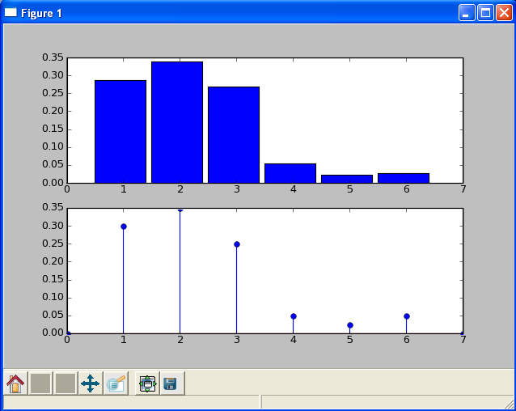
Using stats objects
CREATING NEW DISCRETE DISTRIBUTIONS
# Create a loaded dice.
>>> from scipy.stats import rv_discrete
>>> xk = [1,2,3,4,5,6]
>>> pk = [0.3,0.35,0.25,0.05,
0.025,0.025]
>>> new = rv_discrete(name='loaded',
values=(xk,pk))
# Calculate histogram
>>> samples = new.rvs(size=1000)
>>> bins=linspace(0.5,5.5,6)
>>> subplot(211)
>>> hist(samples,bins=bins,normed=True)
# Calculate pmf
>>> x = range(0,8)
>>> subplot(212)
>>> stem(x,new.pmf(x))

Slide 73
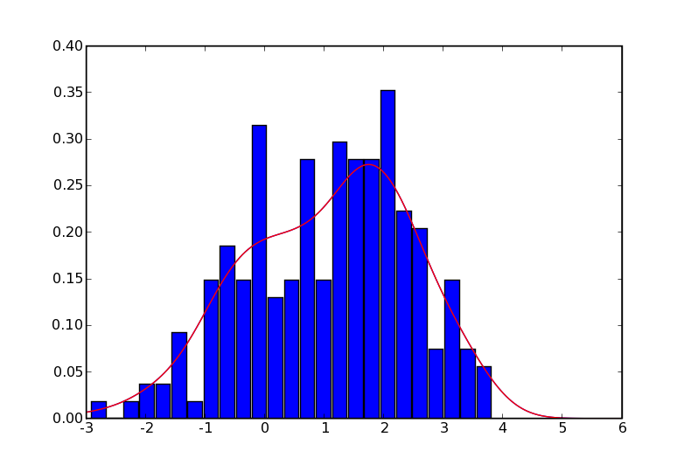
Statistics
Continuous PDF Estimation using Gaussian Kernel Density Estimation
# Sample normal dist. 100 times.
>>> rv1 = stats.norm()
>>> rv2 = stats.norm(2.0,0.8)
>>> samp = r_[rv1.rvs(size=100),
rv2.rvs(size=100)]
# Kernel estimate (smoothed histogram)
>>> apdf = stats.kde.gaussian_kde(samp)
>>> x = linspace(-3,6,200)
>>> plot(x, apdf(x),’r’)
# Histogram
>>> hist(x, bins=25, normed=True)

Slide 74
Linear Algebra
scipy.linalg --- FAST LINEAR ALGEBRA
Uses ATLAS if available --- very fast
Low-level access to BLAS and LAPACK routines in modules linalg.fblas, and linalg.flapack (FORTRAN order)
High level matrix routines
  Linear Algebra Basics: inv, solve, det, norm, lstsq, pinv
  Decompositions: eig, lu, svd, orth, cholesky, qr, schur
  Matrix Functions: expm, logm, sqrtm, cosm, coshm, funm (general matrix functions)

Slide 75
Linear Algebra
LU FACTORIZATION
EIGEN VALUES AND VECTORS
>>> from scipy import linalg
>>> a = array([[1,3,5],
... [2,5,1],
... [2,3,6]])
# time consuming factorization
>>> lu, piv = linalg.lu_factor(a)
# fast solve for 1 or more
# right hand sides.
>>> b = array([10,8,3])
>>> linalg.lu_solve((lu, piv), b)
array([-7.82608696, 4.56521739,
0.82608696])
>>> from scipy import linalg
>>> a = array([[1,3,5],
... [2,5,1],
... [2,3,6]])
# compute eigen values/vectors
>>> vals, vecs = linalg.eig(a)
# print eigen values
>>> vals
array([ 9.39895873+0.j,
-0.73379338+0.j,
3.33483465+0.j])
# eigen vectors are in columns
# print first eigen vector
>>> vecs[:,0]
array([-0.57028326,
-0.41979215,
-0.70608183])
# norm of vector should be 1.0
>>> linalg.norm(vecs[:,0])
1.0

Slide 76
Matrix Objects
STRING CONSTRUCTION
DIAGONAL
>>> from numpy import mat
>>> a = mat('[1,3,5;2,5,1;2,3,6]')
>>> a
matrix([[1, 3, 5],
[2, 5, 1],
[2, 3, 6]])
>>> a.diagonal()
matrix([[1, 5, 6]])
>>> a.diagonal(-1)
matrix([[3, 1]])
TRANSPOSE ATTRIBUTE
SOLVE
>>> a.T
matrix([[1, 2, 2],
[3, 5, 3],
[5, 1, 6]])
>>> b = mat('10;8;3')
>>> a.I*b
matrix([[-7.82608696],
[ 4.56521739],
[ 0.82608696]])
>>> from scipy import linalg
>>> linalg.solve(a,b)
matrix([[-7.82608696],
[ 4.56521739],
[ 0.82608696]])
INVERTED ATTRIBUTE
>>> a.I
matrix([[-1.1739, 0.1304, 0.956],
[ 0.4347, 0.1739, -0.391],
[ 0.1739, -0.130, 0.0434]
])
# note: reformatted to fit slide

Slide 77
Integration
scipy.integrate --- General purpose Integration
Ordinary Differential Equations (ODE)
  integrate.odeint, integrate.ode
Samples of a 1-d function
  integrate.trapz (trapezoidal Method), integrate.simps (Simpson Method), integrate.romb (Romberg Method)
Arbitrary callable function
  integrate.quad (general purpose), integrate.dblquad (double integration), integrate.tplquad (triple integration), integrate.fixed_quad (fixed order Gaussian integration), integrate.quadrature (Gaussian quadrature to tolerance), integrate.romberg (Romberg)

Slide 78
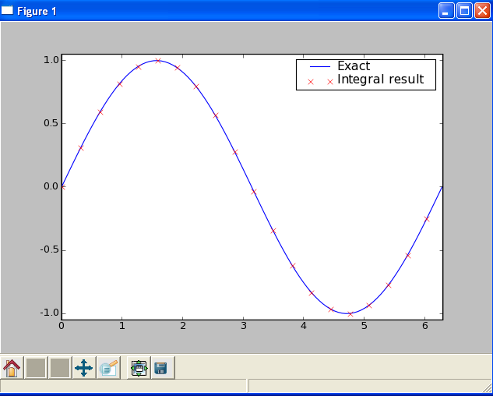
Integration
scipy.integrate --- Example
# Compare sin to integral(cos)
>>> def func(x):
return integrate.quad(cos,0,x)[0]
>>> vecfunc = vectorize(func)
>>> x = r_[0:2*pi:100j]
>>> x2 = x[::5]
>>> y = sin(x)
>>> y2 = vecfunc(x2)
>>> plot(x,y,x2,y2,'rx')
>>> legend([‘Exact‘,
... ‘Integral Result’])
Notes:
# compute short-time FFT
# compute short-time FFT # compute short-time FFT

Slide 79
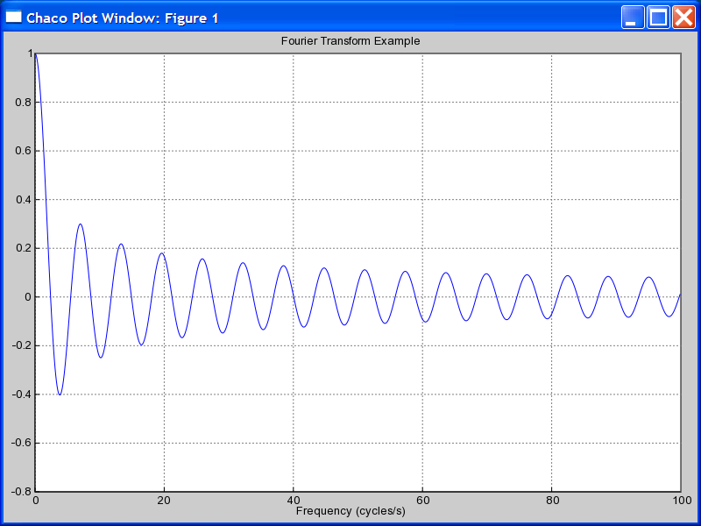
Special Functions
scipy.special
Includes over 200 functions:
Airy, Elliptic, Bessel, Gamma, HyperGeometric, Struve, Error, Orthogonal Polynomials, Parabolic Cylinder, Mathieu, Spheroidal Wave, Kelvin
FIRST ORDER BESSEL EXAMPLE
>>> from scipy import special
>>> x = r_[0:100:0.1]
>>> j0x = special.j0(x)
>>> plot(x,j0x)

Slide 80
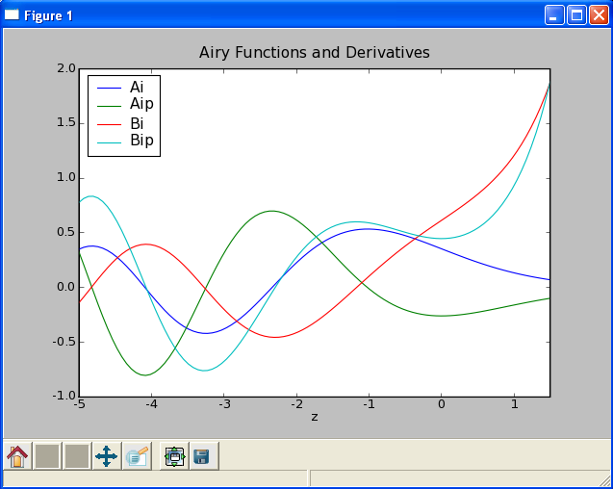
Special Functions
scipy.special
AIRY FUNCTIONS EXAMPLE
>>> z = r_[-5:1.5:100j]
>>> vals = special.airy(z)
>>> plot(z,array(vals).T)
>>> legend(['Ai', 'Aip', ‘Bi‘,'Bip'])
>>> xlabel('z’)
>>> title('Airy Functions and Derivatives‘)

Slide 81
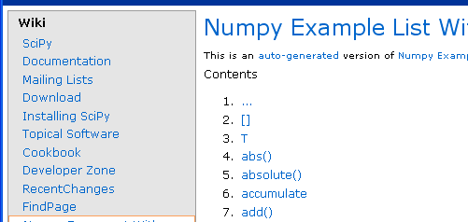
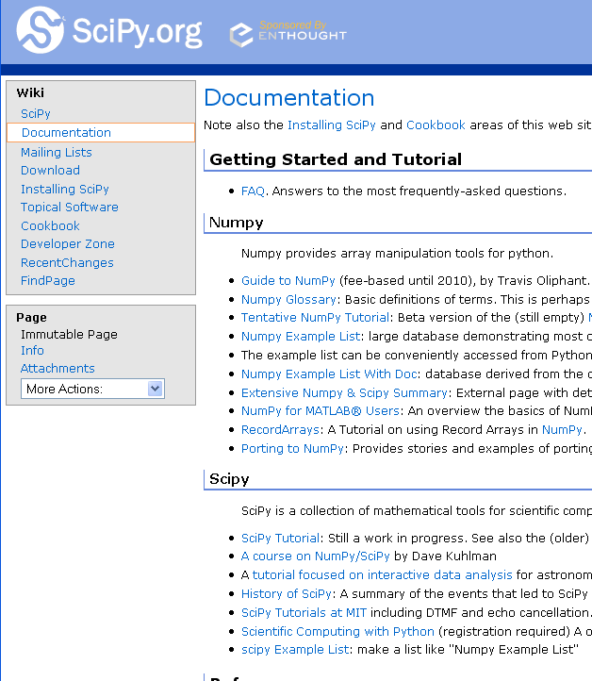
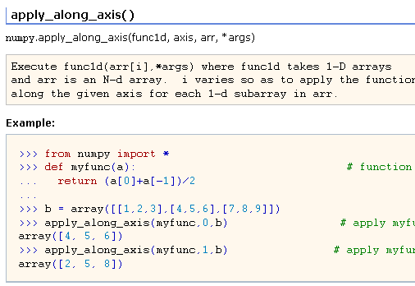
Helpful Sites
SCIPY DOCUMENTATION PAGE
NUMPY EXAMPLES
http://www.scipy.org/Documentation
http://www.scipy.org/Numpy_Example_List_With_Doc

Slide 82
PyLab
Sometimes the union of the 5 packages is called pylab: ipython -pylab.
Literally 1000's more modules/packages for Python
PMV
PIL
IPython
MayaVi
VTK
SciPy
Matplotlib
DejaVu
RPy
NumPy
PMV
ETS
ViPEr
MolKit
Python
Pygame

Slide 83




Extras: MayaVi
Prabu
Ramanchandran

Slide 84

Extras: Enthought Tool Suite
http://www.enthought.com
http://code.enthought.com

Slide 85
You can get involved
New algorithms in SciPy
Documentation improvements
Community interaction (mailing lists and bug tracker)
SciPy conference 2008 at Caltech in Pasadena, CA (August 19-24)
http://www.scipy.org

