Slide 1
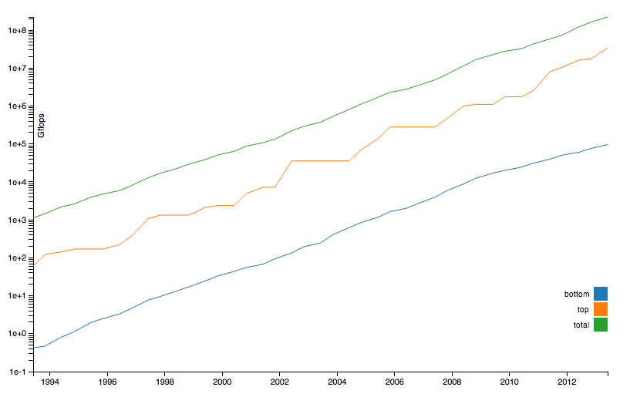
Technology Trends

Slide 2
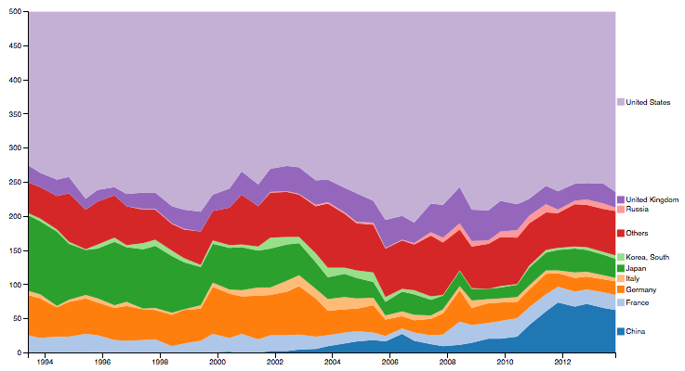
Who Uses Supercomputing?

