Slide 1
Athena: a micro
programming language
Bahawal Baloch CS171032
Mohammad Raza CS171064

Slide 2
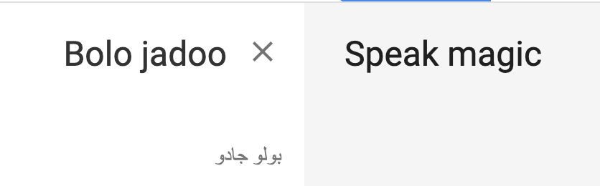
Why Roman Urdu?
To engage young minds in programming regardless of their educational background.
A language easy to understand and build programming concepts.
Roman urdu is inherently easy to understand for native and non-native speakers both.

Slide 3
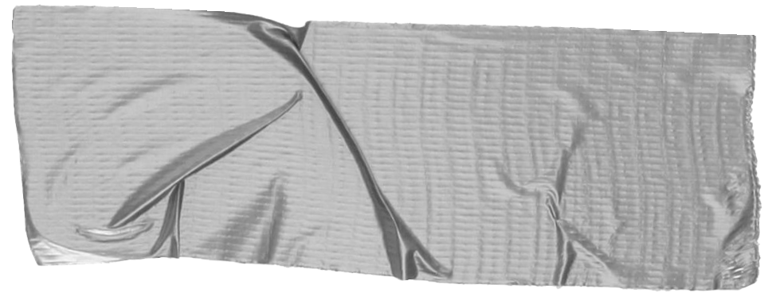

Tokens
➔ Print/Scan
Bolo “Bahawal”
Pocho naam
➔ Conditional
Agar (if)
Warna (else)
➔ Loop
dubara N
ruko (break)

Slide 4
Regex
➔ identiﬁer
[a-zA-Z]+
➔ number
-?[0-9]+(\.[0-9]+)?
➔ string
\”([^\\\”|\\.])*\”
➔ operator
\+|\-|\=|\*|\/

Slide 5
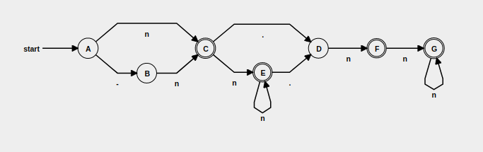
DFA Number
n->-?[0-9]+(\.[0-9]+)?

Slide 6
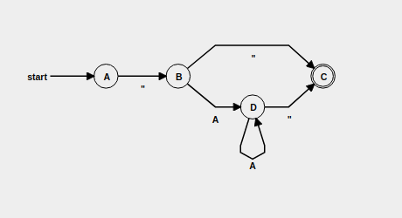
DFA string

Slide 7
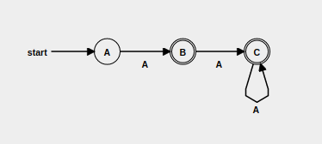
DFA Identifiers
A->[a-zA-Z]

Slide 8
Thank you!
Any suggestions?

