Slide 1
Programming with WebGL

Slide 2
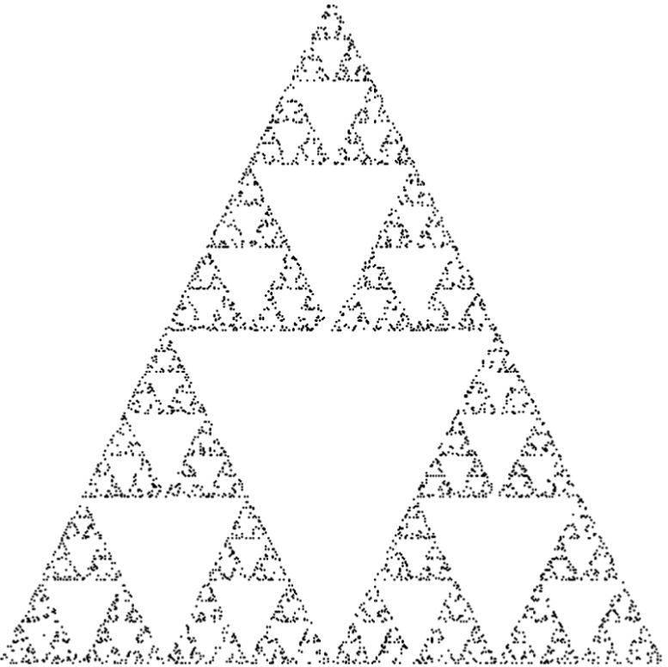
Sierpinski Gasket
( 0.0, 1.0 )
( -1.0, -1.0 )
( 1.0, -1.0 )

Slide 3
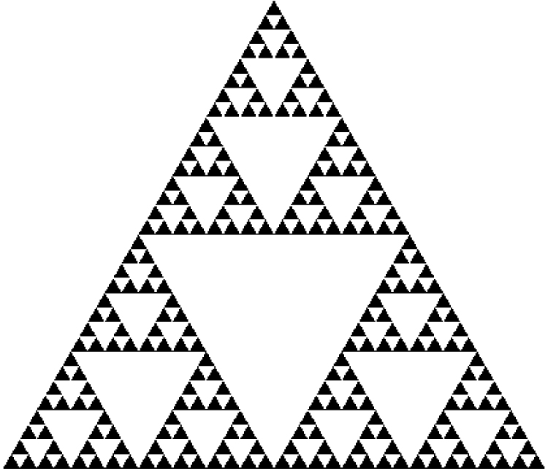
Sierpinski Gasket
( 0.0, 1.0 )
( -1.0, -1.0 )
( 1.0, -1.0 )

Slide 4
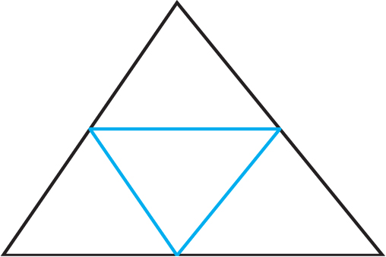
2D Gasket with Recursion
function divideTriangle( a, b, c, count )
{
if ( count === 0 ) {
triangle( a, b, c );
}
else {
var ab = mix( a, b, 0.5 );
var ac = mix( a, c, 0.5 );
var bc = mix( b, c, 0.5 );
--count;
divideTriangle( a, ab, ac, count );
divideTriangle( c, ac, bc, count );
divideTriangle( b, bc, ab, count );
}
}
b
ab
bc
a
ac
c

Slide 5
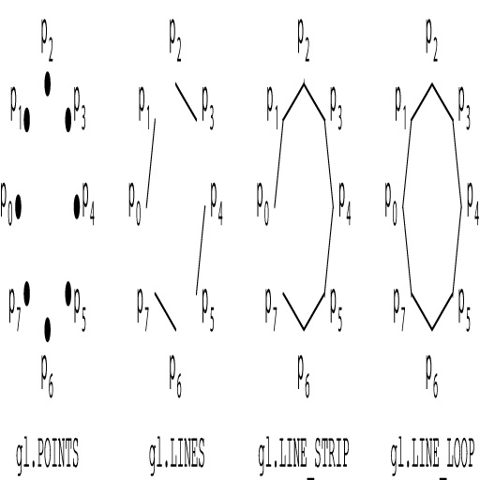
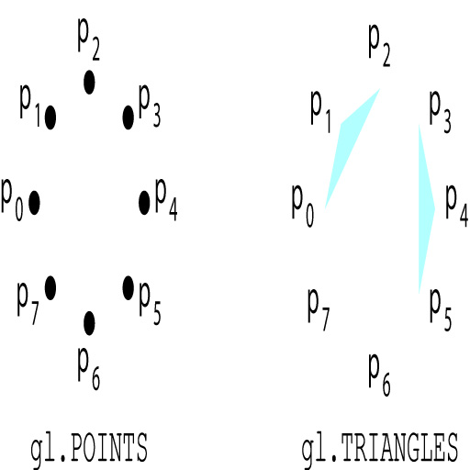
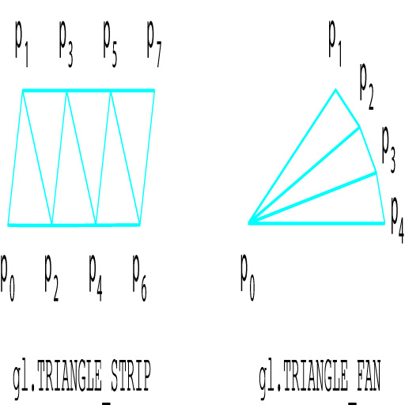
gl.drawArrays

Slide 6
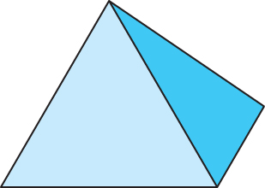
3D Gasket

Slide 7
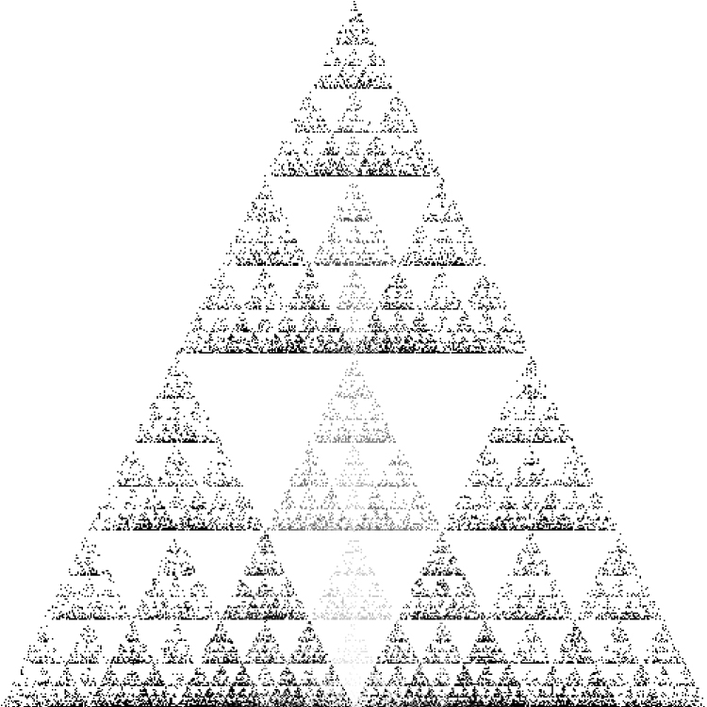
3D Gasket using Points
* See gasket3.js
* See gasket3.js

Slide 8
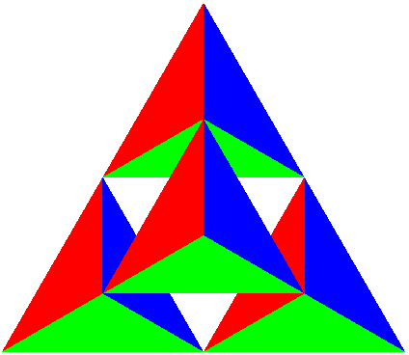
3D Gasket using Polygons
b
ab
bc
bd
a
ac
ad
c
cd
d

Slide 9
Hidden Surface Removal
glEnable( gl.DEPTH_TEST );
gl.clear( gl.COLOR_BUFFER_BIT | gl.DEPTH_BUFFER_BIT );

Slide 10
Vertex Shader
attribute vec3 vPosition;
attribute vec3 vColor;
varying vec4 color;
void
main()
{
gl_Position = vec4(vPosition, 1.0);
color = vec4(vColor, 1.0);
}

Slide 11
Fragment Shader
precision mediump float;
varying vec4 color;
void
main()
{
gl_FragColor = color;
}

Slide 12
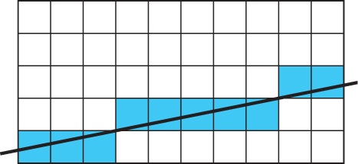
Rasterization
Vertex attribute vs. Fragment attribute

Slide 13
Assignments
Project #1: First WebGL program-Draw the Koch snowflake
Read related sections in Chapter 2

