Slide 1

DrivePro - Automobile Dealer Management System
Team 1
Chitra Periya 002893640
Rachita Shah 002482615
Siddharth Bahekar 002417718

Slide 2
Agenda
Objectives
Requirement Collection
Conceptual Modelling
Logical Modelling
Physical Database Design
Entity-Relationship Diagram
Queries
Applications
Challenges
Summary

Slide 3
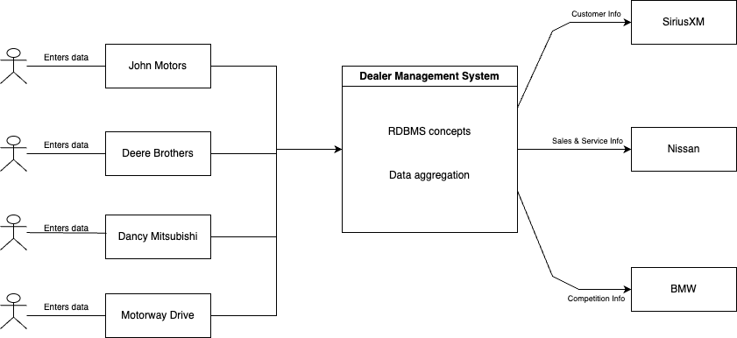

Objective
The main objective of the system is:
Streamline dealership operations
Adapt to the increasing volume of data generated
Provide actionable insights
Tools & Techniques
Oracle SQL
Visual Paradigm
RDMS Concepts

Slide 4
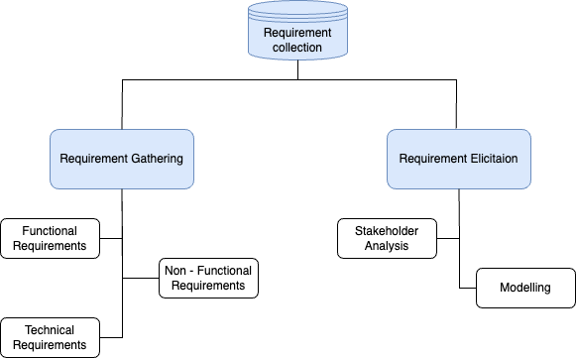
Requirements Collection

Slide 5
Requirement Gathering
Functional Requirements
Enrolments: Performed CRUD operation on vehicle, customer, employee, dealership, etc..
Validations: Enforced data and referential integrity using constraints and ensured data accuracy
Documentation: Maintained formal documentation and revised it in cycles
Non-Functional Requirements
Scalability
Usability
Maintenance

Slide 6
Requirement Elicitation
Stakeholder Analysis
Identified needs and expectation by doing online research on existing systems
Analyzed what data needs to be captured, stored, and managed by the system
Applied expertise and pitched ideas based on previous work experience
Modelling
Conceptual Modelling
Logical Modelling
Physical Database Design

Slide 7
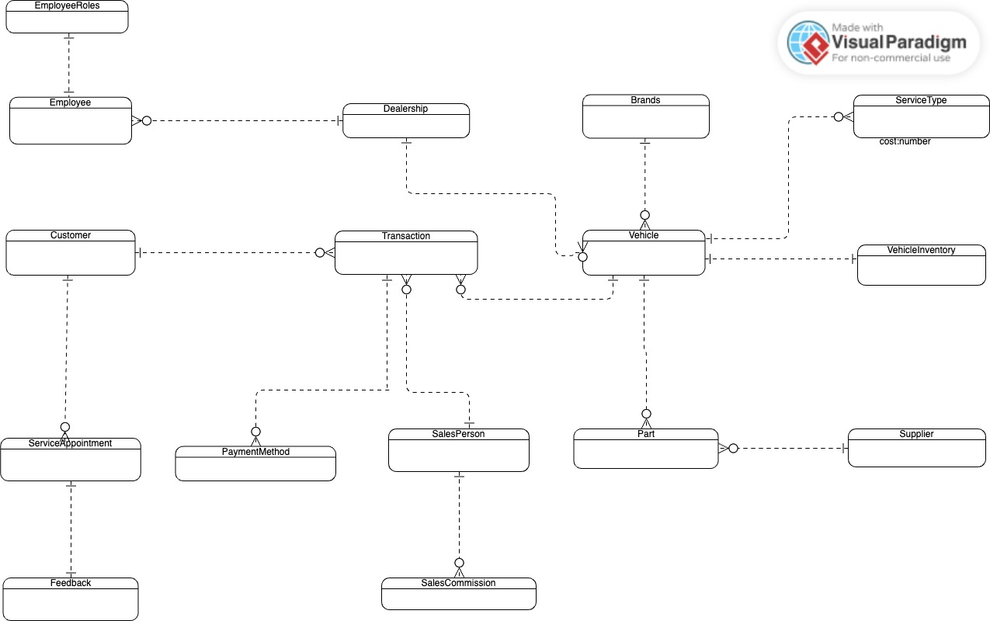
Conceptual Modelling

Slide 8
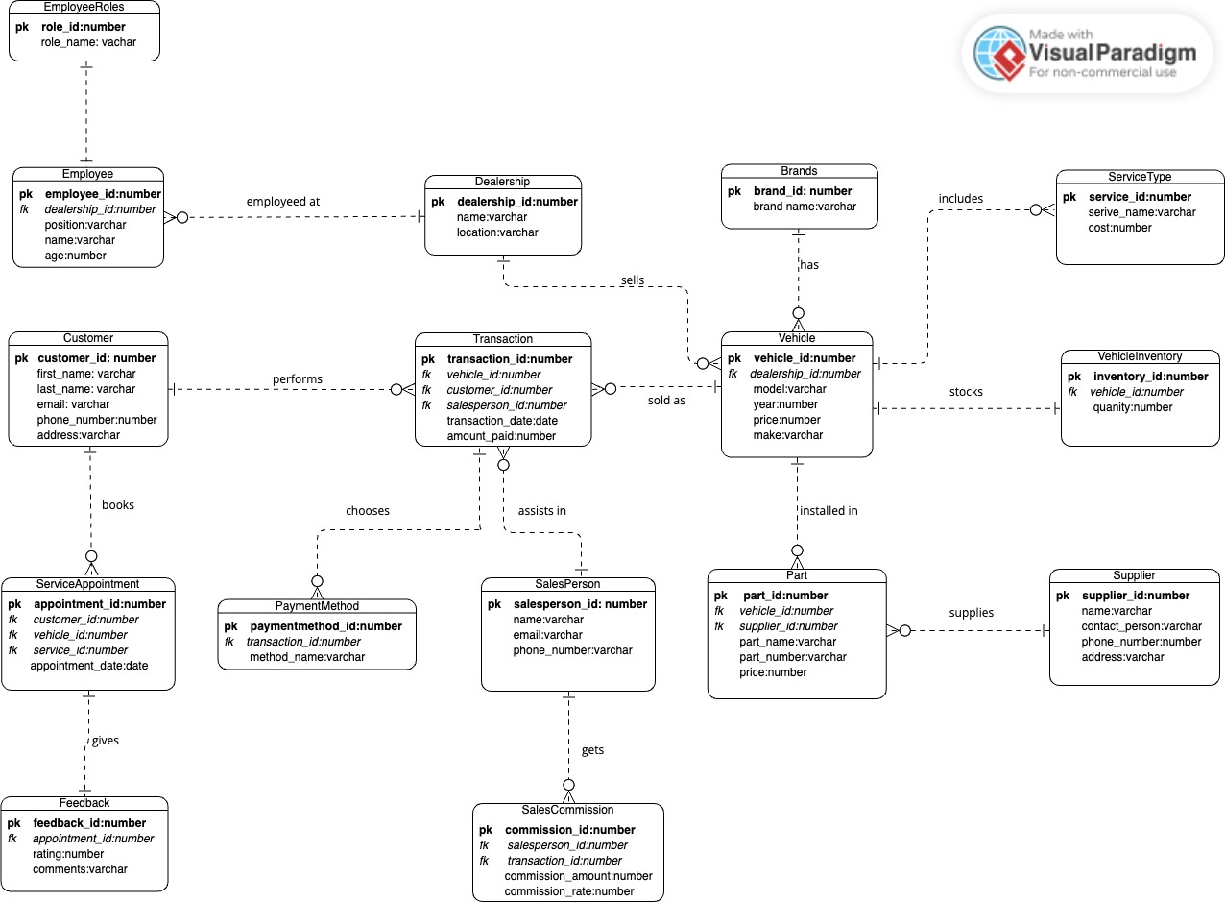
Logical Modelling

Slide 9
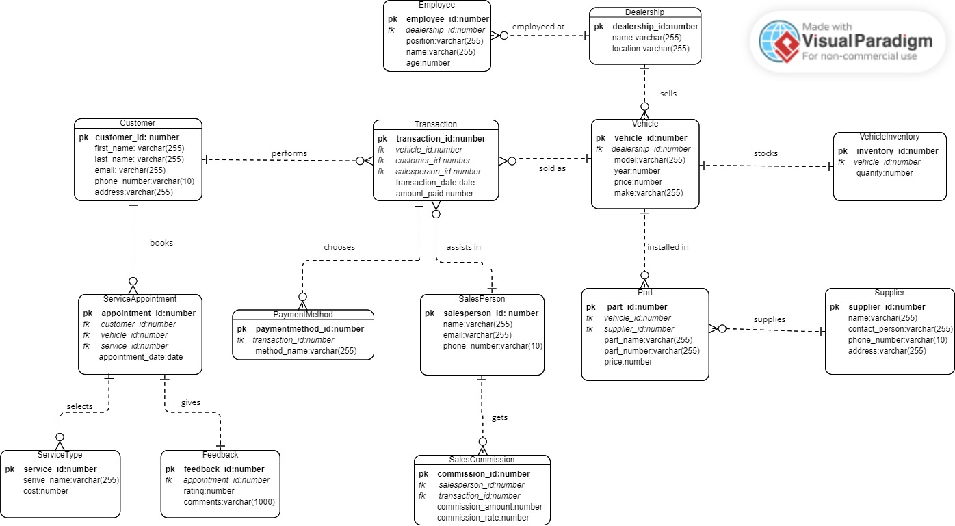
Physical Database Design

Slide 10
Business Rules
Each dealership within the system must have a unique name and location
Feedback ratings must range from 1 to 5 and linked to service appointments
Employee records require a minimum age of 18
Pricing information for parts must be non-negative
Transactions must include a valid date
Employees and Vehicles must be affiliated with a specific dealership
Transactions must involve a vehicle, customer, and salesperson
Service appointments must include a customer, vehicle, and service type
Parts must be associated with a vehicle and supplier
Customers can engage in multiple transactions

Slide 11
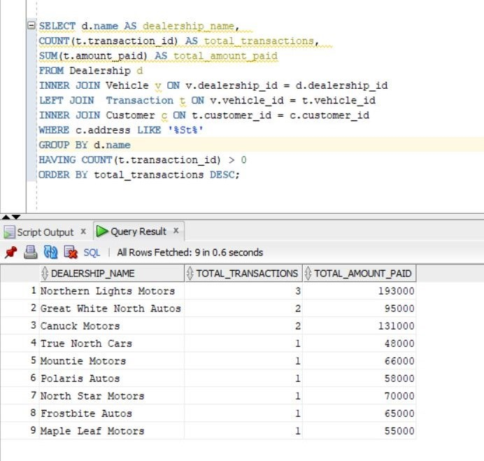
Query 1 – Complex Query
Returns the dealership name, the total number of transactions, and the total income of each dealership

Slide 12
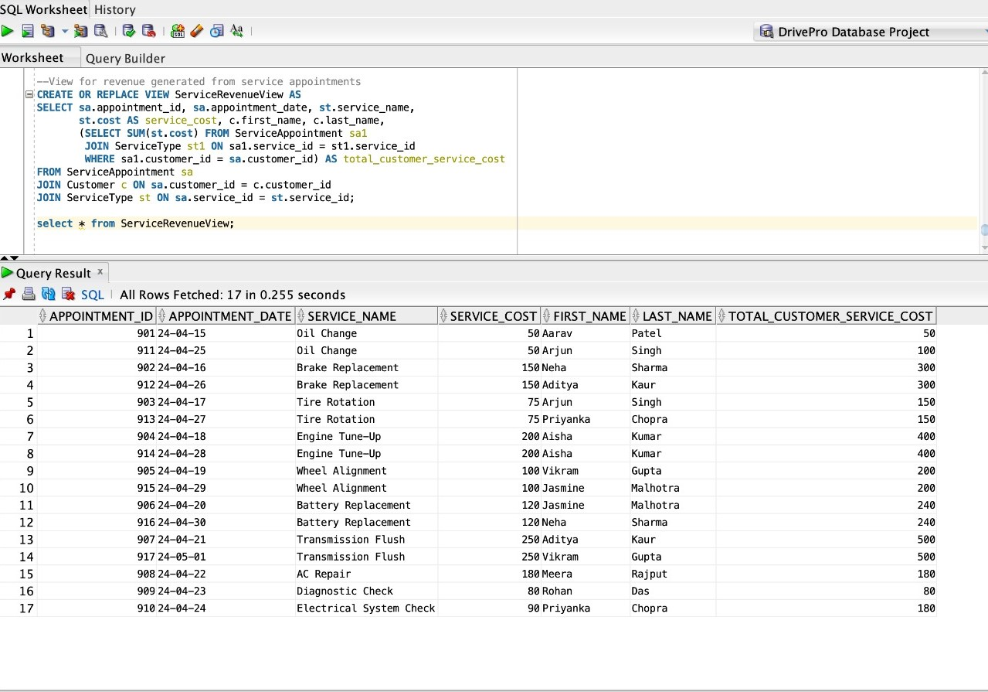
Query 2 - View
Revenue generated from service appointments

Slide 13
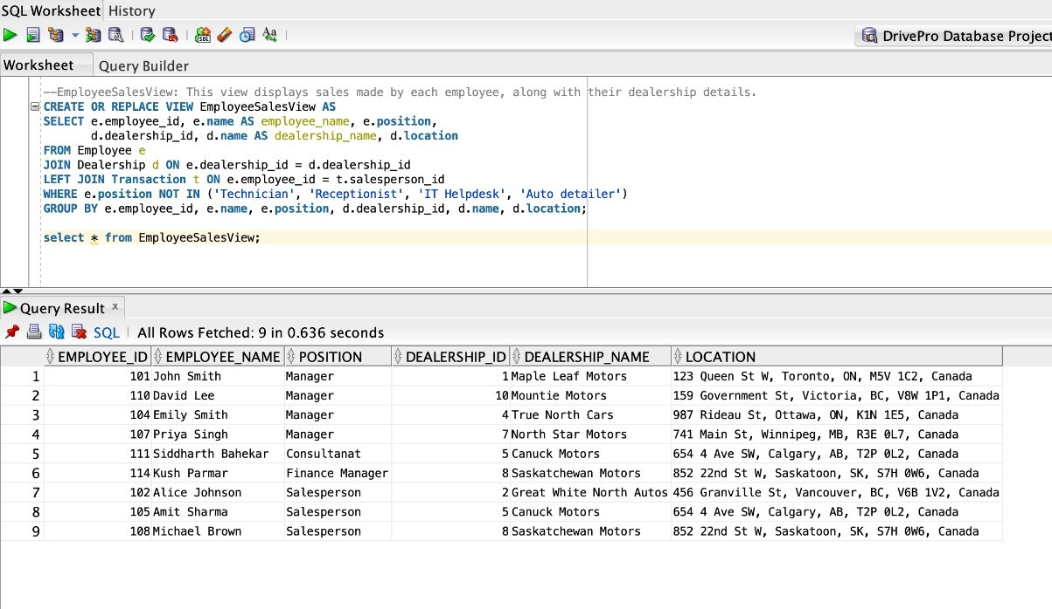
Query 3 - View
Sales made by each employee, along with their dealership details

Slide 14
Applications
Customer Management: Use customer data to improve marketing and service, keeping customers happy and loyal
Employee Management: Monitor employee performance and offer training to boost morale, productivity, and retention
Resource Management: Sales, service, inventory
Feedback Management: Gather feedback, analyze sentiment, and improve to keep customers satisfied and loyal
Revenue Management: Improve forecasting and performance analysis

Slide 15
Challenges
Technical Competency: Dealership staff needs to be trained in order to utilize the application to full extent
Integration: Difficulty in integration with industry due to version discrepancy and standalone nature
Security Concerns: Issues in handling sensitive information such as payment and customer information
Maintenance: Maintaining uniform information is challenging

Slide 16
Summary
Modernize dealer operations with an advanced Automotive Dealer Management System (DMS)
Address sales, inventory, and data challenges to boost efficiency and customer satisfaction
Encompasses requirement gathering, database design, implementation, testing, and maintenance phases
Utilize ERDs, RDBMS, and ETL processes for reliability and scalability
Revolutionize dealership workflows, enhance customer satisfaction, and empower stakeholders with actionable insights for sustained success in the competitive automotive market

