Slide 1

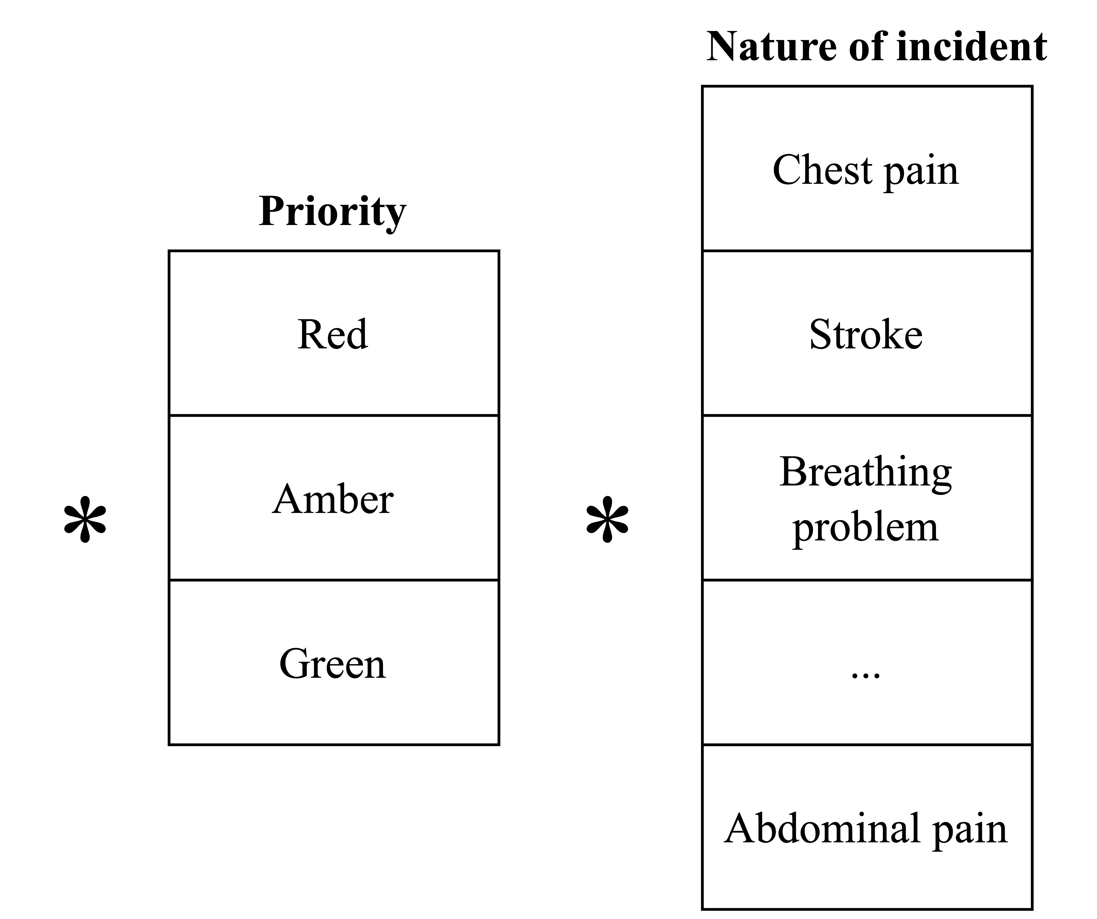
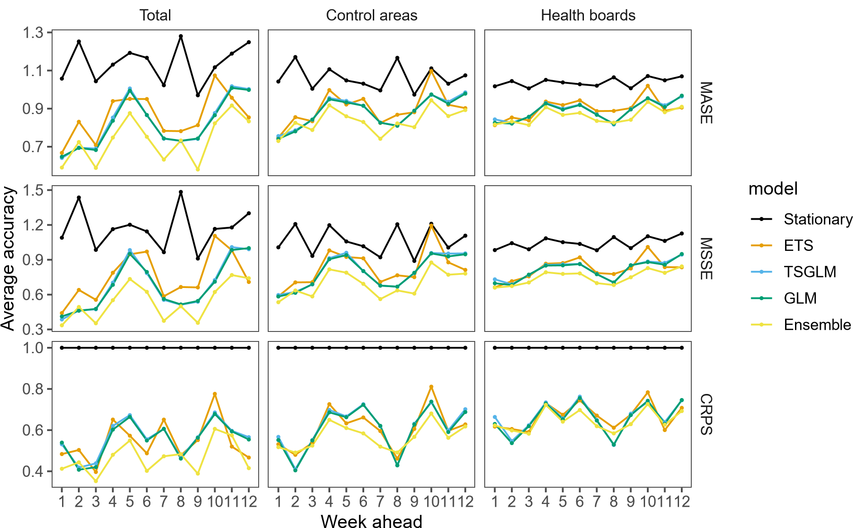
Unlocking Emergency Medical Services potential: enhancing coordination and accuracy through forecast reconciliation
Accurate forecasts of Emergency Medical Services (EMS) demand might be required at national, regional, and sub-regional levels and/or by the nature of incidents and priorities.
Structure of ambulance demand data
EMS demand forecast: A national challenge.
Current practice: Forecasts are produced independently.
Acknowledge uncertainty: Forecast distributions are produced.
Forecast reconciliation: Coherent forecasts across levels.
Benefits: Improved coordination and accuracy.
A graphical illustration of the forecast distribution
Forecast accuracy comparison using CRPS
Forecast accuracy comparison across forecast horizon
Actual
Fitted
Point Forecast
CRPS Base | Stationary | 30.387 | 10.882 | 5.500 | 0.302
Base | ETS | 14.309 | 6.074 | 3.476 | 0.244
Base | GLM | 15.396 | 6.253 | 3.576 | 0.244
Base | TSGLM | 15.316 | 6.227 | 3.575 | 0.245
Base | Ensemble | 12.978 | 5.727 | 3.430 | 0.243
MinT | Stationary | 30.368 | 10.902 | 5.498 | 0.313
MinT | ETS | 13.515 | 5.967 | 3.547 | 0.243
MinT | GLM | 13.839 | 5.917 | 3.453 | 0.246
MinT | TSGLM | 14.000 | 5.947 | 3.455 | 0.248
MinT | Ensemble | 12.585 | 5.728 | 3.426 | 0.247
140
120
Incidents
100
80
Jul 22
Jul 29
Aug 05
Date
Reproducibility and generalization:
Paper is fully reproducible and written using Quarto.
Adherence to reproducibility and transparency principles.
GitHub repository is accessible to public.
Proposed framework can be adapted to other service sectors.
Call to Action
Learn more about the paper and implement the proposed framework. Full paper and all r codes available at https://github.com/bahmanrostamitabar/forecasting-emergency-medicine

