Slide 1

Promote your local food business and farmers markets.
Contact:
Founder/CEO – Bilal Ahmed
bilal@mytweetmark.com
http://www.homecook.me
on @twitter: http://twitter.com/homecookme
http://twitter.com/mytweetmark

Slide 2

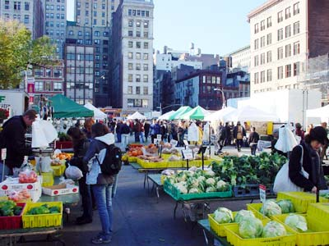
What's the problem, farmer?
Farmers markets are new to United States hence most of the small individual businesses that sell products and items don't have social media profiles, email or Internet accounts!!!
Opportunity:
According to the USDA, It's over $1 billion industry, over 16% growth in United States in the past year (2009-2010) and over 6100 farmer markets!

Slide 3
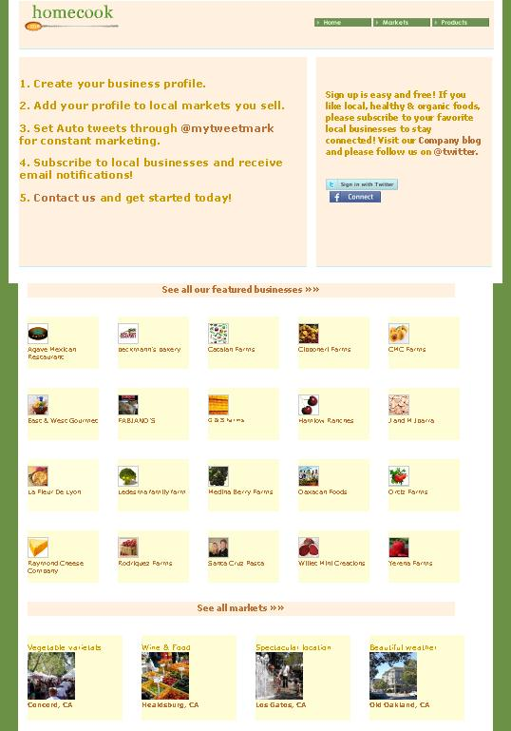
Homepage:
Twitter Authentication or
Facebook Connect
Featured farmers.
Featured farmers markets.
Featured products.
Customer testimony videos.
Map of farmers markets.

Slide 4
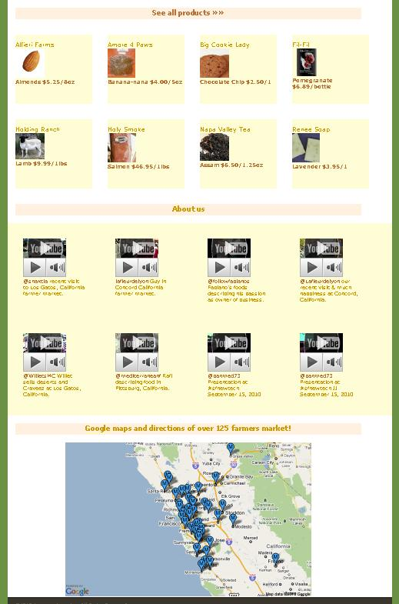
Homepage:
Twitter Authentication or
Facebook Connect
Featured farmers.
Featured farmers markets.
Featured products.
Customer testimony videos.
Map of farmers markets.

Slide 5
Features:
Create your profile.
If business, add yourself to local farmers markets.
Write blogs.
Write recipes.
Create information links.
Subscribe to local business and receive email notifications, deals and coupons.
Search for food products and items.
Navigate local farmers markets.
Google maps to farmers markets location.
Navigate business Twitter profiles and contact them.

Slide 6
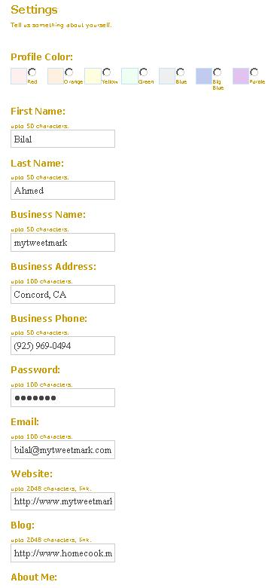
Your Profile:
Your profile information helps others to know more about you or your business. Fill in:
Color
Name
Business name.
Phone.
Address.
Website.
Blog.
About me.
Other private info.

Slide 7
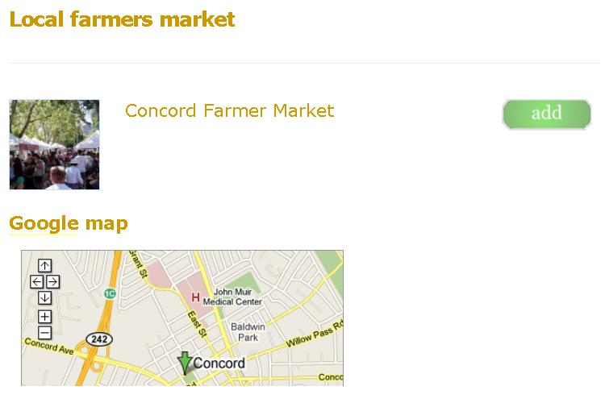
If you are a business, please add yourself to the local farmers market. Your business will appear within the market listing for navigation:
Click the 'add' button.

Slide 8
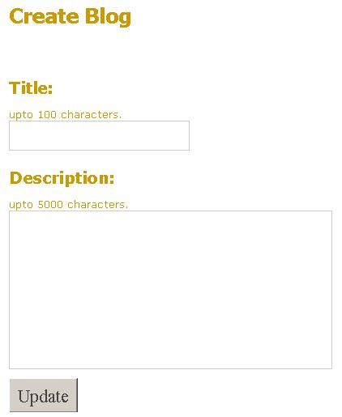
Create a blog, enter:
Title.
Description.
Click the 'Update' button.
You can also edit and delete blogs from the main profile screen.

Slide 9
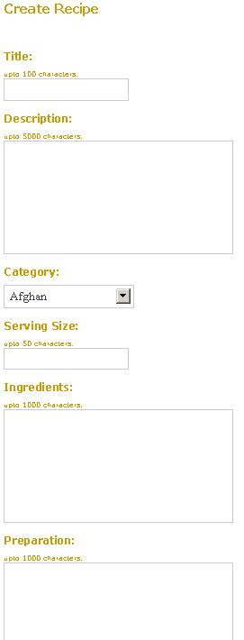
Create a recipe, enter:
Title.
Description.
Category.
Serving size.
Ingredients.
Preparation.
Recipe source.
Serving recommendation.
Story.
Click the 'Update' button.

Slide 10
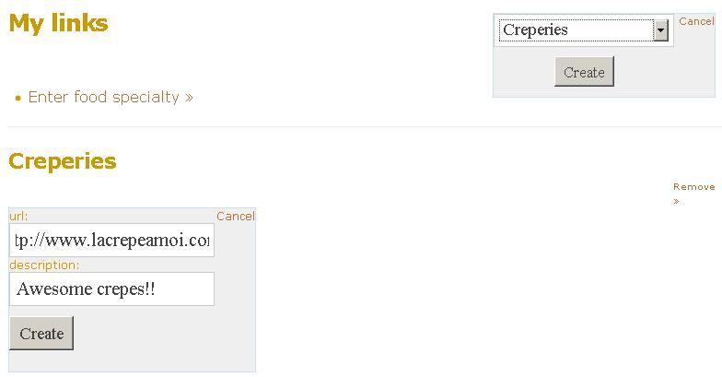

Create Information links:
Share categorized information Internet links with others, e.g. food specialty Creperies, business link www.lacrepeamoi.com and description 'Awesome Crepes!!'
Click the 'Create' button.

Slide 11
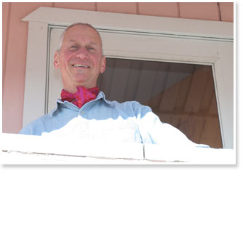
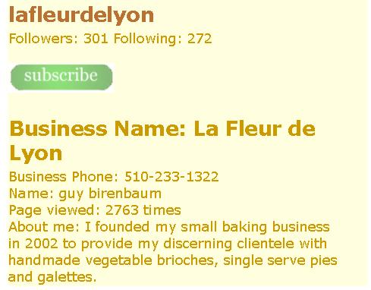

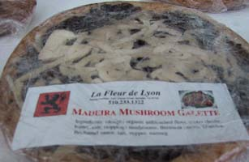
Subscribe to your favorite local businesses:
Please make sure to enter your email address before subscribing to a business.
Subscriptions will keep you informed on local business notifications, coupons and deals.
Click the 'subscribe' button.

Slide 12
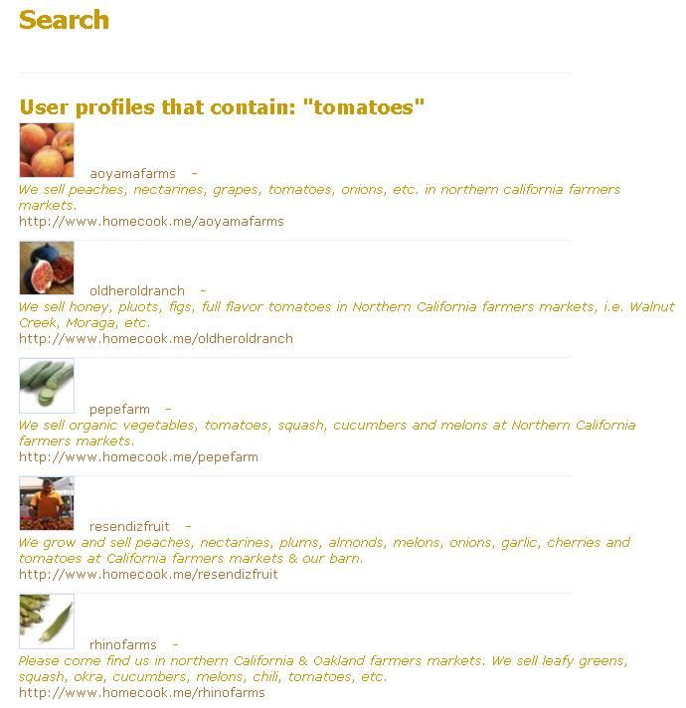
Search:
Search for your favorite farmers market products and items.
Connect with them through @twitter.
Click on 'Search' from main logged in profile page.

Slide 13
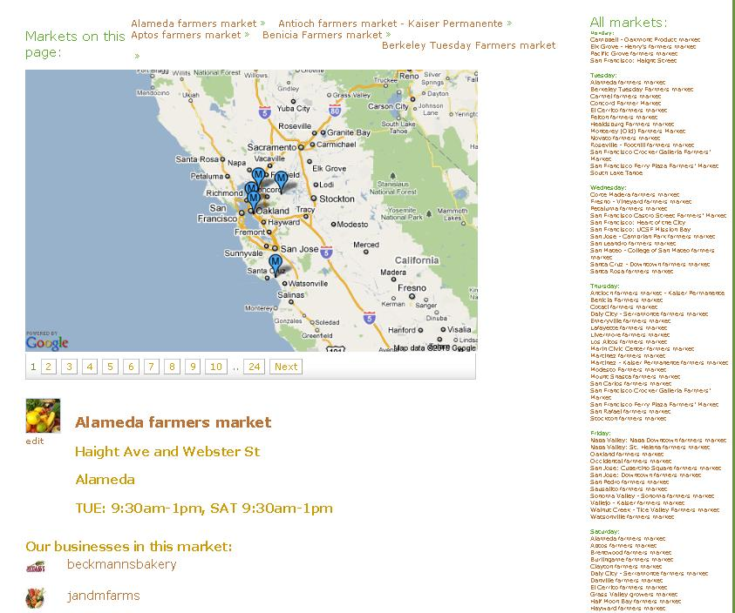
Navigate farmers markets:
Google maps.
Web 2.0++ look and feel.
Farmer market listing by day.
Businesses within market.
Address.

Slide 14
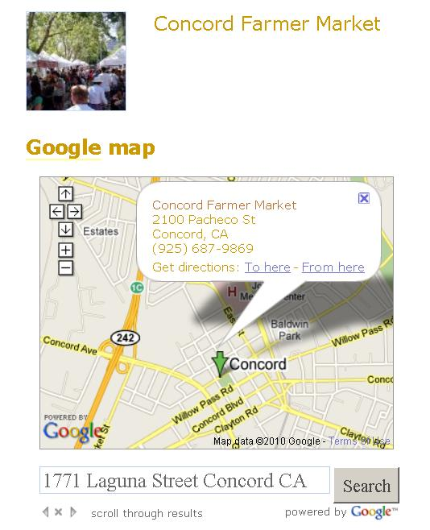
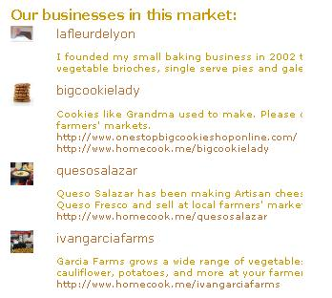
Interactive location map of farmers markets:
Google maps.
Direction from and to.
Each market also contains list of local businesses selling within.

Slide 15
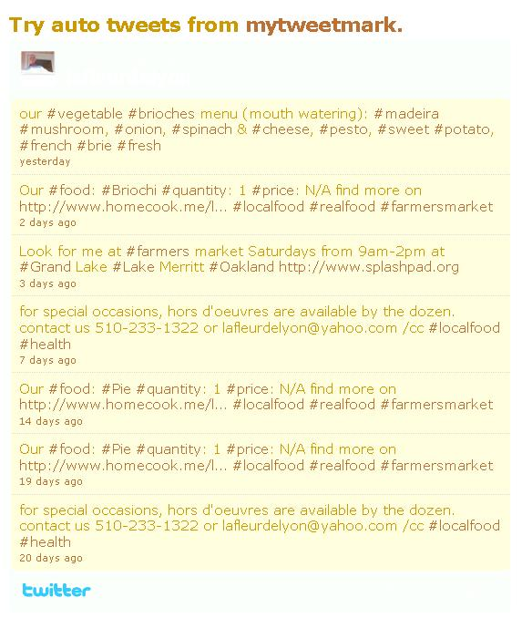
Auto tweets through @mytweetmark on Twitter so over 100 million users can see our customers and be found on Google Search:
Market location.
Product price, quantity and category.
Tags, e.g. #cheese, #farmersmarket, #oakland, #localfood, #realfood, #buylocal, #california, #local, #socialmedia, #fb, #spinach, #chicken, #beef, #carrot, etc. which allows other people to find you on @twitter through search, and google search as well.
Contact phone number.

Slide 16





Competition Analysis – The other helpful food organizations and companies:
Foodzie.
Foodspotting.
Pacific Coast Farmers market association.
Urban Village.
California farmers market association.
Marin Agricultural Institute.
However, NOBODY is so focused on a LARGE scale farmers markets geographic area and their local businesses with social media like us!!
Contact:
Founder/CEO – Bilal Ahmed
bilal@mytweetmark.com
http://www.homecook.me
on @twitter: http://twitter.com/homecookme
http://twitter.com/mytweetmark

