Slide 1
Features Introduction
mytweetmark.com

Slide 2
Long-term Goal
mytweetmark allows you to share your bookmarks, posts and blogs on twitter and facebook. We provide analytics to our users that helps them determine page views and traffic generated through twitter and facebook activities.

Slide 3
Fulfilling
Customer Needs
Product features: Use Twitter oauth or facebook connect to access. Create bookmarks, posts and blogs. User analytics to determine page views and traffic sources.
Users can use existing accounts to create content. The content is found by other users through hashtags, tweets, feeds and mytweetmark community.

Slide 4
Strengths and Advantages
Users can categorize content.
The tweets or feeds contain a link back to the user profile.
Custom hashtags are supported.
Free internet marketing through twitter.
Tweets are high priority on Google real-time search results.

Slide 5
Next Steps of Action
Analyze feeds and tweets.
Find patterns that are useful to users.
Create many viral features e.g. last 10 links posted on twitter or facebook.
Identify paid features.
Integrate with paypal.
Continue to focus on user virality/retention.

Slide 6
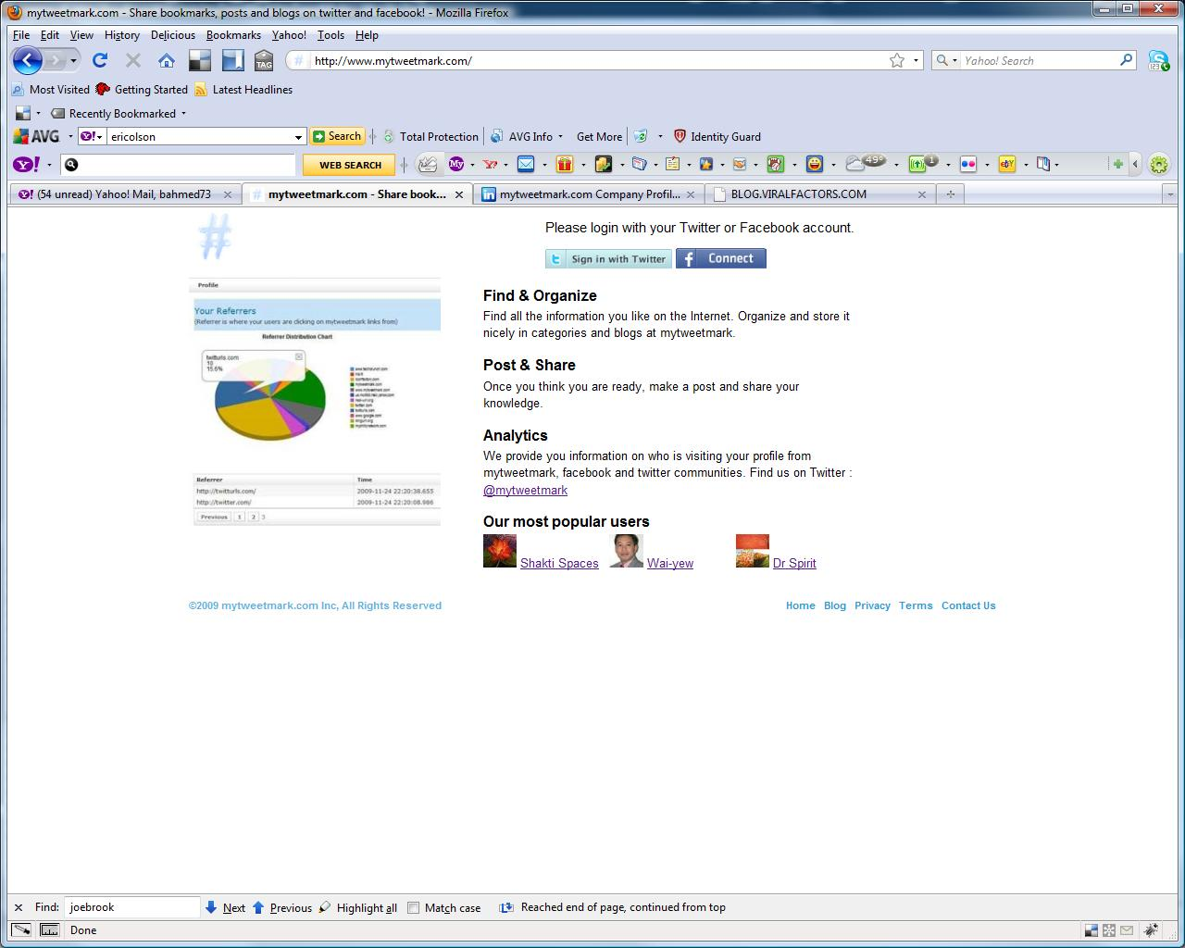
Homepage

Slide 7
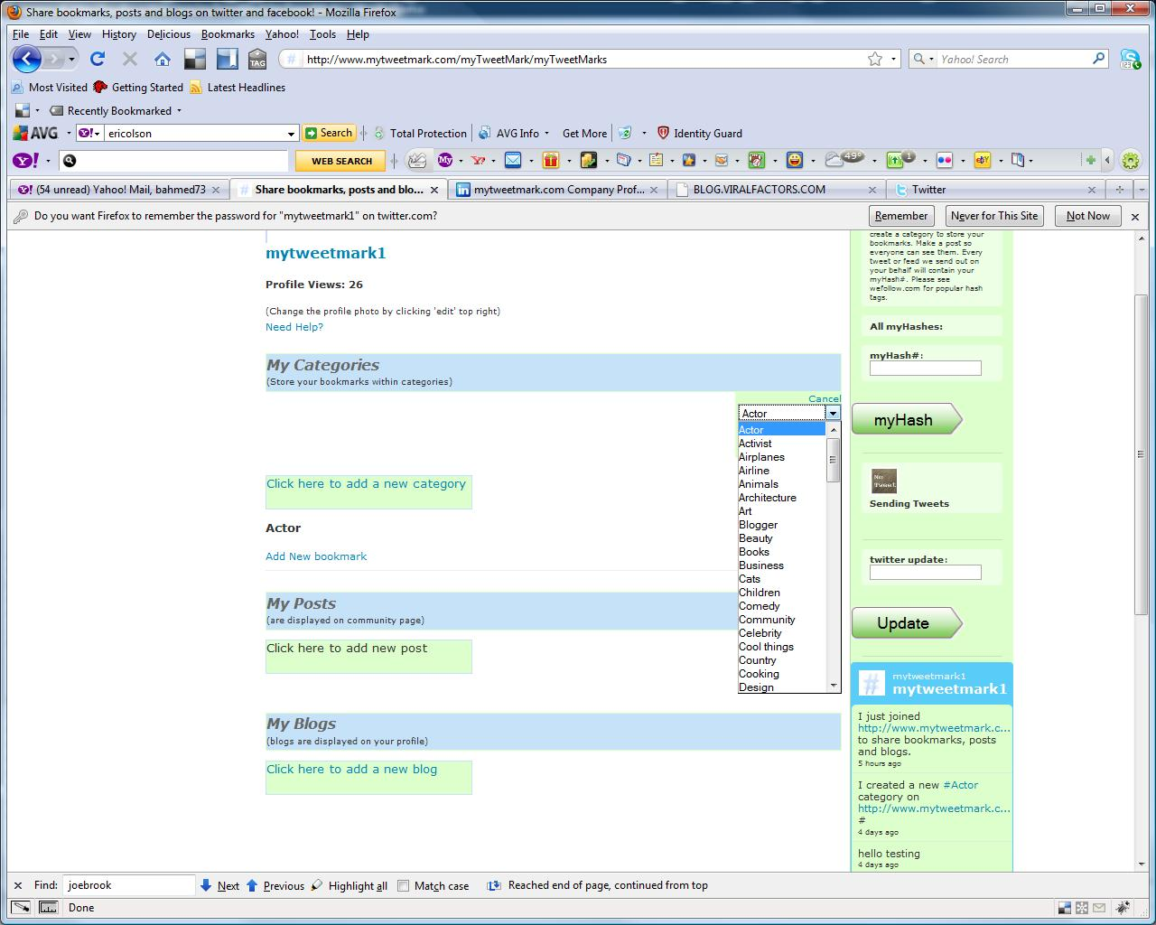
User Dashboard

Slide 8
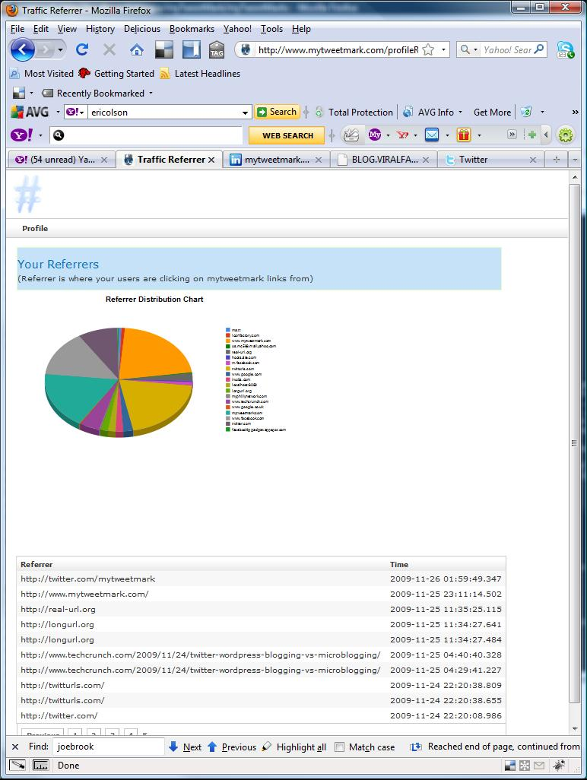
Analytics

Slide 9
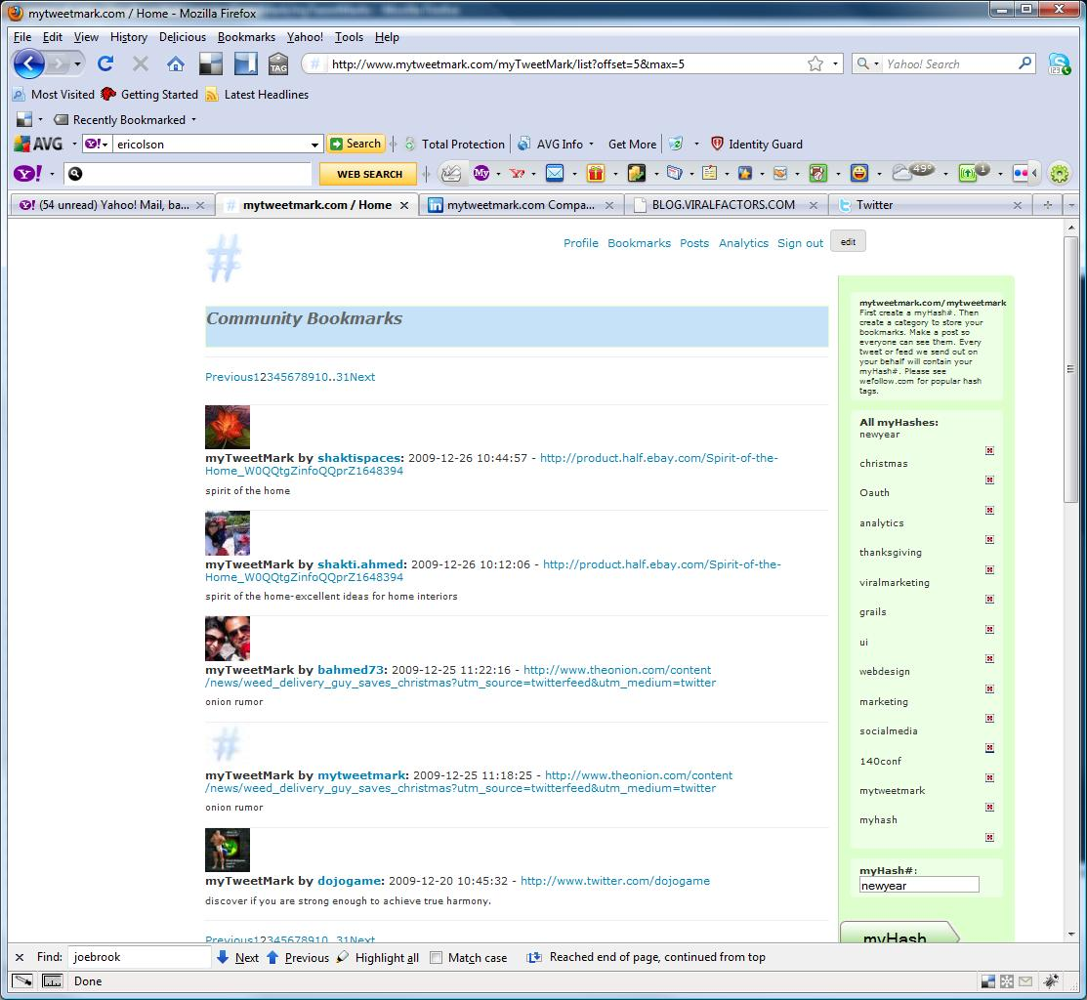
Community Bookmarks

Slide 10
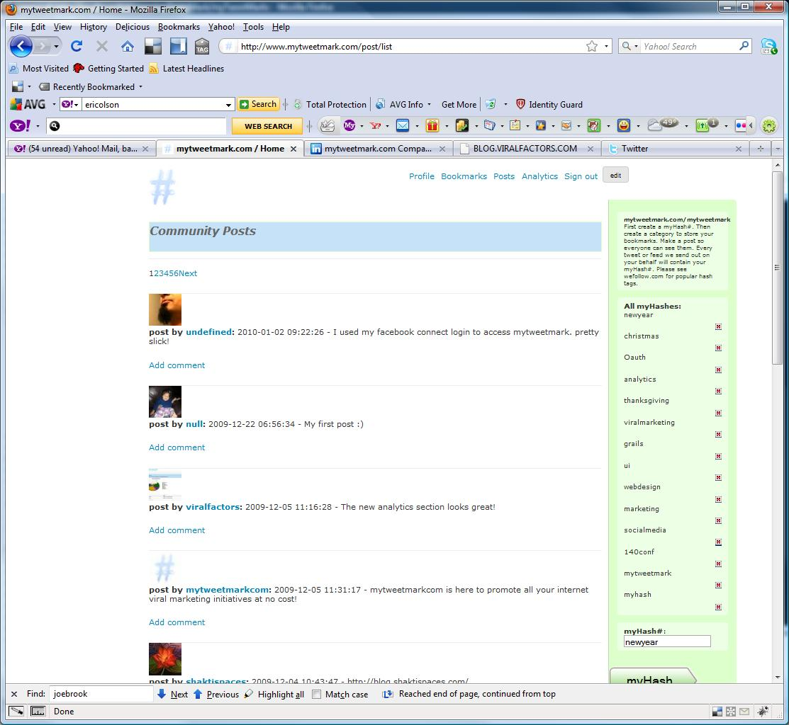
Community Posts

