Slide 1

Mytweetmark is a platform of web 2.0 technologies and services that helps customers reach out to larger audience and customers while increasing followers on Twitter.

Slide 2

Facebook Access
Facebook has over 400,000,000 users and they are growing.
Facebook connect feature allows you to login with facebook account
Click "Like" and “comment” on a business profile and the status message will appear on Facebook with correct notifications with a link back to mytweetmark brand profile.

Slide 3
Twitter Access
Twitter has over 100,000,000 users and they are growing.
The Twitter connect feature allows you login with Twitter oAuth, a secure protocol.
Any content created on mytweetmark is tweeted as status on the Twitter business account for viral marketing.

Slide 4
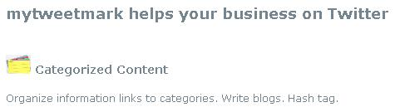
Categorized Content
Business links – Store valuable information links for your business.
Blogs – Share content and pictures.
Twitter hash tags – Custom and weighed tags on Twitter to increase reach and audience.

Slide 5
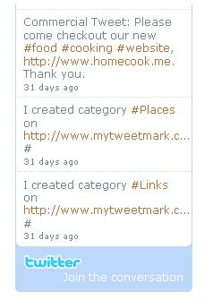
Scheduled Tweets
Tweets allow link back to business profile and create brand awareness.
Daily, weekly and monthly tweets.
Choose from low, medium and high frequency.
Schedule priority.

Slide 6
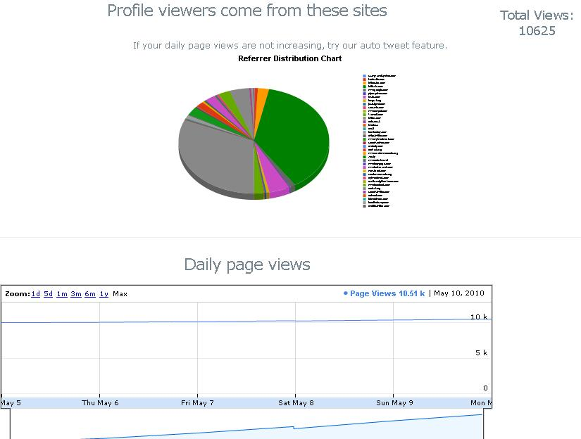
Analytics
Graphic chart distribution from which websites the brand customers are visiting
Daily graphical page views (count) of brand page visited by customers
Custom analytics

Slide 7
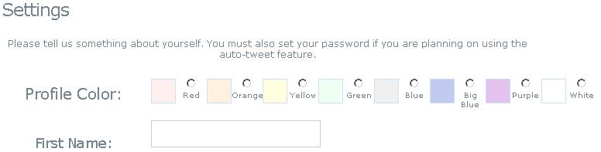
Brand Skins
8 colors available for brand business profile customization.
Custom skins option also available.

Slide 8

Feed Analyzer
Import business contacts from tweets.
Import links from tweets.
Import valuable hash tags from tweets, etc. conferences.
Additional feed analyzers available on request.

Slide 9
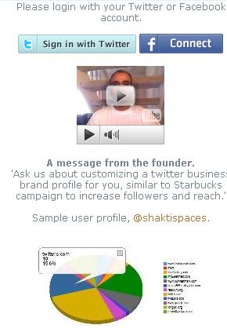
A word from Founder
“Ask us about customizing a twitter business brand profile for you, similar to Starbucks campaign to increase followers and reach.”
- Bilal Ahmed

Slide 10

Next?
Beta program. Users will get FREE subscription.
We are looking to help you! Please contact us at bilal@mytweetmark.com.
Customizations. We can help you customize your profile. Please contact us today.
Need Twitter advice? We would love to help.

