Slide 1

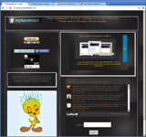
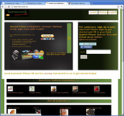
Introduction to @mytweetmark!
Bilal Ahmed
CEO/Founder
http://www.mytweetmark.com
http://www.homecook.me

Slide 2


Markets
@mytweetmark:
  Twitter for business users
  25-30 Million targeted business users
  Social media management system
  Analytics and Services
@homecookme:
  Over 6000 farmers' markets in US
  $1 billion industry, 16% growth in 2010
Competition:
  Flowtown, foodzie, (Pacific Coast) PCFMA

Slide 3
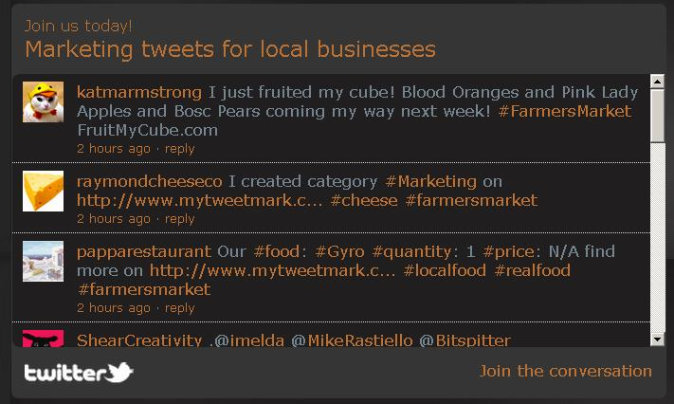
Execution Plan
Intellectual Property: Farmers' markets tweets & work-flow for local businesses
Revenue Driver: $30/month subscription
Scalability: Less hardware overhead with subscriptions business model.

Slide 4
Customer Traction
Revenue: So far free; now offering $30/month subscriptions or refer-a-friend
# of Customers: 150 customers in over 130 farmers' market in Northern California
Sales approach: First month free, then $30/month
Sales cycle: Recurring monthly revenue
Customers very happy! Social media and software development is very expensive!!

Slide 5
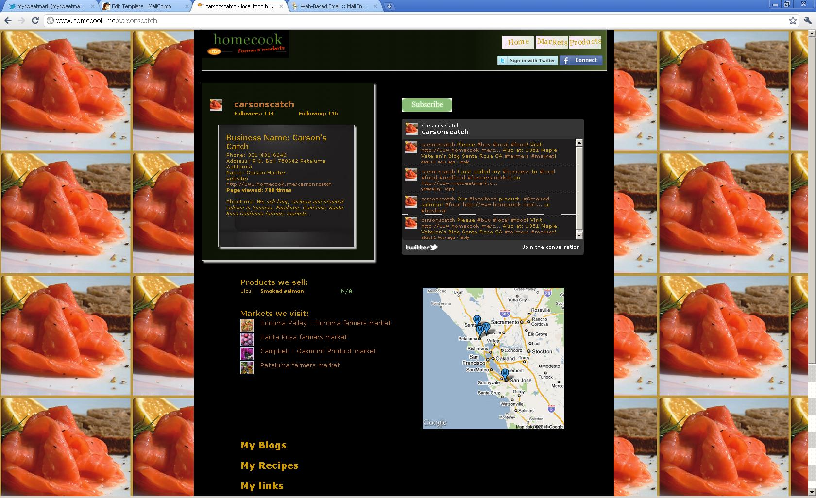
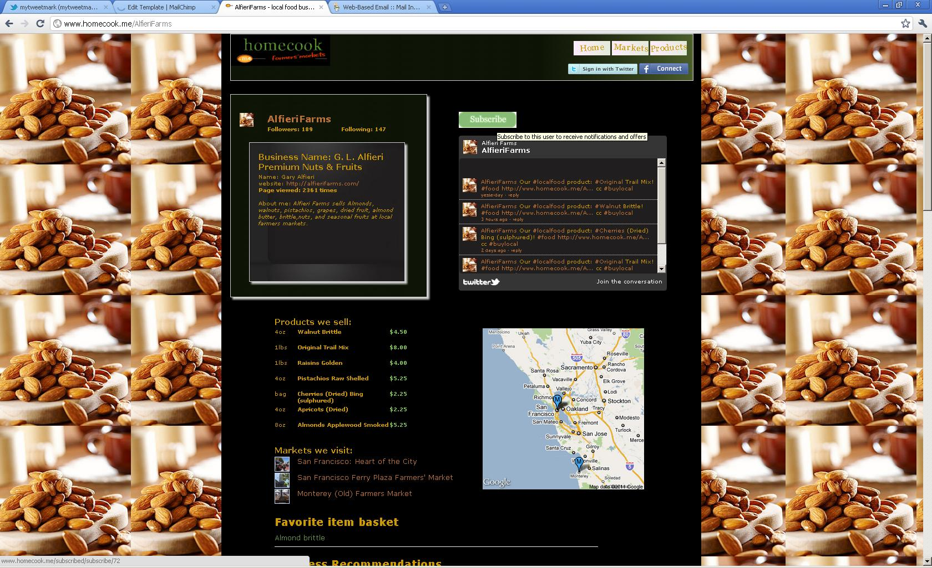




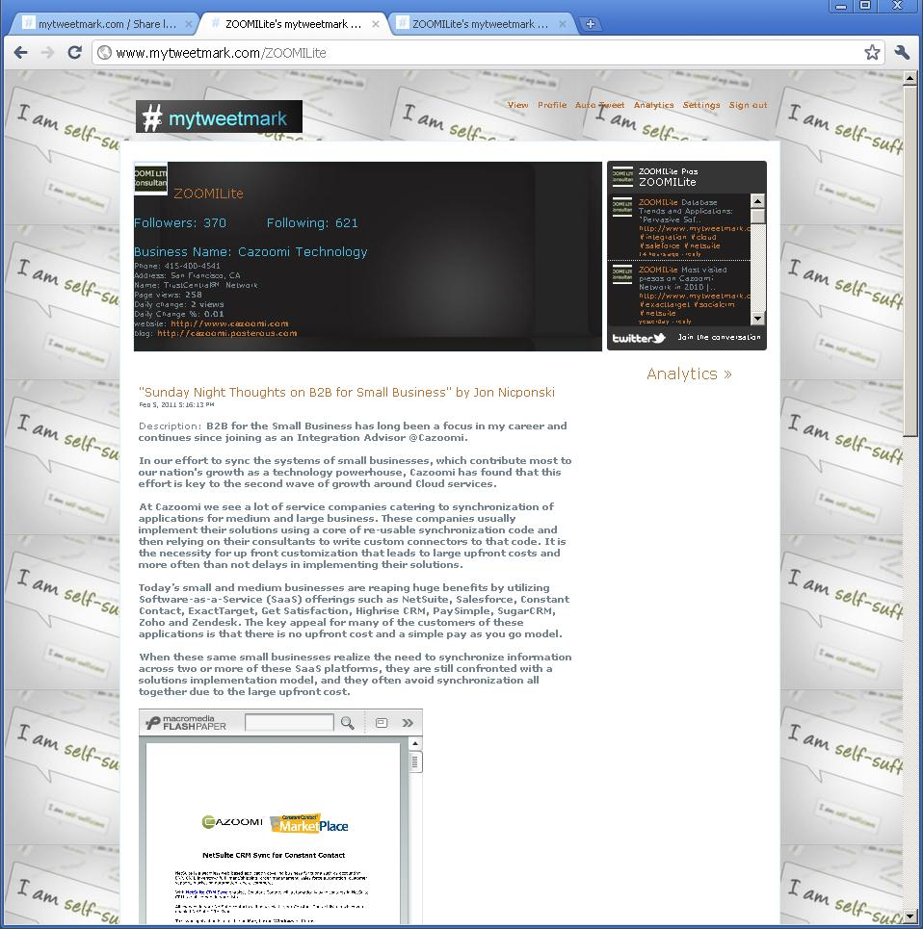
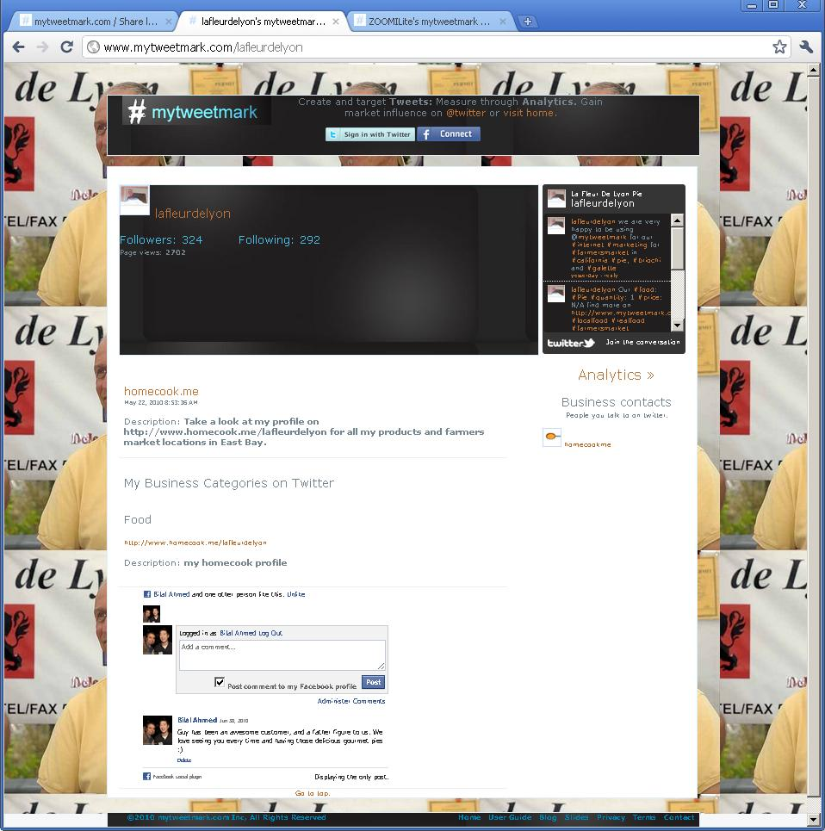
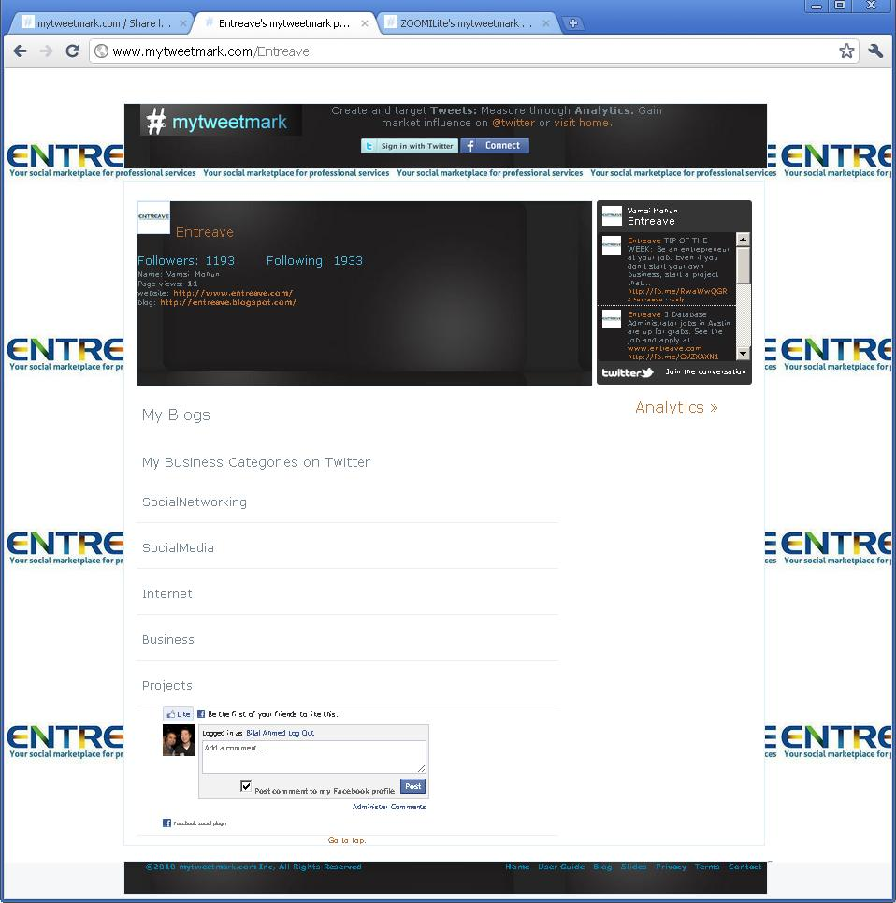
Business customer profiles

Slide 6
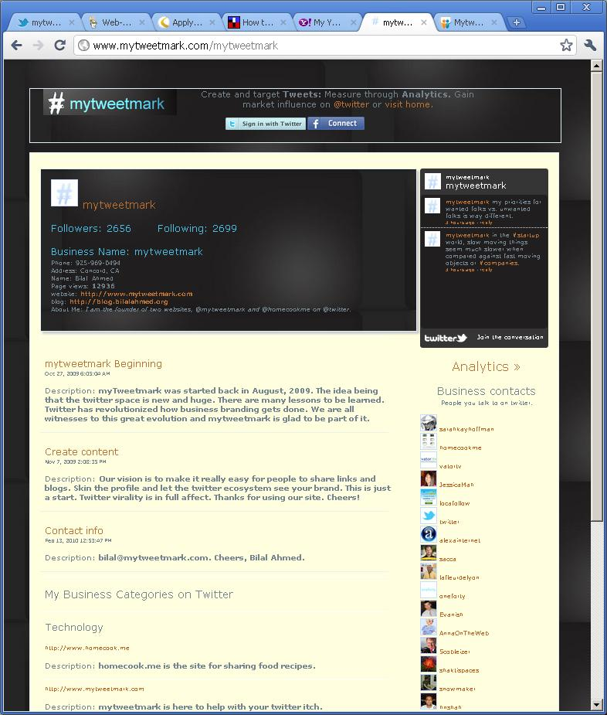
@mytweetmark features:
Business profile
Auto tweets
Contacts management
Content: blogs, bookmarks and hashtags
Profile custom skins

Slide 7
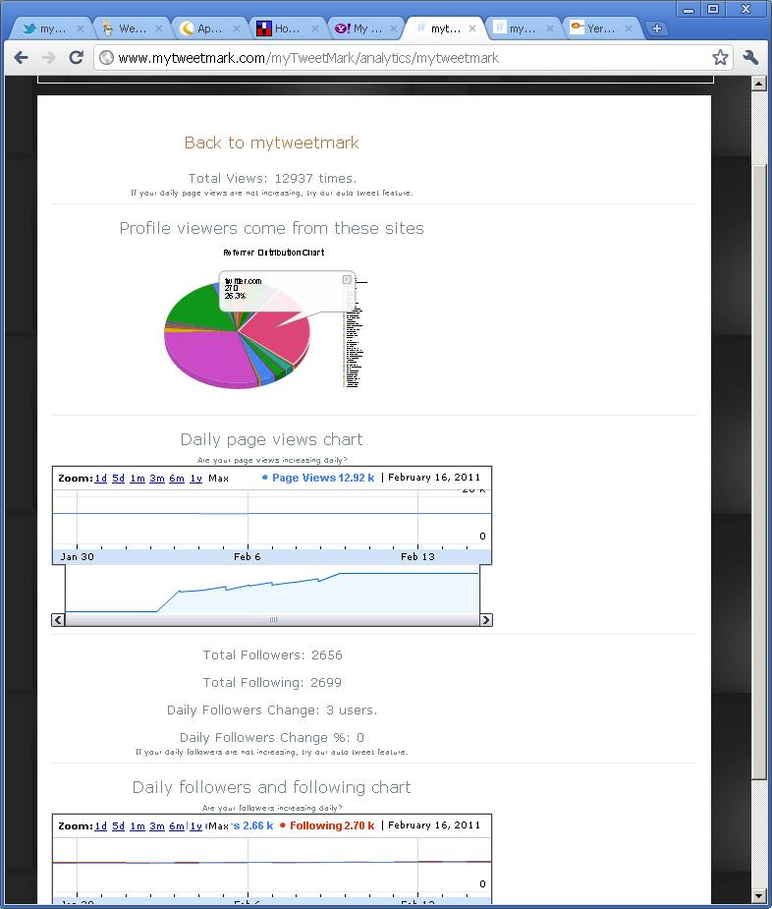
@mytweetmark features:
Analytics
Daily page views
Reference destinations analytics
Google charts
Tweet analytics

Slide 8
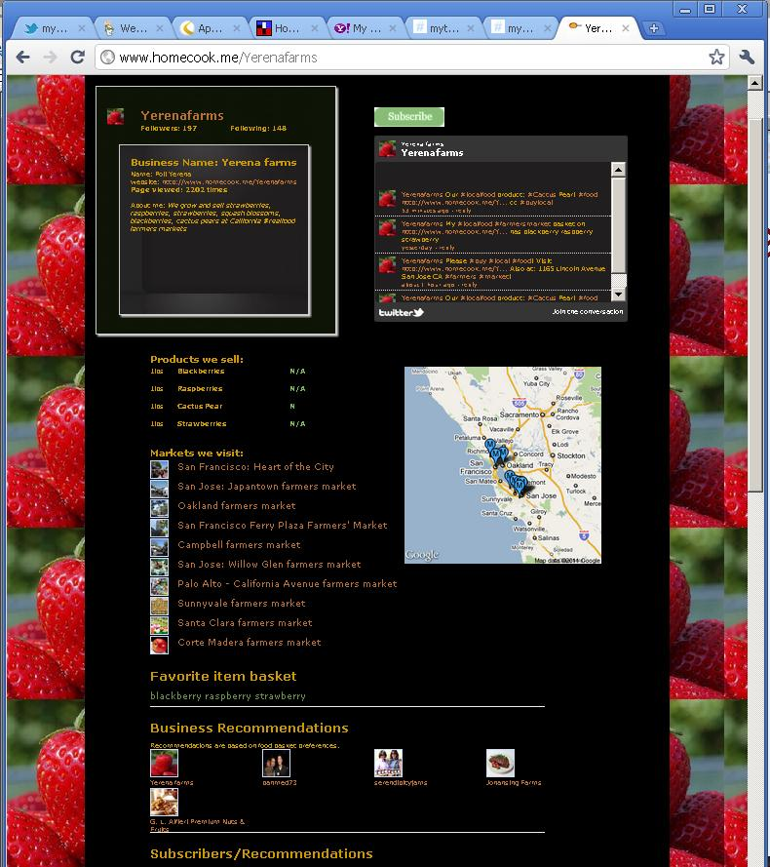
@homecookme features:
Farmers' markets
Content: Blogs, bookmarks and recipes
Google maps and directions
Business profile
Profile custom skins
Products/prices

Slide 9
Management Team/Board of Advisors
Bilal Ahmed:
  CEO/Founder.
  Previous companies: IBM, Novell, Lockheed Martin, hi5.com and bebo.com.
  15 years in Bay Area, California, software.
Advisors:
  Steve Hoffman, founder founderspace.com, CEO thinkhuge
  Akash Garg, Co-founder hi5.com, CTO bebo.com

Slide 10
Revenue Projections
2011:
  100 biz subscriptions at $30/month = $36k + USDA grants (October) = $300k = 360k
2012 (includes USDA grants):
  200 biz subscriptions at $30/month = $72k + 1000 user subscriptions at $1/month = 30k = 102k + USDA 300k = 402k
2013 (includes USDA grants):
  1000 biz subscriptions at $30/month = 360k + 10000 user/consumer $1/month = 300k + USDA 300k = 960k

Slide 11
Investment
Pre-money: $2M
Seeking $500k; 960K revenue in 3rd year
Fill 1 engineering & 1 business for 2011; market product & advertising.
Current Burn rate: $6800/month
Exit:
  Flowtown, foodzie, foodspotting, yelp, urbanspoon, google, aol, twitter

