Slide 1

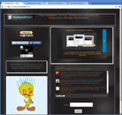
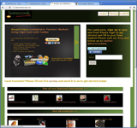
Introduction to @mytweetmark!
Bilal Ahmed
CEO/Founder
http://www.mytweetmark.com
http://www.homecook.me

Slide 2


Markets
@mytweetmark:
  Twitter for business users
  25-30 Million targeted business users
  Social media management system
  Analytics and Services
@homecookme:
  Over 6000 farmers' markets in US
  $1 billion industry, 16% growth in 2010
Competition:
  Flowtown, foodzie, (Pacific Coast) PCFMA

Slide 3
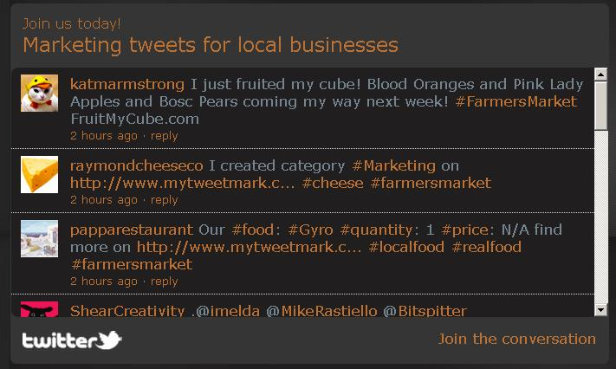
Execution Plan
Intellectual Property: Farmers' markets tweets & work-flow for local businesses
Revenue Driver: $30/month subscription
Scalability: Less hardware overhead with subscriptions business model.

Slide 4
Customer Traction
Revenue: So far free; now offering $30/month subscriptions or refer-a-friend
# of Customers: 150 customers in over 130 farmers' market in Northern California
Sales approach: First month free, then $30/month
Sales cycle: Recurring monthly revenue
Customers very happy! Social media and software development is very expensive!!

Slide 5
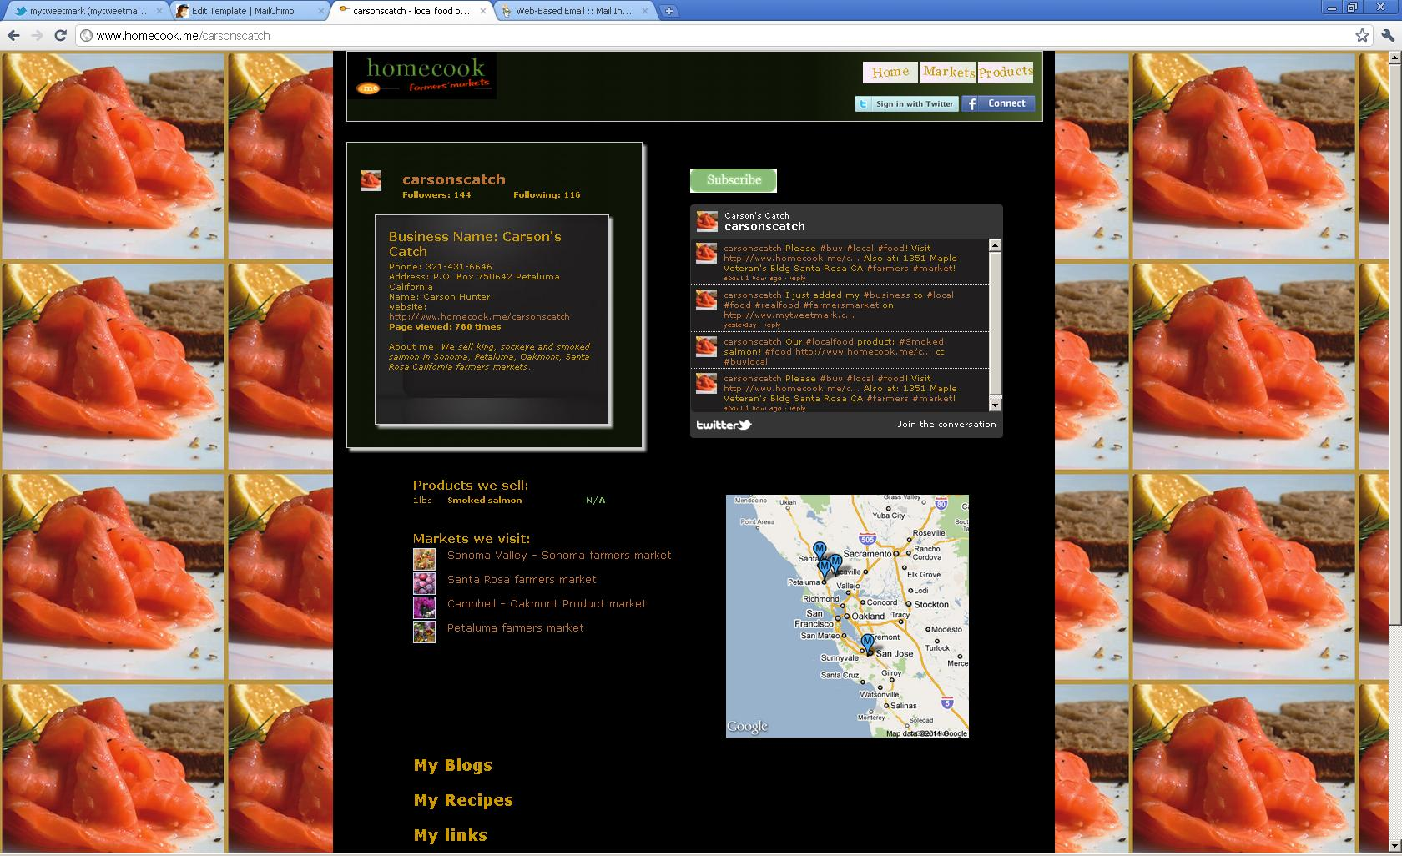
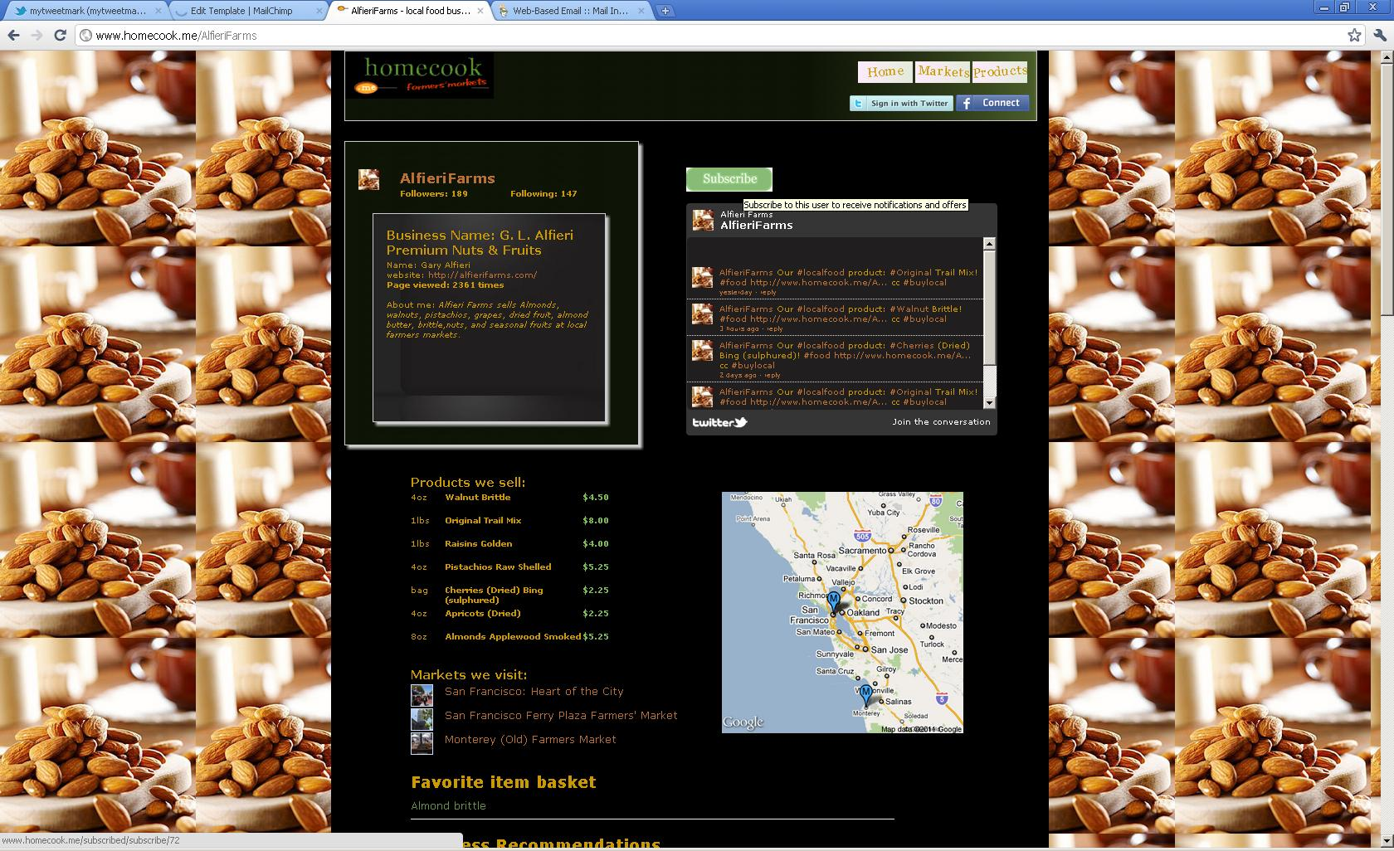




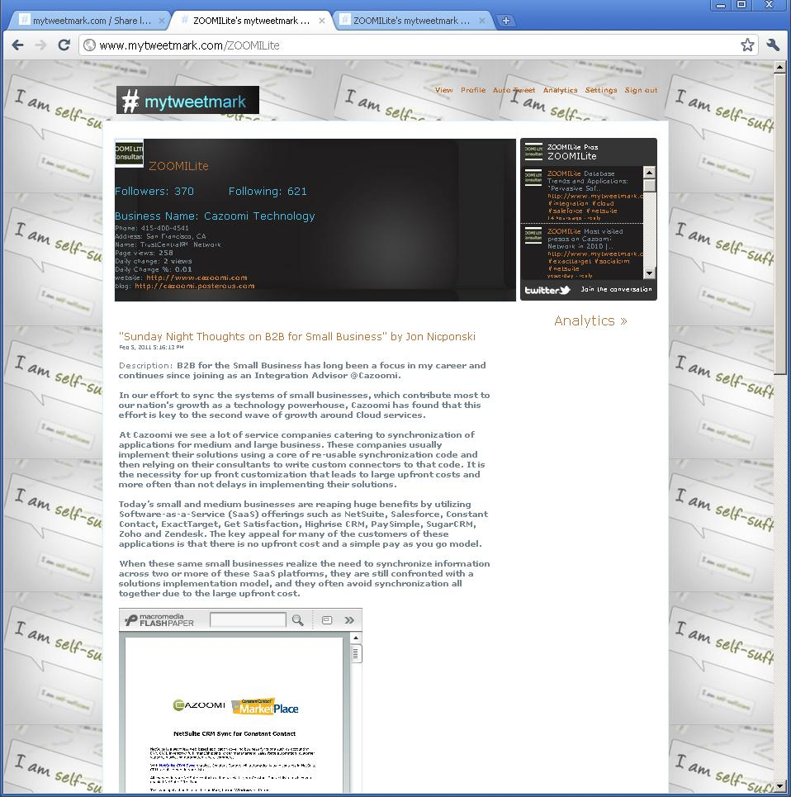
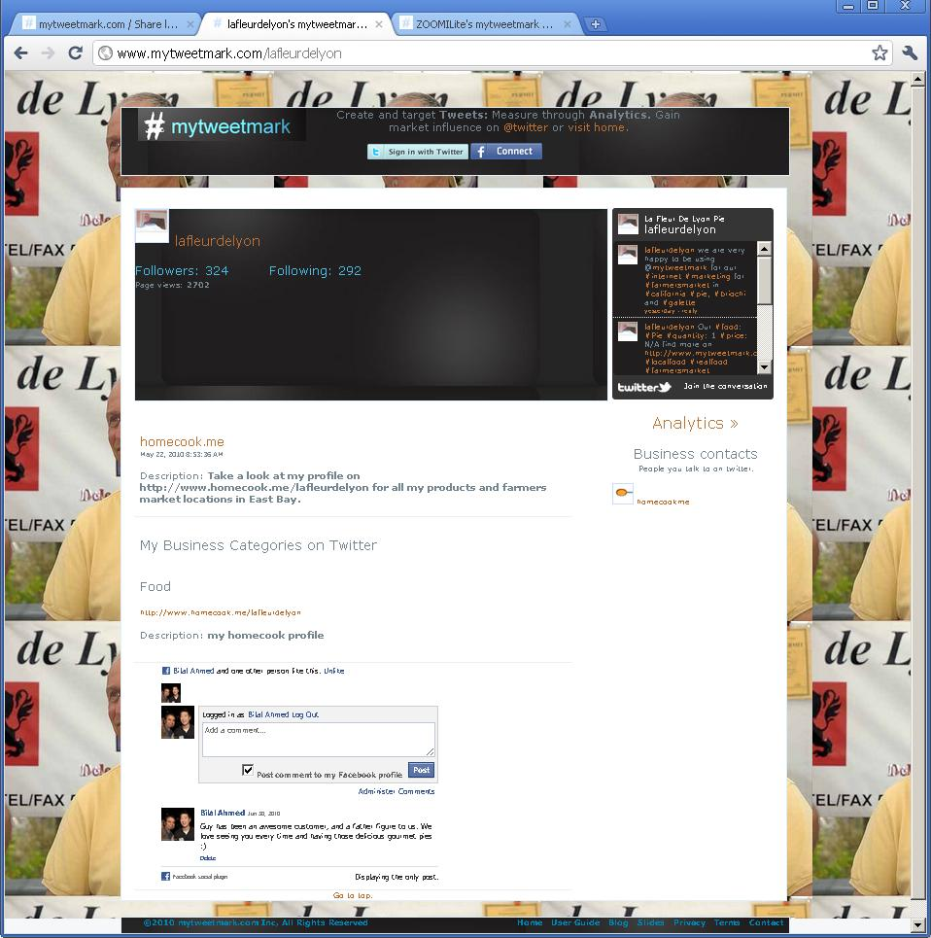
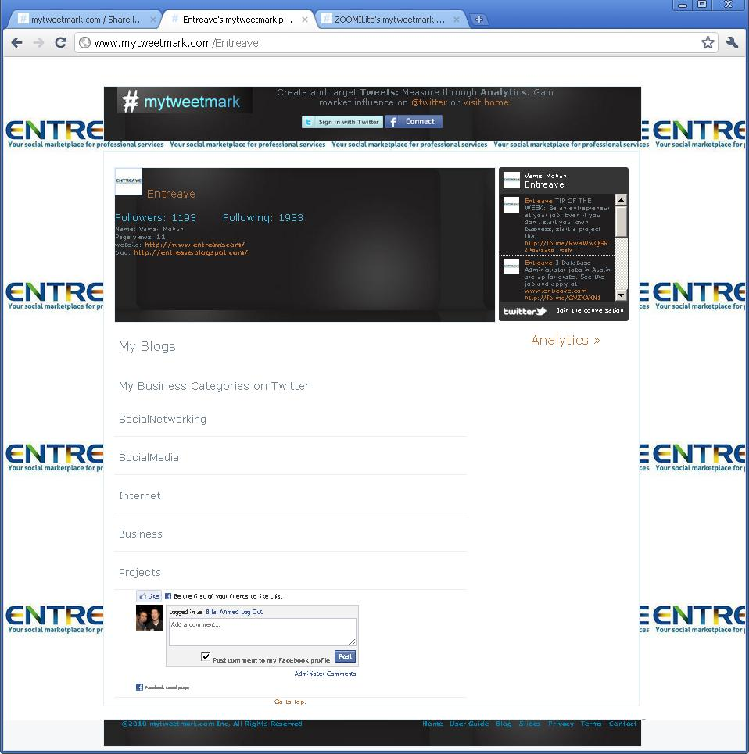
Business customer profiles

Slide 6
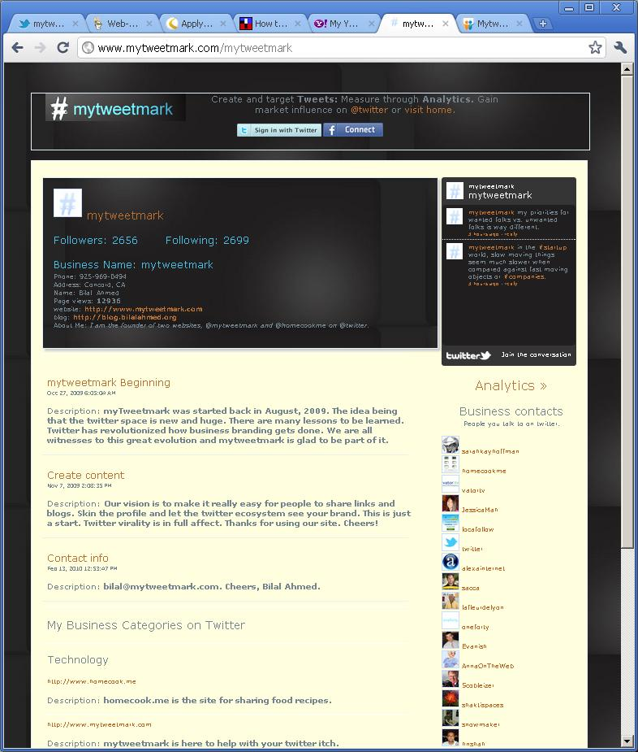
@mytweetmark features:
Business profile
Auto tweets
Contacts management
Content: blogs, bookmarks and hashtags
Profile custom skins

Slide 7
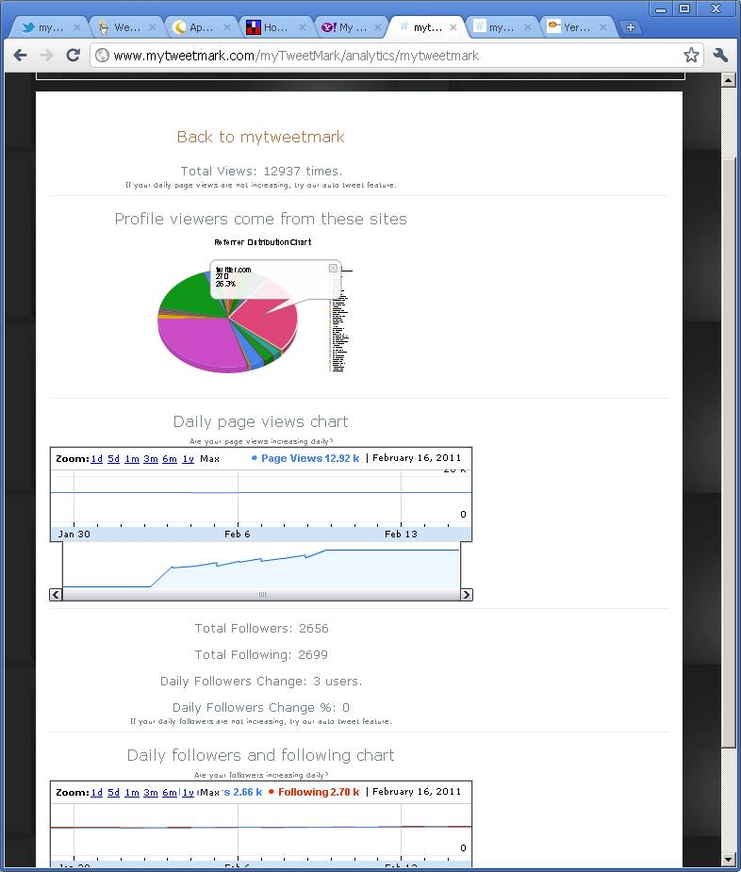
@mytweetmark features:
Analytics
Daily page views
Reference destinations analytics
Google charts
Tweet analytics

Slide 8
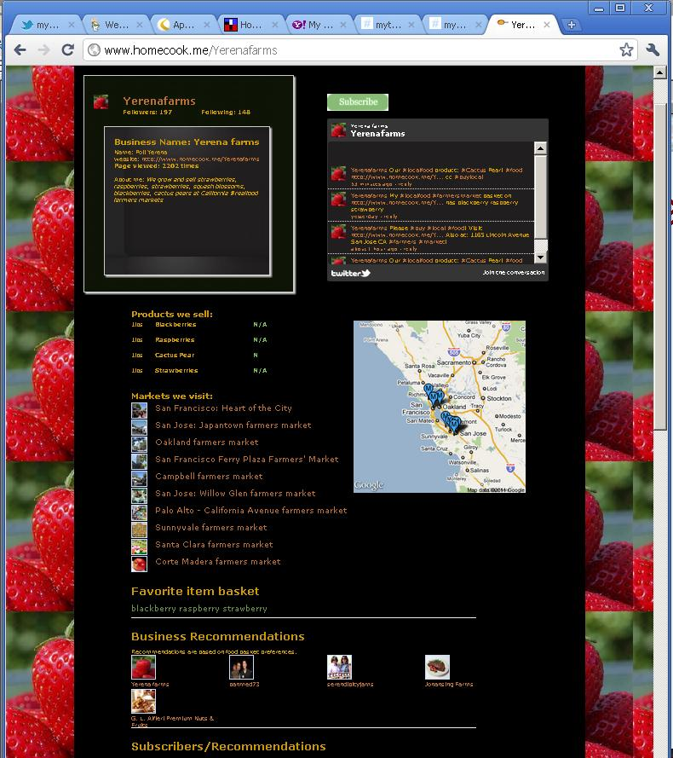
@homecookme features:
Farmers' markets
Content: Blogs, bookmarks and recipes
Google maps and directions
Business profile
Profile custom skins
Products/prices

