Slide 1

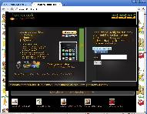
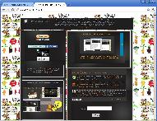
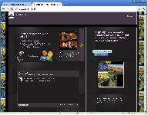
@mytweetmark
Bilal Ahmed
CEO/Founder
http://www.mytweetmark.com
http://www.homecook.me
http://www.winehome.me
mytweetmark is a platform of web 2.0 technologies and services. Create and measure tweets through @mytweetmark. Measure through analytics. Gain social media marketing influence. Promote your local food & wine business and farmers’ markets with @homecookme & @winehomeme.

Slide 2




Market Size
@mytweetmark:
  Twitter for business users; 25-30 Million targeted business users
  Social media management system (SMMS); Analytics and Services
@homecookme:
  Over 6000 farmers' markets in US; $1 billion industry, 16% growth in 2010
@winehomeme:
  $19B spent in wine in California in 2010; California has 2700 wineries. ½ of US

Slide 3
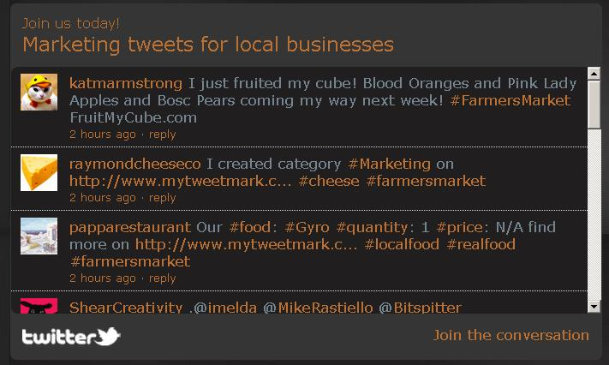
Execution Plan
IP: Farmers' markets tweets, wine & work-flow for local businesses
Revenue Driver: $30/month subscription
Scalability: Less hardware overhead with subscriptions business model.

Slide 4

Customer Traction
Customers very happy! Social media and software development is very expensive!!
Revenue: So far free; now offering $30/month subscriptions; email campaigns
# of Customers: 200 customers in over 150 farmers' market in Northern California and Austin, Texas
Over 1000 total local small businesses
Interviewing wineries for customer development/lean startup

Slide 5
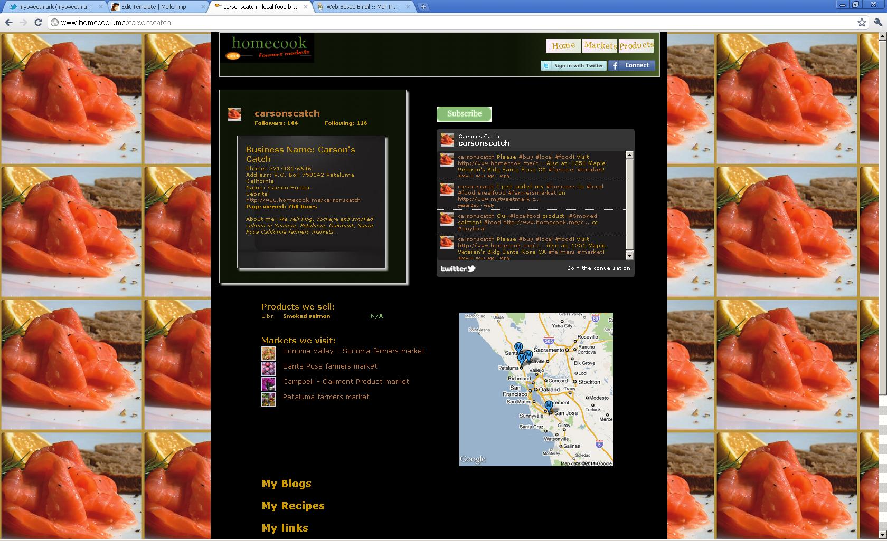
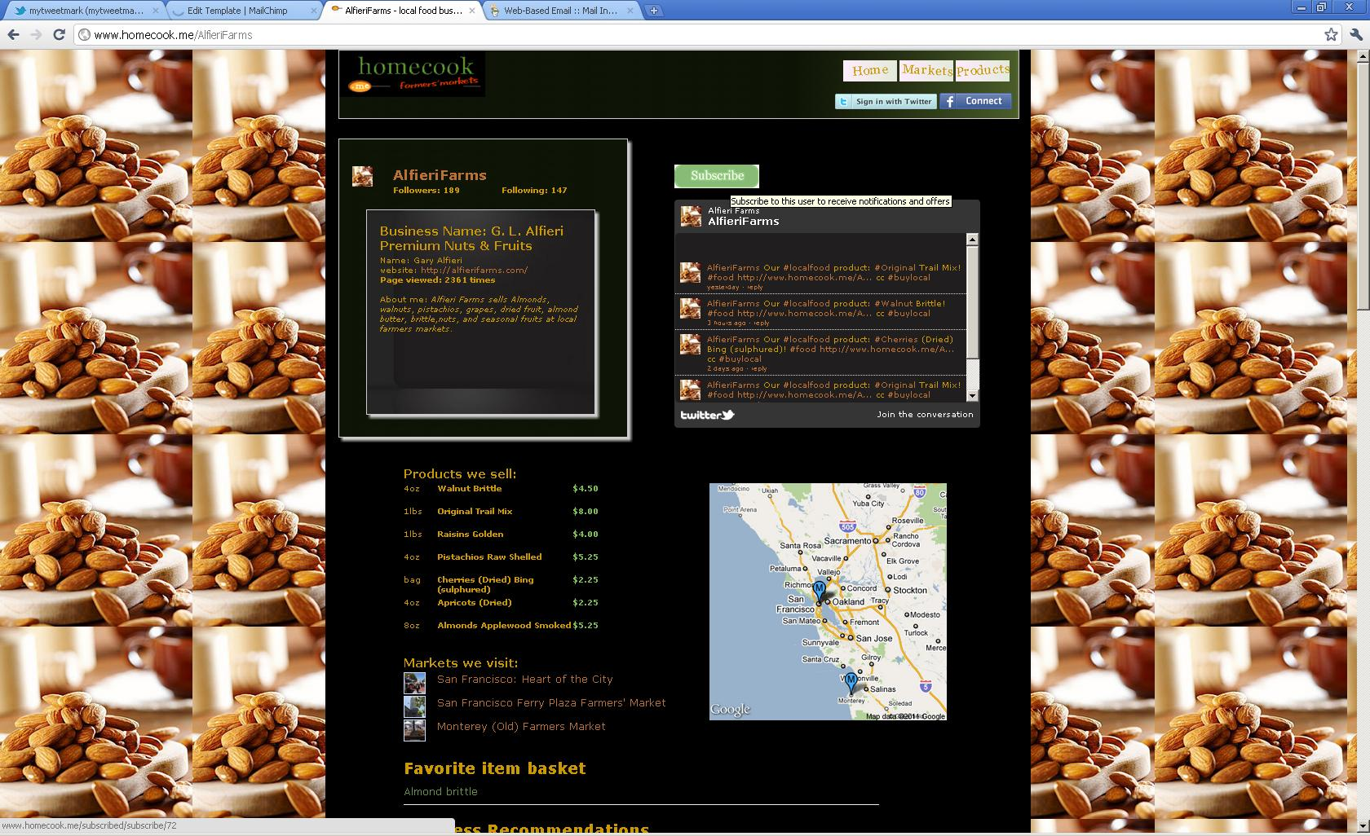




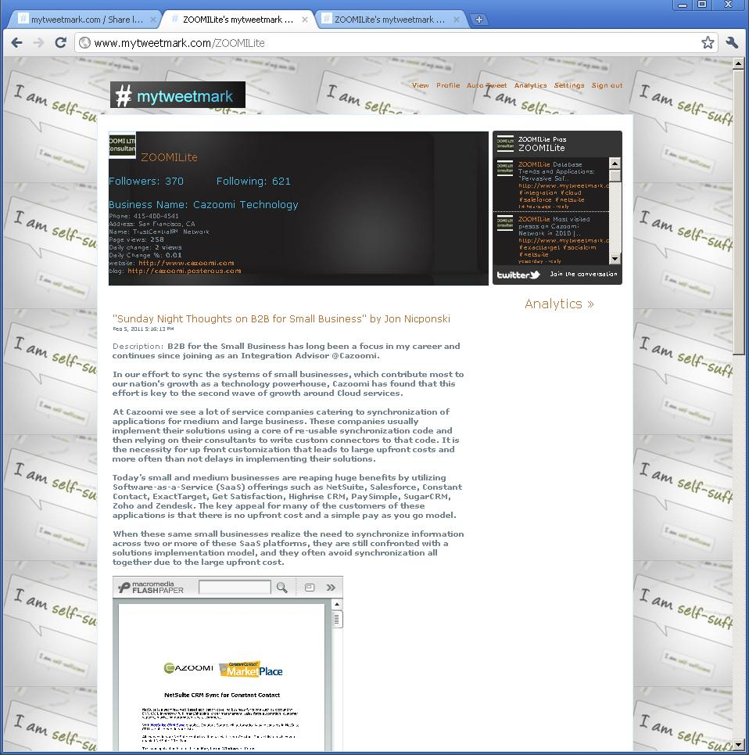
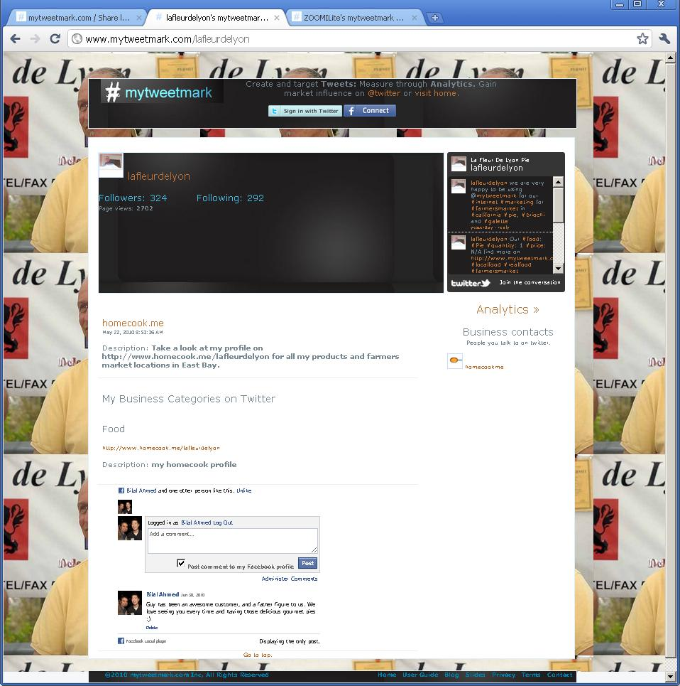
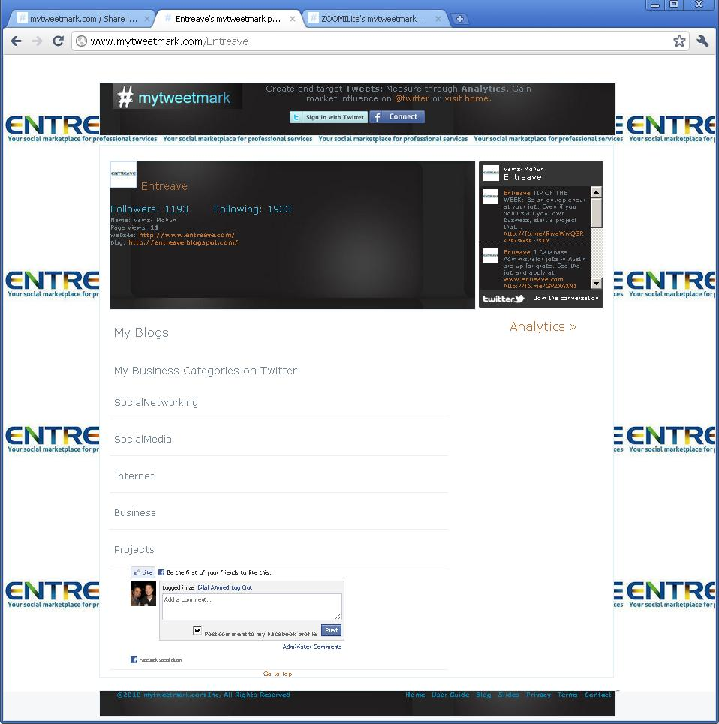
Business customer profiles

Slide 6
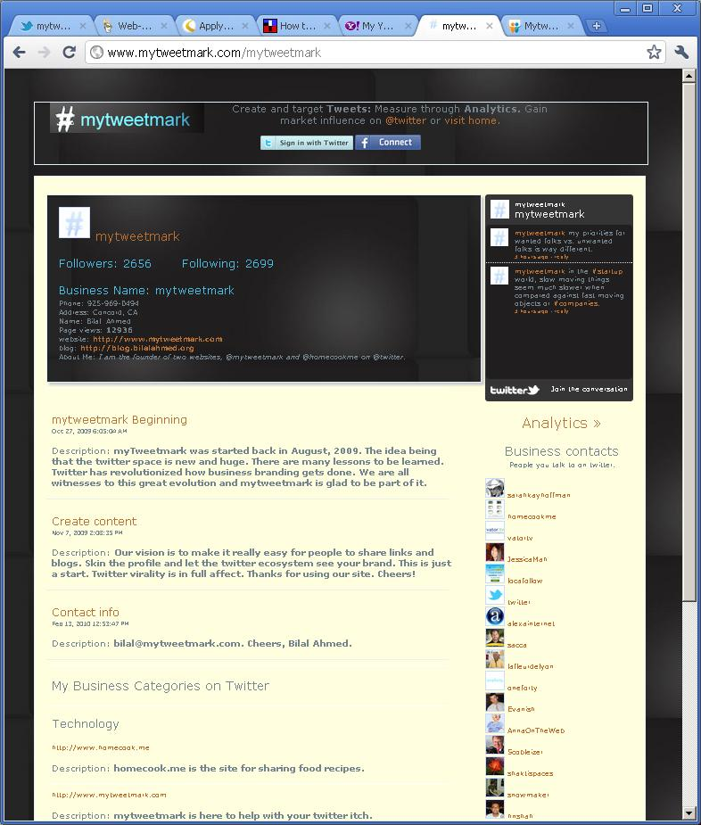
@mytweetmark features:
Business profile
Auto tweets
Contacts management
Content: blogs, bookmarks and hashtags
Profile custom skins

Slide 7
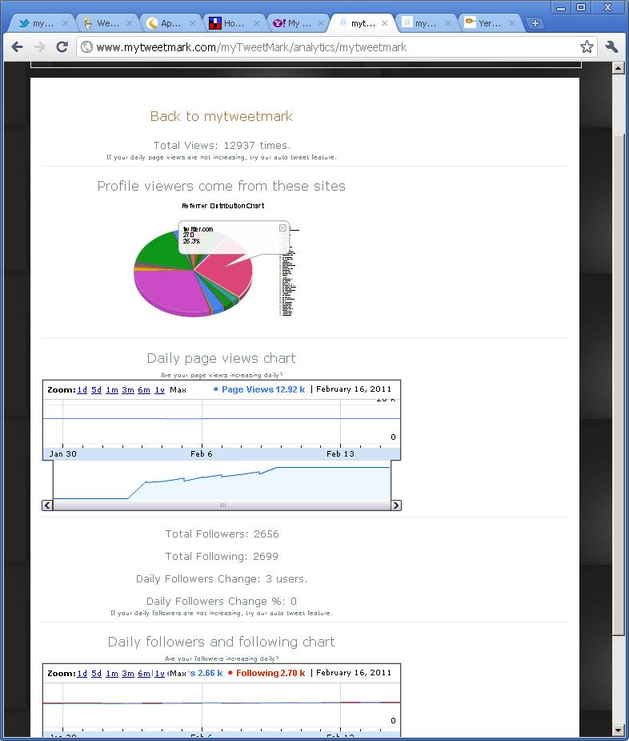
@mytweetmark features:
Analytics
Daily page views
Reference destinations analytics
Google charts
Tweet analytics

Slide 8
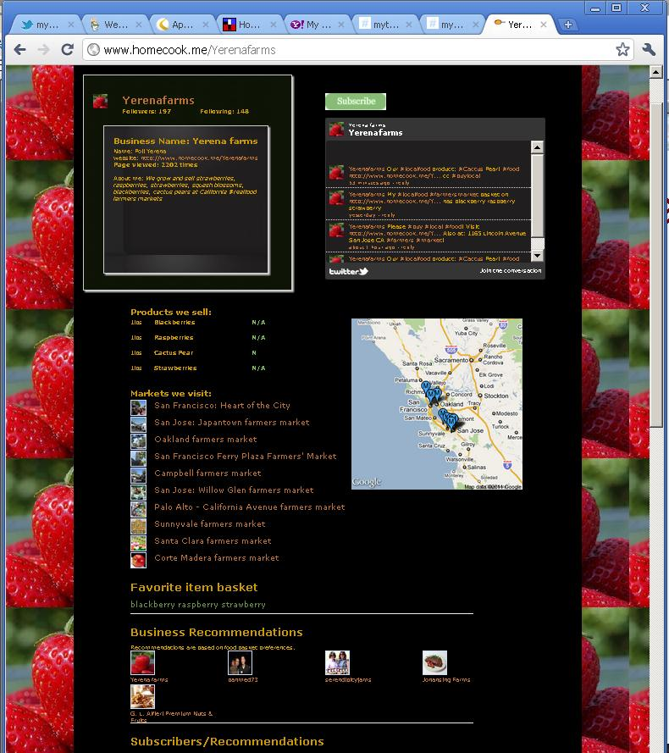
@homecookme features:
Farmers' markets
Content: Blogs, bookmarks and recipes
Google maps and directions
Business profile
Profile custom skins
Products/prices

Slide 9
Management Team/Board of Advisors
Bilal Ahmed:
  CEO/Founder.
  Previous companies: IBM, Novell, Lockheed Martin, hi5.com and bebo.com.
  15 years in Bay Area, California, software.
Advisors:
  Steve Hoffman, founder founderspace.com, CEO thinkhuge

Slide 10
Revenue Projections
2011 336k
2012 504k
2013 2m~
2014 14m~
2015 27.5m~

Slide 11
Investment
Pre-money: $2M
Seeking $500k; 27.5M revenue in 2015
Fill 1 engineering & 1 business for 2011; market product & advertising
Current Burn rate: $6800/month
Prior investment: 100k
Exit:
  Flowtown, foodzie, foodspotting, yelp, urbanspoon, google, aol, twitter

