Slide 1
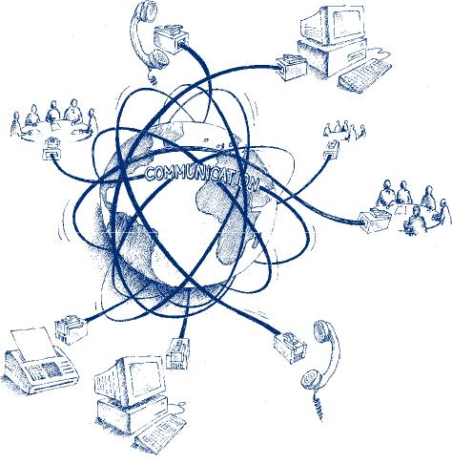
Seamless …….
……… @ KOM
Dipl.-Ing. Maximiliane Musterfrau
Dipl.-Inform. xxx XXX
Dr.-Ing.
Dipl.-Wirtsch.-Inform. xxx XXX
Source: http://www.sycor-asia.com/opencms/as/products_services/complementary_services/Telecommunication/

Slide 2
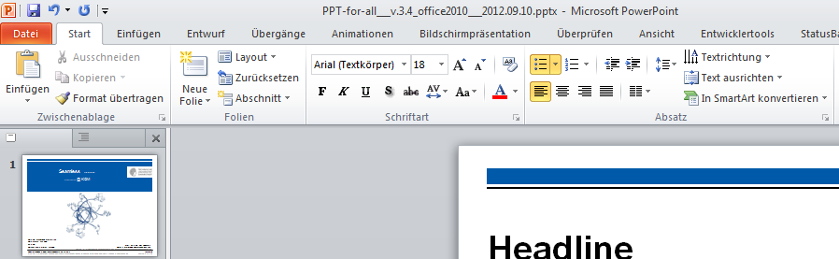
Headline
Level 0
Level 1
Level 1
Level 2
Level 2
Another Level 0
Level 1
Level 1
Please use these buttons for creating bullets!

Slide 3

Thank you for your attention! Questions?

