Slide 1
Album artwork
SONG TITLE
ARTIST NAME

Slide 2
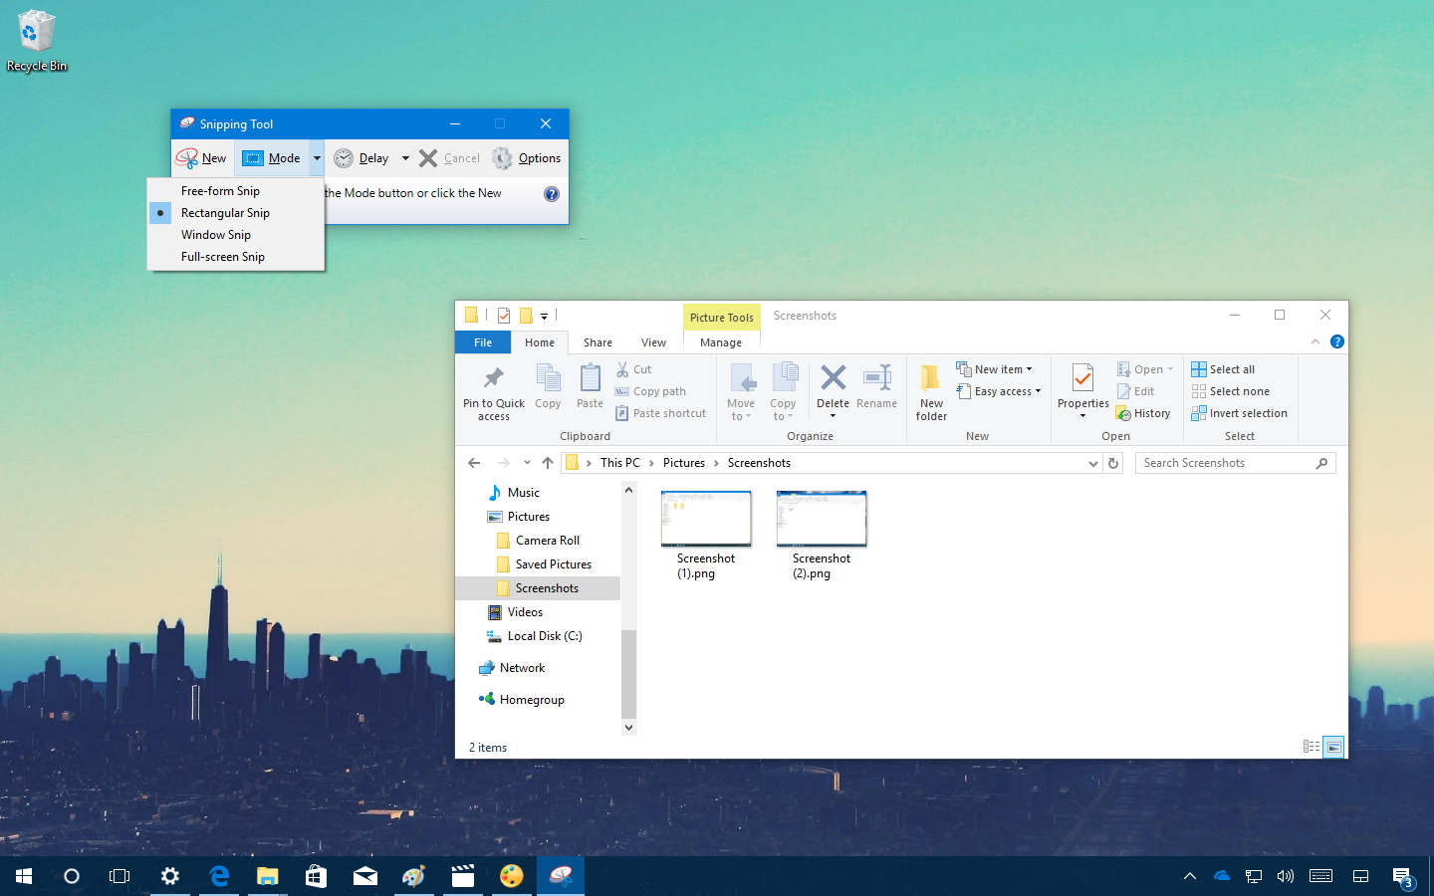
Album Artwork
SONG TITLE
ARTIST NAME

