Slide 1


Professional Transportation Planner
Team : DevTeam
Presentation & Demo
Professor: Kakani Vijay
School of Global Convergence Studies
Notes:
1

Slide 2

Contents
Introduction
Meet the Team
Project Overview
Analysis
Prequisities
Acknowledgement
AI Integration
Video Demo
Conclusion
Q&A
School of Global Convergence Studies
2

Slide 3
Meet The Team
Bahodir Nematjanov
(12225254)
Khamidova Leyla
(12204514)
Ozodbek Umurzakov
(12235639)
Akniyet Suiindik
(12225266)
Akimov Sarvar
(12204514)
School of Global Convergence Studies
3

Slide 4
Project Overview
This project focuses on helping people choose better transportation options by providing smart route planning and travel insights.
The system takes input from the user such as the starting location and destination using a simple interface.
After receiving the input, it connects to a mapping API (GraphHopper) to calculate and compare different routes like walking, driving, or taking public transport.
Once the routes are analyzed, the AI assistant (using Gemini) helps answer user questions and gives suggestions based on cost, travel time, and environmental impact.
The goal is to make travel decisions easier, smarter, and more eco-friendly.
School of Global Convergence Studies
4

Slide 5




Project Overview
(software)
Prequisities
AI Integration
RAG
Acknowledgement
School of Global Convergence Studies
5

Slide 6
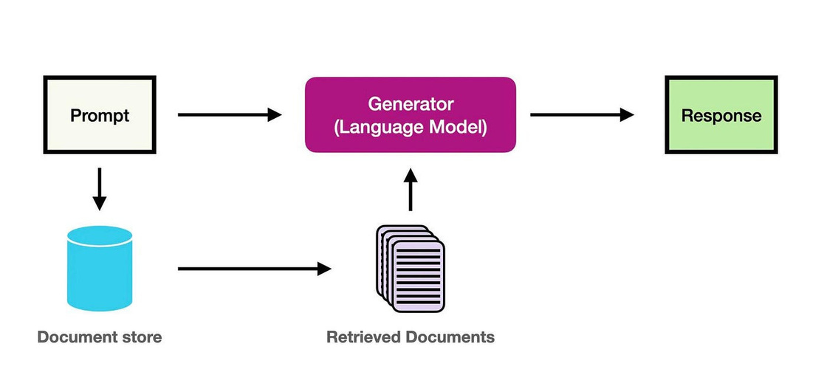
Project Overview
School of Global Convergence Studies
6

Slide 7
Reasons why we chose the 2nd option
1.Multi-modal transportation: to offer flexibility for users
2.AI insights: to enhance user decision-making
3. Route cost & environmental impact: to support informed and eco-friendly choices
4.Gradio UI: fast, interactive web interface without building from scratch
School of Global Convergence Studies
17

Slide 8
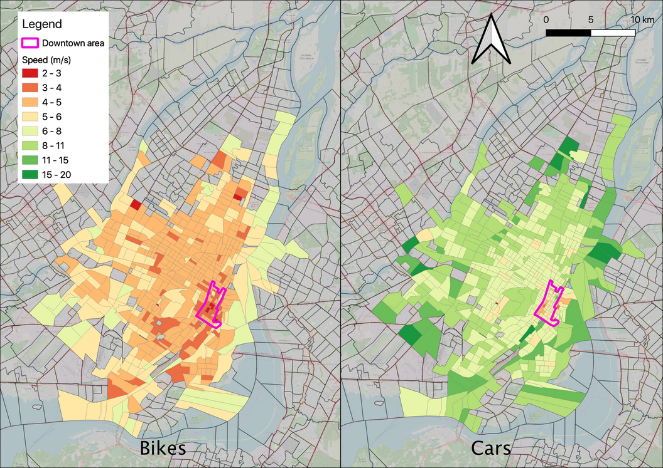
Key features
Route comparison (car, walk, bike)
Cost estimation & travel time
AI-based recommendations using RAG
Environmental impact reporting
School of Global Convergence Studies
7

Slide 9
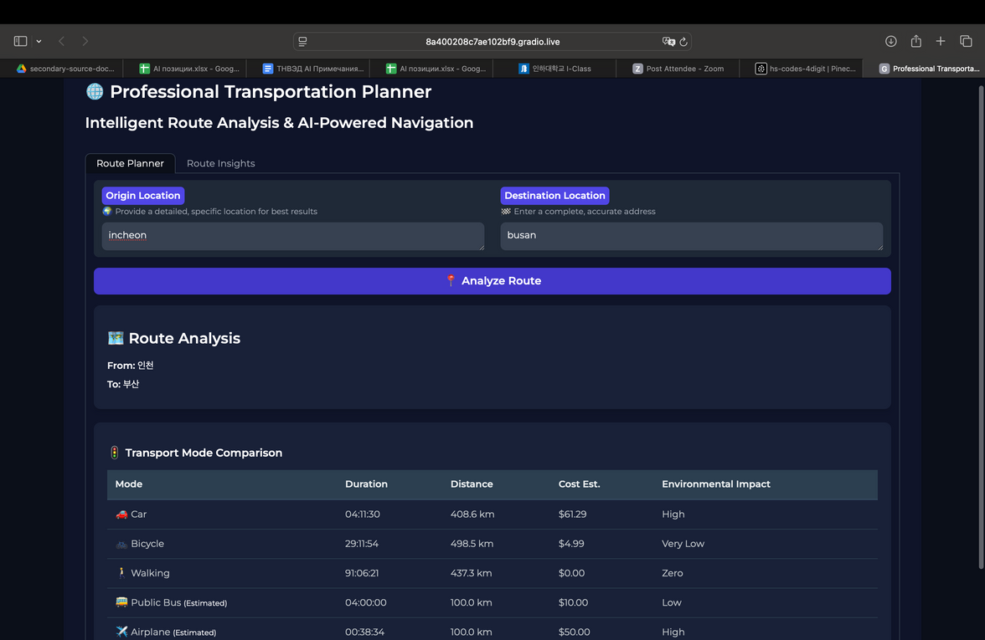
The User Interface Local Host Site
School of Global Convergence Studies
10

Slide 10
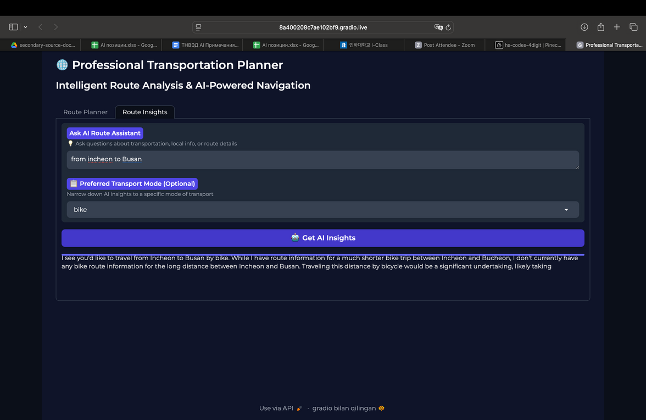
The User Interface Local Host Site
School of Global Convergence Studies
10

Slide 11
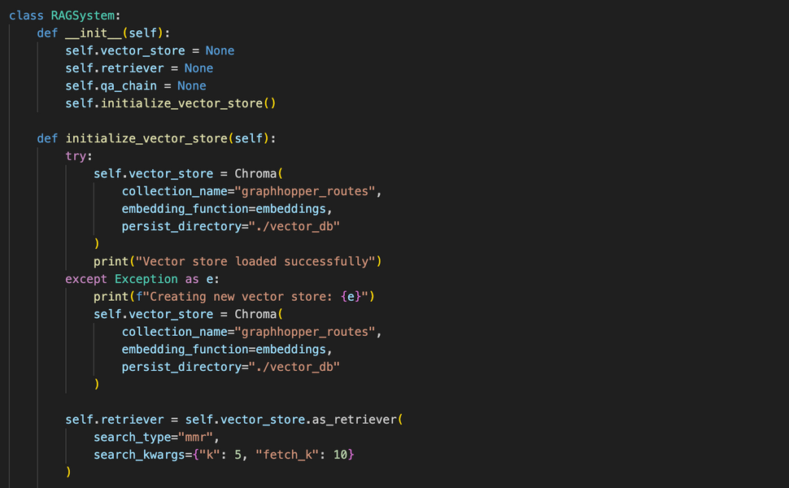
Code Analysis
Rag
RAG System Initialization
School of Global Convergence Studies
11

Slide 12
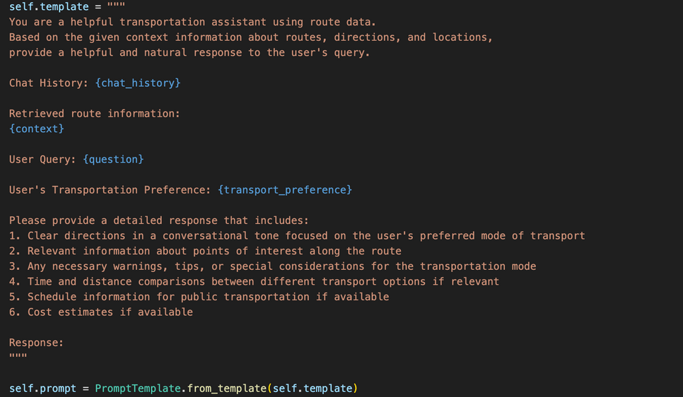
Code Analysis
The Prompt Engineering
School of Global Convergence Studies
13

Slide 13
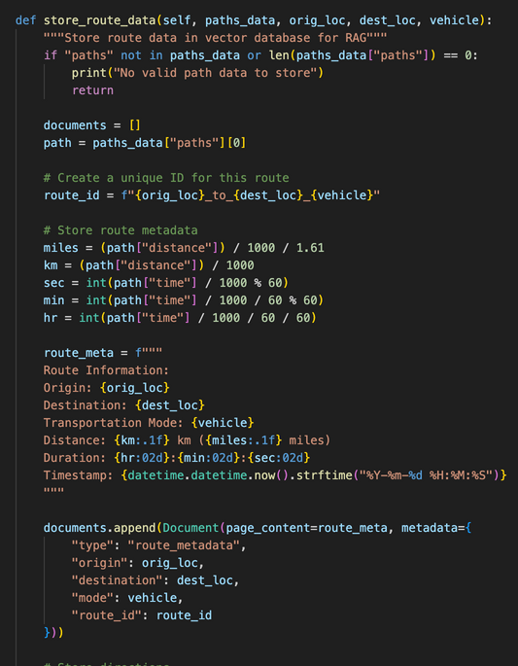
Code Analysis
Creates documents from three types of data:
Route metadata (origin, destination, distance, duration)
Step-by-step directions
Overall route summary
Organizes information with proper metadata tags for each document type
Formats distances in both kilometers and miles, and durations in hours:minutes
Generates a unique route ID to connect related documents
Adds all documents to a vector store for later retrieval and querying
School of Global Convergence Studies
14

Slide 14
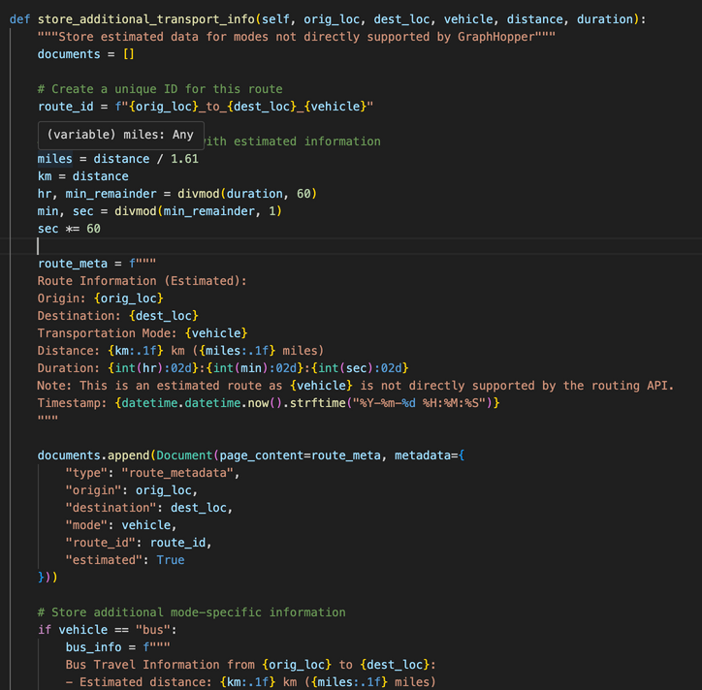
Code Analysis
Creates a unique route ID to identify this specific origin-destination-vehicle combination
Formats estimated route metadata with distance (in km and miles) and duration (in hours:minutes
)
Adds a special "estimated" flag in the metadata to distinguish this from actual API-provided routes
Provides mode-specific additional information based on the vehicle type:
For buses: includes fare estimates, stop frequency information
For airplanes: includes airport procedures time, ticket price ranges, baggage considerations
Adds all documents to the vector store with appropriate metadata tags for retrieval
School of Global Convergence Studies
15

Slide 15
Video Demo
School of Global Convergence Studies
23

Slide 16
Q&A
For More Questions
School of Global Convergence Studies

