Slide 1
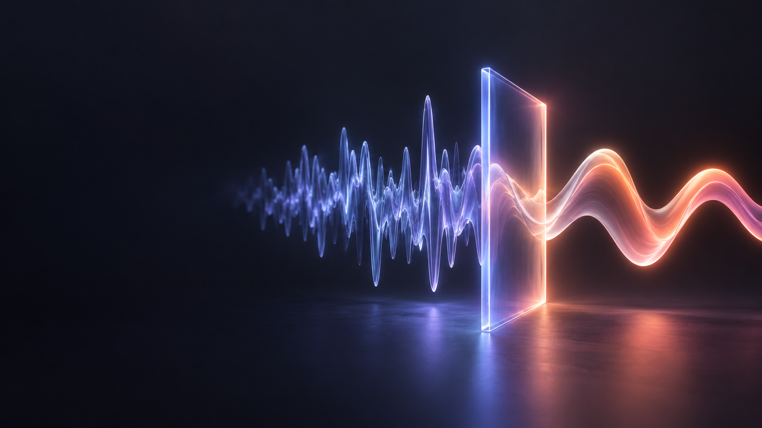
DUBLA
Every video,
understood.
AI video translation and dubbing
English to Uzbek / Investor pitch 2026
Notes:
Dubla is an AI-powered video translation and dubbing product. This deck presents the initial English to Uzbek focus and a rights-led commercial strategy.

Slide 2
One language barrier. Many lost moments.
The content exists.
Understanding does not always follow.
STUDENT
an excellent course
PROFESSOR
a global lecture
DEVELOPER
a technical talk
PROFESSIONAL
industry expertise
VIEWER
a film or documentary
Different people. The same pause between play and comprehension.
02
Notes:
These examples illustrate the problem. They are personas, not survey findings.

Slide 3
Uzbekistan is online. Language access trails behind.
94.2%
1.54m
429
of residents used the internet
university students
EF English proficiency score
National Statistics Committee, Jan–Aug 2025
Invest Uzbekistan, 2025/26
EF EPI 2025; global average 488
A connected audience and a measurable language gap
Population signals, not Dubla customer counts. EF EPI is a self-selected test sample.
03
Notes:
Internet use: https://stat.uz/en/press-center/news-of-committee/64213-zbekiston-a-olisining-94-2-foizi-internetdan-fojdalanadi-4
Students: https://invest.gov.uz/en/reason/demographics
EF EPI 2025 Uzbekistan score and global average: https://www.ef.com/wwen/epi/regions/asia/uzbekistan/
EF's index is not a population census or an estimate of all Uzbek speakers' ability.

Slide 4
Dubla gives a video an Uzbek voice
Upload content you have rights to. Receive a translated, dubbed video.
EN
UZ
Original speech
Natural Uzbek audio
AI translation + AI dubbing + synchronized video
04
Notes:
Dubla's core product is video translation and dubbing. The content-rights condition is part of the intended workflow, not a claim that any video link may be copied or redistributed.

Slide 5
A simple output rests on four precise steps
01
02
03
04
Listen
Translate
Voice
Sync
Speech becomes timed text
Meaning and terms are checked
Uzbek speech is generated
Audio and video align
A person can review the language and timing before export.
05
Notes:
The stages summarize the current product concept and implementation in the local Dubla repository: transcription, translation, voice synthesis, and rendering. AI provider behavior depends on configured services.

Slide 6
Quality lives in the details viewers hear
An editable segment is the basic unit of a trustworthy dub.
02:14 – 02:19
ORIGINAL
The model learns from examples.
UZBEK DUB
Model misollar orqali o‘rganadi.
Meaning
Voice
Timing
terminology
pronunciation
speech pace
06
Notes:
The transcript pair is an illustrative example, not a customer project or measured quality result. The repository contains a transcript editor and dubbing pipeline; quality performance requires controlled user evaluation.

Slide 7
Start with people who own the content
English to Uzbek localization for partners who can authorize it.
01
Educators & universities
lectures, open courses, conference talks
02
Creators & publishers
owned video catalogs and channel libraries
03
Companies
training, product education, internal video
07
Notes:
These are proposed initial customer segments, not proven customers or signed partnerships. The recommended starting point is rights-cleared, partner-owned material.

Slide 8
The addressable market is paid video minutes
The audience is large. A credible revenue estimate needs partner and usage data.
38.7m
Market model
Licensed video minutes
people in Uzbekistan in 2026
×
Paid share of those minutes
Potential reach is wider than students alone.
× realized revenue per minute
Invest Uzbekistan, 2026
No published Uzbekistan AI dubbing spend figure was reliable enough to use as TAM.
08
Notes:
2026 population: https://invest.gov.uz/en/reason/demographics
The market equation is Dubla's analytical framework, not a factual market estimate. The factors require pilot validation. The 38.7m population is potential reach, not a customer or revenue forecast.

Slide 9
Uzbek dubbing already has competitors
Language support alone does not define a winning product.
PRODUCT
VERIFIED OFFER
FOCUS
ElevenLabs
Uzbek in Dubbing v2
Global
HeyGen
Uzbek video translation
Global
Rask AI
Uzbek translation and voiceover
Global
Roviy
Uzbek video dubbing
Local
GapirAI
Uzbek video dubbing
Local
Sources: official product and support pages, checked October 2026
09
Notes:
ElevenLabs: https://elevenlabs.io/docs/overview/capabilities/dubbing
HeyGen: https://help.heygen.com/en/articles/11391941-video-translation-languages-we-support
Rask AI: https://www.rask.ai/tools/video-translator/uzbek-video-translator
Roviy: https://roviy.uz/
GapirAI: https://gapirai.uz/
Descriptions are limited to capabilities verified on official product pages. They do not imply identical quality, rights policies, prices, or customer traction.

Slide 10
A sharper place for Dubla to compete
Proposed position: the Uzbek localization workflow for rights holders.
RIGHTS
LANGUAGE
Confirm ownership, license, or permission before production
Build Uzbek terminology and pronunciation review
PRODUCTION
DISTRIBUTION
Give teams control over transcript, voice, and timing
Deliver files or tracks to approved partner channels
Strategic hypothesis to test in signed pilots, not a claimed moat today.
10
Notes:
This is proposed competitive positioning, not a verified claim that competitors lack these capabilities. Roviy, for example, publishes a content-rights policy and creator-oriented workflow: https://roviy.uz/qoidalar . Pilot evidence is required to establish differentiation.

Slide 11
Content rights belong in the product flow
A video link does not grant translation or redistribution rights.
ACCEPT
VERIFY
Owned videos
Licensed catalogs
Open licenses that permit adaptation
Who owns the work?
Does the license allow translation?
Where may the dub be published?
Partner permission or a valid license precedes production and release.
11
Notes:
YouTube explains that translations are derivative works controlled by the original copyright owner: https://support.google.com/youtube/answer/2797466?hl=en
YouTube states a user cannot download other users' videos through its download feature: https://support.google.com/youtube/answer/56100?hl=en
Creative Commons license terms differ, including whether adaptation and commercial use are allowed: https://creativecommons.org/share-your-work/cclicenses/
This slide is a product and partnership principle, not jurisdiction-specific legal advice.

Slide 12
Revenue follows finished, authorized minutes
Subscription minutes for creators; contracted volumes for publishers and teams.
375,000 UZS
1,150,000 UZS
Creator / month
Pro Studio / month
60 included video minutes
300 included video minutes
Contribution per minute = revenue per minute − AI, render, and review cost
Current product pricing configuration. Customer demand and margins remain to be validated.
12
Notes:
Prices and included minutes come from the local Dubla repository file server/services/payments/paymentPlans.js, inspected on 2026-10-07. They are product configuration, not evidence of paid customers or realized revenue.
The proposed B2B volume model is an assumption requiring sales validation. Contribution economics require observed AI, rendering, storage, and quality review cost per completed minute.

Slide 13
The next proof is commercial, legal, and audible
Working product foundation exists. The next gates test real demand.
1
SIGNED RIGHTS
Secure partner catalogs and permitted channels
2
LISTENER QUALITY
Blind evaluation of Uzbek meaning and voice
3
PAID REPEAT USE
Measure returning customers and minutes
4
UNIT ECONOMICS
Track contribution per completed minute
Milestones, not current traction.
13
Notes:
The Dubla repository contains an implemented React interface, backend AI workflow, transcript editing, private media, and minute-based payments. This slide does not assert live customers, signed licenses, revenue, or achieved quality metrics. The four gates are forward-looking validation work.

Slide 14
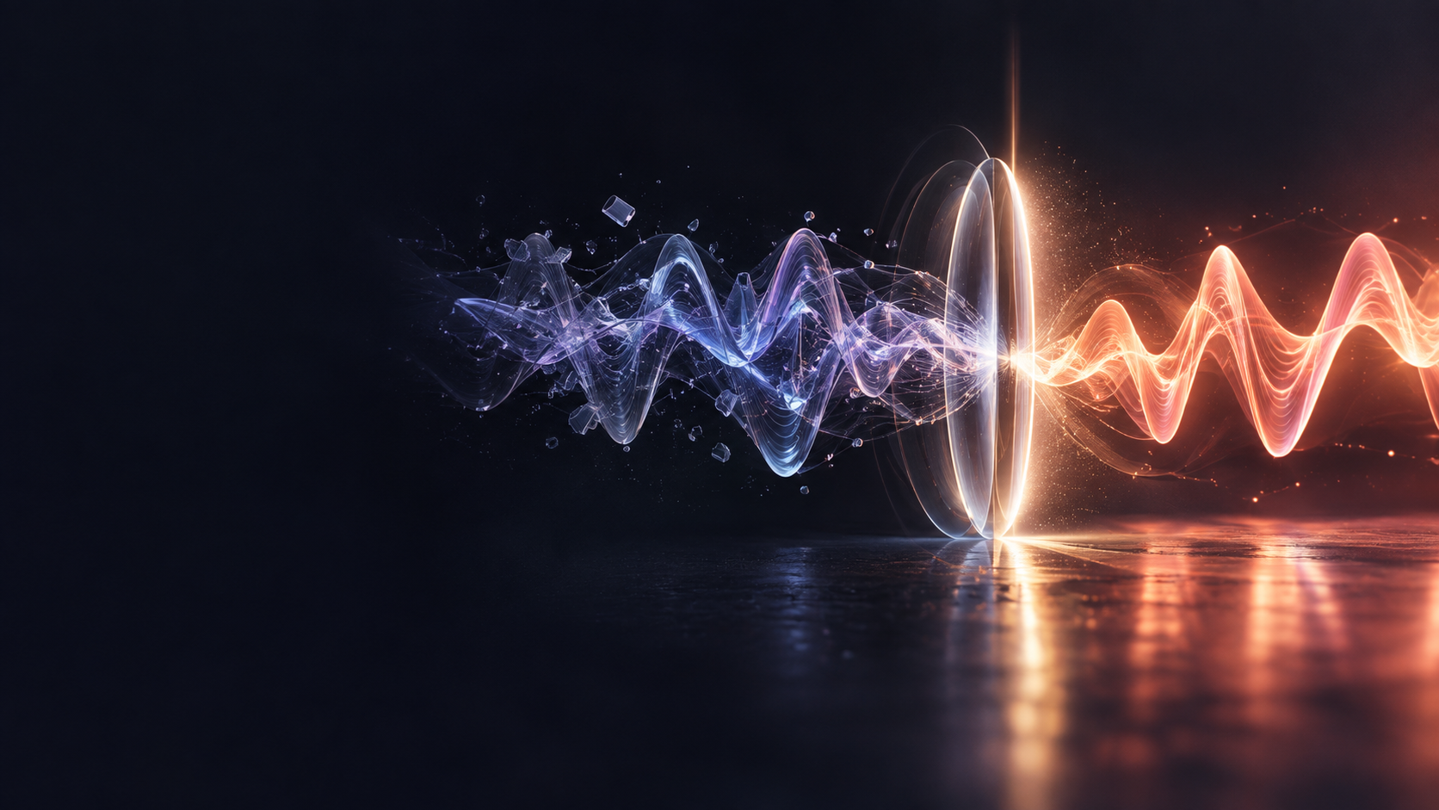
Language should not
decide who can
understand a video.
DUBLA
Breaking the language barrier
between people and video.
Notes:
Closing statement. The presentation intentionally does not state a funding ask or claimed traction because those details were not provided and should not be invented.

