Slide 1

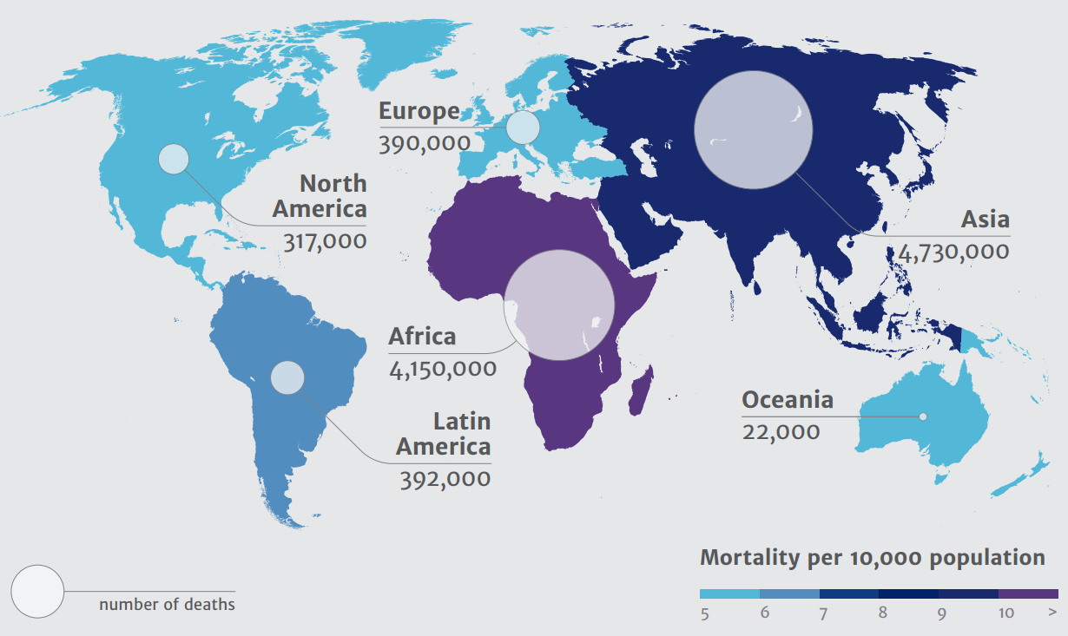


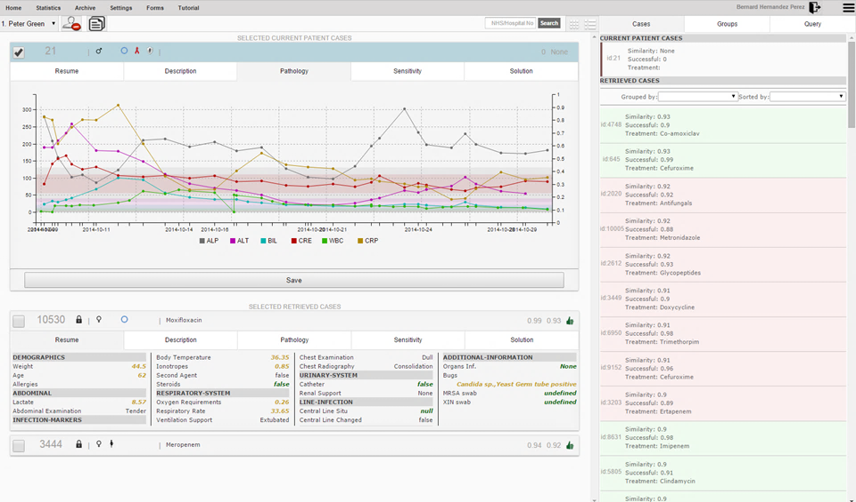



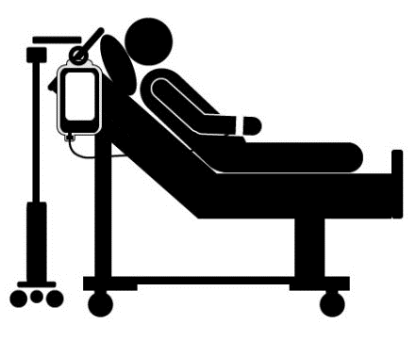



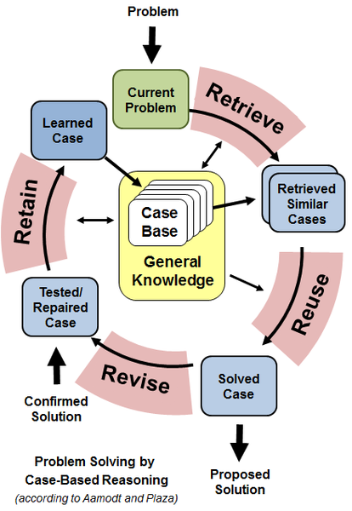





Point-of-Care Intelligent Decision Support System for Antimicrobial Prescribing in the Intensive Care Unit
Bernard Hernández¹, Pau Herrero¹, Luke Moore², Esmita Charani², Alison Holmes² and Pantelis Georgiou¹
¹Centre for Bio-Inspired Technology, EEE Department, Imperial College London, South Kensington Campus, London SW7 2AZ, UK
²Centre for Infection Prevention and Management, Medicine Department, Imperial College London, Hammersmith Campus, London W12 0NN, UK
OVERVIEW
The Problem
Antibiotic Resistance rise is considered a major problem worldwide [1][2]
Consumption and misuse of antibiotic in humans is increasing globally [3]
Infection by resistant bacteria causes more than 700.000 deaths worldwide [1]
Possible Solutions
Developing new drugs
Developing new diagnostic tests
Improve antibiotic prescribing/stewardship using Clinical Decision Support
AIM
ENIAPP (ENhanced Imperial Antibiotic Prescribing Policy application) is an intelligent clinical decision support system developed at Imperial College that uses past clinical cases to inform clinicians about personalized and effective antimicrobial prescribing at the patient bed side in the Intensive Care Unit.
Deaths per year attributable to AMR by 2050 and mortality per 10.000 population [1]
METHODOLOGY
RESULTS
SYSTEM ARCHITECTURE
In a small 6-week pilot study conducted by infection specialists with a small case-base (approximately 80 cases), ENIAPP recommended the correct treatment 95% of the times
Initial usability studies based on focus group feedback from potential users were satisfactory
SERVER
CLIENT
Demographics
API
Pathology
DB
CBR
Microbiology
The back-end, developed in Java and SQL, runs in a server within the NHS firewall. The front end is developed in JavaScript, CSS and HTML and is accessible to any mobile device connected to a secure NHS Wi-Fi.
CASE-BASED REASONING
CBR uses previous experience in form of cases to understand and solve new problems [4]
CBR Case: {Parameters, Solution, Outcome}
CBR Cycle:
Retrieve cases based on similarity
Reuse solutions through adaptation/combination
Revise solution monitoring patient evolution
Retain case attending to usefulness and reusability
Similarity Measure: K-Nearest Neighbors
CONCLUSION
We have shown that ENIAPP:
Enhances continuity, interpersonal communication and knowledge transfer
Has potential to provide personalized, accurate and effective diagnoses
Improves reliability and consistency of data collection
Improves data visualization, interpretation and analysis
Future Work:
Extend and adapt for use in secondary care
Introduce patient module
Therapeutic Drug Monitoring pharmacy module for individualised dosing
Extend study and validation using interrupted time series analysis
Parameters
Demographics: {Weight, Age, Gender, HIV, Diabetes, Pregnant, Allergies, Body
Temperature, Lactate, Abdominal Examination, Chest Examination, Respiratory
Rate, Oxygen Requirement, Chest Radiography, Catheter, Renal Support,
Ventilation Support, Chest Radiograph, Central Line Situ, Organs Infected}
Pathology: {Alanine Aminotransferase, Alkaline Phosphatase, Bilirubin,
Creatinine, C-Reactive Protein, White Blood Cells}
Susceptibility: {Culture, Organism, Antibiotic, Sensitivity}
Solution:
Past successful and unsuccessful cases
Outcome:
Success of applied treatment validated by the clinician
REFERENCES
[1] Review on Antimicrobial Resistance. “Antimicrobial Resistance: Tackling a Crisis for the Health and Wealth of Nations”. 2014.
[2] Centre for Disease Control and Prevention. ”Antibiotic Resistance Threats in the United States”. 2013.
[3] Centre for Disease Control and Prevention. ”The State of the World’s Antibiotics”. 2015.
[4] A. Aamodt and E. Plaza, “Case-based Reasoning: Foundational Issues, Methodological Variations and System Approaches”, AI Commun, 1994.
Notes:
OVERVIEW:
- AMR infections in healthcare settings are to which most deaths are related.
- Misuse …
- Resistance …

