Slide 1
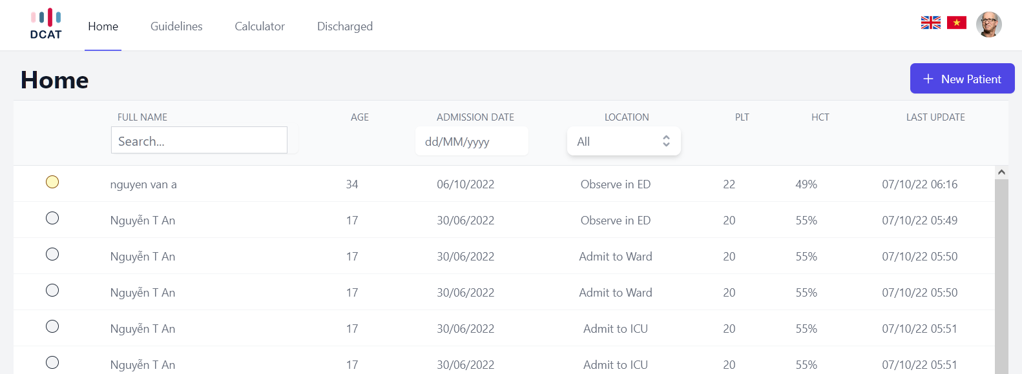
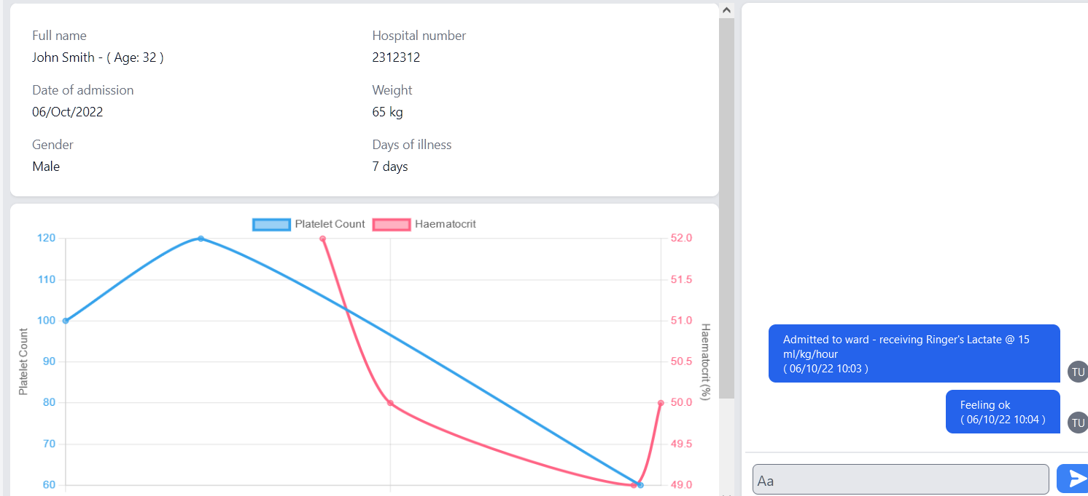
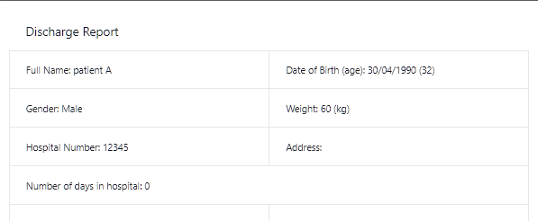




The development of a machine learning-driven clinical decision support system for the management of acute dengue in Vietnam – ASTMH 2022
Damien K. Ming¹, Bernard Hernandez¹, Nguyen Quang Huy², Luu Phuoc An², Ho Quang Chanh², Dong Thi Hoai Tam², Nguyen Tuan², Cameron P. Simmons³, Bridget Wills², Pantelis Georgiou¹, Alison H. Holmes¹, Sophie Yacoub² on behalf of the VITAL consortium (vital.oucru.org)
¹Imperial College London, London, United Kingdom, ²Oxford University Clinical Research Unit (OUCRU), Ho Chi Minh City, Viet Nam, ³Institute of Vector-Borne Disease, Monash Melbourne, Australia
Introduction
Seasonal dengue epidemics exert significant pressure on healthcare settings worldwide
Adoption of appropriate clinical decision-support systems (CDSS) at patient point-of-care could improve the quality and consistency of care.
As a multidisciplinary of clinicians, engineers, software designers, we developed the D-CAT (Dengue Clinical Assessment Tool) with the aim of augmenting decision-making in a hospital setting within Vietnam.
Methods
We performed process mapping and semi-structured interviews to understand better the determinants in decision-making in dengue.
In parallel, machine learning models (XGBoost and Neural network) machine learning models were trained from clinical data from 4,131 patients between 1999-2018 for prediction of dengue shock.
Interface design was done through a human-centred design process with a UX designer.
The system
The system uses a lightweight reactive UI and is accessible through computers, tablets and mobile phones. Individual user profiles are password-protected. Language switching between English and Vietnamese can be toggled. Additional functions and modules can be added on to the architecture in future.
A patient information system provides at-a-glance data on recent results, observations and location, with secure data storage on the intranet.
The machine learning module utilises age, sex, day of illness, haematocrit, platelet data over admission to predict risk of shock (developmental hold out set testing AUROC = 0.82). Output currently uses a traffic light system to indicate predicted risk.
A discharge report which contains all laboratory results and clinical events
Next steps
Prospective evaluation is planned 2022-2023 through workshops, usability testing in clinical areas and evaluation of model performance.
References
Applied machine learning for the risk-stratification and clinical decision support of hospitalised patients with dengue in Vietnam, Ming et al., 2022 PLOS Digital Health
Mapping patient pathways and understanding clinical decision-making in dengue management to inform the development of digital health tools Huy et al., 2022 submitted

