Slide 1








Multi-morbidity poses a complex problem for infection management.
INTRODUCTION
METHODS
RESULTS
CONCLUSION & FUTURE WORK
Multi-morbidity is a growing problem leading to a higher risk of infection, increased complexity and uncertainty
Obesity is a major co-morbidity and is also a driver of other co-morbidities. Many obese patients fail to be treated appropriately leading to significant health inequalities
The literature mainly focuses on general clustering and co-morbidity disease prediction, with more work needed to understand the relationship between other diseases and infection management
We investigated the impact of obesity as a co-morbidity on infection related patient outcomes
Notes:
Multi-morbidity or the presence of concurrent medical conditions in an individual is a significant challenge to healthcare, with its prevalence continuing to increase given the ageing population. Co-morbid conditions put individuals at a high risk of developing an infection with a greater chance of poor outcomes, including increased length of hospital stay, chance of readmission and risk of death. These patients often fail to be treated appropriately due to polypharmacy and a lack of evidence. A large part of the literature focuses on clustering and disease prediction in general, but more work is needed to understand impact of wider determinants and diseases on infection management and outcomes.

Slide 2






A data engineering approach was taken towards data extraction and analysis.
INTRODUCTION
METHODS
RESULTS
CONCLUSION & FUTURE WORK
Demographics
Height and weight
Obesity diagnosis
Length of ICU stay
Antibiotic treatment lengths
Data extracted
MIMIC-IV
Electronic health record information for patients admitted to a large Harvard teaching hospital between 2008 and 2019
Dataset
Grouped according to diagnoses and BMI into healthy, overweight, obese, and morbidly obese categories
Data aggregation
Patients who received antibiotics during an ICU stay
Population
Performed using SciPy
One-way ANOVA
Pairwise Tukey method
Kruskal-Wallis Test
Statistical analysis
Notes:
MIMIC-IV contains electronic health record information for patients admitted to a Harvard teaching hospital between 2008 and 2019
MIMIC-IV is the latest version of the MIMIC database which contains EHR information for patients admitted to the Beth Israel Deaconess Medical Center (BIDMC) in Boston, Mas- sachusetts between 2008 and 2019. A large teaching hospital as part of Harvard Medical School. MIMIC-IV consists of three modules; the core module covers demographics, records and timing information, the hosp module contains all data from the hospitals overarching EHR, finally the icu module. MIMIC-IV is a relational database meaning links between tables can be established through common columns. Access to MIMIC-IV was obtained through becoming a credentialed user on PhysioNet and completing associated training (a training course in human subjects research)

Slide 3
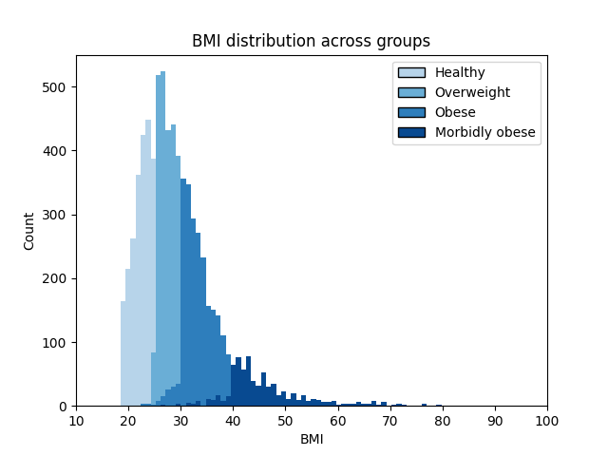
Co-morbid obesity leads to significantly worse infection outcomes.
INTRODUCTION
METHODS
RESULTS
CONCLUSION & FUTURE WORK
Mean | Number of patients | Body mass index (BMI) | Death rate | Length of ICU stay (days) | Antibiotic treatment length (days)
Healthy (HE) | 19,612 | 22.40 | 0.18 | 5.86 | 5.18
Overweight (OW) | 2,405 | 27.38 | 0.18 | 7.98 | 5.86
Obese (OB) | 3,803 | 33.34 | 0.15 | 7.14 | 5.60
Morbidly obese (MB) | 1,543 | 46.28 | 0.17 | 8.14 | 6.39
Length of ICU stay (days)
 | HE | OW | OB | MB
HE
OW
OB
MB
Antibiotic treatment length (days)
 | HE | OW | OB | MB
HE
OW
OB
MB
 | Statistically significant difference between groups (alpha = 0.05)
 | No statistically significant difference between groups
Notes:
Co-morbid conditions provide a significant challenge to infection management, causing increased complexity and uncertainty. Obesity is a major driver of co-morbidities with its prevalence continuing to increase given modern diets and lifestyles. We investigated the current impact of co-morbid obesity on infection patient outcomes.
Subsequent statistical analysis through a one-way ANOVA (analysis of variance), the pairwise Tukey method and Kruskal-Wallis Test confirmed a statistically significant (alpha = 0.05 ) difference in LOS between all groups, except those who are overweight and those with morbid obesity . Similar results were obtained for antibiotic treatment length with all p-values being statistically significant other than for obese and overweight populations. Comparing categorical outcome variables re-treatment and death through the Chi-Square test of independence also rejects the null hypothesis and shows statistically different outcomes between groups.
Co-morbid obesity leads to significantly worse infection outcomes including extended antibiotic treatment and increased length of stay
Future research will aim to further understand the impact of co-morbidities, such as obesity, on antibiotic management and explore how to most appropriately model multi-morbidity within data-driven clinical decision support systems.

Slide 4
Next steps include understanding relationships further through graph methodologies.
INTRODUCTION
METHODS
RESULTS
CONCLUSION & FUTURE WORK
Conclusion
Future Work
Understand potential confounders, and if the impact of obesity, on antibiotic management is clinically meaningful
Model patients' co-morbidities through graphs methods to elucidate more of the underpinning relationship between co-morbidities and infection as well as provide useful input information to AI models
Analysis of a large-scale critical care database confirms previous research that obesity is associated with extended length of ICU stay and increased antibiotic treatment.
Results highlight the inherent messy nature of electronic health record data
Node features
Node features
Distance
Disorder 1
Learnt edge
Disorder 2
Treatment
Demo-graphics
Procedures

