Slide 1
How Physiology-based Pharmacokinetic (PBPK) modelling can aid optimisation of antimicrobials
Christopher Darlow
NIHR Academic Clinical Lecturer (Infectious Diseases & Medical Microbiology)
University of Liverpool

Slide 2
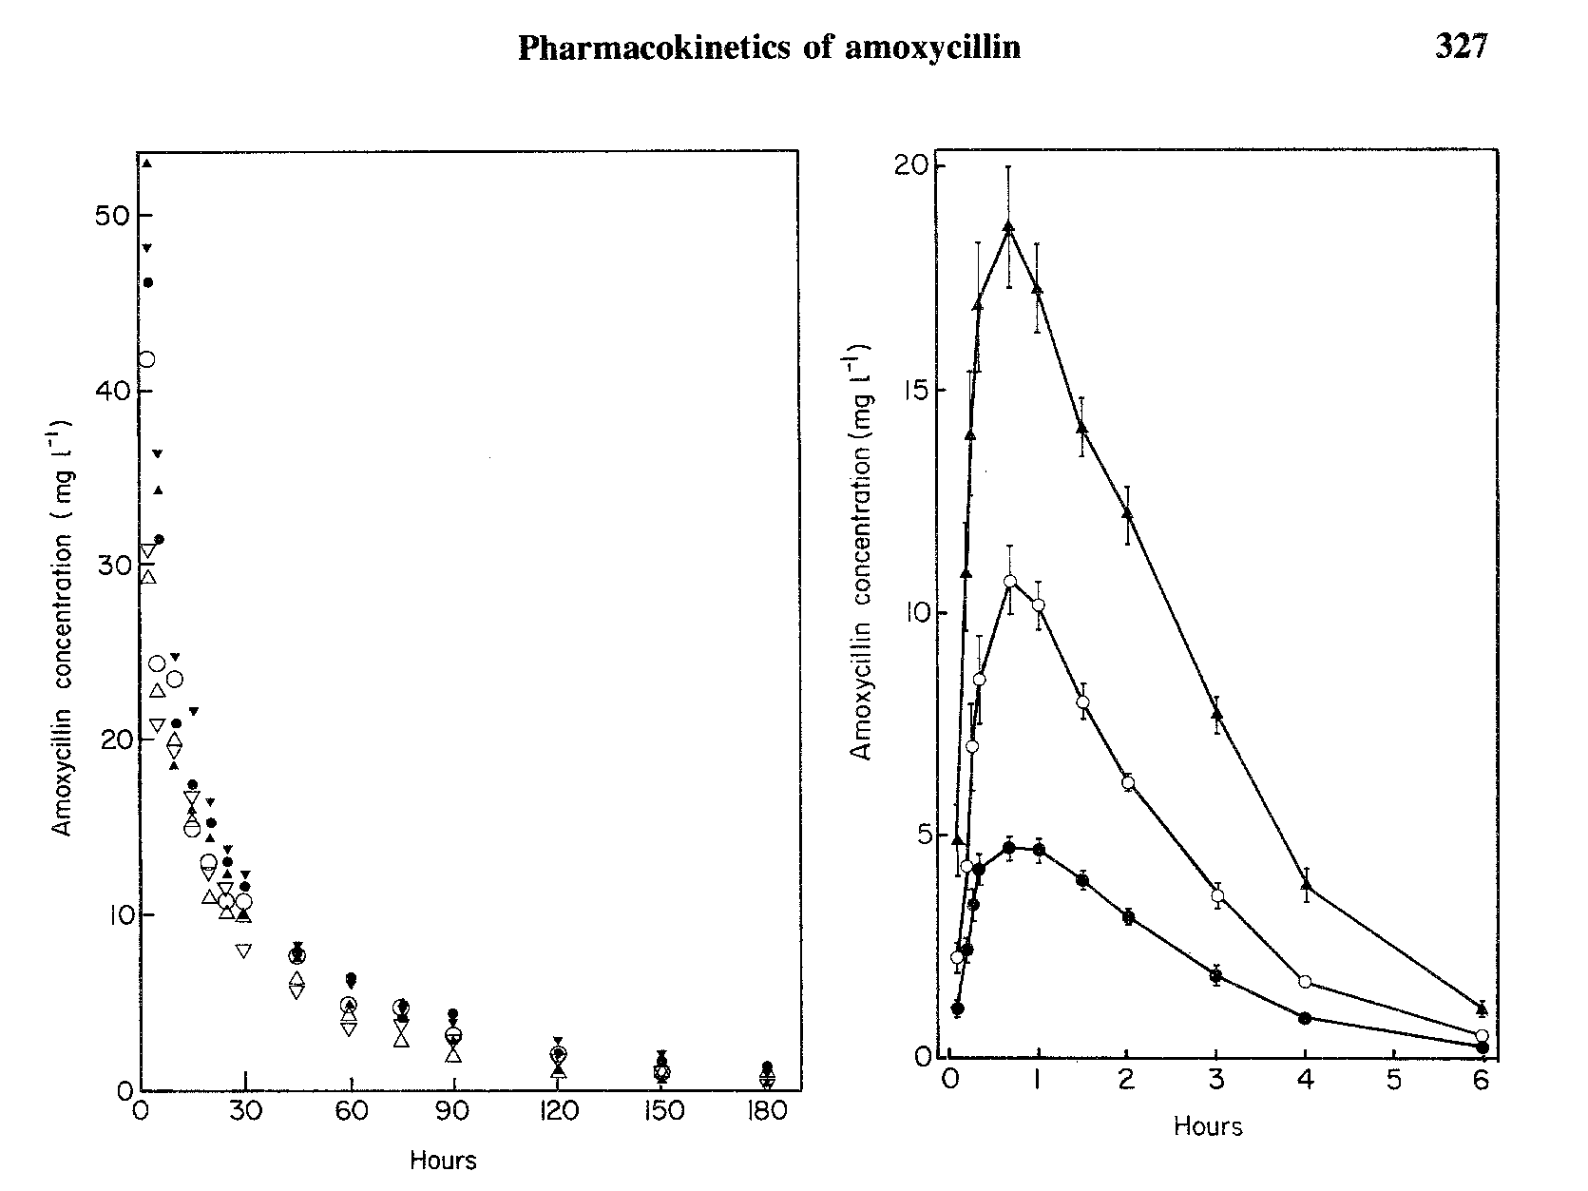
Tradition antimicrobial pharmacokinetics
Hill et al, Journal of Infection 1980 2, 320-332

Slide 3
Population Pharmacokinetics
IV drug
V = x * (y*body weight) * (z*age)
CL = x * (y*renal function) * (z*liver function)
Peripheral compartment
Plasma
(V)
Drug clearance
(CL)

Slide 4
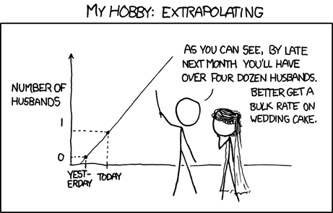
Issues with this approach
Data often only from healthy volunteers and from a narrow demographic range
Consequently, use limited to confines of the data
Use in special populations and demographics extrapolates beyond the data.

Slide 5
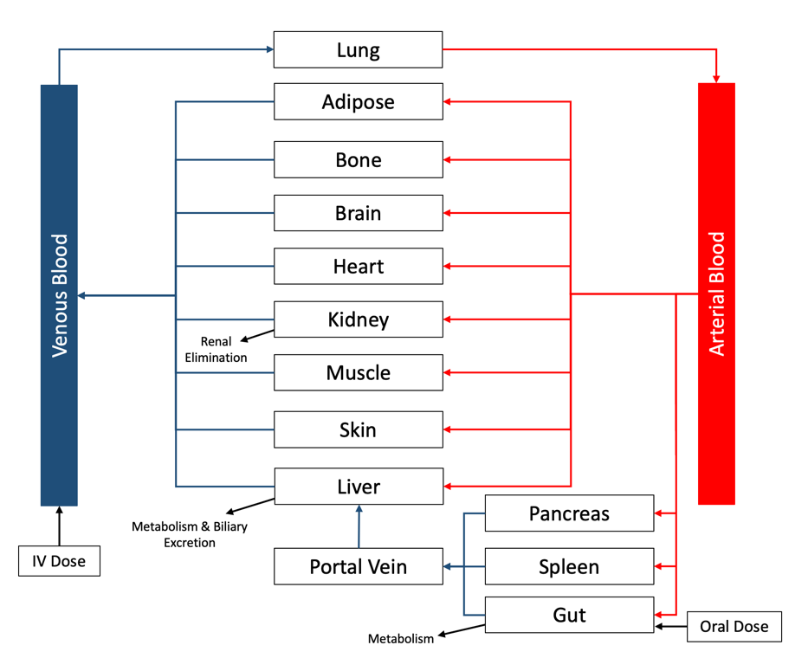
PBPK modelling

Slide 6
Role of PBPK modelling in CAMO-Net
Prediction of antimicrobial PK in varying physiologies
Different demographics (e.g. ethnicities)
Different age groups (e.g. children, neonates, elderly)
Different physiological circumstances (e.g. obesity, renal failure, pregnancy)
Prediction of tissue concentrations where sampling impractical
Prediction of the effect of drug-drug interactions

Slide 7
Specific plans
Build PBPK models for amoxicillin, clavulanic acid and flucloxacillin
Use these models to explore systemic and tissue drug exposures in special populations (neonates, obesity etc) and differing demographics (e.g. non-Caucasian ethnicities)
Long term look to integrating with a systems pharmacology pharmacodynamic model

Slide 8
Thank you

