Slide 1

Applied machine learning to optimise clinical management of acute febrile illnesses and neonatal care
Damien Ming Imperial College London
21st June 2023

Slide 2
Acute febrile illnesses
An inherently dynamic condition
Evaluation of patient severity and risk is fundamental
Focus on machine learning approaches which capture change over time

Slide 3
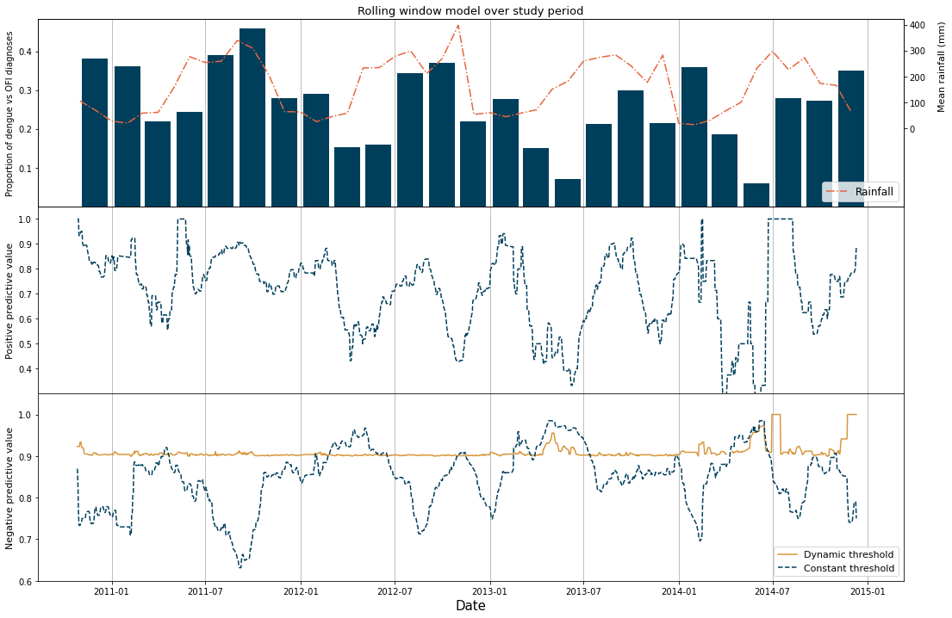
Overview
Predicting acute febrile illness diagnoses using routine laboratory data (Vietnam)
n=8,100 with acute febrile illness
incorporation of seasonal factors (rainfall/temperature) increases robustness of model
Summarised periodic
Daily
Continuous real-time

Slide 4
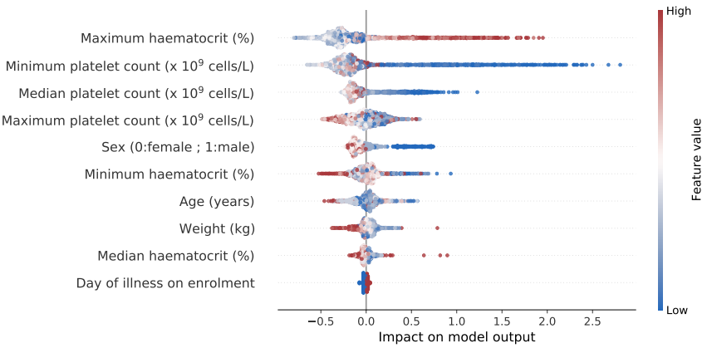
Overview
Predicting severity for hospitalised patients with dengue (Vietnam)
n = 4,131 with confirmed dengue
full blood count and change over 48 hours of admission excludes severe disease for inpatients
Summarised periodic
Daily
Continuous real-time

Slide 5
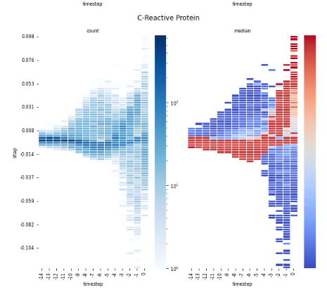
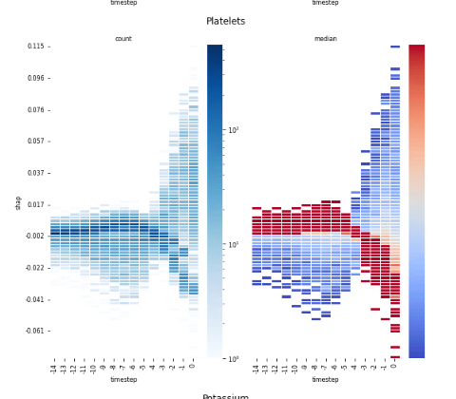
Overview
Predicting pathogenic bacterial bloodstream infections (UK) at point of blood culture acquisition
n=20,850 undergoing blood cultures
dynamics of routine biomarkers over time are important for predictive performance
Summarised periodic
Daily
Continuous real-time

Slide 6
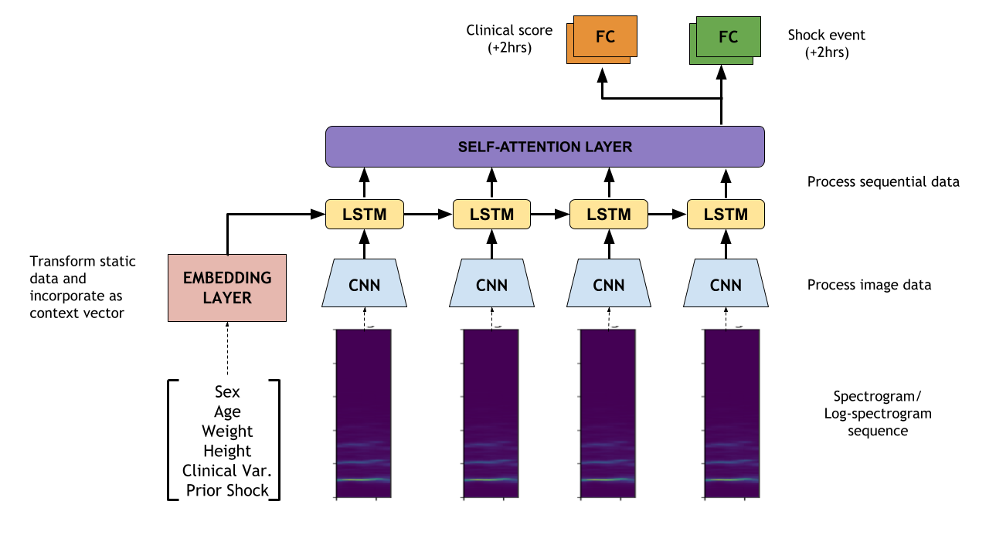
Overview
Non-invasive continuous pulse waveform monitoring to risk stratify and predict shock in dengue (Vietnam)
n=174 patients with dengue monitored for up to 72 hours with a pulse oximeter
dynamically risk stratify with reference to NEWS2 scoring and shock
Summarised periodic
Daily
Continuous real-time

Slide 7
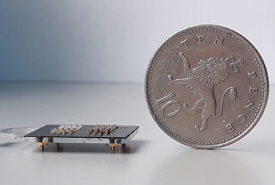
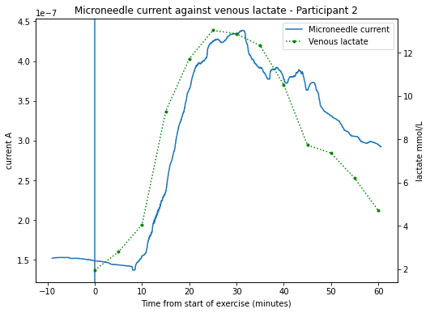
Overview
Continuous sensing of interstitial lactate using a minimally-invasive biosensor
n=10 healthy volunteers exercising to capture lactate dynamics in real-time
Summarised periodic
Daily
Continuous real-time

