Slide 1

Data linkage resources, access, analysis, and outputs for integrated care
CAMO-UK researchers meeting
21 June 2023
Nina Zhu PhD MPH MSc
Imperial College London

Slide 2
Primary care
Secondary care
Second Generation Surveillance System (SGSS)
Hospital Episode Statistics (HES)
National
North West London Pathology
(NWLP)
Regional
Whole Systems Integrated Care (WSIC)
Secondary User Service (SUS)
Local
Imperial Clinical Analytics, Research and Evaluation (iCARE)

Slide 3
Imperial Clinical Analytics, Research and Evaluation (iCARE)
Real-time routine clinical and laboratory data
De-identified for research accessible through TRE
Creates, tests, and evaluates clinical interventions
Linkage with WSIC, images, tissue bank, and genomics

Slide 4
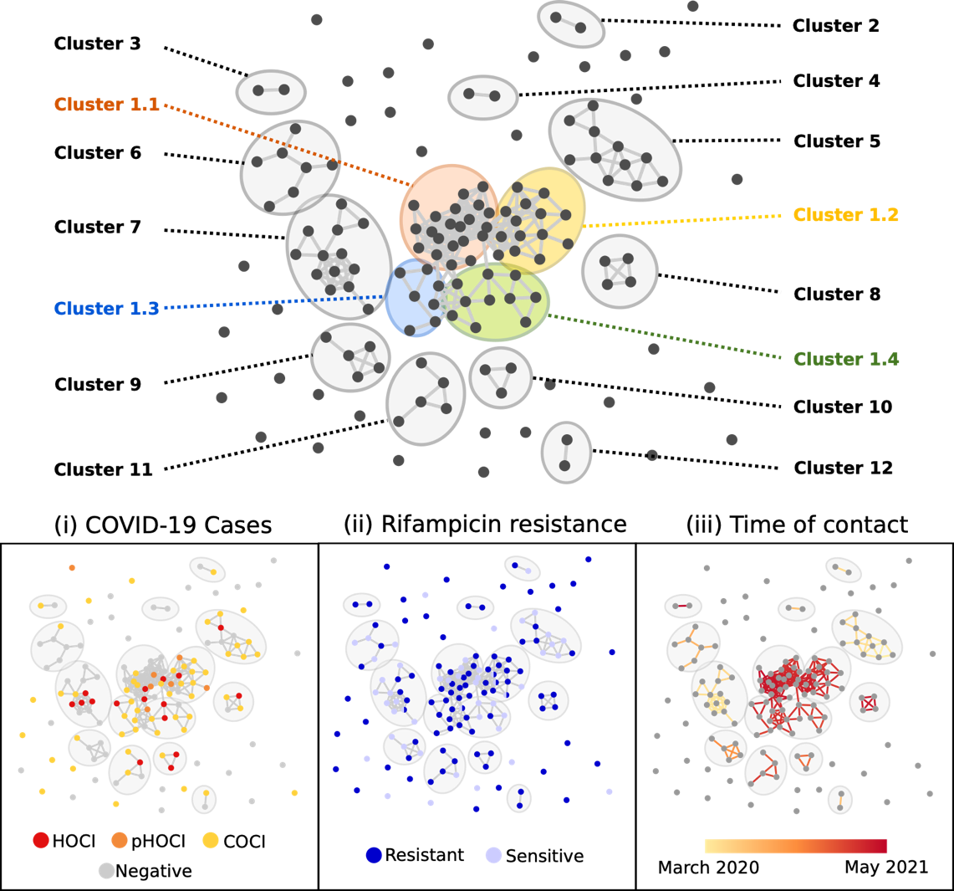
Early identification of newly emerged resistant pathogens, simulation of transmission and clustering
Real-time monitoring of HCAI burden, vaccination among staff, and screening and laboratory capacity during the pandemic
Zhu et al. 2021; Zhu, Myall et al. 2023

Slide 5
Whole Systems Integrated Care (WSIC)
Linked clinical and social care records
De-identified for research accessible through TRE
Expanded linkage with North West London Pathology
Allow assessment of social determinants influencing care access, infection and AMR burden

Slide 6
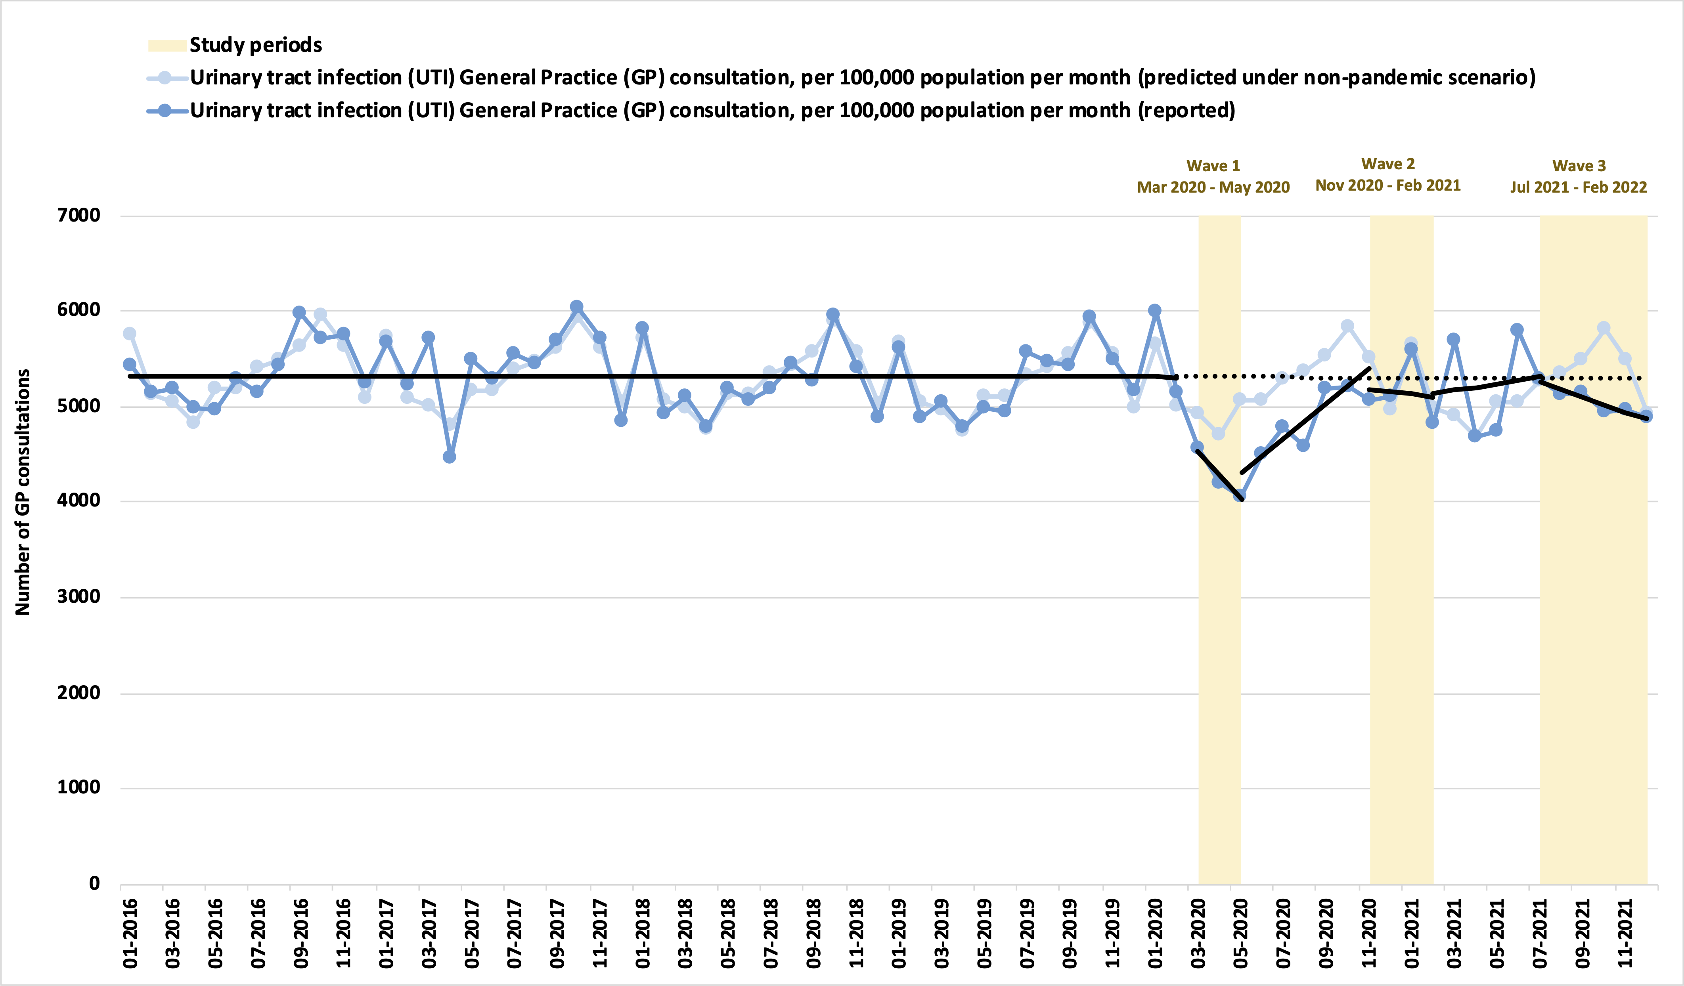
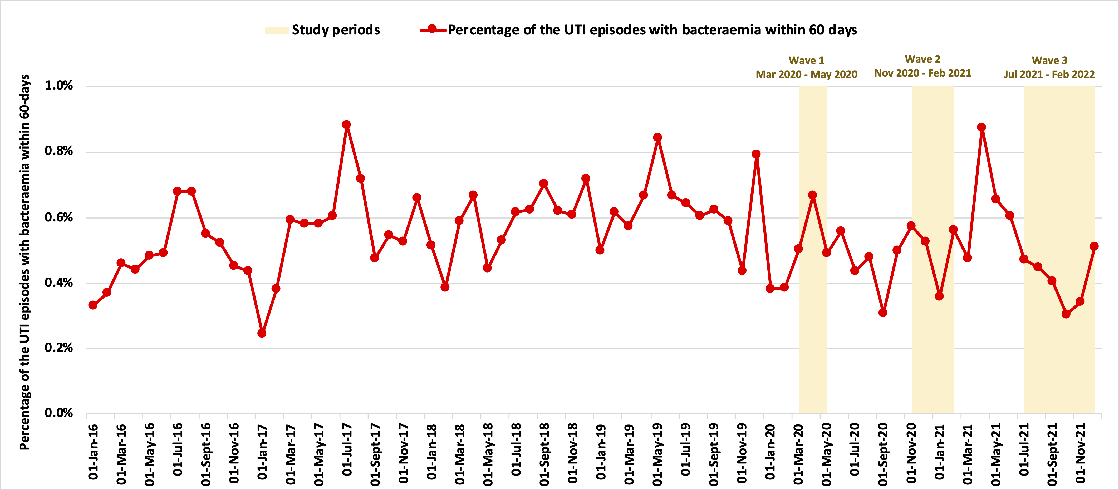
Ecological analysis
Individual-based risk modelling and economic analysis
AMR surveillance
Second Generation Surveillance System (SGSS)
North West London Pathology
(NWLP)
GP antimicrobial prescribing indicator and patterns
NHS Business Service Authority (BSA)
Whole Systems Integrated Care (WSIC)
Hospital electronic records
Hospital Episode Statistics (HES)
Secondary User Service (SUS)
Follow patient journey across primary and secondary care to assess treatment outcomes, supported by linkage with prescribing and laboratory data
Zhu et al. 2023

