Slide 1

Leveraging time series dependencies for clinical management of acute febrile illnesses using machine learning
Damien Ming
d.ming@ic.ac.uk
CAMO-NET meeting
14th December 2023

Slide 2
Clinical scenarios
A 59 year old man has been admitted to hospital in the UK with abdominal pain and is awaiting investigations. On day 3 of admission, he develops a fever and becomes less responsive.
A 24 year old woman develops fever and body aches in Vietnam, and attends the local hospital. Over the next 3 days she develops some gum bleeding but then makes a full recovery.

Slide 3
Medical observation and patient dynamics
Change in clinical state over time in the past is important for future prediction
Methodologically, repeated measurements of different quantities a unique statistical challenge
Pre-requisites: data of sufficient fidelity, linkage, fusion of data at different frequencies

Slide 4
Aims of session and discussion:
Discuss challenges in synthesising time series information for acute care of infections
Multi-modal incorporation of diverse data (data fusion) and emergent themes
Implementation of models to the clinical setting

Slide 5
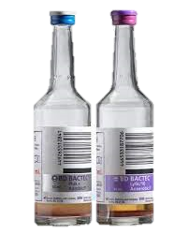
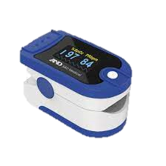
2 exemplar case studies
Bacterial bloodstream infections (BSI) using blood biomarkers
Dengue severity using pulse waveform and PPG

Slide 6
Example 1: Bacterial bloodstream infections (BSI)
Significant healthcare burden (2.91 million deaths in 2019)
Positive predictive value of blood cultures ~ 7.5%
Result turnaround time 24-48 hours
Priorities in different settings – maximising NPV vs PPV

Slide 7
Research question
Can the use of longitudinal patient information help predict BSIs and what is the added contribution of such time series data?

Slide 8

Dataset – iCARE and EHR
March 2014 – Dec 2021 at Imperial College NHS Trust
20,850 patients undergoing blood culture sampling
Biomarker data up to 14 days prior (where available) extracted

Slide 9
Microbiological definitions
¹Escherichia coli, Klebsiella spp., Enterococcus spp., Pseudomonas spp., Proteus spp., Serratia spp., Citrobacter spp., Streptococcus spp., Staphylococcus aureus.
BSI state – according to WHO priority pathogens list ¹ (18.5%)
Non-BSI state – no growth at 5 days or isolation only of one of ² (71.5%)
² Coagulase negative Staphylococcus group, Micrococcus spp., Corynebacterium spp. excluding Corynebacterium striatum.

Slide 10
Data methods
Initial training and hold-out set temporal split
5-fold cross validation
Missing values forward filled where possible otherwise masked
A long short-term memory (LSTM) approach for time series data, with logistic regression and feature engineering as baseline
Tuning using Bayesian optimisation
Training (n=15,212)
Test (n=5,638)
March 2014
Feb 2021
Dec 2021

Slide 11
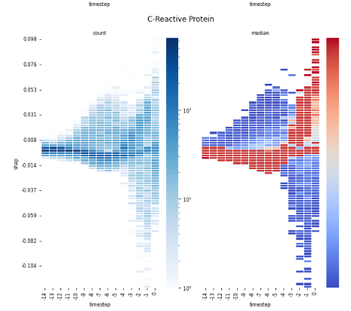
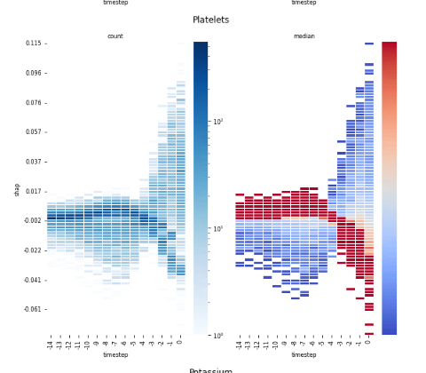

Slide 12
Handling of missing data and MNAR
The pattern of biomarker acquisition and measurement is reflective of clinical need
Forward fill, interpolate, imputation, masking
Models are built on the premise that local practices remain consistent

Slide 13
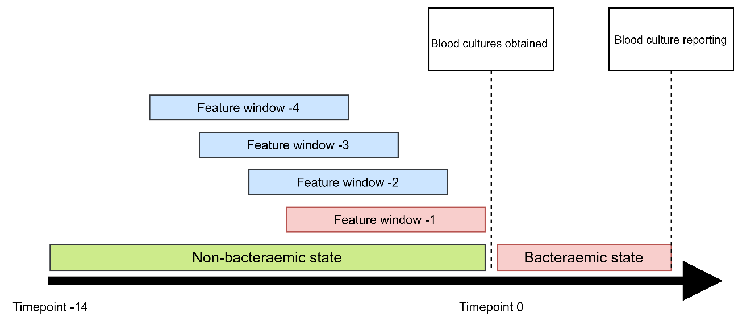
What about a real-time monitoring system?

Slide 14
Synthesis of metadata to augment prediction
Patient factors: immunosuppression status, risk factors, clinical assessment derived from natural language processing
Laboratory metadata: time to positivity vs inoculum volume, information derived from MALID-TOF, use of adjunctive diagnostics e.g. sepsityper
Fusion of data another challenge…

Slide 15
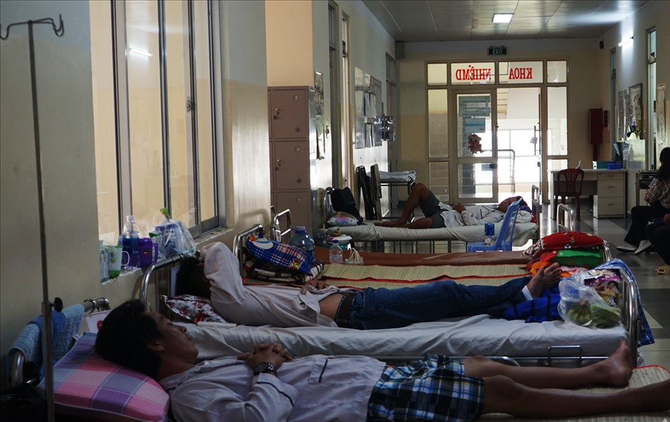
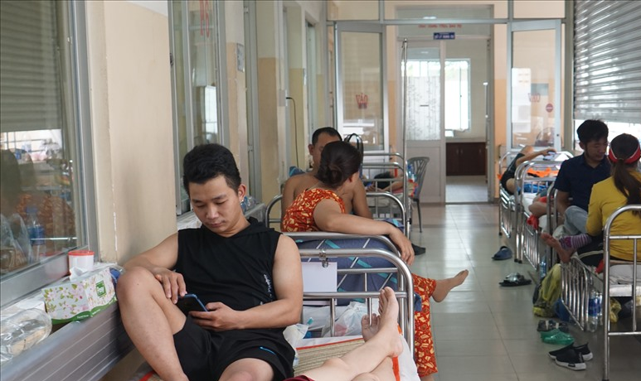
Example 2 – dengue risk prediction
Patients admitted to hospital fulfil dengue with warning signs (and are at increased risk)
Tools for close monitoring of patients are lacking

Slide 16
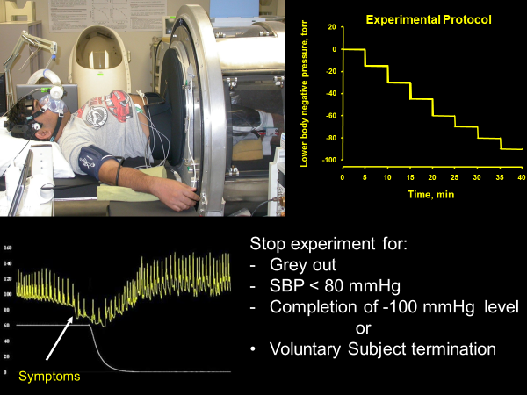
Wearables using photoplethysmography (PPG)
Morphology of pulse waveform related to cardiovascular status
(and also derivation of pulse, SpO2, respiratory change)

Slide 17
Research question
Can pulse waveform alone provide safe patient monitoring in dengue (and prediction of risk in) – and how can its performance be enhanced?

Slide 18
Methods
Prospective recruitment of 153 patients admitted to Ho Chi Minh City with acute dengue (2021-2022)
PPG monitoring for 24+ hours alongside standard vital signs monitoring
Approach using PPG signals and prediction of outcomes e.g. NEWS2, dengue shock, other relevant outcomes
Can we incorporate relevant clinical data to the signal waveform too? Or synthesise with other machine learning models?

Slide 19
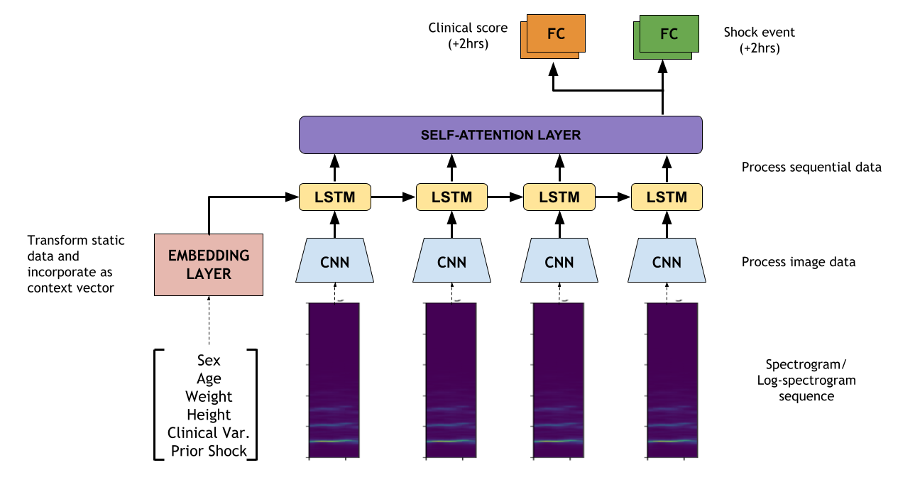
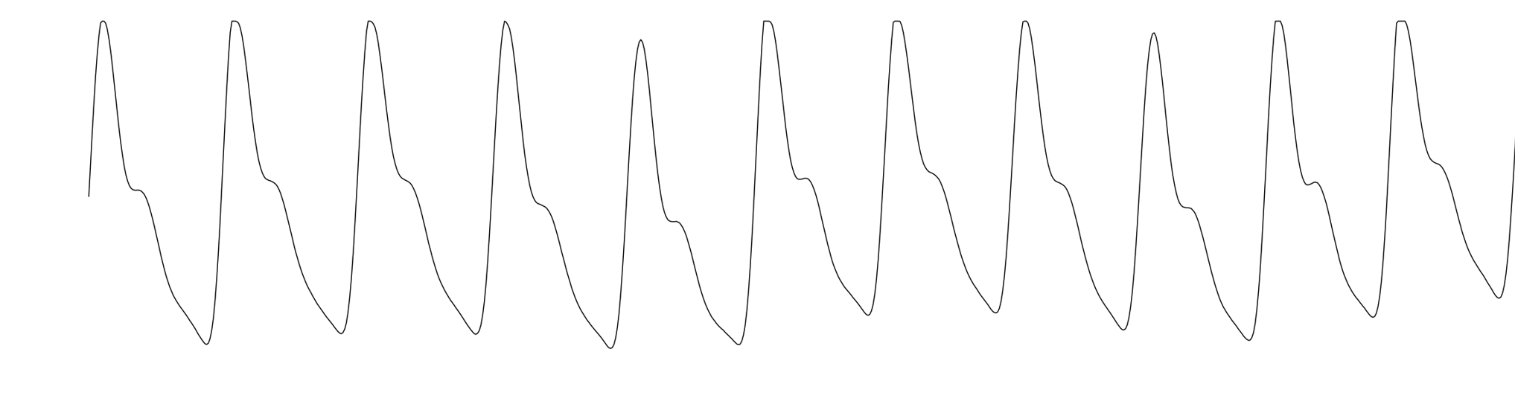
Multi-modal approach to prediction
2-hour prediction horizon
Dr John Daniels and Professor Pantelis Georgiou
Centre for BioInspired technology, Imperial College London

Slide 20
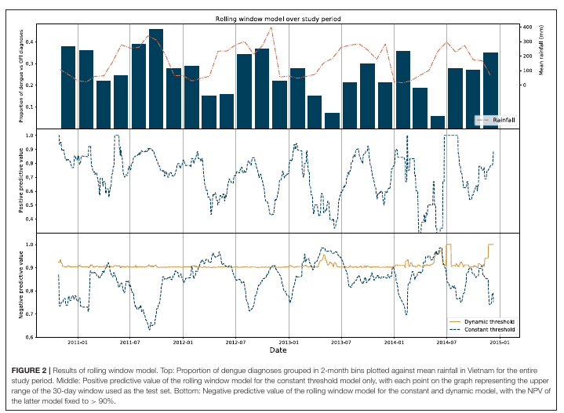
Beyond patient related factors
Synthesis of seasonal, epidemiological, population level data as a proxy of strain virulence etc…
Dengue prediction and seasonality factors

Slide 21
Conclusion
Time series dependencies are important and a move away from static scores applied at one timepoint could bring benefits to clinical care
Leveraging such modalities relies on availability of data
Connectivity and electronic healthcare records
Role of signal acquisition such as through wearable devices
Complex diverse datasets need synthesis to provide relevant classifications/predictions

