Slide 1

Towards the development of a continuous model for the assessment of bacteremia, bloodstream infection and sepsis
June 21st, 2024
Óscar Escudero-Arnanz
oscar.escudero@urjc.es
Department of Signal Theory and Communications, Telematics and Computing Systems
Rey Juan Carlos University
https://github.com/oscarescuderoarnanz
Joint work with Bernard Hernandez, Cristina Soguero-Ruiz, Inmaculada Mora-Jiménez, and A. G. Marques
26-28 June 2024
IEEE 37th International Symposium on Computer Based Medical Systems

Slide 2


Academic journey
Rey Juan Carlos University (URJC), Madrid, Spain
B.Sc. in Telecommunications
M.Sc. in Telecommunications
Ph.D. in Artificial Intelligence and Data Science
Università Campus Bio-Medico (UCBM), Roma, Italy
Visiting researcher (PhD)
Imperial College London (ICL), London, United Kingdom
Visiting researcher (PhD)
Notes:
Academic Journey. My name is Óscar Escudero Arnanz. I have studied both my bachelor's and master's degrees in telecommunications at the Universidad Rey Juan Carlos, and I am currently pursuing a Ph.D. in Artificial Intelligence and Data Science.
I have conducted a research stay as PhD student at Università Campus Bio-Medico and am currently on a research stay at Imperial College London.

Slide 3
Academic journey
Rey Juan Carlos University (URJC), Madrid, Spain. Ph.D. in Artificial Intelligence and Data Science
Electronic Health Record
Irregular Multivariate Time Series
Distance measures and kernel methods
Multimodal Architectures
Interpretable Recurrent Neural Networks
Interpretable Spatio-Temporal Graph Neural Networks
[1] Escudero-Arnanz Ó, Mora-Jiménez I, Martínez-Agüero S, Álvarez-Rodríguez J, Soguero-Ruíz C. Temporal Feature Selection for Characterizing Antimicrobial Multidrug Resistance in the Intensive Care Unit. InAAI4H@ ECAI 2020 Sep (pp. 54-59)
[2] Escudero-Arnanz, Óscar, Rodríguez-Álvarez, J., Mikalsen, K. Ø., Jenssen, R., & Soguero-Ruiz, C. On the Use of Time Series Kernel and Dimensionality Reduction to Identify the Acquisition of Antimicrobial Multidrug Resistance in the Intensive Care Unit. KDD 2021 Health Day and 2021 KDD Workshop on Applied Data Science for Healthcare.
[3] Escudero-Arnanz Ó, Mora-Jiménez I, Martínez-Agüero S, Álvarez-Rodríguez J, Soguero-Ruíz C.
Feature Selection and Tree-based Models to Predict Multidrug-Resistance. CASEIB 2020.
[4] Oscar Escudero-Arnanz, Antonio G. Marques, Cristina Soguero-Ruiz, Inmaculada Mora-Jiménez, Gregorio Robles. dtwParallel: A Python Package to Efficiently Compute Dynamic Time Warping Between Time Series. SoftwareX, 2023.
[5] Oscar Escudero-Arnanz, Antonio G. Marques, Rosa Sicilia, Cristina Soguero-Ruiz. Low-Rank Tensor Completion for Heart Failure Detection in Multivariate Time Series with Missing Data. IEEE 37th International Symposium on Computer Based Medical Systems 2024.
[6] Oscar Escudero-Arnanz, Antonio G. Marques, Inmaculada Mora-Jiménez, Joaquín Álvarez-Rodríguez, Cristina Soguero-Ruiz. Leveraging Multivariate Time Series Analysis and Machine Learning for the Characterization of Antimicrobial Resistance in the Intensive Care Unit. Engineering Applications of Artificial Intelligence. (submitted, 2024, under review)
[7] Oscar Escudero-Arnanz, Cristina Soguero-Ruiz, Inmaculada Mora-Jiménez, Joaquín Álvarez-Rodríguez, Antonio G. Marques. Explainable AI Techniques for Irregular Temporal Prediction of Antimicrobial Multidrug Resistance Acquisition in Intensive Care Unit Patients. Engineering Applications of Artificial Intelligence. (to submit on 30th in June 2024)
[8] Oscar Escudero-Arnanz, Cristina Soguero-Ruiz, Inmaculada Mora-Jiménez, Joaquín Álvarez-Rodríguez, Antonio G. Marques. Explainable Spatio-Temporal Graph Architecture for Irregular Multivariate Time Series in Inference Tasks. IEEE TSIPN. (to submit on 30th in July 2024)
Clinical Task
Notes:
During my PhD I had worked
With data from Electronic Medical Records, which I have modeled as Irregular Multivariate Time series.
I have proposed methods that evaluate the distance and similarity between MTS
Multimodal architectures
graphs, and interpretable recurrent neural networks
to tackle inference tasks in the health domain.

Slide 4
Problem definition
Bacteremia
Bloodstream Infection (BSI)
Sepsis
The presence of bacteria in the bloodstream, which can originate from various sources such as wounds, surgical procedures, or other infections
Bacteremia with systemic signs of infection
A severe systemic response to infection, often marked by widespread inflammation, organ dysfunction, and a high risk of mortality
Notes:
Problem Definition: First, I will briefly introduce the definition of three clinical concepts that I will reference throughout the presentation: bacteremia, BSI, and sepsis.
Bacteremia: The presence of bacteria in the bloodstream, which can originate from various sources such as wounds, surgical procedures, or other infections.
BSI (Bloodstream Infection): Bacteremia with systemic signs of infection.
Sepsis: A severe systemic response to an infection, often marked by widespread inflammation, organ dysfunction, and a high risk of mortality.

Slide 5
Objective
Prediction
Bacteremia
BSI
Sepsis
Notes:
Considering the three terms above, the objective of this work is to predict whether a patient will develop bacteremia, BSI, and/or sepsis during their stay in the ICU. I will provide more details on the final objective of this work later.

Slide 6
Databases & inclusion criteria
Data Sources
We will use data from four public datasets…
Focusing on patients in the Intensive Care Unit (ICU).
Inclusion Criteria for Patients
Exclude patients with more than 85% missing values.
MIMIC
AUMC
HiRID
eICU
Biochemical markers
Vital signs
Statics
4
55
7
Notes:
To achieve this, we will use four widely-used public datasets in state-of-the-art work related to our objective. Specifically, we will use MIMIC, eICU, HIRID, and AUMC. We will focus on ICU-admitted patients, and for now, we will focus on the MIMIC dataset.
Additionally, given that we have a large number of patients, but not all of high quality, we have established a patient inclusion criterion. A patient will be excluded if they have more than 85% missing values.
Finally, it should be noted that these missing data have been calculated considering a total of 66 variables, of which 55 are biochemical markers, 7 are vital signs, and 4 are static.

Slide 7
Labels definition. Bacteremia
Bact.
Antib.
Sample
Susp. Inf.
ΔSofa
 | 0 |  |  |  |  |  |  |  |  |  |  |  |  |  |  |  |  |  |  |  |  |  |  |  |  |  |  |  |  |  |  |  |  |  |  |  |  |  |  |  |  | 72h
O
24h
Notes:
Labels Definition: The next step was to define the labels for the problem. In the figure we are looking at, the x-axis represents time and the y-axis represents features. The blue-shaded areas represent patient information before ICU admission or after ICU discharge.
For bacteremia, if a culture is performed, i.e., a sample is taken, we will select the onset as the time point when the sample was taken. We will propagate the value of 1 forward for 24 hours.

Slide 8
Labels definition. Suspected Infection
Bact.
Antib.
Sample
Susp. Inf.
ΔSofa
 | 0 |  |  |  |  |  |  |  |  |  |  |  |  |  |  |  |  |  |  |  |  |  |  |  |  |  |  |  |  |  |  |  |  |  |  |  |  |  |  |  |  | 72h
O
24h
48h
O
24h
Bact.
Antib.
Sample
Susp. Inf.
ΔSofa
 | 0 |  |  |  |  |  |  |  |  |  |  |  |  |  |  |  |  |  |  |  |  |  |  |  |  |  |  |  |  |  |  |  |  |  |  |  |  |  |  |  |  | 72h
O
24h
48h
O
24h
Notes:
Suspected infection
For the definition of suspected infection, a variable needed to establish the BSI label, we have two approaches:
If antibiotic treatment occurred first, it must be followed by fluid sample collection within 24 hours.
If fluid sample collection occurred first, it must be followed by antibiotic treatment within 72 hours to be classified as suspected infection.
The earlier of the two times is taken as the suspected infection (SI) time. After this, the SI window is defined to begin 48 hours before the SI time and end 24 hours after the SI time.

Slide 9
Labels definition. BSI
O
BSI
Bact.
Antib.
Sample
Susp. Inf.
ΔSofa
 | 0 |  |  |  |  |  |  |  |  |  |  |  |  |  |  |  |  |  |  |  |  |  |  |  |  |  |  |  |  |  |  |  |  |  |  |  |  |  |  |  |  | 72h
O
24h
48h
O
24h
Notes:
BSI:
Bloodstream infection (BSI) is defined as the presence of bacteremia concurrent with suspected infection.

Slide 10
Labels definition. Sepsis
Sepsis
BSI
Bact.
Antib.
Sample
Susp. Inf.
ΔSofa
 | 0 |  |  |  |  |  |  |  |  |  |  |  |  |  |  |  |  |  |  |  |  |  |  |  |  |  |  |  |  |  |  |  |  |  |  |  |  |  |  |  |  |  |  |  |  |  | 72h
48h
O
24h
O
O
24h
48h
O
24h
Notes:
Sepsis:
Finally, the onset of sepsis is defined as the concurrence of suspected infection and a SOFA score increase of two or more points.

Slide 11
Pre-processing
Pre-processing
Each patient has been segmented into windows
Window Size: Fixed at 6 hours
Look Back Period: 6 hours
Look Ahead Period: 1 hour
Prediction Goal
The aim is to predict within a 6-hour look back and 1-hour look ahead window whether the patient will develop:
Bacteriemia
BSI
Sepsis
Prediction
bacteremia
BSI
Sepsis
Notes:
Pre-processing: After previously introducing the label definitions, the next step is to detail the preprocessing carried out for each patient. Each patient has been segmented into overlapping windows of 6 hours in length, from ICU admission to ICU discharge. Considering this definition, the goal is to predict in T+1 the probability of developing bacteremia, BSI, and/or sepsis.

Slide 12
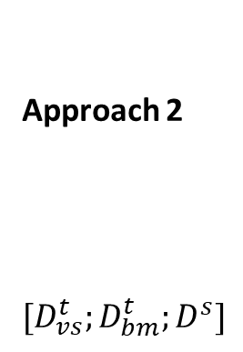


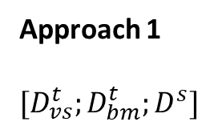
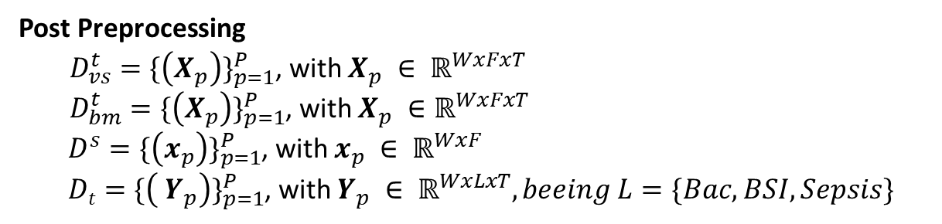
Approaches
Post Preprocessing
${D_{vs}^{t}=\{\left(X_{p}\right)\}}_{p=1}^{P}$, with $X_{p} ∈ ℝ^{WxFxT}$
${D_{bm}^{t}=\{\left(X_{p}\right)\}}_{p=1}^{P}$, with $X_{p} ∈ℝ^{WxFxT}$
${D^{s}=\{\left(x_{p}\right)\}}_{p=1}^{P}$, with $x_{p} ∈ ℝ^{WxF}$
${ Dt=\{\left( Y_{p}\right)\}}_{p=1}^{P}$, with $Y_{p} ∈ ℝ^{WxLxT}, beeing L=\{Bac, BSI, Sepsis\}$
Windows (W)
Time (T)
Features (F)
Approach 2
$$[D_{vs}^{t};D_{bm}^{t};D^{s}]$$
Approach 1
$$[D_{vs}^{t};D_{bm}^{t};D^{s}]$$
Model
Bacteremia
Bacteremia
$$[D_{vs}^{t};D_{bm}^{t};D^{s}]$$
Model
BSI
Model
BSI
Sepsis
$$[D_{vs}^{t};D_{bm}^{t};D^{s}]$$
Model
Sepsis
Notes:
Description of the data.
We propose two approaches to approach the prediction of Bacteremia, BSI and sepsis.
- Independent prediction
- Multilabel prediction

Slide 13
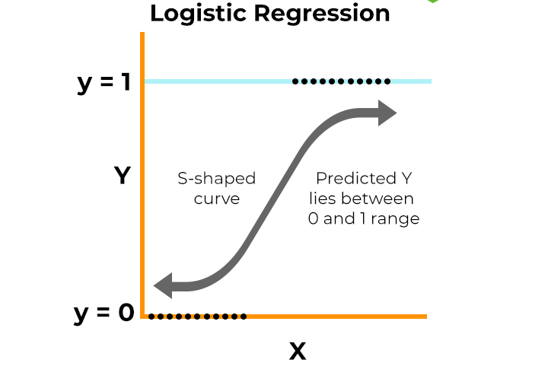


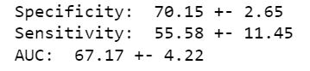


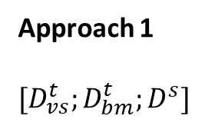
Approaches
Approach 1
$$[D_{vs}^{t};D_{bm}^{t};D^{s}]$$
LR
Bacteremia
$$[D_{vs}^{t};D_{bm}^{t};D^{s}]$$
LR
BSI
$$[D_{vs}^{t};D_{bm}^{t};D^{s}]$$
LR
Sepsis
Results
Bacteremia
BSI
Sepsis
Notes:
Logistic Regression: A statistical model used to predict the probability of a binary variable. In our case, it is used to predict the probability that a patient will develop bacteremia, BSI, or sepsis. Logistic regression estimates the parameters of a logistic function that fits the training data, allowing classification of observations into two distinct categories.
Regarding the results, we can observe that this approach is capable of predicting bacteremia with almost 77% AUC, BSI with 65% AUC, and sepsis with 67% AUC. In this slide, I present the relevance of the 20 most important variables to predict if a patient develops bacteremia, BSI, and sepsis.

Slide 14
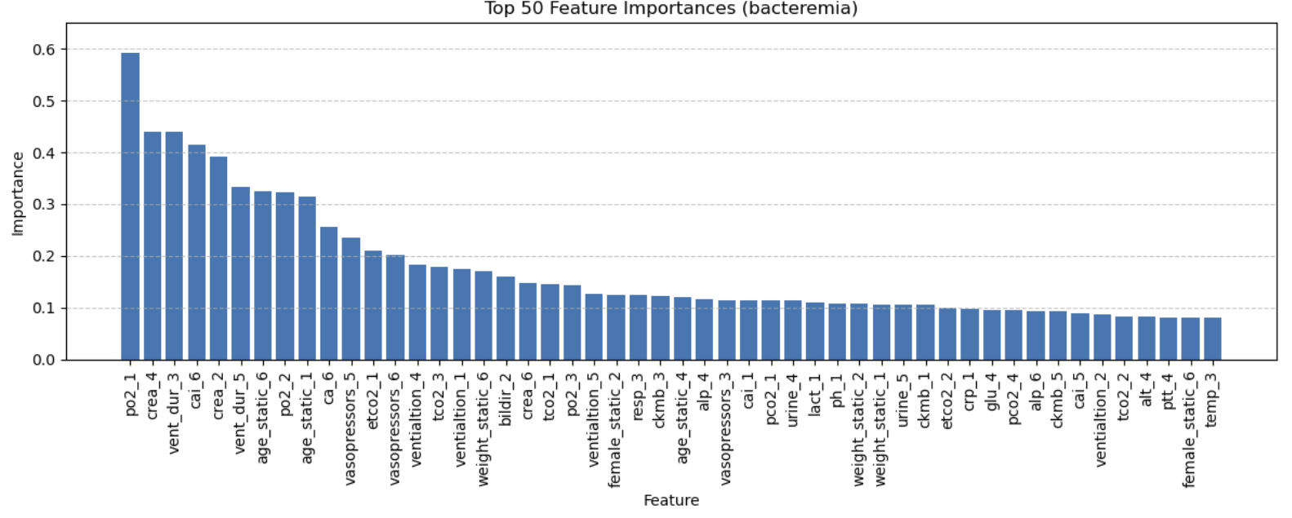
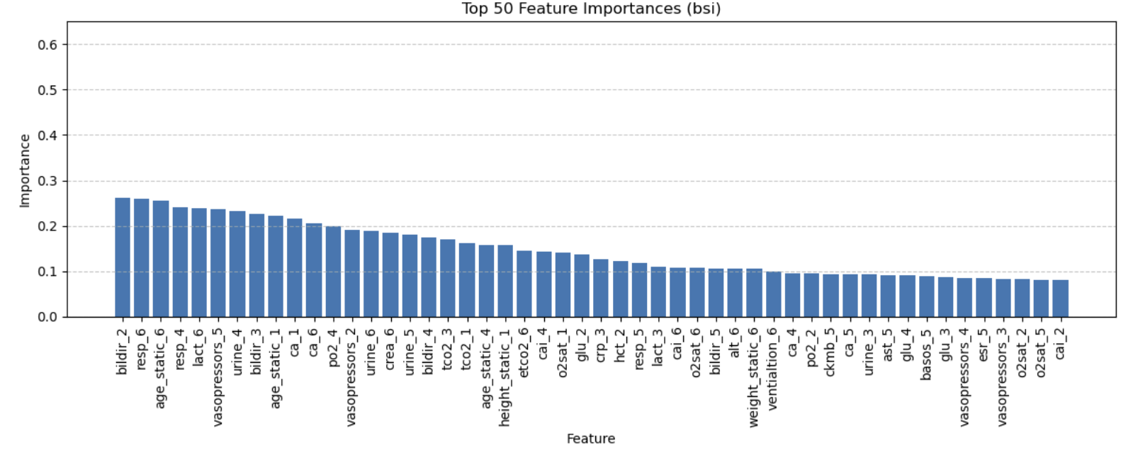
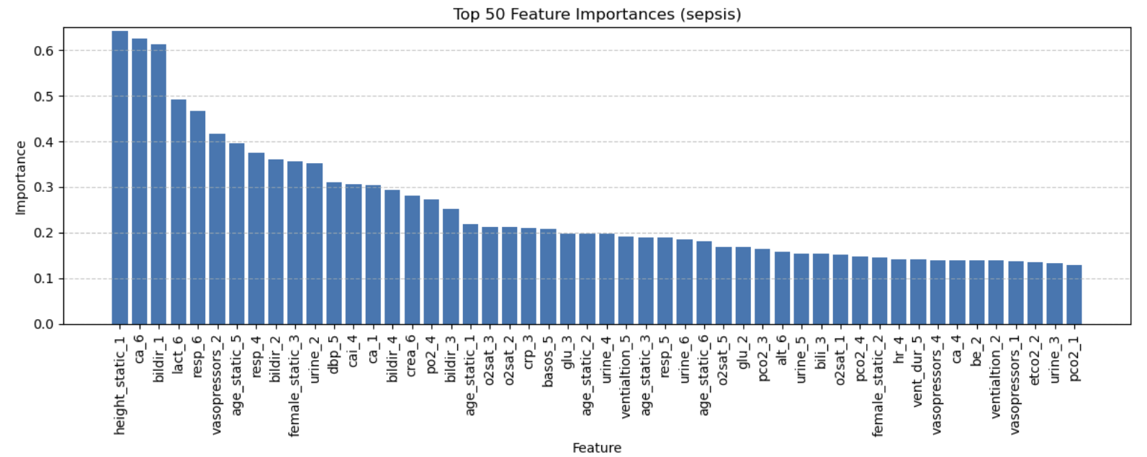
Approaches

Slide 15
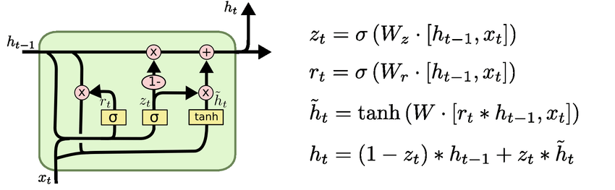
Approaches
Approach 1
$$[D_{vs}^{t};D_{bm}^{t};D^{s}]$$
GRU
Bacteremia
$$[D_{vs}^{t};D_{bm}^{t};D^{s}]$$
GRU
BSI
$$[D_{vs}^{t};D_{bm}^{t};D^{s}]$$
GRU
Sepsis
Results
Bacteremia
BSI
Sepsis
Running…
Running…
Running…
Notes:
Gated Recurrent Unit (GRU): GRUs are a type of recurrent neural network (RNN) used to model temporal sequences and sequential data. Unlike standard RNNs, GRUs are capable of handling long-term dependencies thanks to their update and reset gates, which control the flow of information. This makes them suitable for predicting future events in medical time series, such as the development of infections in ICU patients.

Slide 16
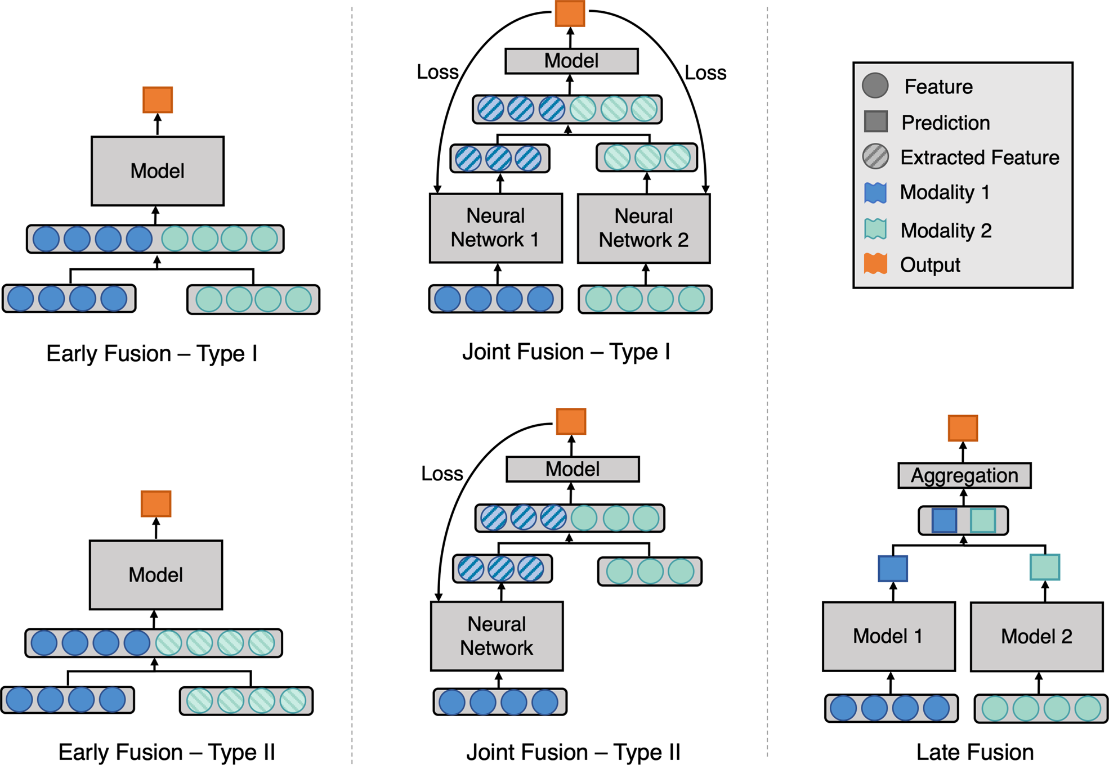
Approaches
Approach 1
$$[D_{vs}^{t};D_{bm}^{t};D^{s}]$$
MA
Bacteremia
$$[D_{vs}^{t};D_{bm}^{t};D^{s}]$$
MA
BSI
$$[D_{vs}^{t};D_{bm}^{t};D^{s}]$$
MA
Sepsis
Notes:
Multimodal Approach: Finally, we employed multimodal architectures, considering the nature of the variables, both temporal and static. We use an autoencoder to reduce the space of temporal features. The obtained embedding is combined with the static variables, specifically, they are concatenated. This new set of features constitutes the input to a logistic regressor.

Slide 17
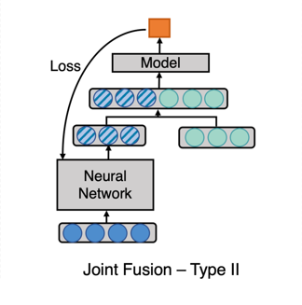





Approaches
Out
Approach 1
$$[D_{vs}^{t};D_{bm}^{t};D^{s}]$$
Model
MA
Bacteremia
Multimodal Architectures (MA)
$$[D_{vs}^{t};D_{bm}^{t};D^{s}]$$
MA
BSI
AE
$$[D_{vs}^{t};D_{bm}^{t};D^{s}]$$
MA
Sepsis
$${D_{bm}^{t};D}_{vs}^{t}$$
$$D^{s}$$
Results
Bacteremia
BSI
Sepsis
Notes:
Regarding the results, we can observe that this approach is capable of predicting bacteremia with almost 77% AUC, BSI with 65% AUC, and sepsis with 67% AUC. The second approach involves performing multilabel prediction, i.e., obtaining a probability between 0 and 1 for each of the labels. To achieve this, we have adapted the previously mentioned models. Currently, these experiments are in progress.

Slide 18
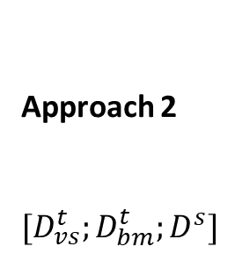
Approaches
Post Preprocessing
${D_{vs}^{t}=\{\left(X_{p}\right)\}}_{p=1}^{P}$, with $X_{p} ∈ ℝ^{WxFxT}$
${D_{bm}^{t}=\{\left(X_{p}\right)\}}_{p=1}^{P}$, with $X_{p} ∈ℝ^{WxFxT}$
${D^{s}=\{\left(x_{p}\right)\}}_{p=1}^{P}$, with $x_{p} ∈ ℝ^{WxF}$
${ Dt=\{\left( Y_{p}\right)\}}_{p=1}^{P}$, with $Y_{p} ∈ ℝ^{WxLxT}, beeing L=\{Bac, BSI, Sepsis\}$
Windows (W)
Time (T)
Features (F)
Approach 2
$$[D_{vs}^{t};D_{bm}^{t};D^{s}]$$
Bacteremia
Model
BSI
Sepsis
Notes:
Explain idea of this slide.

Slide 19
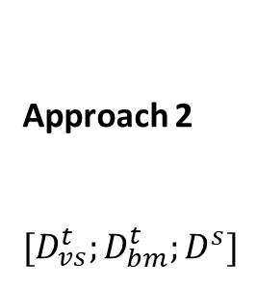
Approaches
Approach 2
$$[D_{vs}^{t};D_{bm}^{t};D^{s}]$$
Bacteremia
LR
BSI
Sepsis
Results
Bacteremia
BSI
Sepsis
Running…
Running…
Running…
Notes:
Pass

Slide 20
Approaches
Approach 2
$$[D_{vs}^{t};D_{bm}^{t};D^{s}]$$
Bacteremia
GRU
BSI
Sepsis
Results
Bacteremia
BSI
Sepsis
Running…
Running…
Running…
Notes:
Pass

Slide 21
Approaches
Approach 2
$$[D_{vs}^{t};D_{bm}^{t};D^{s}]$$
Bacteremia
MA
BSI
Sepsis
Results
Bacteremia
BSI
Sepsis
Running…
Running…
Running…
Notes:
Pass

Slide 22
Future work
Implement multitask learning as a third approach
Predict outcomes at T time steps look forward
Evaluate different window sizes and sliding intervals (look backward)
Assess interpretable architectures to identify the most relevant variables for the prediction task
Notes:
Future Work: Finally, for future work, we aim to:
Implement multitask learning as a third approach.
Predict outcomes T time steps ahead.
Evaluate different window sizes and sliding intervals (look backward).
Evaluate interpretable architectures to identify the most relevant variables for the prediction task.
The results shown are preliminary, with possible overfitting, design criteria to be revised, among others.
We have been immersed in this work for less than 2 months, where we have tackled data cleaning, preprocessing and model design.
After finishing my stay I will continue with the project and collaboration, with a possible future stay again.

Slide 23

THANK YOU FOR YOUR ATTENTION!
For any further doubt or suggestion
Óscar Escudero-Arnanz, oscar.escudero@urjc.es
PhD Student
Department of Signal Theory and Communications, Telematics and Computing Systems Rey Juan Carlos University
26-28 June 2024
IEEE 37th International Symposium on Computer Based Medical Systems

Slide 24
Features considered
Biochemical markers
1. Albumin (alb) [g/dL]
2. Alkaline phosphatase (alp) [IU/L]
3. Alanine aminotransferase (alt) [IU/L]
4. Aspartate aminotransferase (ast) [IU/L]
5. Band form neutrophils (bnd) [%]
6. Base excess (be) [mEq/L]
7. Basophils (basos) [%]
8. Bicarbonate (bicar) [mEq/L]
9. Bilirubin direct (bildir) [mg/dL]
10. Blood urea nitrogen (bun) [mg/dL]
11. Calcium (ca) [mg/dL]
12. Carboxyhemoglobin (hbco) [-]
13. Chloride (cl) [mEq/L]
14. CO2 partial pressure (pcO2) [mmHg]
15. Creatine kinase (ck) [IU/L]
16. Creatine kinase MB (ckmb) [ng/mL]
17. Creatinine (crea) [mg/dL]
18. C-reactive protein (crp) [mg/L]
19. Endtidal CO2 (etcO2) [mmHg]
20. Eosinophils (eos) [%]
20. Eosinophils (eos) [%]
21. Erythrocyte distribution width (rdw) [%]
22. Erythrocyte sedimentation rate (esr) [mm/hr]
23. Fibrinogen (fgn) [mg/dL]
24. Glucose (glu) [mg/dL]
25. Hematocrit (hct) [%]
26. Hemoglobin (hgb) [g/dL]
27. Lactate (lact) [mmol/L]
28. Lymphocytes (lymph) [%]
29. Magnesium (mg) [mg/dL]
30. Mean cell hemoglobin (mch) [pg]
31. Mean corpuscular hemoglobin concentration (mchc) [%]
32. Mean corpuscular volume (mcv) [fL]
33. Methemoglobin (methb) [%]
34. Neutrophils (neut) [%]
35. O2 partial pressure (po2) [mmHg]
36. Partial thromboplastin time (ptt) [sec]
37. Phosphate (phos) [mg/dL]
38. pH of blood (ph) [-]
39. Platelet count (plt) [K/ul]
40. Potassium (k) [mEq/L]
40. Potassium (k) [mEq/L]
41. Prothrombin time (inrpt) [-]
42. Prothrombine time (pt) [K/ul]
43. Red blood cell count (rbc) [m/uL]
44. Sodium (na) [mEq/L]
45. Total bilirubin (bili) [mg/dL]
46. Total CO2 (tco2) [mEq/L]
47. Troponin I (tri) [ng/mL]
48. Troponin T (tnt) [ng/mL]
49. White blood cell count (wbc) [K/ul]
50. Respiratory rate (resp) [insp/min]
51. Endtidal CO2 (etco2) [mmHg]
52. O2 partial pressure (po2) [mmHg]
53. CO2 partial pressure (pco2) [mmHg]
54. Urine output (urine) [mL]
55. Duration of ventilation (vent_dur) [sec]

Slide 25
Features considered
Vital signs
mean arterial pressure (map) [mmHg]
heart rate (hr) [bpm]
temperature (temp) [C]
systolic blood pressure (sbp) [mmHg]
diastolic blood pressure (dbp) [mmHg]
oxygen saturation (o2sat) [%]
calcium ionized (cai) [mmol/L]
Statics
age [years]
sex [-]
weight [kg]
height [cm]

Slide 26
Features considered
Biochemical markers |  |  |  |  | Vital signs | Statics
Albumin (alb) [g/dL] | alkaline phosphatase (alp) [IU/L ] | alanine aminotransferase (alt) [IU/L] | aspartate aminotransferase (ast) [IU/L] | band form neutrophils (bnd) [%] | mean arterial pressure (map) [mmHg] | age [years]
base excess (be) [mEq/L] | Basophils (basos) [%] | Bicarbonate (bicar) [mEq/L] | bilirubin direct (bildir) [mg/dL ] | blood urea nitrogen (bun) [mg/dL] | heart rate (hr) [bpm] | sex []
Calcium (ca) [mg/dL] | Carboxyhemoglobin (hbco) [-] | Chloride (cl) [mEq/L] | CO2 partial pressure (pcO2) [mmHg] | creatine kinase (ck) [IU/L] | temperature (temp) [C] | weight [kg]
creatine kinase MB (ckmb) [ng/mL] | Creatinine (crea) [mg/dL] | C-reactive protein (crp) [mg/L] | endtidal CO2 (etcO2) [mmHg] | Eosinophils (eos) [%] | systolic blood pressure (sbp) [mmHg] | height [cm]
erythrocyte distribution width (rdw) [%] | erythrocyte sedimentation rate (esr) [mm/hr] | Fibrinogen (fgn) [mg/dL] | Glucose (glu) [mg/dL] | Hematocrit (hct) [%] | diastolic blood pressure (dbp) [mmHg]
Hemoglobin (hgb) [g/dL] | Lactate (lact) [mmol/L] | Lymphocytes (lymph) [%] | Magnesium (mg) [mg/dL ] | mean cell hemoglobin (mch) [pg] | oxygen saturation (o2sat) [%]
mean corpuscular hemoglobin concentration (mchc) [%] | mean corpuscular volume (mcv) [fL] | Methemoglobin (methb) [%] | Neutrophils (neut) [%] | O2 partial pressure (po2) [mmHg] | calcium ionized (cai) []
partial thromboplastin time (ptt) [sec] | Phosphate (phos) [mg/dL] | pH of blood (ph) [-] | platelet count (plt) [K/uL] | Potassium (k) [mEq/L]
prothrombin time (inrpt) [-] | prothrombine time (pt) [K/ul] | red blood cell count (rbc) [m/uL] | respiratory rate (resp) [insp/min] | Sodium (na) [mEq/L]
total bilirubin (bili) [mg/dL] | totcal CO2 (tco2) [mEq/L] | troponin I (tri) [ng/mL] | troponin t (tnt) [ng/mL] | white blood cell count (wbc) [K/uL]

