Slide 1
Analysis and Implementation of Data Imputation Techniques for Laboratory Data
Final Year Project 2021
Thursday, 24 June 2021
Supervisor: Dr Pantelis Georgiou
Co-supervisor: Dr Bernard Hernandez Perez
Second marker: Dr Timothy Constandinou
Agrim Manchanda (CID: 01333674)

Slide 2
Overview of presentation
Introduction and Motivation
Background Materials
Project Aims and Deliverables
Overview of Design & Implementation
Experiments & Results
Conclusion, Achievements and Future Work

Slide 3
Introduction and Motivation
Missing laboratory data is an ever-present challenge in clinical domain.
Clinical Decision Support Systems (CDSSs) rely on completeness for accurate predictions.
Simple techniques exist but are inadequate.
Scope to investigate better data imputation techniques suitable for laboratory data.
Patient | Date | Lab Code
Patient |  | EOS | MONO | BASO | …. | NRBCA
1 | 23/03/20 | 0.40 | NaN | 0.10 | …. | 0.00
2 | 24/03/20 | NaN | 0.50 | 0.10 | …. | NaN
2 | 23/03/20 | 0.20 | NaN | 0.10 | …. | 0.00
3 | 23/03/20 | 0.40 | 0.50 | NaN | …. | 0.00
4 | 23/03/20 | 0.10 | NaN | 0.10 | …. | NaN
5 | 23/03/20 | NaN | 0.40 | 0.10 | …. | 0.00
Patient | Date | Lab Code
Patient |  | EOS | MONO | BASO | …. | NRBCA
1 | 23/03/20 | 0.40 | 0.47 | 0.10 | …. | 0.00
2 | 24/03/20 | 0.28 | 0.50 | 0.10 | …. | 0.00
2 | 23/03/20 | 0.20 | 0.47 | 0.10 | …. | 0.00
3 | 23/03/20 | 0.40 | 0.50 | 0.10 | …. | 0.00
4 | 23/03/20 | 0.10 | 0.47 | 0.10 | …. | 0.00
5 | 23/03/20 | 0.28 | 0.40 | 0.10 | …. | 0.00
Source: [1]: Bernard Hernandez Perez. Data-driven web-based intelligent decision support system for infection management at point of care. PhD thesis, Imperial College London, 2 2019.
Notes:
Missing laboratory data is an ever-present problem in the clinical domain which is unavoidable for many reasons.
It presents a bigger challenge for clinical decision support systems which rely on completeness of data for accurate classifier predictions on severity of disease.
Simple methods exist but are inadequate because they do not exploit feature correlations which exist between biochemical marker or analytes in laboratory data.
Therefore this presents an opportunity to explore better data imputation techniques for this use case.

Slide 4
Background Material (1)
Types of missing data:
Missing at Random (MAR)
Missing Completely at Random (MCAR)
Missing Not At Random (MNAR)
Current landscape:
Imputation depends on feature types and nature of missing data.
Separate studies validated Machine Learning (ML) methods.
Increasing potential for use of Bayesian Networks (BN).
Notes:
There are three types of missing data:
MAR: Missingness depends on other observed features in the data set.
MCAR: Missingness is completely arbitrary for e.g. diagnostic or machine error.
MNAR: Missingness happens due to an unobserved reason outside of data set.
Current landscape:
Imputation depends on the feature types and the nature of missing data.
ML methods has been studied and validated in the past.
Rise in the adoption of BN for clinical

Slide 5
Background Material (2)
Machine Learning
Bayesian Networks
Keys:
Dependent Variable
Independent Variables
Yes | No
… | …
A | B | C
… | … | …
… | … | …
… | … | …
A
B
C
A | B | C
… | … | …
… | … | …
… | … | …
A | B | C
… | … | …
… | … | …
… | … | …
A | B | C
… | … | …
… | … | …
… | … | …
A | Yes | No
Yes | … | …
No | … | …
A | Yes | No
Yes | … | …
No | … | …
Model Learning → Evaluation
Structure Learning → Parameter Learning → Inference

Slide 6
Project Aims and Deliverables
Aim: “Compare the performance of ML based and BN methods with simple median imputation.”
Key Deliverables:
Design: Imputation framework which provides a methodology.
Implementation: Develop the framework and create an open source library.
Experimentation: Carry out an empirical study on a real-life laboratory data set.
Documentation: Create a reference point for project findings and results.
Notes:
Deliverables:
Design: imputation framework which provides a methodology.
Implementation: develop an open-source Python library.
Experiment: carry out an empirical study on real-life laboratory data.
Document: provide supporting online documentation.

Slide 7
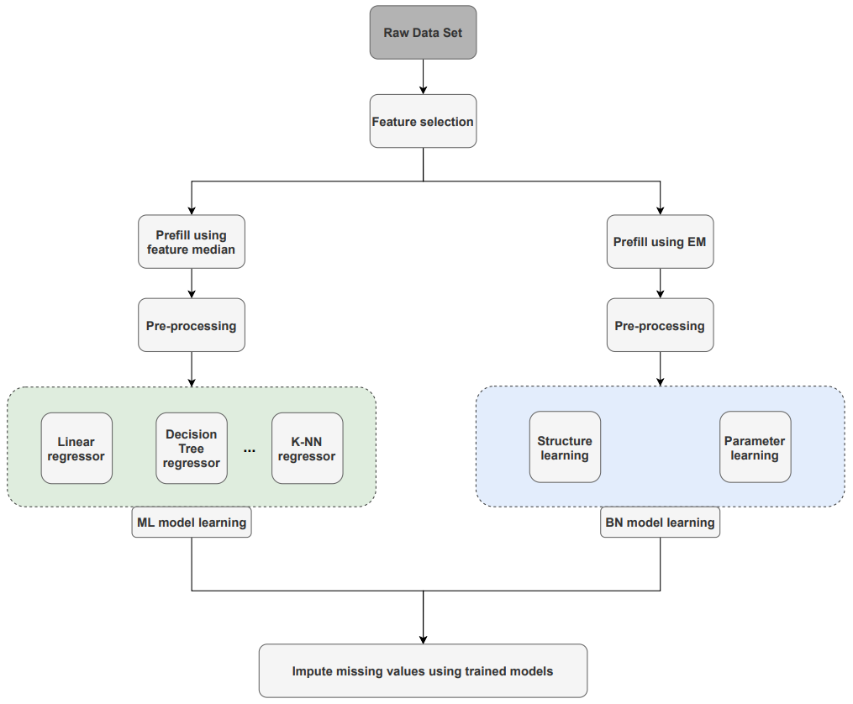
Overview of Design & Implementation
Patient | Date | Lab Code
Patient |  | EOS | MONO | BASO | …. | NRBCA
1 | 23/03/20 | 0.40 | NaN | 0.10 | …. | 0.00
2 | 23/03/20 | 0.20 | NaN | 0.10 | …. | 0.00
3 | 23/03/20 | 0.40 | 0.50 | NaN | …. | 0.00
4 | 23/03/20 | 0.10 | NaN | 0.10 | …. | NaN
5 | 23/03/20 | NaN | 0.40 | 0.10 | …. | 0.00
EOS | MONO | BASO | …. | NRBCA
0.40 | NaN | 0.10 | …. | 0.00
0.20 | NaN | 0.10 | …. | 0.00
0.40 | 0.50 | NaN | …. | 0.00
0.10 | NaN | 0.10 | …. | NaN
NaN | 0.40 | 0.10 | …. | 0.00
Stage 1:
EOS | MONO | BASO | …. | NRBCA
0.40 | 0.47 | 0.10 | …. | 0.00
0.20 | 0.47 | 0.10 | …. | 0.00
0.40 | 0.50 | 0.10 | …. | 0.00
0.10 | 0.47 | 0.10 | …. | 0.00
0.28 | 0.40 | 0.10 | …. | 0.00
Stage 2:
Stage 3:
EOS | MONO | BASO | …. | NRBCA
0.40 | 0.47 | 0.10 | …. | 0.00
0.40 | 0.50 | 0.10 | …. | 0.00
0.28 | 0.40 | 0.10 | …. | 0.00
Stage 4:
EOS | MONO | BASO | …. | NRBCA
0.40 | 0.47 | 0.10 | …. | 0.00
0.40 | 0.50 | 0.10 | …. | 0.00
0.28 | 0.40 | 0.10 | …. | 0.00
Stage 5:
EOS | MONO | BASO | …. | NRBCA
0.40 | 0.38 | 0.10 | …. | 0.00
0.40 | 0.50 | 0.08 | …. | 0.00
0.21 | 0.40 | 0.10 | …. | 0.00
Full description of the analysis, design and implementation details in Chapter 4 and 5 of Final Report.

Slide 8
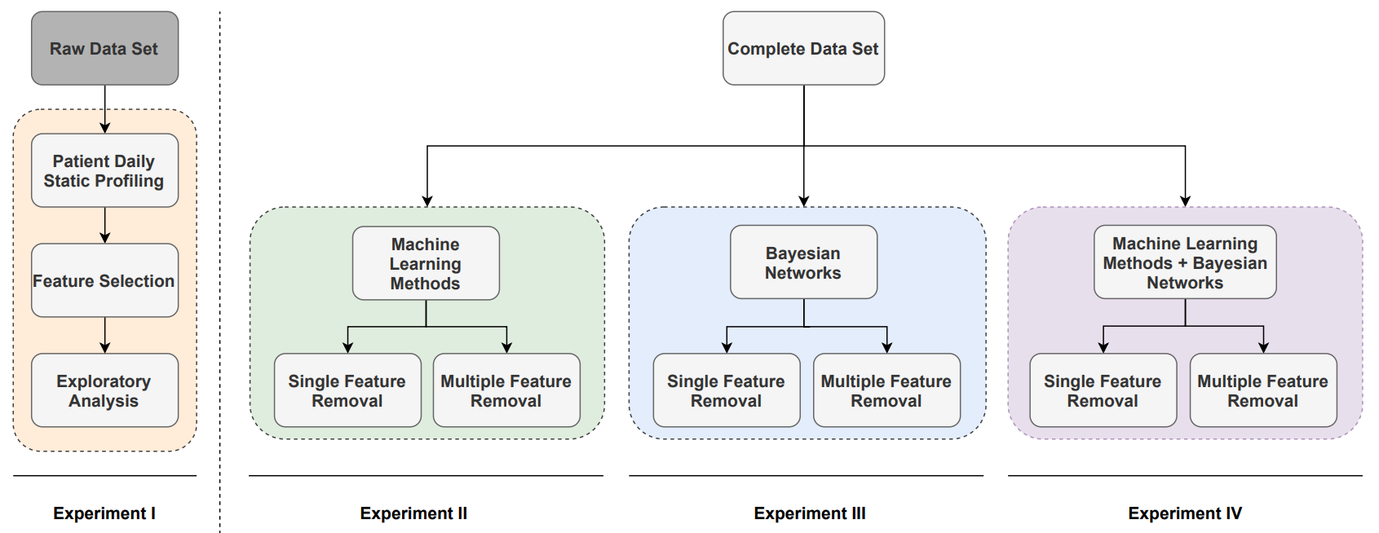
Experiments
Full description of the experiment methodology presented in Chapter 6 of Final Report.

Slide 9
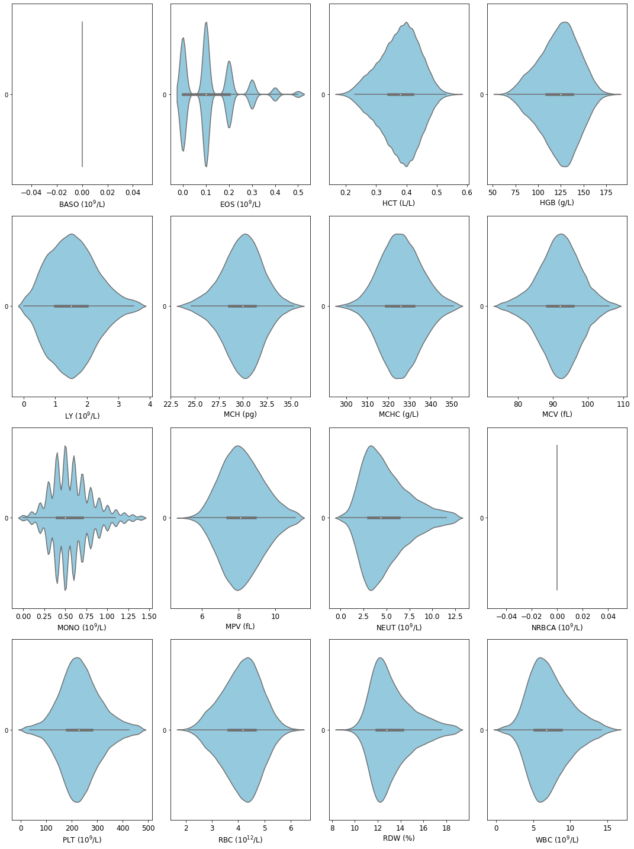
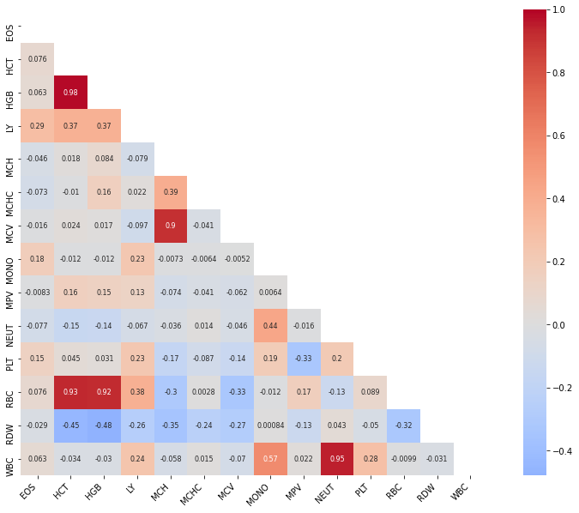
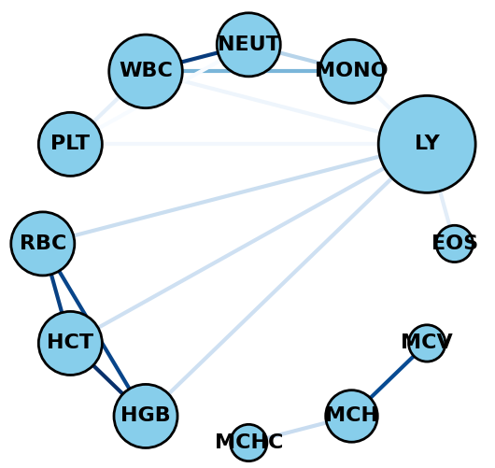
Experiment I – Overview of pathology data
Deliverable 3 & 4
Full description of results available in Chapter 7 – Section 2 of Final Report.
Notes:
Distributions: tried to understand distribution of features to see if any underlying distribution assumptions uphold, even if they appear Gaussian statistically they were not. Two features did not exhibit any dispersion so were not used for predicting.
Correlations: Used Pearson’s correlation coefficient to find relations, strong correlations are shown in red which were also validated by the experiment results.

Slide 10
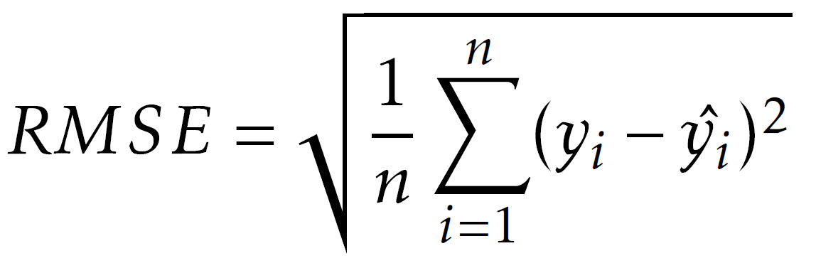
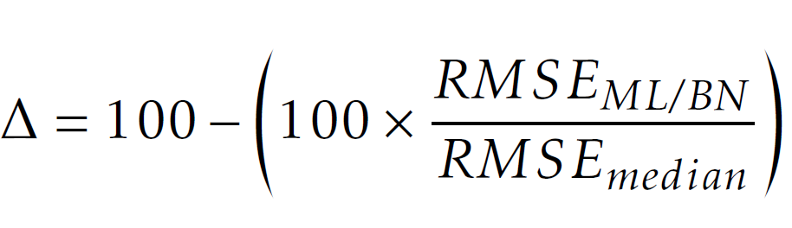
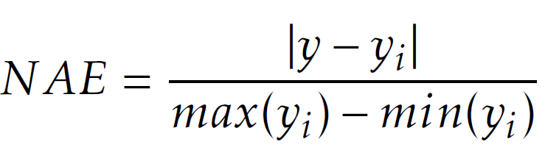
Results: Evaluation Metrics
Full description of evaluation metrics presented in Chapter 7 – Section 7.1.
Notes:
Three evaluation metrics. RMSE as it is more interpretable. Custom defined Delta to characterise improvement of the imputation methods against simple median imputation.
Distribution: obtained normalised absolute error to characterise distribution of errors to understand how models perform across features.

Slide 11
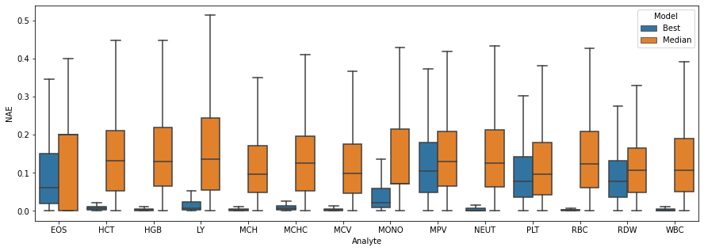
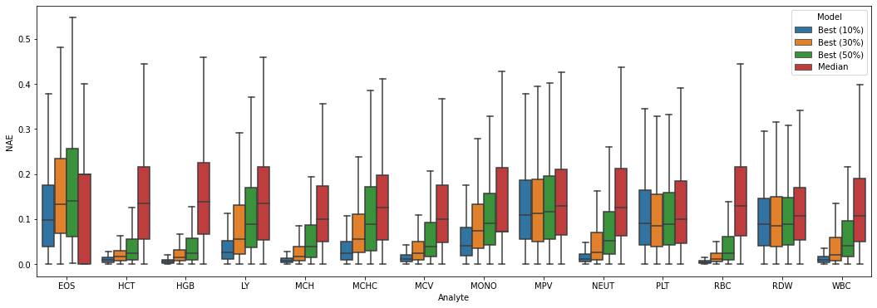
Experiment II – Imputation using ML based methods
Single Feature Removal
Multiple Feature Removal
For all analytes, error distribution for ML based (orange) is significantly lower than median imputation.
→ ML methods impute with higher accuracy than median.
For all proportions of missing values (10%, 30% and 50%), central tendency and dispersion remains below median imputation.
median changes the distribution of data.
ML methods to a much lower extent (relatively).
Remaining results presented in Chapter 7 – Section 7.2 of Final Report.

Slide 12
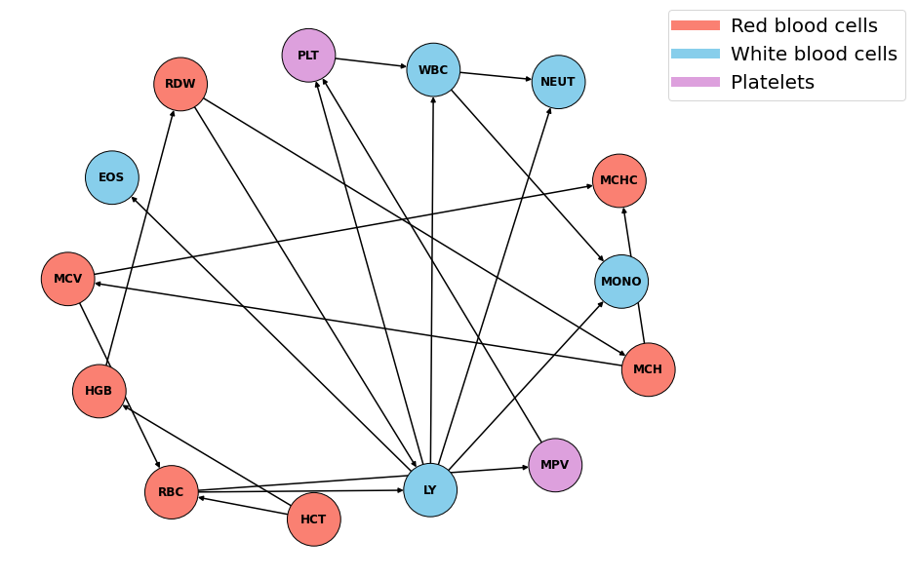
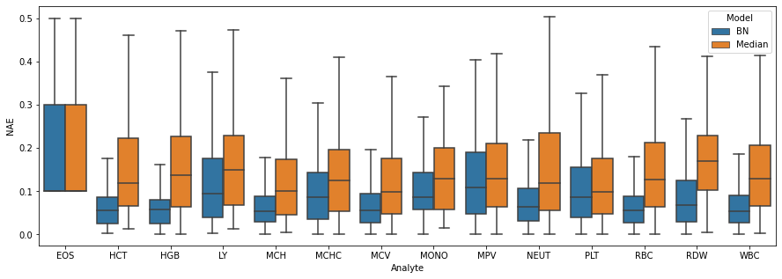
Experiment III – Imputation using BNs (1)
Single Feature Removal
Single Feature Removal
For all analytes, error distribution for BNs (blue) is lower than median imputation (orange).
→ BNs perform better than median imputation.
Remaining results presented in Chapter 7 – Section 7.3 of Final Report.

Slide 13
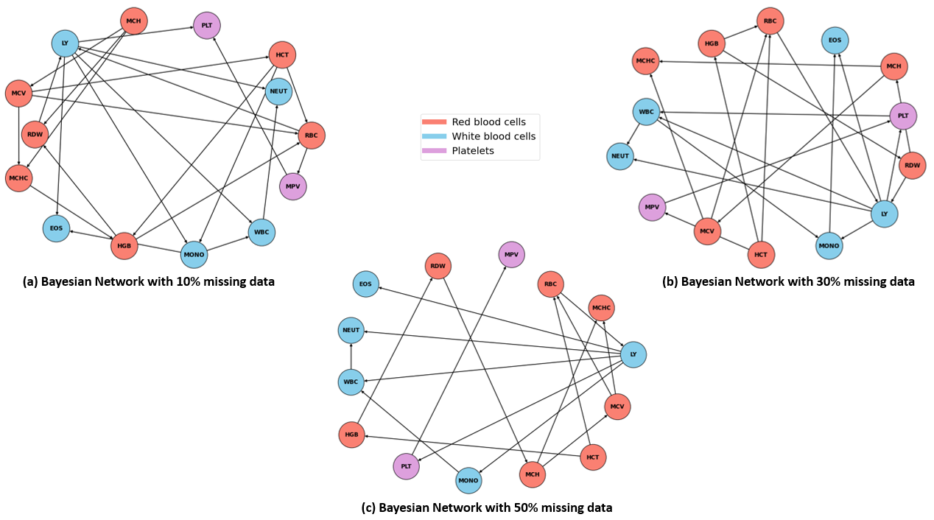
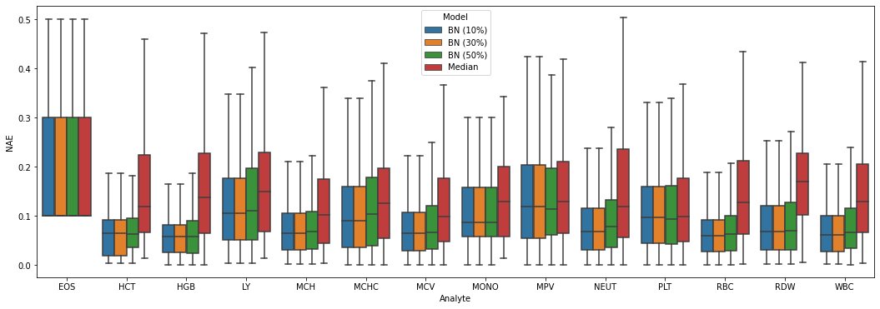
Experiment III – Imputation using BNs (2)
Multiple Feature Removal
Multiple Feature Removal
For all proportions of missing values (10%, 30% and 50%), central tendency and dispersion remains below median imputation.
BN central tendencies are heterogenous so they are more consistent.
Remaining results presented in Chapter 7 – Section 7.3 of Final Report.

Slide 14
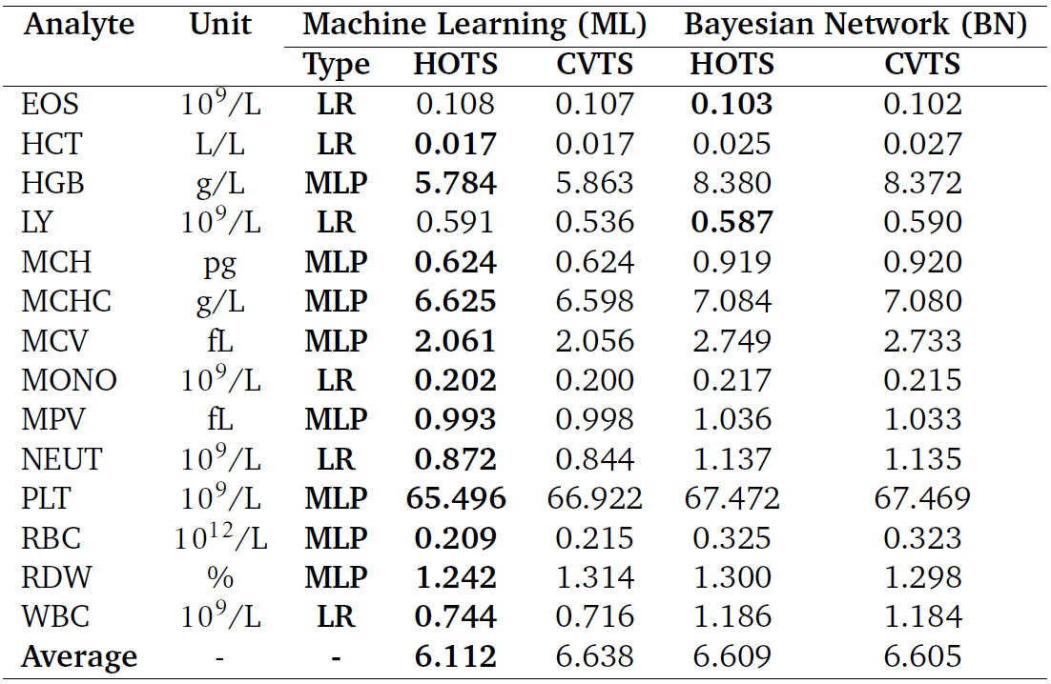
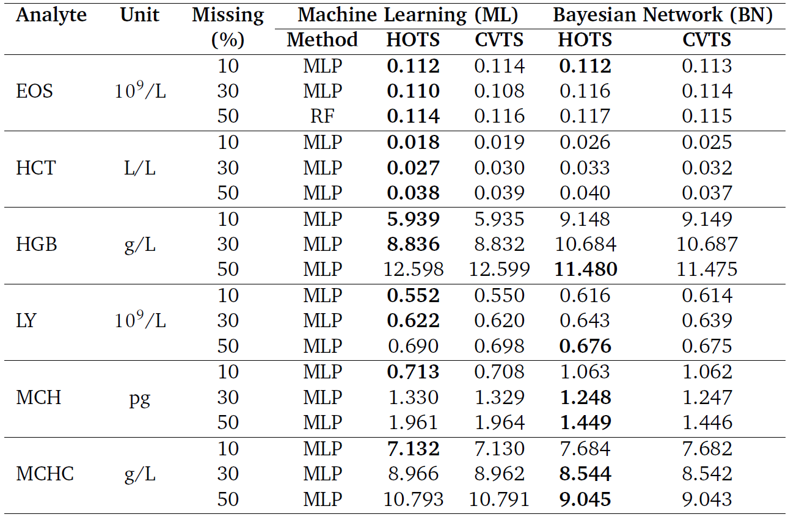
Experiment IV – Comparing ML based and BN methods
Single Feature Removal
Multiple Feature Removal
RMSE scores are more comparable.
→ discretisation of data impacts performance of ML methods.
For all proportions of missing values (10%, 30% and 50%), more variation in the best method.
performance of ML methods degrades linearly.
BNs have a lower RMSE at higher missing values.
*Best performing method is highlighted in bold showing it has a lower RMSE. Full table of results accessible in Chapter 7 – Section 7.4 of Final Report.

Slide 15
Conclusion, Achievements and Future Work
Deliverable 3 & 4
Conclusions & Achievements
Future Work
Empirically shown simple median imputation performs poorly.
→ high RMSE for all the analytes under all scenarios.
→ changes the distribution of underlying data.
Recommendation 1: ML based methods for CDSSs predictive modelling as they impute with high accuracy.
Recommendation 2: BNs more suitable for clinicians as they are interpretable and intuitive.
All project objectives were met.
Integration into CDSS to carry out pilot studies.
Extending experiments to consider other laboratory panels.
Temporal profiling to use longitudinal data.
Enhancing model performances especially BNs.

