Slide 1


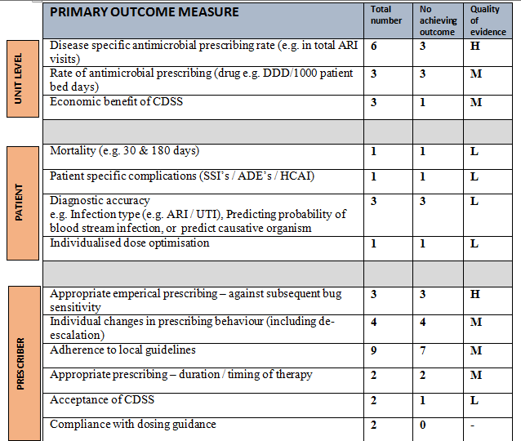
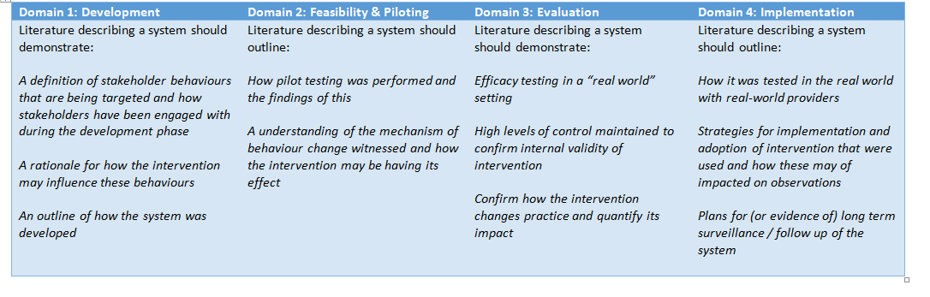
Clinical decision support systems for antimicrobial management: a systematic review of interventions in primary and secondary care
Timothy M Rawson¹, Luke SP Moore^{1,2}, Bernard Hernandez¹, Esmita Charani¹, Enrique Castro-Sanchez¹, Pau Herrero¹, Benedict Hayhoe¹, William Hope³,
Pantelis Georgiou¹, Alison H Holmes^{1,2}
1. Imperial College London, London, UK; 2. Imperial College Healthcare NHS Trust, London, UK; 3. University of Liverpool, Liverpool, UK
Introduction
Clinical decision support systems (CDSS) for antimicrobial management can support healthcare professionals to optimise antimicrobial therapy. A systematic review of qualitative and quantitative studies describing CDSS in primary and secondary care was undertaken to create a pragmatic picture of the field and produce recommendations for future research.
Results
Fifty-eight articles were included describing 38 CDSS. CDSS included were defined as conventional systems (incorporating guidelines, algorithms, and prompts) integrated with electronic medical records (24/38; 63%), intelligent (machine learning) systems (3/38; 8%), web based guidelines (3/38; 8%), pharmacokinetic tools (2/38; 5%), and other systems (6/38;16%). 11/38 (19%) CDSS were deployed in primary care and 27/38 (71%) in secondary care. Primary care CDSS tended to focus on single conditions, such as acute respiratory tract infections, whereas secondary care CDSS focused on empirical antimicrobial selection and prophylaxis in surgery.
CDSS studies failed to report consideration of the non-infection expert, end-user workflow, or routine decision making pathways. They focused on narrow aspects, such as antimicrobial selection, using proxy outcome measures that demonstrate significant outcomes at a hospital or prescriber level, whilst failing to demonstrate direct benefit to the patient. Engagement with CDSS by clinicians was poor.
Methods
PRISMA guidelines were followed. Medline, EMBASE, HMIC Health and Management, and Global Health databases were searched from 1st January 1980 to 31st October 2015. All primary research studies describing CDSS for antimicrobial management in adults in primary or secondary care were included. Critical care orientated CDSS were excluded. Two researchers independently screened abstracts and extracted data against a framework adapted from the Stage Model of Behaviour Intervention Development and the Medical Research Council’s developing and evaluating complex interventions guidance. For qualitative studies, thematic synthesis was performed. Quality was assessed using Integrated quality Criteria for the Review Of Multiple Study designs (ICROMS) criteria. Grading of Recommendations Assessment, Development and Evaluation (GRADE) criteria was used to rate the overall level of evidence for individual outcome measures at either patient, prescriber, or hospital unit level.
Table 3. Summary of primary outcome measures reported in the literature
Discussion
The design of CDSS interventions must consider the factors influencing non-expert decision-making to ensure integration into routine workflow and promote engagement with these interventions. Future work must expand CDSS beyond simply selecting appropriate antimicrobials, instead integrating this aspect with dose optimisation, patient engagement, and surveillance mechanisms to provide personalised decision support. Developing clear and systematic reporting frameworks for CDSS interventions would address the identified gaps in the reporting of evidence for current CDSS.
.
CDSS characteristics |  | n = (%)
Types of decision support | Antibiotic prescribing | 29 (76)
 | Physician feedback | 1 (3)
 | Alerts / prompts | 7 (18)
 | Dose optimisation | 3 (8)
 | De-escalation | 2 (5)
 | Surveillance | 2 (5)
CDSS Platform | Integrated into EMR | 28 (74)
 | On PDA device | 3 (8)
 | Web-based application | 5 (13)
 | Standalone software | 2 (5)
System Attributes | Rule based* | 29 (76)
 | Causal Probabilistic Networks | 1 (3)
 | Drug-bug logic | 1 (3)
 | Pharmacokinetic modelling* | 2 (5)
 | Fuzzy cognitive mapping | 1 (3)
 | Guidelines | 2 (5)
 | Predictive models | 1 (3)
 | N/A | 2 (5)
References
Table 1. Framework for evaluation of clinical decision support systems reported in the literature
Table 2. Summary of clinical decision support system characteristics
Author contact: tmr07@imperial.ac.uk
Acknowledgements: This report is independent research funded by the National Institute for Health Research, Innovation for Invention Scheme (i4i). The authors would also like to thank the NIHR Health Protection Research Unit in Healthcare Associated Infections and Antimicrobial Resistance at Imperial College London & www.ProjectPal.org for their support with this project.

