Slide 1


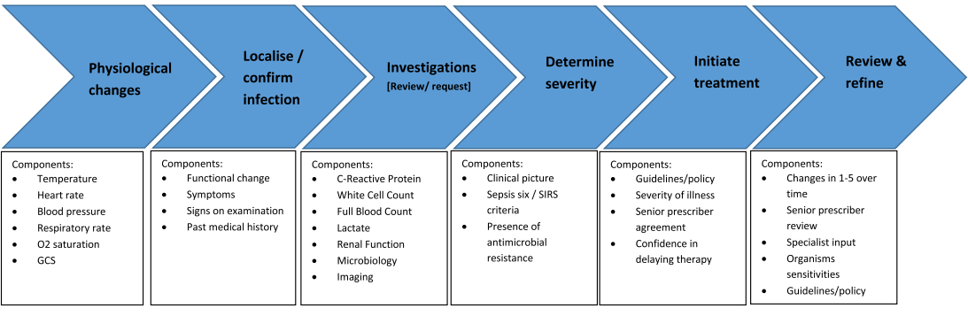
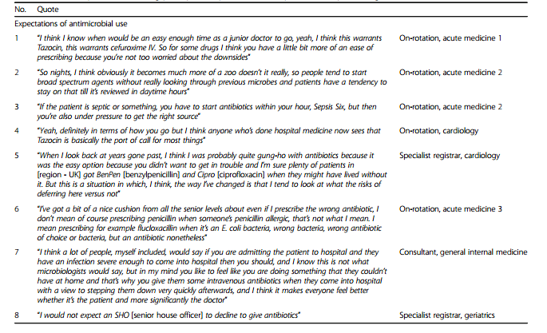

Mapping decision pathways for acute infection management in UK secondary care: a qualitative study
Timothy M Rawson¹, Esmita Charani¹, Luke SP Moore^{1,2}, Bernard Hernandez¹, Enrique Castro-Sanchez¹, Pau Herrero¹, Pantelis Georgiou¹, Alison Holmes^{1,2}
1. Imperial College London, London, UK; 2. Imperial College Healthcare NHS Trust
Introduction
The importance of behaviour change interventions in improving the use of antimicrobials in infection management has been recognised. Despite the growing body of evidence describing knowledge, attitudes, and cultural determinants of antimicrobial prescribing, little data exists mapping clinicians’ decision pathways in this field. We conducted a study to map physician decision making processes for acute infection management in secondary care to identify potential targets for quality improvement interventions.
Table 2. Selected quotes surrounding expectations of antimicrobial use
Results
The decision pathway for the management of acute infections follows a Bayesian-like step-wise approach, with information processed and systematically added to prior assumptions, across six common themes (figure 1), guiding subsequent management. Fever, C-reactive protein, and local microbiologist guidance and advice are regarded as key factors within this pathway
Several themes were also reported that influence different steps in the decision making pathway of physicians.
These were;
a desire to provide optimal care for the patient with infection by providing rapid and often intravenous therapy, regardless of whether this was in accordance with evidence;
perceptions that stopping/de-escalating therapy was a senior doctor decision with junior trainees not expected to contribute to this process; and
expectation of interactions with local guidelines and microbiology service advice. Senior feedback on review of junior doctor prescribing decisions was often lacking, causing frustration and confusion on appropriate practice within this cohort.
Additionally, previously published factors including the role of team hierarchies and prescribing etiquette was found to heavily influence decision making for infection management amongst the study participants.
Methods
Newly qualified though to Consultant level physicians from 10 non-infection medical specialties participated in semi-structured interviews of up to 32 minutes duration. Interviews were audio recorded, transcribed verbatim, and analysed using NVIVO11.0® using grounded theory methodology. Analytical categories were created using a constant comparison approach and participants were recruited to the study until thematic saturation was reached (twenty physicians were ultimately interviewed).
Table 3. Selected quotes surrounding expectations of stopping / deescalating therapy
Table 1. Participant specialties
Grade | Specialty
Consultant | Acute Medicine
Consultant | Acute Medicine / Endocrinology
Consultant | Haematology
Consultant | Haematology
Consultant | Haematology
Consultant | Care of the Elderly
Consultant | Gastroenterology / Acute Medicine
Consultant | Respiratory Medicine
Consultant | Respiratory Medicine
Specialist Registrar | Care of the Elderly
Specialist Registrar | Care of the Elderly
Specialist Registrar | Cardiology
Specialist Registrar | Clinical Pharmacology & Therapeutics / General Medicine
Core Trainee Year 2 | On rotation - Acute Medicine
Core Trainee Year 1 | On rotation - Acute Medicine / Stroke Medicine
Foundation Year 2 | On rotation - Gastroenterology
Foundation Year 2 | On rotation - Respiratory Medicine / General Medicine
Foundation Year 2 | On rotation - Acute Medicine
Foundation Year 1 | On rotation - Renal Medicine
Foundation Year 1 | On rotation - Acute Medicine
Discussion
Interventions to improve infection management must incorporate mechanisms to promote distribution of responsibility for decisions made. The disparity between expectations upon prescribers to start but not review/stop therapy requires addressing urgently with mechanisms to improve communication and feedback to junior prescribers to facilitate their continued development as prudent antimicrobial prescribers.
.
Author contact: tmr07@imperial.ac.uk
Acknowledgements: This report is independent research funded by the National Institute for Health Research, Innovation for Invention Scheme (i4i). The authors would also like to thank the NIHR Health Protection Research Unit in Healthcare Associated Infections and Antimicrobial Resistance at Imperial College London & www.ProjectPal.org for their support with this project.

