Slide 1



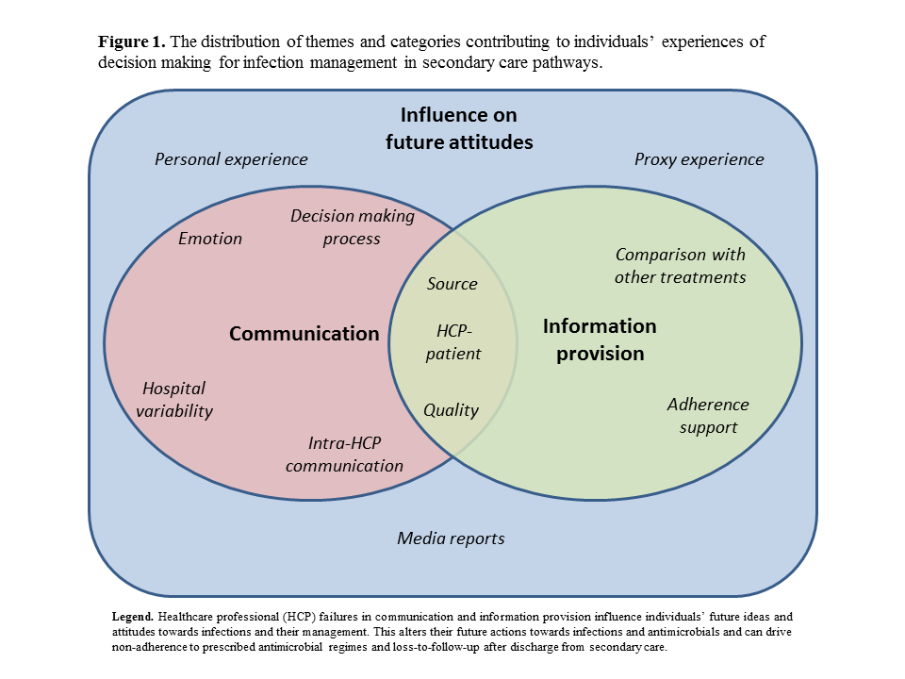
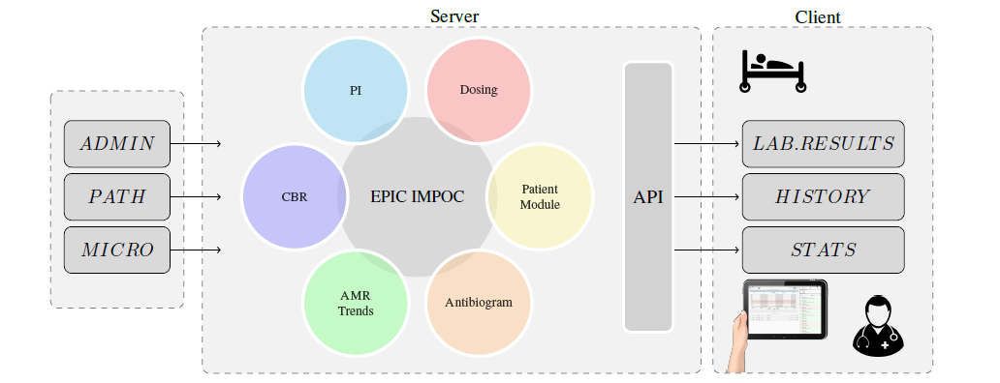
Patient-centred interventions to promote citizen engagement with infection-related decision making
Timothy M Rawson¹, Bernard Hernandez¹, Luke Moore^{1,2}, Enrique Castro-Sanchez¹, Esmita Charani¹, Pantelis Georgiou¹, Raheelah Ahmad¹, Alison Holmes^{1,2}
1. Imperial College London, London, UK; 2. Imperial College Healthcare NHS Trust, London, UK
Introduction
Suboptimal healthcare professional – patient communication and information provision are likely to affect patients’ future attitudes towards infections and antimicrobial usage. Using qualitative methodologies, we engaged with patients to explore mechanisms for addressing current failures in information provision and communication.
Results
Participants felt excluded from decision making and there was consensus in the potential value of personalised information specific to their own infection, co-morbidities, and management. Participants reported that this would complement information provided by trusted healthcare professionals and promote better communication between healthcare professionals and their patients. Information formats were required in both electronic and printable formats to suit individual preferences and technology capabilities.
An in-house clinical decision support tool was used to populate a personalised information leaflet that aims to provide individualised infection and antimicrobial information, automatically updating in real time through direct communication with local hospital electronic health records. This document also provided links to official NHS websites, where patients can search for further information and personal test results. This tool also aims to act as an educational tool regarding antimicrobial adherence and the risks of antimicrobial resistance. Participants reported favouring a simple layout with basic information that can be individualised by the healthcare professional dispensing the information.
Example personalised information leaflet and selected quotes created during the patient co-design session
Yeah. We couldn’t name the antibiotic. She probably, she didn’t know why. There’s obviously a gap there where she’s not completely sure.
I’d like someone to give me a sheet to say I’ve done a test and I think you definitely have a chest infection, and I strongly recommend you take antibiotics
I think it should be serious because it’s your health and it’s not something you can be trivial about and then forget to take the drugs
Some people might be more confident and others less confident. So if you, maybe a definition might be useful, as well, perhaps the keyword and identification of them for a layperson
will probably go home and look things up in their books or on the internet because they’ve been told something and they haven’t taken it in properly.
You can drink alcohol or driving? They’re the biggest ones.
Discussion
Infection management and antimicrobial prescribing decisions in secondary care require improvements in patient engagement. Secondary care physicians must not view infection management episodes as discrete events, but as cumulative experiences which have the potential to shape future patient behaviour and understanding of antimicrobial use. We have developed a simple, personalised support mechanism to enhance healthcare professional – patient communication to improve patient engagement with infection management and antimicrobial therapy. We now plan to assess the impact of this intervention prospectively in clinical practice.
.
Methods
Citizens who had received antimicrobials from secondary care in the preceding 12 months in the UK were recruited to participate in in-depth action participatory research sessions. All participants had experience of infection management across a variety of South-East England healthcare institutes. Two 2.5 hour sessions were run with 10 participants where their experiences of antimicrobial usage and potential solutions for how to address problems identified were explored. Researchers then developed prototype interventions; these models were reviewed and refined via three further 2 hour co-design group sessions held with 20 participants. Data was analysed using NVIVO pro11.0. Reimbursement to participants was provided in line with national public involvement guidelines.
References
Clinical decision support system architecture incorporating a patient engagement tool
Author contact: tmr07@imperial.ac.uk
Acknowledgements: This report is independent research funded by the National Institute for Health Research, Innovation for Invention Scheme (i4i). The authors would also like to thank the NIHR Health Protection Research Unit in Healthcare Associated Infections and Antimicrobial Resistance at Imperial College London & www.ProjectPal.org for their support with this project.

