Slide 1
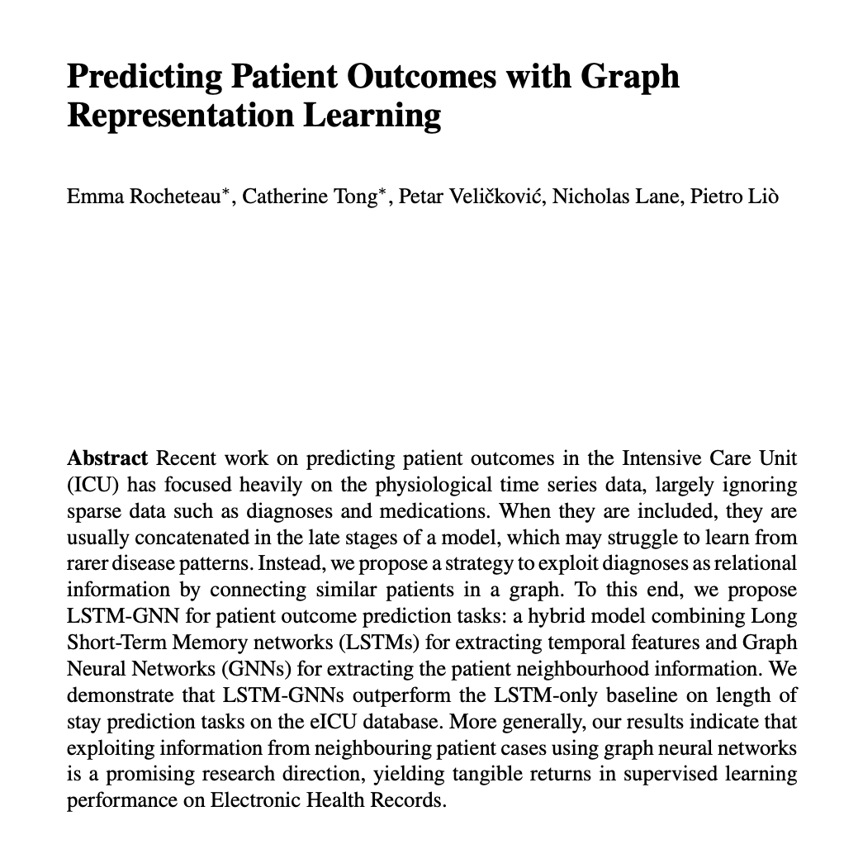


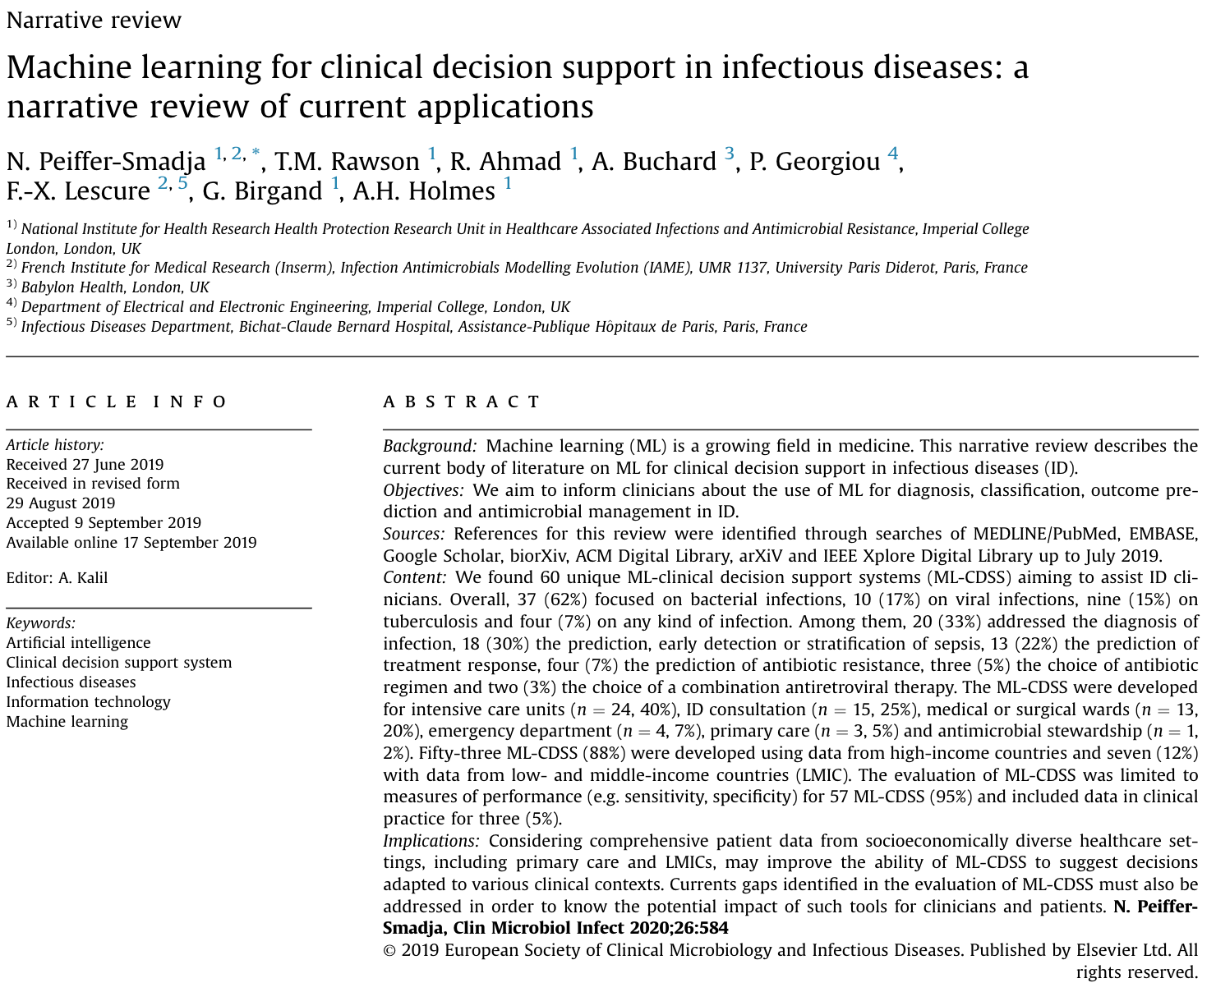




AI clinical decision support has seen limited uptake but can provide innovative information.
INTRODUCTION
METHODS
RESULTS
CONCLUSION & FUTURE WORK
HARD OUTCOMES
MORTALITY
LENGTH
OF STAY
Numerous clinical decision support systems (CDSS) utilising machine learning and electronic health record (EHR) data have been developed to assist with infection management
Unfortunately, the uptake and utilisation of such systems has been limited to date, in part due to acceptance and behavioral issues
By predicting ‘hard’ outcome measures under a given scenario, we aim to provide standard endpoint information to healthcare professionals to explore how this may influence clinical decision making
We created a recurrent neural network to predict mortality and length of stay outcomes for individual patients receiving antibiotics
Notes:
As electronic health records become more prevalent numerous AI techniques have been applied to such data in particular for sepsis diagnosis and antimicrobial therapy selection
CDSS are software designed to provide information to healthcare professionals, patients, or other individuals into order to make informed clinical decisions. This supports the idea of personalised or precision medicine where decisions are tailored to that specific patient as opposed to a one-size fits all approach.
CDSS that are currently in use are generally very simple for example providing warnings, reminding clinicians of local guidelines, and monitoring vital signs. However, as electronic health records (EHR) become more prevalent and with the advent of AI and ML many more sophisticated and complex CDSS have been developed in the last decade. Within infection most research focuses on diagnoses of bacterial infections in particular sepsis within the ICU, as well as risk of infection and to assist with antimicrobial therapy selection. There has also been a large interest over the last year and a half from the research community predict COVID-19 patients’ diagnosis and prognosis.
Problem is once developed such systems are then not used (uptake has been limited) due to numerous reasons including limited integration with current healthcare systems, CDSS often being complex and difficult to use, questions regarding the liability of such systems, issues such as explainability and interoperability, as well as the immature nature of the evaluation and regulation of such technologies, and also critically behavioural influences on how decisions are made within a hospital. This is a wide problem for decision support in general
---
PROBLEM - people work in silos and don't include other complexities in their decision making – only care about their discipline - we hope to change that by incorporating info across specialities such as ICU and clinical microbiology
HOWEVER - Clinicians can also have acess to data that may not be in the EHR so algorithm may not also have whole picture - so this is where clinical autonomy and making independant decisions comes in
---
Work will focus on what clinicians need to help inform their decisions.
Further research into CDSS using EHR data is needed to encourage individuals to make a decision based on an output
Ultimately our work will focus on what could actually influence clinical decision making in the real world. This means considering a number of different influences and ultimately trying to can change a clinician's behaviour when making decisions. The way we foresee approaching this is through developing systems and models which focus on a patient's ‘hard’ outcomes under a given scenario which they are used to from for example clinical studies.
Gold standard outcomes for evidence-based medicine
Others do similar things but we - address many factors are un-biased and give people what they actually need to see to influence decision making

Slide 2



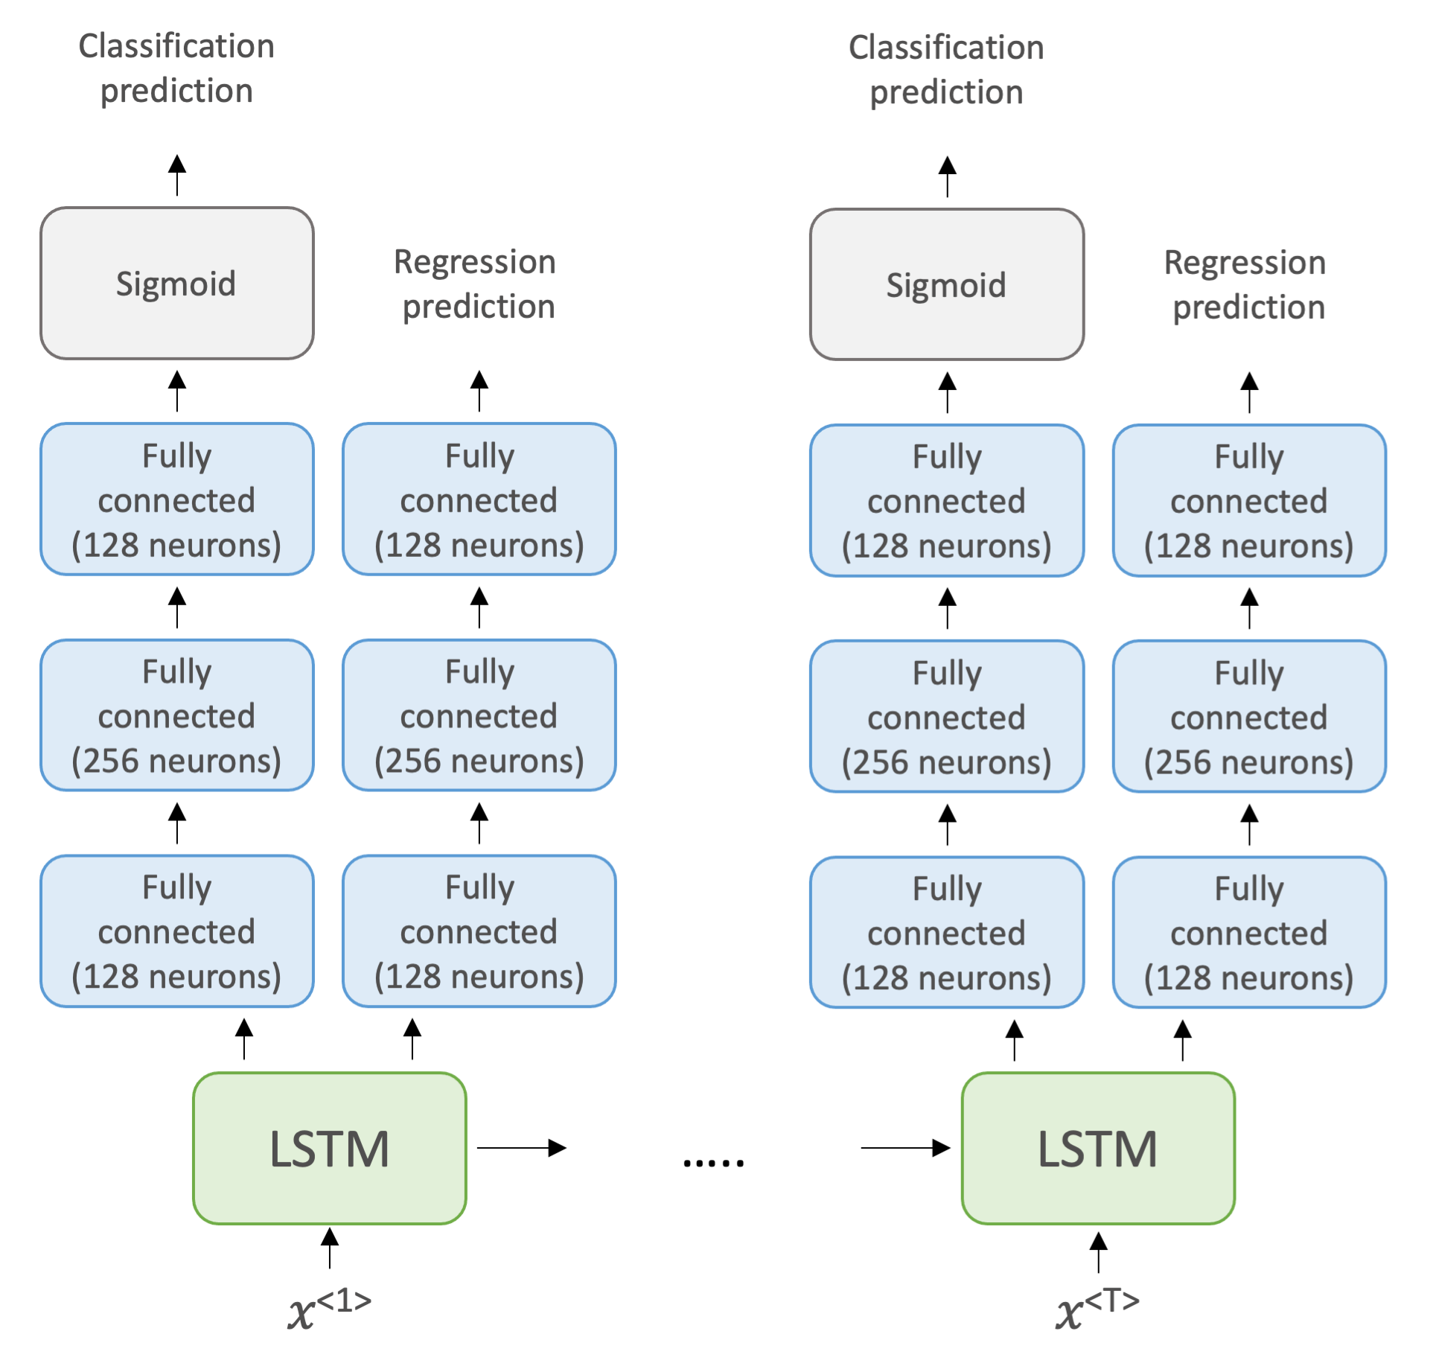
A RNN model was created for mortality and length of stay prediction using MIMIC-IV.
INTRODUCTION
METHODS
RESULTS
CONCLUSION & FUTURE WORK
43
FEATURES
MORTALITY
Dataset
MIMIC-IV electronic health record database
LENGTH OF
STAY (LOS)
Patients who received antibiotics during an ICU stay
Population
Many-to-many RNN Model Architecture
Input features included lab test results and clinical parameters
Features were normalised, aggregated by day for each unique stay and missing values highlighted or forward filled
Data split into training , validation and testing sets
Many-to-many long short-term memory recurrent neural network (LSTM-RNN) was used as it considers the temporal nature of medical data
Entire stay (sequence of days) used as an input
Notes:
- Machine learning (ML) group of algorithms that improve performance without being explicitly programmed. Algorithms receive input data and use statistical analysis and a method called backpropagation to improve output predictions as new data becomes available. Specifically, here I am using Supervised learning which means that each set of input data is linked with the ground truth label. The goal is for the model to (approximate the mapping function) predict the output variables (Y) from input data (x).
In supervised machine learning a model approximates the mapping function from the input data (x) to output variables (Y)
Through labeled training data and backpropagation
Input features including lab test results and clinical parameters were selected based on prevalence and critical care consultant advice
For outcome prediction models' data engineering resulted in 43 features being used to predict patients' chance of death and length of ICU stay.
We want to consider the temporal nature of medical data and to match antibiotic decisions being made on the daily timeframe in hospitals (most often - as opposed to hourly) we agrigated the data by day for each patients unique stay and then created a model that is able to account for this temporal data which is called a recurrent neural network.
In RNN’s however which take a sequence of data as an input, outputs depend on the prior elements within the sequence through the use of ’memory’. In an LSTM cell this process is achieved by using a input, output and forget gate to regulate the cells output and memory. In order to take advantage of temporal information the PyTorch library was used to develop a many to one RNN that contained an LSTM cell with the value of -1 used to represent missing values. A custom dataset class was created with a method to address class imbalance, extract labels and features, pad them to the maximum length and compute a mask so padded time steps are skipped during calculations. Binary cross entropy (BCE) loss was used for classification and mean squared error (MSE) loss used for regression. This figure shows the architecture of this RNN model: Fully connected layers using the Rectified Linear Unit (ReLu) activation function link the LSTM module to outputs predictions. For mortality classification a Sigmoid function is used to obtain a probability of death, with 0.5 used as the threshold for binary transformation (0,1).
------
The entire sequence was used as a sample within the RNN, where as an individual day was used as the sample in the supervised learning approaches. But for all the training and testing tests were split according to unique stays to ensure there wasn't overlap/ crossover between the train and test, and the unique stays within the training and test set were the same for all models.
So as many to an RNA, it looks at every single timestamp in the sequence, and then it makes a prediction. And the sequences are padded to the appropriate length, and then MASKS so that kind of padded part isn't included in the calculations, through the data loader that I have made. Problem is this is currently only predicting at the end of a patients stay. What I think I would do in the future is duplicate every single sample, so that you have every possible sequence length up to the length, of their stay, because then the model would learn to predict at any point given in a stay. You could also then argue that this is more comparable to the previous sklearn algorithms, as it will have the same number of data points.
Sklearn algorithms only make a prediction about the future outcomes based on what the present state of the patient not the past
Future - show that one model was statistically significant better than the others through bootstrapping or confidence intervals

Slide 3
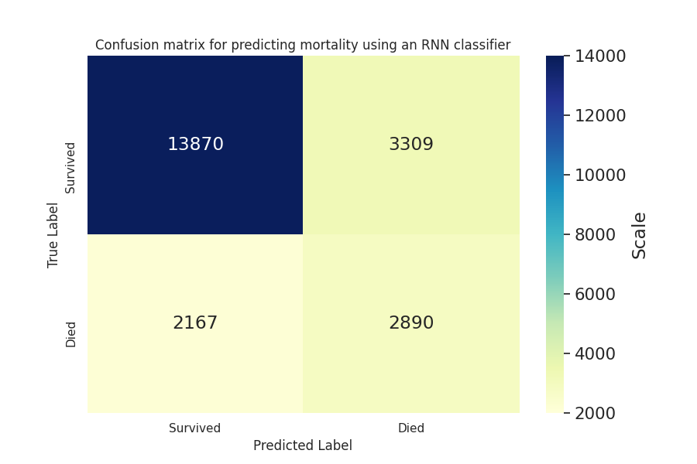
Results present a promising step towards predicting ‘hard’ patient outcome measures.
INTRODUCTION
METHODS
RESULTS
CONCLUSION & FUTURE WORK
RNN Model Performance
In total 18,988 patients, associated with 22,845 unique ICU stays, were included across datasets
 | Metric | Result
Mortality classification | AUROC | 0.78
MORTALITY CLASSIFICATION | Accuracy | 0.75
 | Precision | 0.47
 | Recall | 0.57
 | F1 Score | 0.51
Length of stay regression | Root mean squared error | 3.67
Notes:
The RNN model achieved an accuracy of 0.75. The RNN struggled with false negative and positive predictions to a reduced extent.
For regression the RNN obtained a RMSE of 3.67. Given the units this is still far from being clinically useful, showing the inherent difficulty of this regression task. The improvement however is promising and indicates more complex algorithmic architectures are able to model the data more appropriately to improve predictions.
Results on the unseen test set.
Results present a promising step towards predicting the ‘hard’ outcome measures mortality and length of ICU stay for patients receiving antibiotics through routinely collected EHR data. However, they also highlight difficulties associated with mortality class imbalance and the inherent regression challenge of estimating patient length of stay.

Slide 4







Next steps include stakeholder engagement and focusing on antibiotic cessation decisions.
INTRODUCTION
METHODS
RESULTS
CONCLUSION & FUTURE WORK
Conclusion
Future Work
Conduct patient and public involvement studies and regularly engage with clinical stakeholders to inform CDSS development
Promising step towards predicting the ‘hard’ outcome measures mortality and LOS for patients receiving antibiotics through temporal neural networks and routinely collected EHR data
Results highlight the inherent regression challenge of estimating LOS, while the confusion matrix shows difficulties associated with class imbalance and discerning false positives and false negatives from true negatives in mortality classification
Continue
Create AI models that focus on the decision to cease antibiotic treatment
Discern the ability of such a tool to influence antimicrobial decision making
VS
Stop
Notes:
Future research will discern the ability of such a tool to influence antimicrobial decision making.
How do healthcare professionals use CDSS to manage the treatment of patients with infections?
How can CDSS influence individuals' behaviour and drive change regarding antibiotic prescribing?
How can we ensure sustained integration and adoption of future CDSS that assist with antibiotic decision making?
One major question within infection management is when is it most appropriate to stop antimicrobial treatment. Cessation is a collective, data-driven decision, meaning CDSS can have a larger influence and acceptance by end users
With each model providing a distinct prediction for a certain scenario the clinician responsible for decision making will be able to compare and contrast results leading to informed and fair judgements. As such the system would act as an appropriate CDSS providing information regarding when it is suitable to stop antibiotic treatment to the decision maker.

